Slide 1
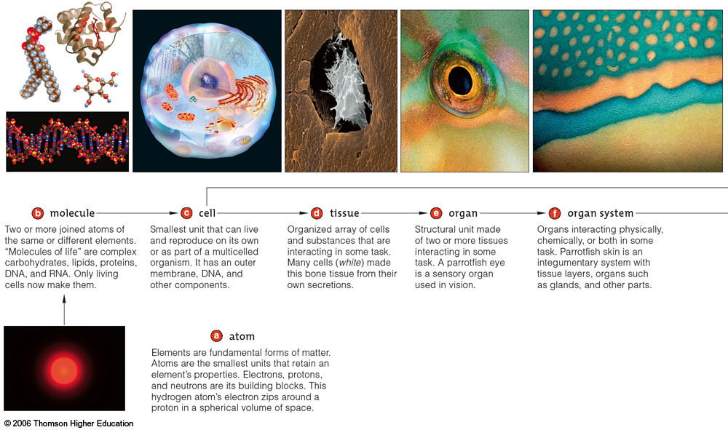
Emergent properties
Why is the whole greater than the sum of its parts?
Notes:
Everyone has heard the saying that the whole is greater than the sum of its parts. Think of the individual members of a football team or a softball team. One player is insufficient to win a game. Think about all of the parts that make up an airplane. Distribute them all over a runway and describe what each part does or is used for. Can any of the parts fly? Much of our world can be shown as examples of a new branch of science called emergence.

Slide 2
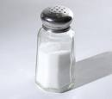
Emergent properties: From elements to an ionic molecule
Common table salt
Chemical formula is NaCl
Or salt is one atom of Na+ and one of Cl-
Notes:
2
Look at a common substance, table salt.

Slide 3
Physical properties of Na+ and Cl⁻
Properties of Na⁺ at room temperature
  Solid
  Molecular weight: 23
  Melting point: +98°C
  Boiling point: +883°C
Properties of Cl⁻ at room temperature
  Gas, dimer Cl2
  Molecular weight: 35
  Melting point: -101°C
  Boiling point: -34°C
Notes:
3

Slide 4
Emergent Properties of NaCl
Properties of sodium chloride
Molecular weight: 58 (predictable)
Melting point: +800°C
Boiling point: +1465°C
NaCl will be a solid at room temperature
Only the molecular weight was predictable from the physical properties of Na⁺ and Cl⁻.
Notes:
4
From the properties of the individual elements we could not describe all of the properties of the molecule.

Slide 5
What are the emergent properties that add up to the basics for a protocell?
Atoms formed
Atoms combined to make precursor molecules
Precursors form into macromolecules (i.e. RNA) and/or structures (i.e. membranes)
Primitive RNAs develop replicase and catalytic activities
Protocells form by primitive membranes enclosing RNAs and other macromolecules
Notes:
5
Lets look at the emergence of life and review what we needed to form a protocell. Could the properties of protocells be predicted?

Slide 6
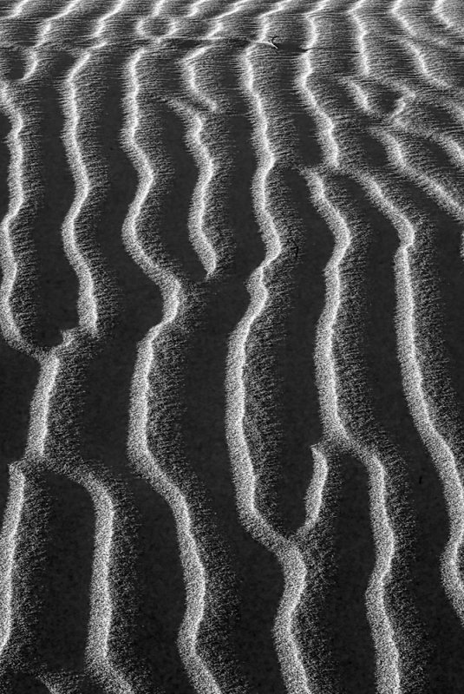
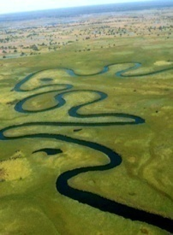
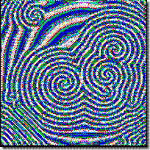
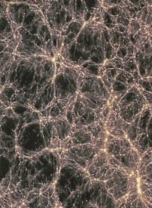
Emergence is a Property of Living and Non-living Systems
Emergence of order & self organization in non-living systems & living systems are similar
Both depend on energy flows that maintain the systems far from thermodynamic equilibrium
Emergence of self-organized chemical systems at some critical density of organic molecules & intermediate levels of energy may have laid foundation for the origin of life
So understanding emergence in simple systems may provide clues to how lifeless molecules led to living cells

Slide 7

Video: Emergence

Slide 8
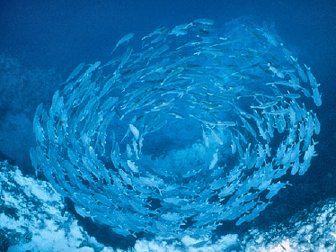
original PBS video page
Video: Emergence
Local copy

Slide 9
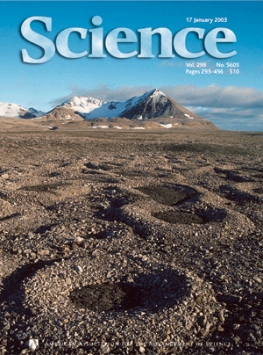
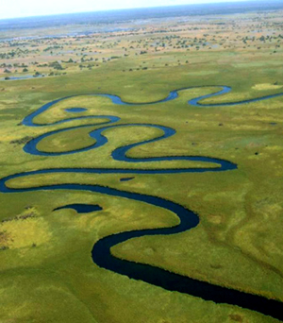


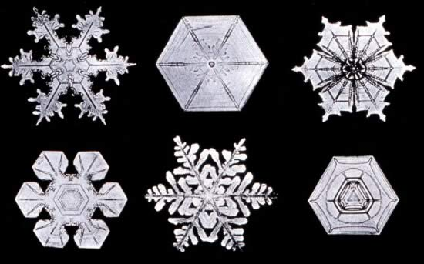
Emergent Properties - Nonliving Systems
Belousov-Zhabotinsky reaction
Notes:
Belousov-zhabotinsky reaction. These are complex reactions of inorganic molecules that produce oscillatory patterns that last for considerable lengths of time. They are far from equilibrium and continue until the starting materials are consumed. The chemical interactions lead to the emergence of patterns of considerable complexity.

Slide 10

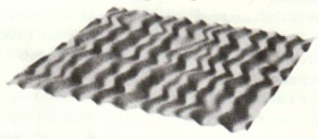
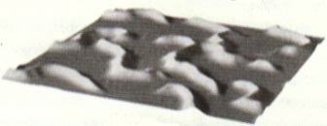
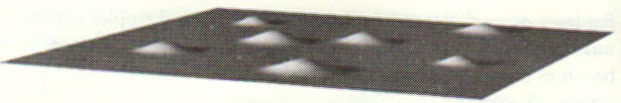
Emergence in Non-living Systems
Why do ripples emerge in sand? i.e. what’s the mechanism?
  Critical mass of interacting sand particles
  Constant intermediate energy input (currents, wind)
Number of Particles
Energy Input

Slide 11

Emergence in Non-living Systems
Self-organized, emergent phenomena seem to defy the Second Law of Thermodynamics which states that inevitably everything in the universe becomes less ordered.
“In a system, a process can occur only if it increases the total entropy of the universe. Energy transformations involved in the processes (i.e. doing work) are never 100% efficient. Some energy is always lost as heat.”
Entropy is a measure of a system’s degree of organization:
  Highly ordered systems have low entropy
  Disorganized systems have high entropy.
Examples?

Slide 12
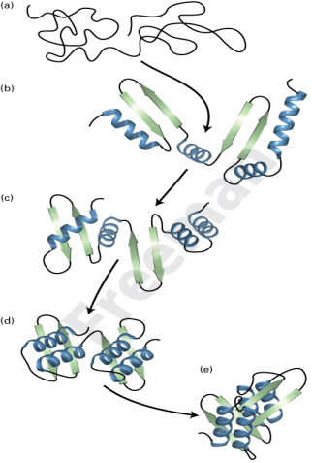
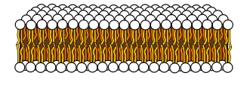
Entropy Driven Reactions
If a reaction is spontaneous due to a large positive increase in entropy it’s said to be entropy driven
Protein folding & formation of lipid bilayers are spontaneous and entropy driven
Both result in decreased entropy of solute but increased entropy of water (the solvent)
They are spontaneous processes
Notes:
Change in Entropy (ΔS) (drive toward disorder)
If the system becomes less ordered (more random) then this is a positive entropy change (+ ΔS). Such changes are generally thermodynamically favored since all matter is becoming more random over time (on average). That is, the universe is tending toward a state of increased, and eventually maximal entropy. However, this doesn’t mean that all reactions result in more entropy. Sometimes a decrease in entropy is driven by other factors.
A negative entropy change, (less random) has a negative value (-ΔS).
Thus, from equation #1, if we assume that ΔH remains constant (an unlikely event) and if entropy increases, ΔG becomes more negative. If, under the same conditions, entropy decreases, ΔG then becomes more positive.
ΔG = ΔH - TΔS
Notice that in the equation for ΔG, ΔS is tied to temperature. As temperature rises the contribution made to ΔG by ΔS increases since ΔS is multiplied by T. Therefore, You can make entropy win over enthalpy by increasing temperature even if the change in entropy is only slightly positive. (doesn’t work if ΔS is negative. Note: In Kelvin, negative temps don’t exist)

Slide 13
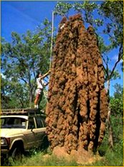
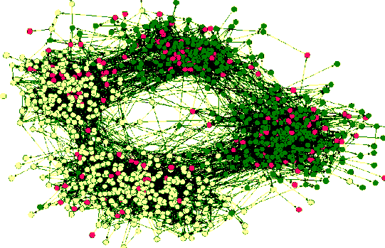
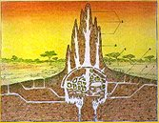
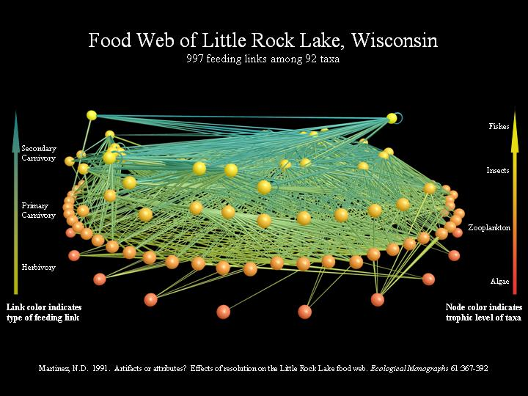
Emergent Properties - Living Systems
The giant ant hill or the school of fish shown here are visible patterns that are generated by the individual actions of organisms and cannot be said in themselves to be the purpose of any individual.
A map of protein interactions or food relationships in the environment is an abstract and complex result of biological phenomena, quite incidental to the phenomena themselves.

Slide 14
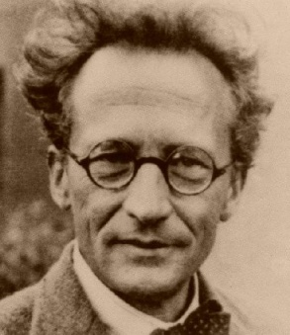
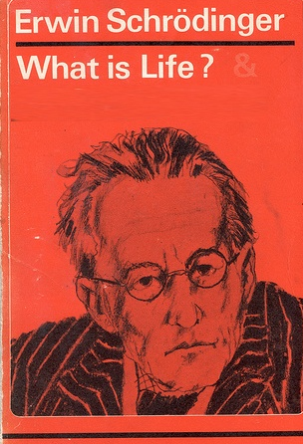
Living Systems
One of most important books in biology
Laid foundations for molecular biology & understanding of DNA and the gene
Life could be understood in terms of laws of physics & chemistry
Pointed out life did not violate the 2nd law of thermodynamics
To maintain itself & escape the inevitable dissolution demanded by the 2nd law, life constantly takes in energy from environment
“Living matter evades decay to thermodynamic equilibrium by having a metabolism.”

Slide 15
Life is an emergent property because
life came into existence in a random process from the non-living some 3.8 billion years ago.
vital or spiritual forces make living entities different from rocks, clouds, and other inanimate things.
life’s fundamental capacities of metabolism and reproduction are possible because of the way component parts like molecules are arranged and interact.
DNA has all the necessary information for life to occur.

Slide 16
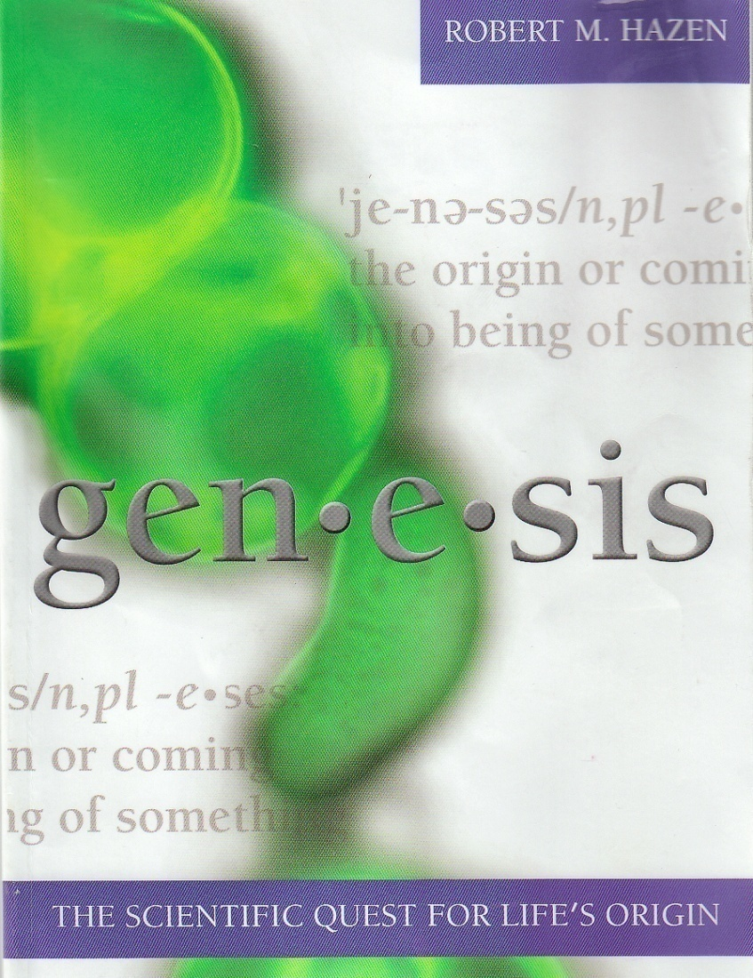
Life as an Emergent Property
Life is the ultimate emergent property
Life arose as inexorable sequence of emergent events, each the inevitable consequence of interactions amongst carbon-based molecules
Universe may be organized such that life spontaneously emerges given appropriate conditions & sufficient time

Slide 17
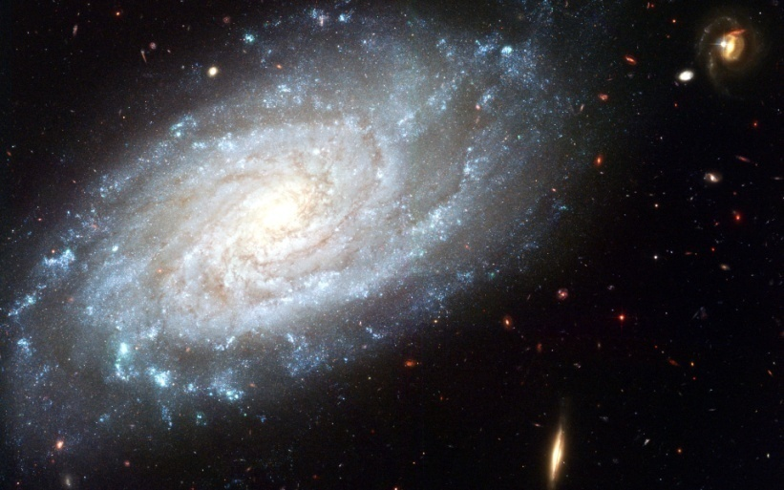
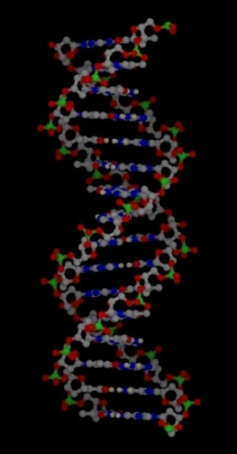
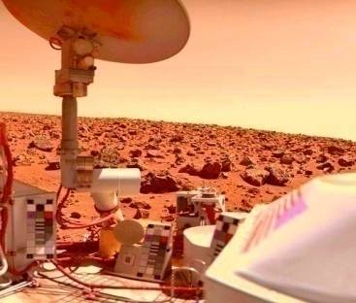
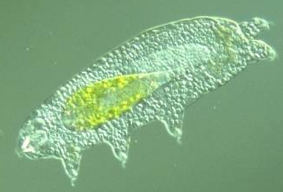
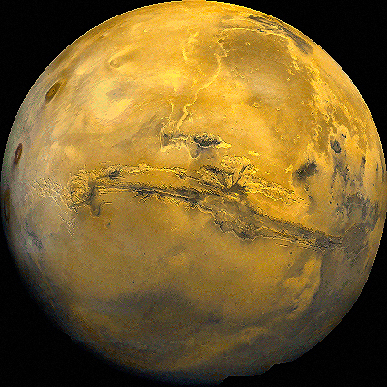
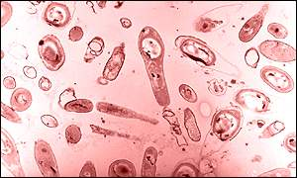
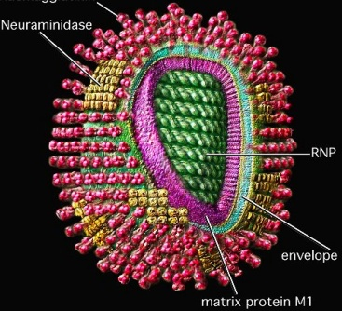
What is Life?

Slide 18
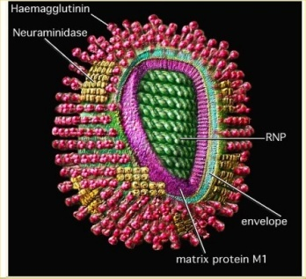
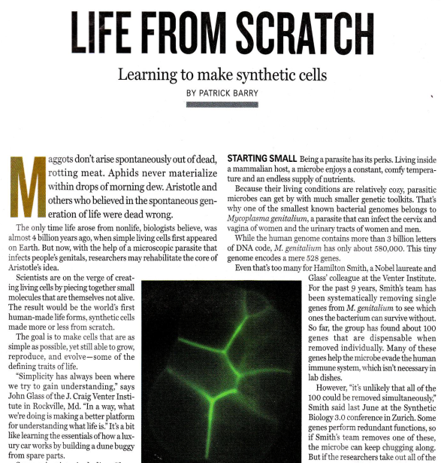
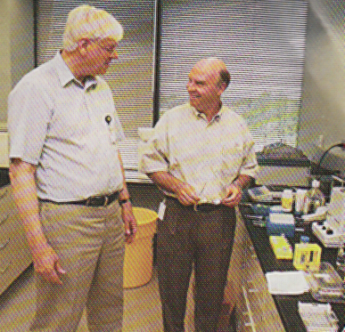
Life in a Test Tube
2002 – Complete functioning virus created from commercially available ingredients
Synthesized 5386 base DNA chain in test tube
2003 – Venter predicts “First “living” cell will be synthesized within 5 years.”

Slide 19

Definition of Life?
“Localized molecular assemblages that regenerate, replicate, and build new functionality through evolution. ”
“Transition to life arises when heritable information takes control of thermodynamic self-assembly, energy transduction, and replication.”
“Living organisms are open systems that are far from thermodynamic equilibrium. They depend on a constant inflow of energy which they utilize to sustain themselves and make copies of themselves using hereditary information stored in DNA. All living organisms are subject to natural selection and hence evolve and change over time.”

Slide 20
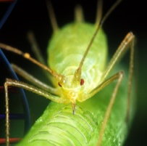
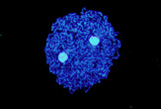
Simplest known bacteria:
  Carsonella ruddii
  182 genes 159,662 base-pairs)
  obligate endosymbionts with aphids

Slide 21
Are Viruses Alive?
Yes
No
Uncertain

Slide 22
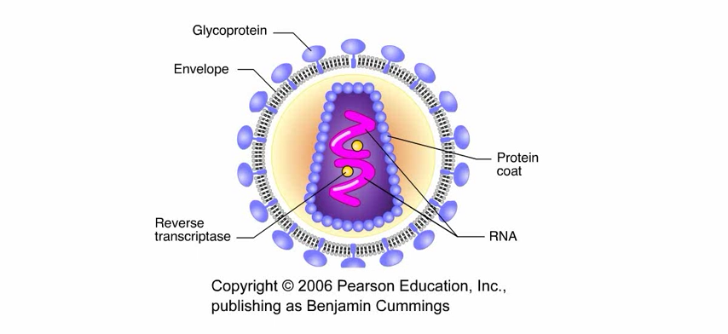
Viruses are simple biological forms. Are they alive?

Slide 23
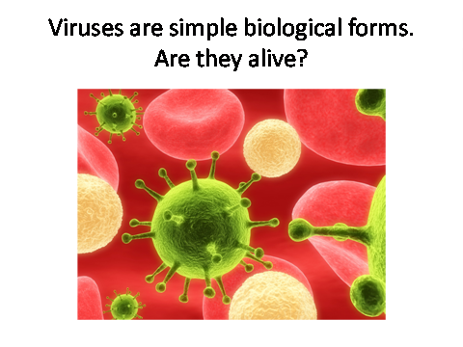
Retrovirus (HIV) Reproductive Cycle Animation (wmv)
Retrovirus (HIV) Reproductive Cycle Animation (swf) (full screen)

Slide 24

Group Assignment
You are part of a team assessing whether or not a virus is alive (4-5 class members per team).
To conduct your analysis you will first need to develop a list of 3 of the most important defining characteristics of life.
Apply your list to viruses and come up with a defense of whether you think viruses are alive or not. Individually write your response based upon your groups thoughts and hand in your (carbon) paper to TA. Each individual in the group must write their own response in their own words.

Slide 25
Are Viruses Alive?
Yes
No
Clicker question

Slide 26
Criteria for Life?
“Localized molecular assemblages that regenerate, replicate, and build new functionality through evolution. ”
“Transition to life arises when heritable information takes control of thermodynamic self-assembly, energy transduction, and replication.”
All life forms are membrane-bound to control movement of substances into and out of the cell

Slide 27
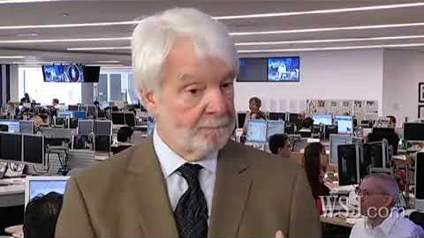
Artificial life has been made
Wall Street Journal Video Link
Local copy

Slide 28
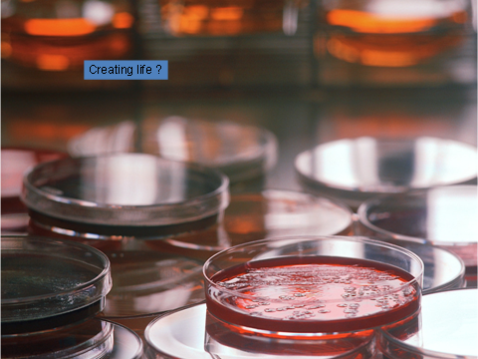
Artificial life has been made
Wall Street Journal Video Link
Local copy
youtube

