Slide 1
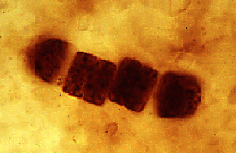
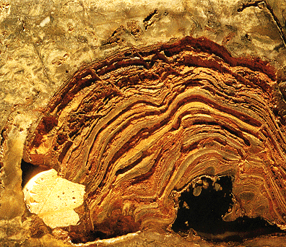
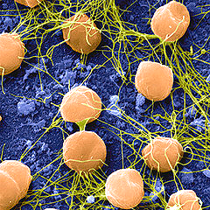
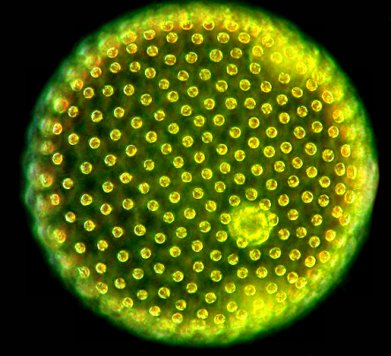
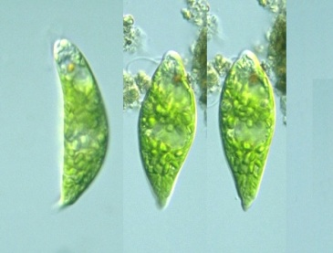
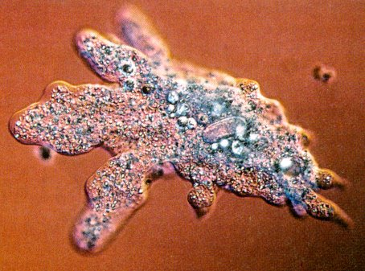
The Evolution of Cellular Life

Slide 2
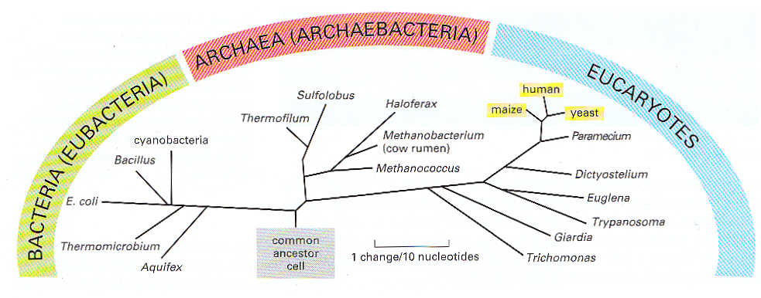
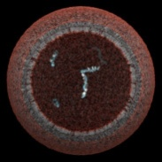
Evolution of Cellular Life
Common proto-cell ancestor of all life
The three major domains of the living world
Bacteria & archaebacteria lumped together until Woese defined Archaea (1968)
Notes:
Branch point for bacteria is the earliest, followed by archea, then eucaryotes. Eucaryotes are ancient but problems in locating them on the time line. All of the domain classification system is based upon molecular studies started by Carl Woese who looked at a small ribosomal RNA for formation of his phylogeny.

Slide 3
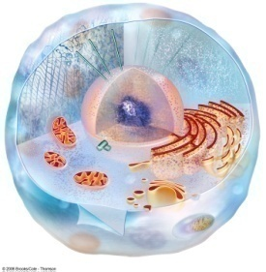
Universal Features of Cellular Life
All extant cells:
enclosed by a membrane
store hereditary information in DNA
replicate their DNA using the same basic mechanism
use RNA for transcription of DNA
translate RNA into protein via tRNA & ribosomes
use proteins as catalysts
use ATP (adenosine triphosphate) for free energy

Slide 4
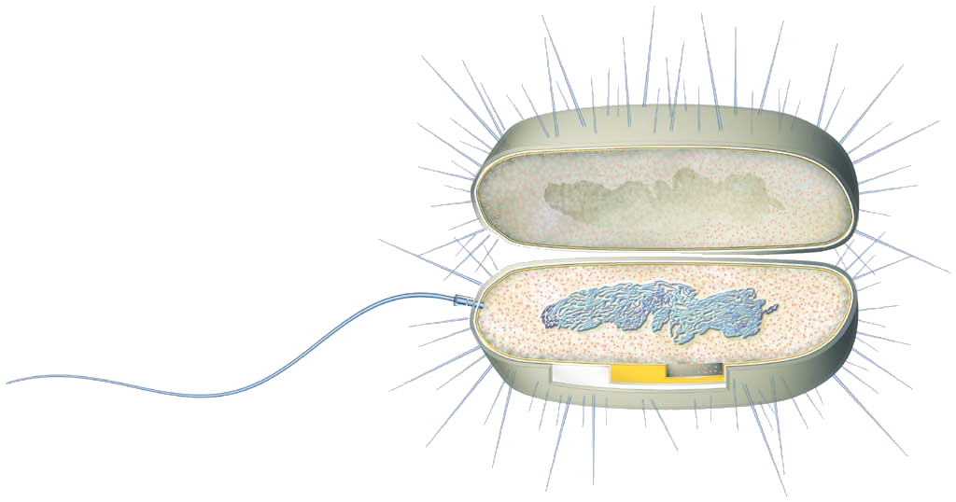
Prokaryotic cell
DNA
capsule
plasma membrane
ribosomes in cytoplasm
bacterial flagellum
pilus
cell wall
cytoplasm
Notes:
Diagrammatic illustration of prokaryotic cell. Note lack of defined nucleus and lack of internal membranes. Pili for adhesion and flagella for movement- neither is an absolute necessity. Need cell walls to maintain shape.

Slide 5
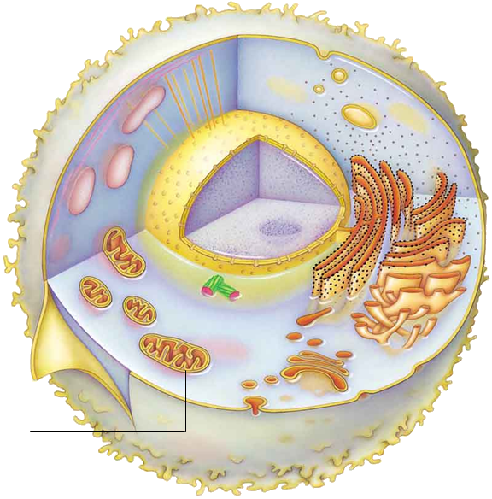
Eukaryotic cell: Animal
nuclear envelope
nucleolus
NUCLEUS
DNA + nucleoplasm
microfilaments
vesicle
components of
cytoskeleton
microtubules
lysosome
rough ER
ribosomes
smooth ER
plasma
membrane
vesicle
Golgi body
mitochondrion
pair of
centrioles
Notes:
Diagrammatic illustration of eukaryotic animal cell.

Slide 6
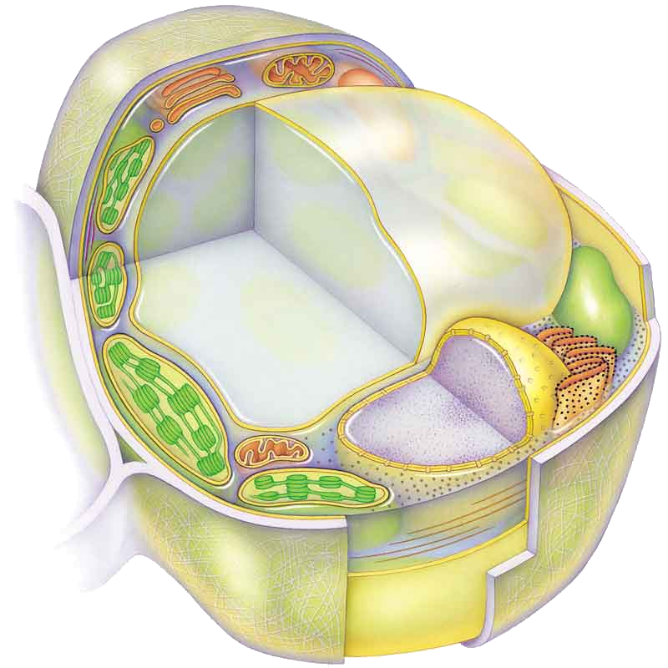
Eukaryotic cell: Plant
Golgi body
vesicle
central vacuole
rough ER)
microfilaments
(components of
cytoskeleton)
ribosomes (attached to
rough ER)
ribosomes in
cytoplasm
smooth ER
mitochondrion
DNA + nucleoplasm
chloroplast
nucleolus
NUCLEUS
nuclear envelope
microtubules
(components of
cytoplasm)
plasma membrane
cell wall
Notes:
Diagrammatic illustration of eukaryotic plant cell.

Slide 7

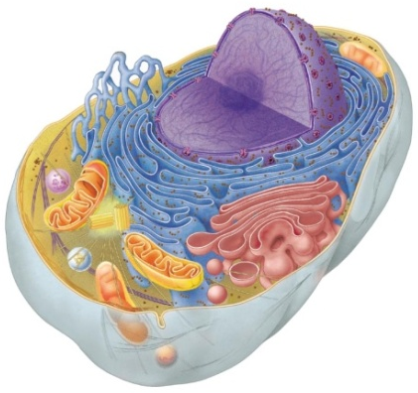
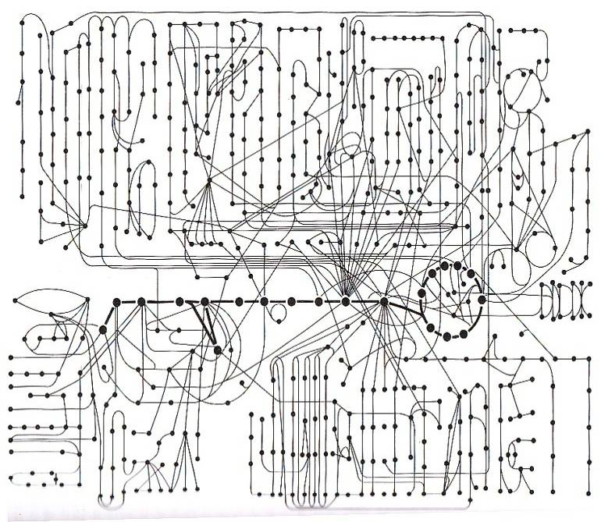
Cells are Complex Systems
500 common cellular metabolic reactions with many interconnections
Most free living Archaea & Eubacteria have 1000-4000 genes
Eucaryotes have more genes & variety of organelles: mitochondria, etc.

Slide 8
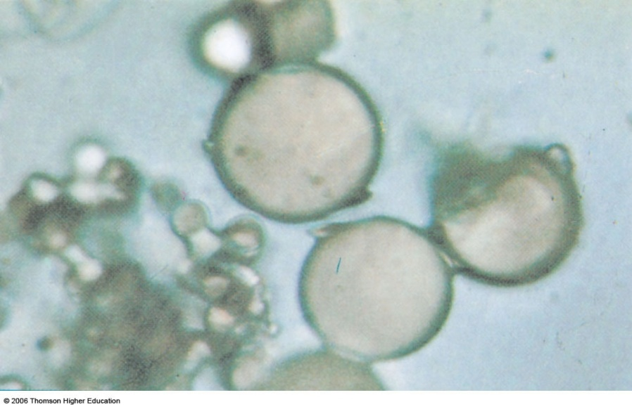
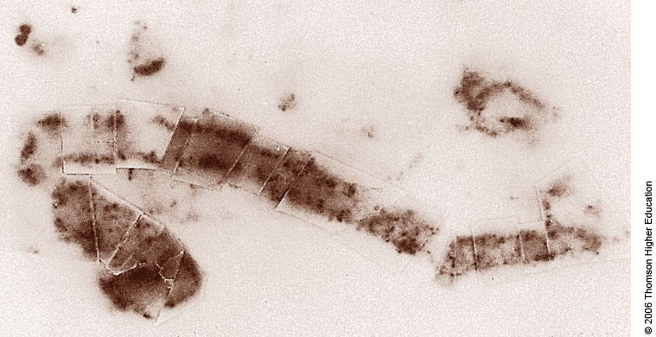
Cell types at different time periods
Hadian period led to possibility of protocells- ~4 BYA
Prokaryotic (most likely bacterial domain)- 3.5 BYA fossil, but possible start at 3.8 BYA. Conditions were anaerobic on Earth.

Slide 9
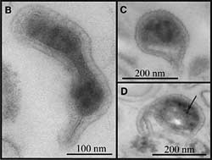
Next up - Archeae
Extremely small archeae isolated from acid mine drainage in California
Archean are thought to arise slightly after Bacteria ~ 3.5 BYA
Notes:
Isolated from slime in mine where the environment is highly acidic. First identified by shotgun cloning and then going back to search for organisms that match genomic profile. Never seen before and could be a harbinger of early life or life on other planet. Get energy from oxidation of iron- otherwise known as making rust. Work of Jill Banfield at UCBerkeley.

Slide 10

When were the first eukaryotes formed?
The lineage is ancient but hard to find during the early prokaryotic period. Not much difference in size from prokaryotes
Evidence of eukaryotic lipids in rocks dated 2.8 BYA
But first in fossil record come around 2.1 BYA, possibly acritarch shown in photograph

Slide 11
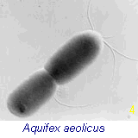
Anaerobic to Aerobic Environment
Beginning of anaerobic bacterial photosynthesis about 3.2 BYA
Aquifex is an example of a living fossil. It has cyclic photosynthesis and is an extremophile growing at 95C.

Slide 12
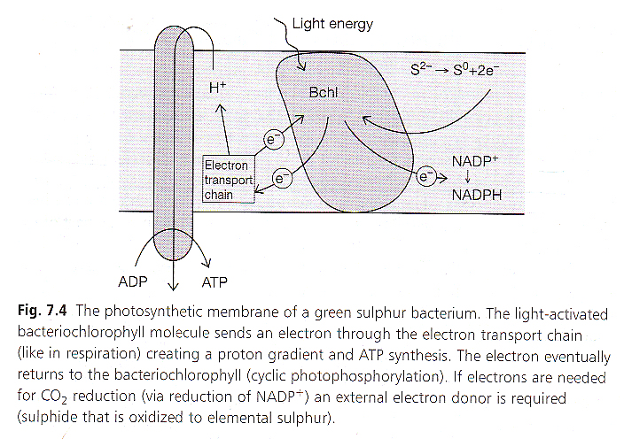
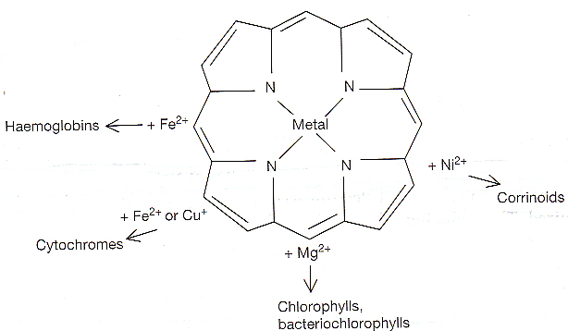
An early, non-oxygenic form of photosynthesis
Some microorganisms shifted to photoautotrophic mechanism using sun as energy source. Slightly altered pigments, originally used to help early cells avoid excessive heat (hydrothermal vents), converted to photo-acceptors. This occurred 3 BYA- cyclic photosynthesis.

Slide 13
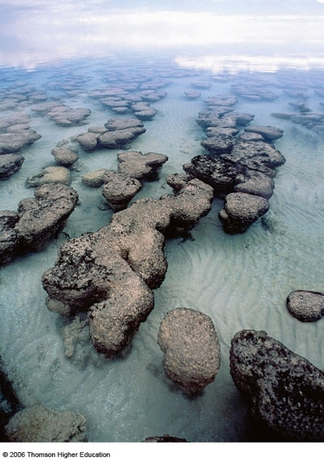
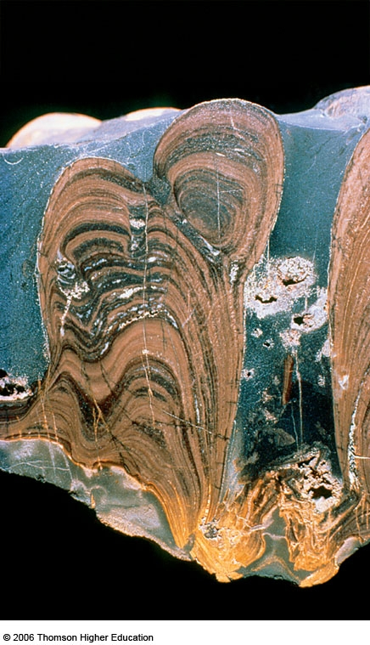
Stromatolites and ancient photosynthetic bacteria
To the left are modern stromatolites found in Australia, thought to be similar to those of 3 to 3.5 BYA
To the left are ancient stromatolite fossils where mats of cyanobacterial cells were flattened and compressed by dissolved minerals and sediments to give stratified appearance

Slide 14
Photosynthetic bacteria- cyanobacteria
Prior to oxygenic photosynthesis there were photosynthetic bacteria.
In modern photosynthesis, oxygen is utilized as a terminal electron acceptor. Earliest bacteria used other electron acceptors.
Cyanobacterial lineage began with cyclic photosynthesis over 3 BYA and increased in diversity and importance along with ability to use non-cyclic photosynthesis

Slide 15
Photosynthesis and oxygen
No oxygen early because there was no source. Oxygen is highly reactive.
Detect oxygen by presence of iron and sulfur oxidized compounds (seen in fossil deposits).
Development of oxygenic or non-cyclic photosynthesis (2.5 BYA) led to slow increase of oxygen present in the sea water and then into the atmosphere. This was the start of the Proterozoic Period.

Slide 16
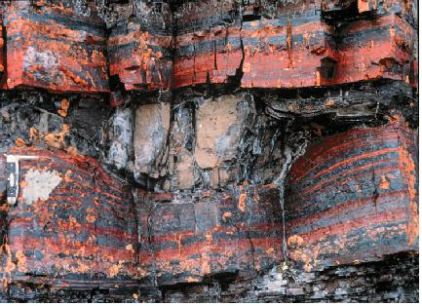
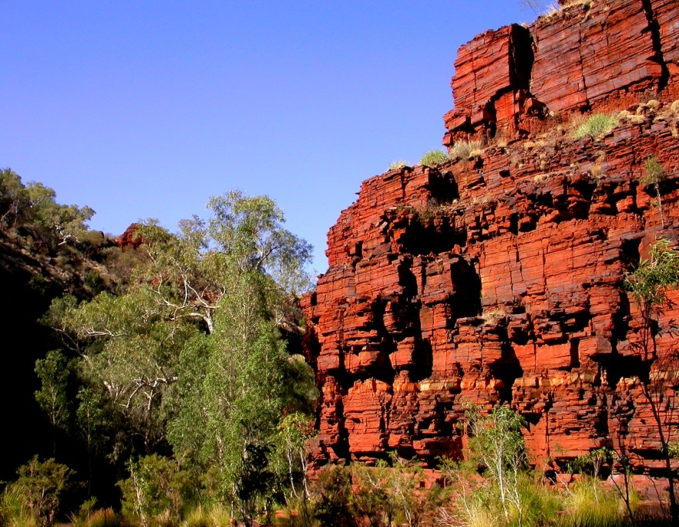
Banded Iron Formation
Early oxygen interacted with iron and other minerals on sea floor
Over next 1.5 BY O₂ levels in the atmosphere slowly increased
When oxygen reached ~15% of atmosphere, reacted with iron to form iron oxides as it had on the sea floor
Layers of iron oxide 1000s of meters thick on bottom of ocean
Aerobic respiration became dominant form of metabolism amongst Eubacteria
Anaerobes retreated to marginal environments

Slide 17
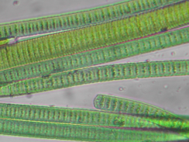
Cyanobacteria Evolved Ability to Split H₂O
Apart from Cyanobacteria, Photosystems I & II never found together in same bacteria
How did they evolve in Cyanobacteria?
Photosystem I first
  employed light energy to drive existing pathways
  used primitive porphyrin molecules to capture photons
Those genes duplicated & Photosystem II evolved – with a new form of chlorophyll that was a powerful oxidant & could split water
At some point I & II were coupled together successfully
Notes:
Figure 7.8A Electron flow in the light reactions of photosynthesis: Both photosystems and the electron transport chain that connects them are located in the thylakoid membrane. The energy from light drives electrons from water to NADPH.

Slide 18
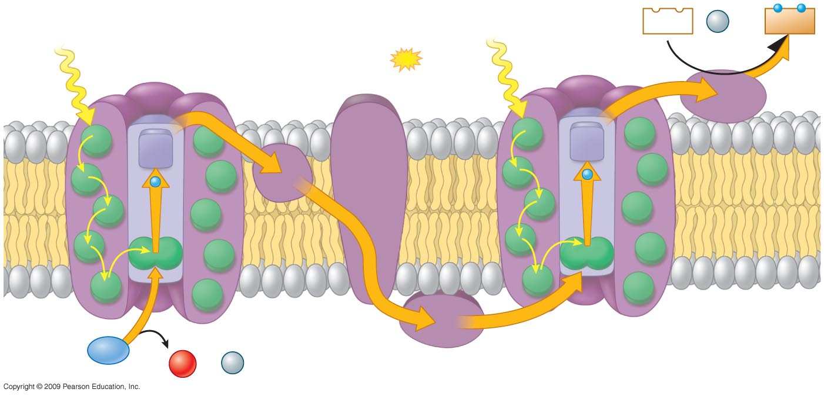
2 Photosystems connected by electron transport chain – generate ATP & NADPH
Electron transport chain
Provides energy for
synthesis of
by chemiosmosis
Photon
NADP⁺
+
H⁺
NADPH
Photon
Photosystem II
ATP
Photosystem I
6
Stroma
1
Primary
acceptor
Primary
acceptor
2
e–
e–
Thylakoid
mem-
brane
4
5
P680
P700
Thylakoid
space
3
H₂O
H⁺
1
−
2
O₂
+ 2
Notes:
Figure 7.8A Electron flow in the light reactions of photosynthesis: Both photosystems and the electron transport chain that connects them are located in the thylakoid membrane. The energy from light drives electrons from water to NADPH.

Slide 19
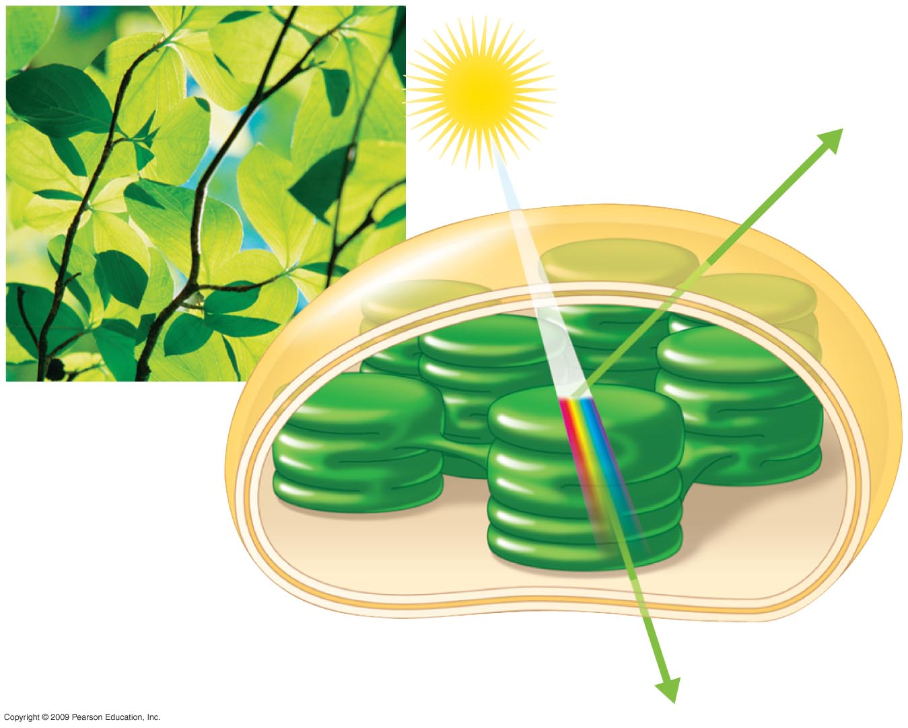
Modern photosynthesis
Light
Reflected light
Chloroplast
Absorbed
light
Thylakoid
Transmitted
light
Notes:
Figure 7.6B The interaction of light with a chloroplast.

Slide 20
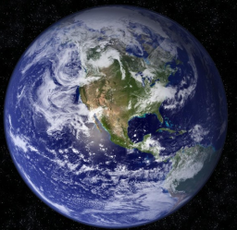
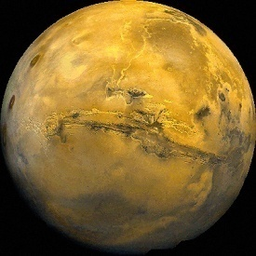
Photosynthesis Transformed the Planet
O₂ energizes almost all existing life
Without O₂ no multicellular plants & animals
Hence no complex food chains & ecosystems
Without O₂ no ozone layer & no oceans
Earth would be like Mars – dry, red, no blue sky

Slide 21
Single Celled to Multicellular
Single cells are highly successful and still comprise 50% of total biomass on Earth
So why proceed further or what is the advantage of multicellularity?
  Collaboration and division of labor allows new resource exploitation

Slide 22
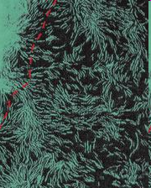
Prokaryotic multicellularity
Formation of loose associations or colonies of single cells
Myxobacteria as an example- live in soil on insoluble organic molecules but form loose clusters of cells that release digestive enzymes that makes it possible to digest the organic matter
Notes:
The picture from http://www.nature.com/news/2005/050630/full/news050627-13.html illustrates a loose organization of prokaryotic cells that exploits a resource that was unavailable to individual bacteria- they can solubilize insoluble forms of organic matter. They have typically large bacterial genomes and form more advanced structures with specialized forms when the deplete the resources in their current niche.

Slide 23
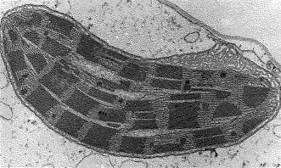
Cyanobacterium or Chloroplast
Chromosome: circular, naked DNA
Ribosomes: 70S, synthesizes its own proteins
Grows, divides, and duplicates its DNA
Two membranes: inner membrane, ¾ protein, synthesizes ATP using light energy (photosynthesis)
Eukaryotic cell without chloroplast cannot make chloroplast
Notes:
Image of chloroplast and list of relevant facts: chromosome is composed of circular, naked DNA: two membranes with inner membrane composed of ¾ protein and employing light it synthesizes ATP; ribosome size is 70S and it synthesizes its own proteins; grows, divides, and duplicates its DNA; eukaryotic cell without chloroplasts cannot make a chloroplast.

Slide 24
Endosymbiont hypothesis
Increase in eukaryotic cell size was enhanced by compartmentalization and presence of endosymbionts- 1-1.2 BYA
The symbiosis started from an interaction between a more primitive eukaryotic cell and an aerobic (or photosynthetic) bacterium.
Interaction may have been parasitism of a eukaryote by a prokaryote or eating (engulfment) of a prokaryote by a eukaryote.
In either mechanism, over time the prokaryote evolved to become a mitochondrion or a chloroplast.

Slide 25
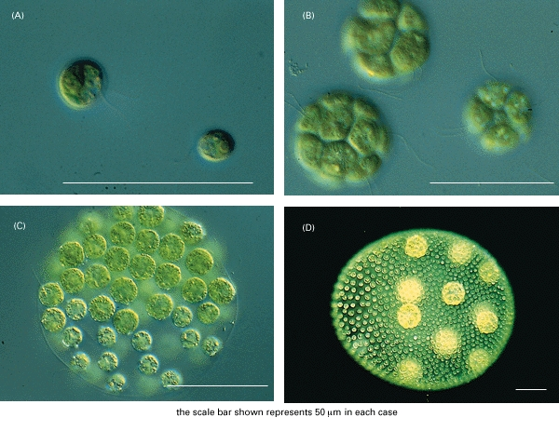
Progression of forms in eukaryotic algae
Notes:
Single celled forms shown in (A) are likely to be Chlamydomonas which are photosynthetic and motile. In (B) these are likely to be members of the genus Gonium which are loose associations of even numbers of cells. Each cell can lead to a new group of cells but flagella all beat in the same direction allowing group to move through water. (D) is a more multicellular form called Volvox. This association of cells is held together by cytoplasmic bridges, moves by flagella as a unit in a rolling fashion but shows some specialization of cellular function. Only a small number of these cells are reproductive and can lead to new colonies. Separation may cause individual cells to die. Volvox has specialization and organization- important characteristics of multicellularity. In this system the whole is greater than the sum of its parts. Movement toward light is enhanced by being multicellular and coordinating flagellar movement. Specialization of division to form new colonies. Ref: Molecular Biology of the Cell. 3rd edition.
Alberts B, Bray D, Lewis J, et al., Garland Science (1994).

Slide 26
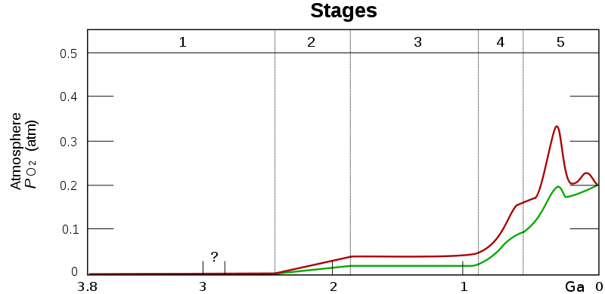
The Oxygen Revolution
High concentrations of O₂ didn’t reach deep sea until ~600 MYA
Until then deep ocean lacked O₂ because of freezing (Snowball Earth)
Not enough O₂ to support larger, more complex animals
First Ediacara appear < 5 MY after oxygen level reached 15% of today’s
O₂ levels continued to rise during pre-Cambrian & Cambrian allowing even larger species to evolve

Slide 27
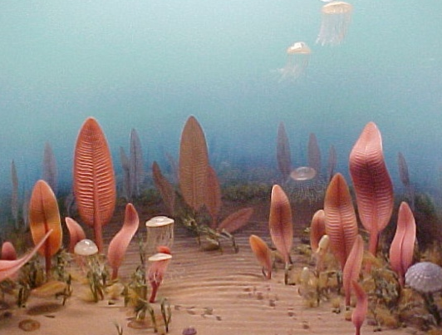
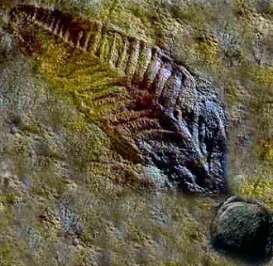
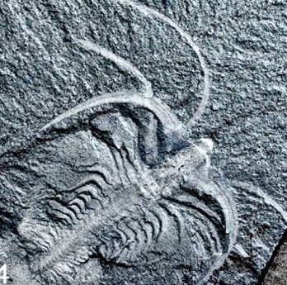
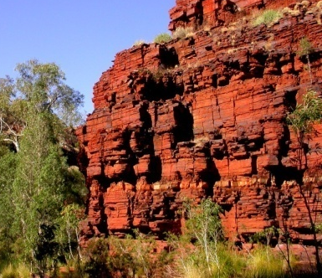
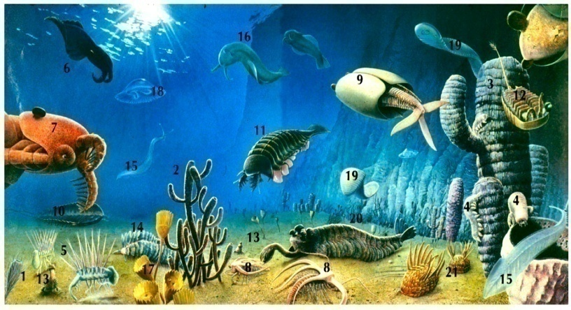
Pre- & Post-Cambrian Evolution

Slide 28
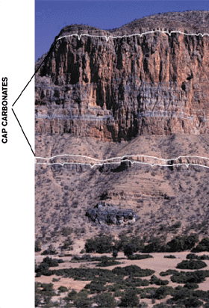
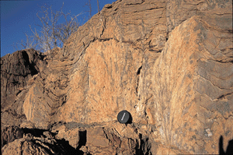
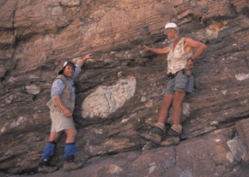
Glacial Deposits Overlain by Carbonates
Layers of glacial deposits world-wide 750 - 600 MYA
Evidence indicates that entire Earth froze for millions of years
Mass extinctions took place
Life clung to existence around volcanoes & open ice at equator
carbonates
glacial deposits
Coast of Namibia
Notes:
How did glacial deposits reach so close to the equator?

Slide 29
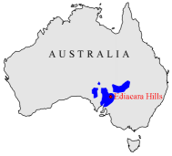
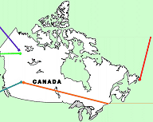
Ediacaran Fauna: 600 - 520 MYA
Discovered in 1946 in southeast Australia – subsequently in Canada & Namibia
Fossils represent the most ancient complex organisms on Earth
Origin & subsequent evolution of many Ediacaran groups remains an enigma
Notes:
It is theorized that microbial life slowed the development of “heterotrophic eating” organisms as niches with single celled animals were sufficient. However, diversifying to eating other organisms provides a whole new mechansim of survival and obtaining energy and building blocks for metabolism. The advantages lead to abrupt increase in these types of forms and development of multicellular variants. It is hypothesized that there was an explosion of small multicellular organisms leading to the Ediacaran life forms. Early eukaryotes were likely asexual and with the development of sexual mechanisms there would be generation of greater diversity. First evidence of sexual fossils was ~900 MY.

Slide 30
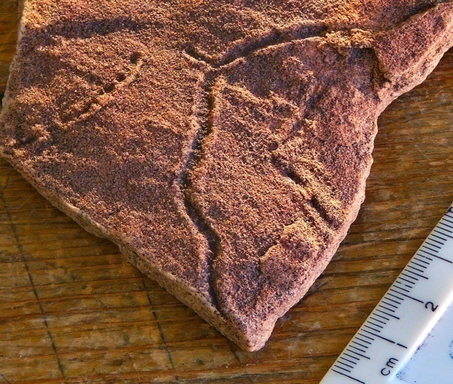
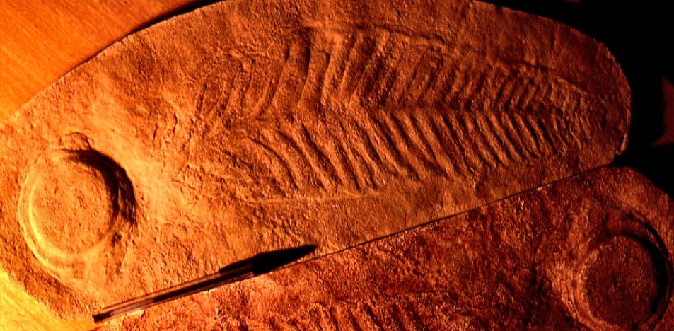
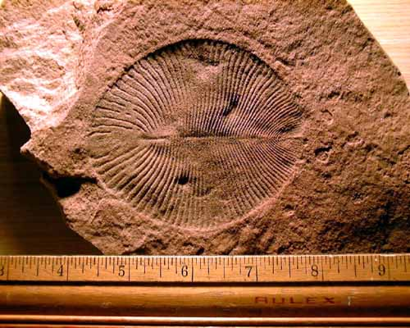


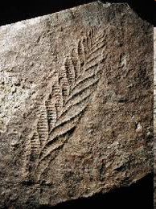
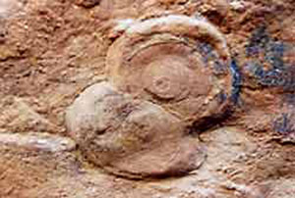
Ediacaran Fauna: 600 - 520 MYA
Notes:
Top left, Ediacaran trace fossil of burrow from a worm; Center, top” Wormlike Dickinsonia costata; Top right, possibly Spriggina, soft bodied organism with contested lineage; bottom left Charniodiscus, a sea-pen like creature; Center bottom, Cyclomedusa (bottom dwelling polyp); Bottom right Charniamasoni (frond)

Slide 31
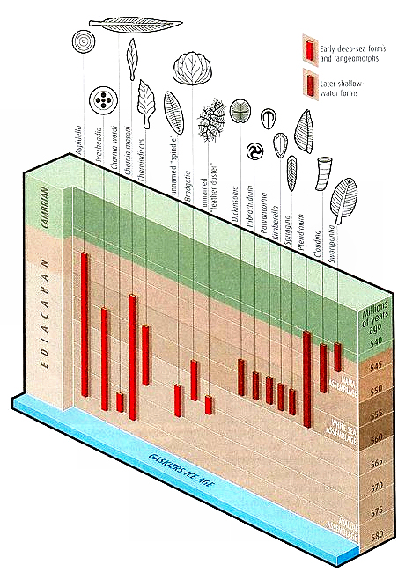
Notes:
Some of these animals, from Aspidella on the left to Swartpuntia on the right. The end of Gaskier’s Ice Age is shown at the bottom, and the red columns indicate the age of rocks where the different species are found in fossil form.

Slide 32

Video: The Cambrian Explosion

Slide 33
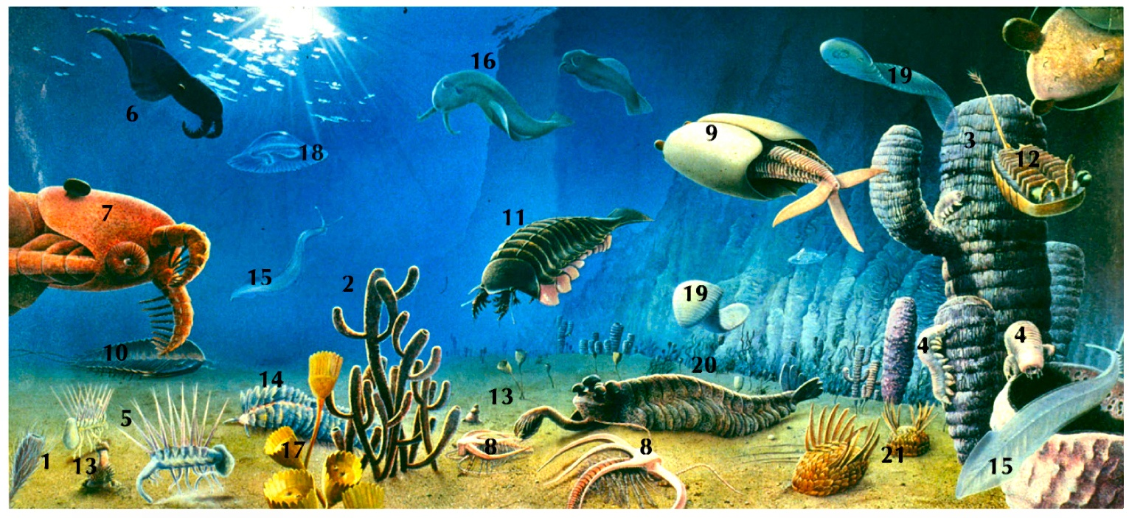
Video: The Cambrian Explosion
mp4 format
youtube copy

Slide 34







The Burgess Shale- Cambrian
Cambrian Movie
Charles Walcott (left) at the Burgess Shale quarry, 1903
Click image for animation
Notes:
More than half a billion years old, the fossils of the Burgess Shale preserves an intriguing glimpse of early life on Earth. They were first discovered in 1909 by Charles D. Walcott, then Secretary of the Smithsonian Institution. These fossils merit special interest for several reasons:
They were buried in an underwater avalanche of fine mud that preserved exceptionally fine details of the structure of their soft parts. Only hard parts are preserved in most other Cambrian deposits, obviously limiting information within the geologic record.
They represent an early snapshot of the complexity of evolving life systems. The Burgess Shale fossils as a group have already developed into a variety of sizes and shapes from the much simpler, pre-Cambrian life forms.
Many of them appear to be early ancestors of higher forms; from algae to the chordates (a major group of animals that includes human primates). Others appear unrelated to any living forms and their later disappearance presents an intriguing mystery. Top right, Opabinia, a predator; Middle right, Ashyela, a velvet worm; Bottom left, Haplophrentis, a shelled organism about 2 cm long; second left possibly Canadaspis, an arthropod; third from left, Marella or lace crab; bottom right Marria Walcotii or Orthrozanclus reburrus?

Slide 35

Video: Post-Cambrian Evolution

Slide 36

Video: Post-Cambrian Evolution
mp4 format
youtube copy

Slide 37






Major Events in the History of Life
multicell plants
archaea
prokaryotes
1st eukaryotes
multicell animals
~3.8
~3.7
~2.1
~0.9
BYA
~3.6
~2.2
~1.1
photosynthetic bacteria
(stromatolite)
photosynthetic protistans
oxygen revolution

Slide 38





Major Events in the History of Life
Cambrian
explosion
Colonization
of land
Permian
extinction
Cretaceous
extinction
Age of
Mammals
Snowball Earth
Ediacaran
.8-.6
.6-.5
.54
.36
.25
.075
.065
BYA

Slide 39






Commonalities in Life Forms:
Molecular & Cell
Amino acid structure
Energy molecule
ATP - Adenosine Triphosphate
L-amino acids
Information molecule
  DNA - Deoxyribonucleic Acid
cell division
Mitosis & meiosis in Eukaryotes and fission in Prokaryotes
Protein
Catalytic Activity
Notes:
39
List of commonalities at cell and molecular level: ATP, DNA, L-amino acids, cell division, protein enzymes.

Slide 40






Fossils of > 250,000 species
Notes:
40
Images of fossils: bacterium, trilobite, fish, Tiktaalik, human, Stromatolite, archaeopteryx, Charniodiscus, a sea-pen like creature (pre-Cambrian).

Slide 41




Fossils–Excellent Records for Some Lineages
Notes:
Images of horse, whale, flower, human. We have excellent fossil records of a number of organisms and structures including these four.

