Slide 1
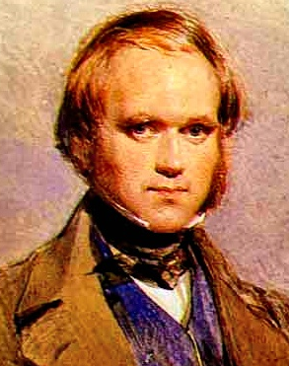
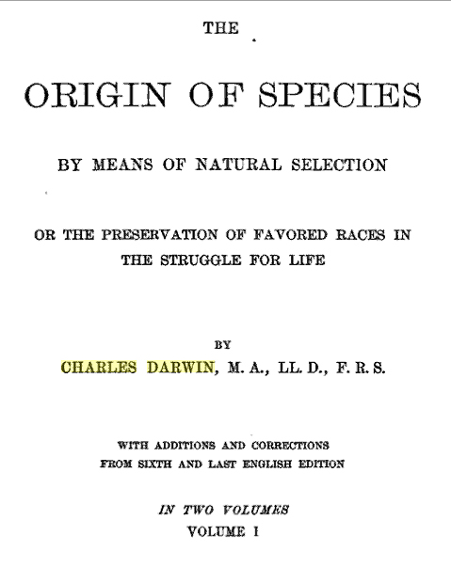
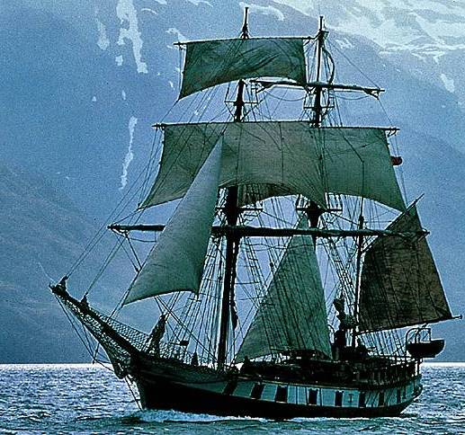
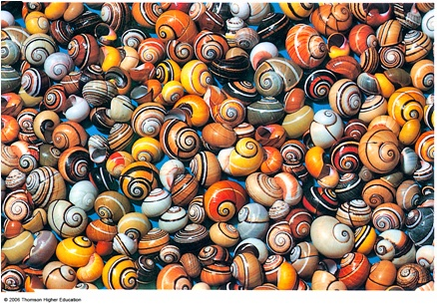
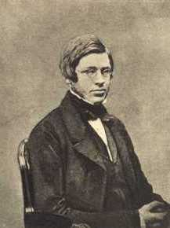
Darwinian Evolution: Growth & Survival

Slide 2
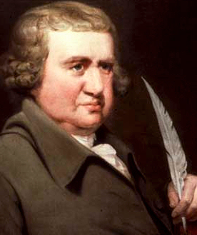
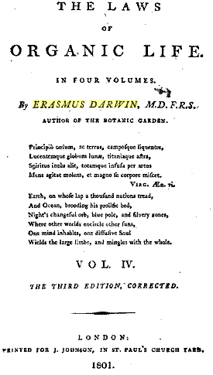
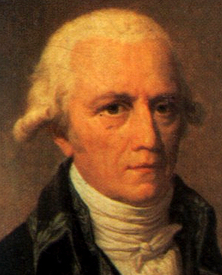
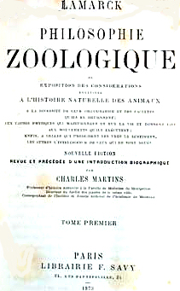
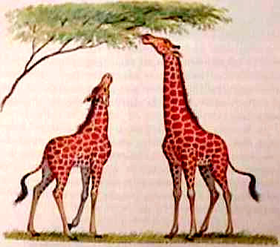
Theories of Evolution
All life derived from one original ancestor
There has been a slow evolutionary change in species from simple to more complex forms
Erasmus Darwin
1800
Lamarck
1809
“All changes in the organic, as well as the inorganic world, are the result of natural laws, not miraculous interposition.”
Acquired characteristics
Notes:
Erasmus Darwin was the grandfather of Charles Darwin. He was a physician, philosopher, and inventor. His ideas on evolution were very similar to what Charles proposed a couple of generations later. The statements to the right are from Erasmus’ ideas.
Hence without parent by spontaneous birth
Rise the first specks of animated earth;
From Nature's womb the plant or insect swims,
And buds or breathes, with microscopic limbs.
ORGANIC LIFE beneath the shoreless waves
Was born and nurs'd in Ocean's pearly caves
First forms minute, unseen by spheric glass,
Move on the mud, or pierce the watery mass;
These, as successive generations bloom,
New powers acquire, and larger limbs assume;
Whence countless groups of vegetation spring,
And breathing realms of fin, and feet, and wing.
From Temple of Nature, published posthumously.
Jean-Baptiste Lamarck was not born into prestige and he was an established naturalist who made many contributions to science particularly in botany and invertebrate taxonomy. He had ides on evolution (as in the quote below his name) and as follows from 1801…. . . time and favorable conditions are the two principal means which nature has employed in giving existence to all her productions. We know that for her time has no limit, and that consequently she always has it at her disposal. His evolutionary thoughts are referred to in a derogatory sense whereas he got to gradual change in relation to the environment in a different way. Genetics finally differentiated from the Lamarkian view to the Darwinian view.

Slide 3
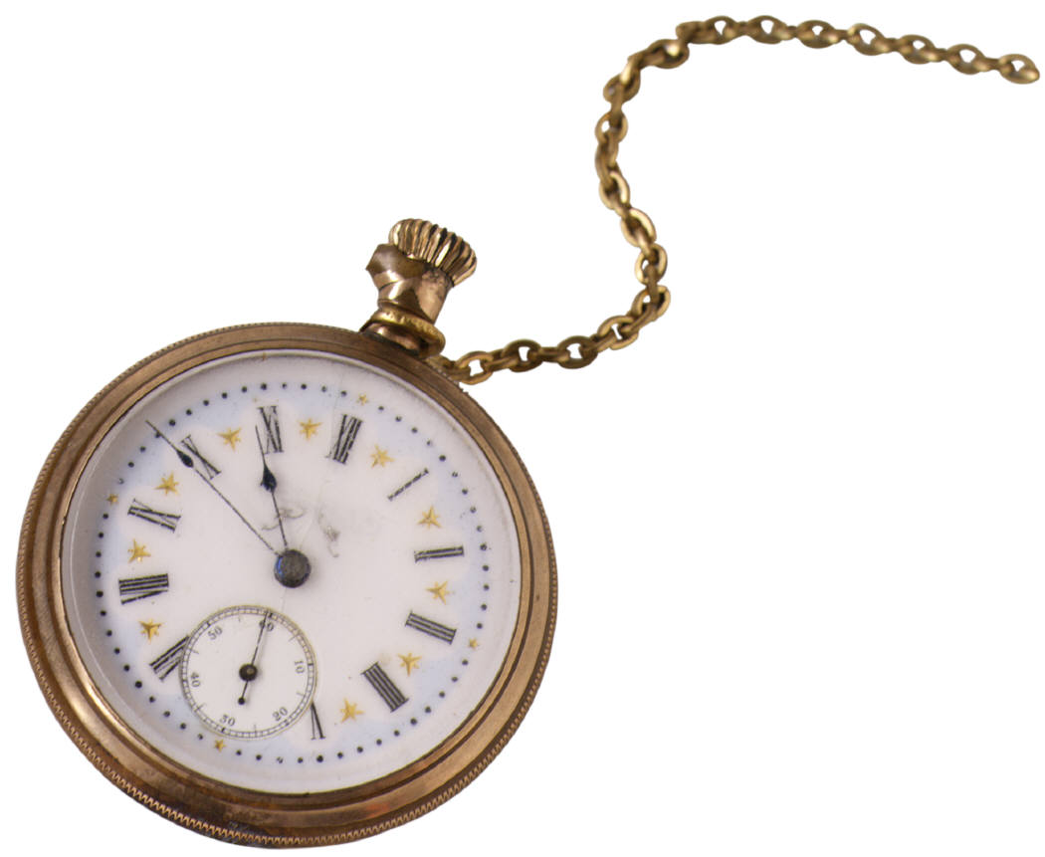
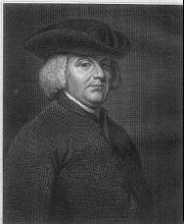

Natural Theology, 1802
William Paley
Notes:
Early creationist philosophies of grand design in nature.

Slide 4
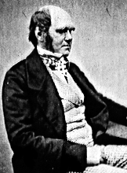
Charles Darwin
1859
Notes:
Published November 1859 expressed the ideas of gradual change by adaptation from common origins with a phylogeny and an impact of natural selection which precludes ideas of “design”. Allowed for extinctions and explained common traits of animal husbandry in an evolutionary perspective. The videos have given you insight into the life of Darwin. The social consequences of this new theory suggest the level of stress or pressure felt by Darwin in publishing his theory which ran contradictory to those of natural theology.

Slide 5
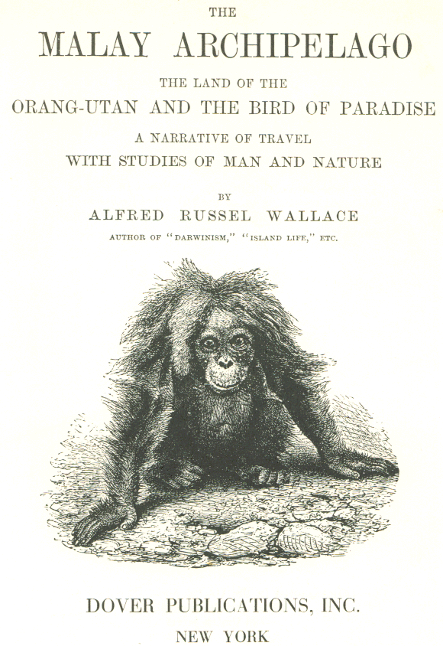
Alfred Russel Wallace
1858
Notes:
Wallace was the co-discoverer of evolution by natural selection and actually published prior to Darwin. Both sets of ideas were complementary. Most of Wallace’s ideas derive from his long time study of the Malay Archipelago, modern Malaysia and Indonesia. Book is most famous scientific travelogue. By his death at 91, Wallace was the most famous British naturalist. Darwin has overshadowed much of a set of works that are overlapping and complementary.

Slide 6
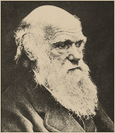
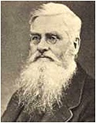
A Mechanism for
Evolutionary Change
“Can we doubt (remembering that many more individuals are born than can possibly survive) that individuals having any advantage, however slight, over others, would have the best chance of surviving and of procreating their kind?...
This preservation of favourable variations I have called Natural Selection, or the Survival of the Fittest.
By this process of descent with modification new species can arise by gradual change from pre-existing species
Thus, species have descended from other species by insensibly fine gradations
“The variations of a species, however slight, ..would affect, either favourably or adversely, prolonging existence.
An antelope with shorter or weaker legs must necessarily suffer more from the attacks of carnivora.
[Thus] any variety having slightly increased powers of preserving existence, will inevitably acquire a superiority in numbers.
The continuation of varieties further and further from the original type--appears [to have] no definite limit….
The superior variety would then alone remain, and would have replaced the original species.”
Notes:
Darwin and Wallace (left, right) with notes underneath.

Slide 7
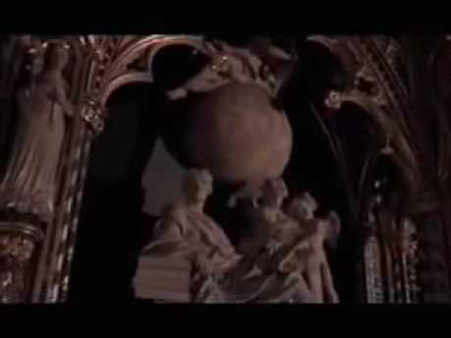
Video: Darwin’s Dangerous Idea

Slide 8
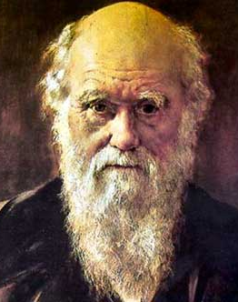
Video: Darwin’s Dangerous Idea
youtube copy

Slide 9
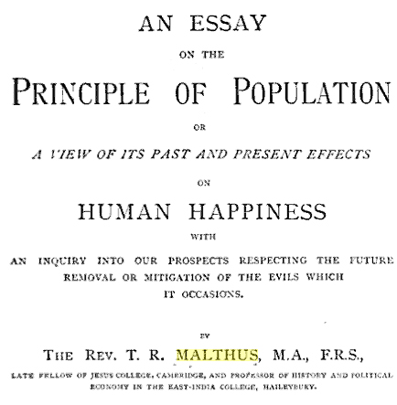
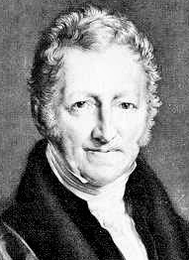
“Many more individuals are born than can possibly survive”
“We cannot fail to be struck with the prodigious power of increase in plants and animals”
“Whether slowly or rapidly their natural tendency must be to increase in geometrical ratio, that is, by multiplication”
“The physical laws to which mankind is subjected are not different from those that prevail in other parts of nature.”
Malthus
1798
Notes:
Impact of Malthus on Darwin:
"In October 1838, that is, fifteen months after I had begun my systematic inquiry, I happened to read for amusement Malthus on Population, and being well prepared to appreciate the struggle for existence which everywhere goes on from long- continued observation of the habits of animals and plants, it at once struck me that under these circumstances favourable variations would tend to be preserved, and unfavourable ones to be destroyed. The results of this would be the formation of a new species. Here, then I had at last got a theory by which to work". Charles Darwin, from his autobiography. (1876) . The main ideas as seen in the pre-class reading is the capability for mass reproduction and the inability of our natural resources to support such growth. Darwin and Wallace saw this is the nature of competitive interactions that allow slight positive variations to be perpetuated over other forms- thus the selection.

Slide 10
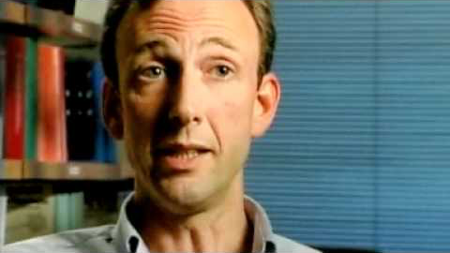
Video: How does Evolution Really Work?

Slide 11

How does Evolution Really Work?
(youtube)
“PBS -Original Source”.
Video (rm) (quicktime)
http://www.pbs.org/wgbh/evolution/educators/teachstuds/svideos.html. Watch video 4
Notes:
Natural selection has four processes;
1.Genetic variation
2. Overproduction of offspring
3. Struggle for existence
4. Differential survival and reproduction.

Slide 12
Which statement is true about evolution by natural selection?
A. Evolution continually improves organisms so that the species now living are better than all earlier organisms that have ever lived, including those that have gone extinct.
B. Natural selection results in evolution because some phenotypes are better adapted than other phenotypes.
C. Evolution acts on individuals to change allele frequencies in the present generation's gene pool.
D. In each generation individuals change such that they are better adapted to the present environment.
Notes:
Correct answer is B. Answer A is Lamarkian. Answer C is wrong because natural selection may cause you to die but evolution acts on populations. Answer D, in a stable environment there may be no change from one generation to another. Again it is the population that changes.

Slide 13
Variation
Having collected and analyzed thousands of specimens from all over the world, Darwin and Wallace were experts on temporal & spatial variations within species.
Both realized that variation in traits invariably caused differences in the ability of individuals to survive and reproduce.
Thus Natural Selection depended on variability within a population – without variation natural selection could not occur.
Darwin & Wallace did not understand the underlying causes of variation since they knew nothing about genes and genetics.

Slide 14
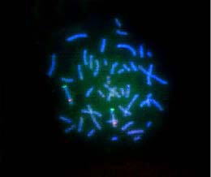
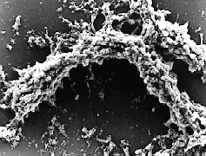
Where does variation come from? Chromosomes and genes
Nearly all genes have multiple forms or alleles- two alleles are needed to trace inheritance.
Genes encode the information used to generate the phenotype and are heritable.
Individuals in a population represent the genetic pool or genetic resources of the population.
Mutations or changes to the genome occur at predictable rates for any species.
Most mutations are deleterious and are not passed on but many are neutral under the current environmental conditions and are passed on. This adds to the genetic diversity of the population.
Useful mutations may provide an advantage immediate or under changing conditions.
human
barley
Notes:
To introduce students to chromosomes that contain genes, this slide presents an image of fluorescently illuminated human chromosomes and scanning electron micrographs of barley chromosomes during mitosis.

Slide 15
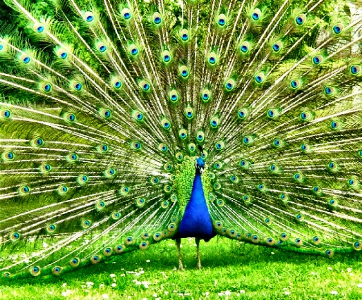
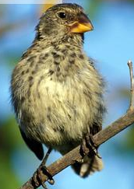
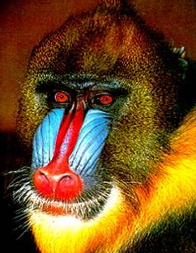
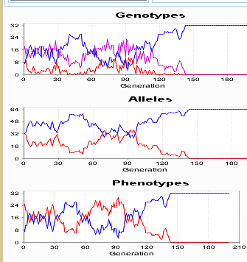
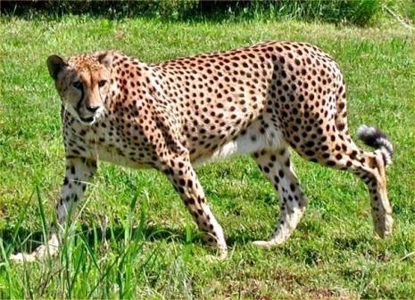
The Forces that Drive Evolution
  Natural
  Selection

Slide 16
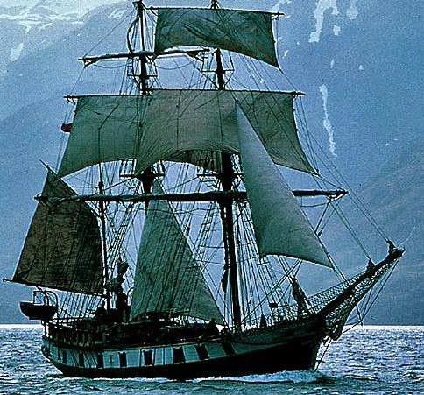
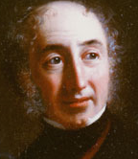
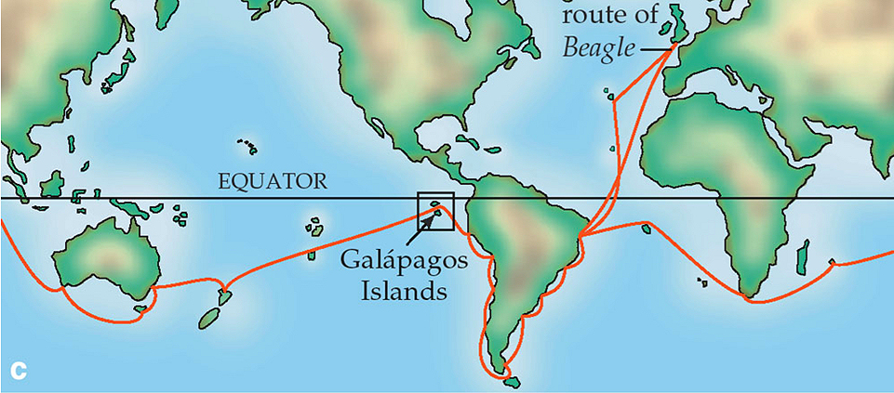
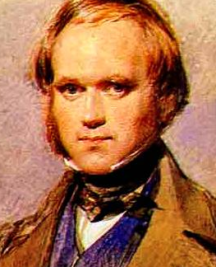
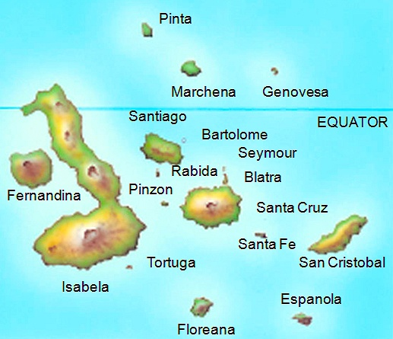
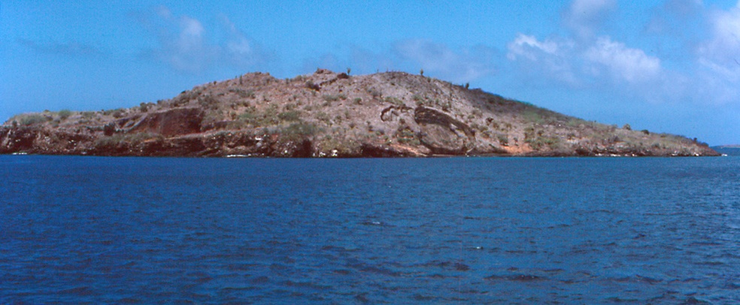
The Voyage of the Beagle: 1831-1836
Captain
Fitzroy
H.M.S. Beagle
Notes:
This slide shows the location of the Galapagos islands near the equator some 500 miles off the coast of Ecuador. The map illustrates the route taken during the voyage of the Beagle. Darwin stopped at the Galapagos towards the end of the 5 year journey and stayed for several days, exploring and collecting specimens, including individuals of the rather drab group of finch species that inhabited the islands.

Slide 17
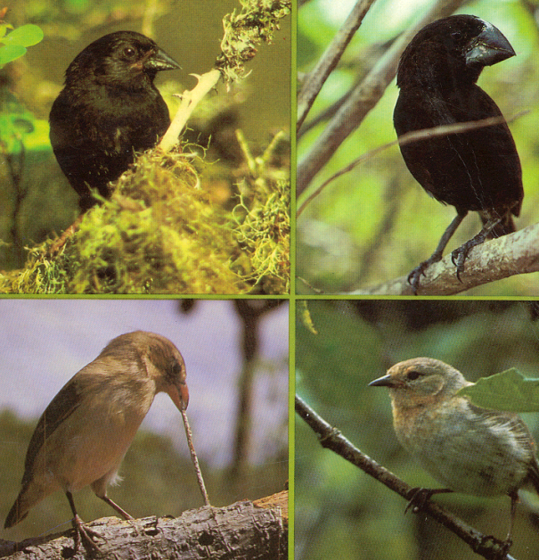
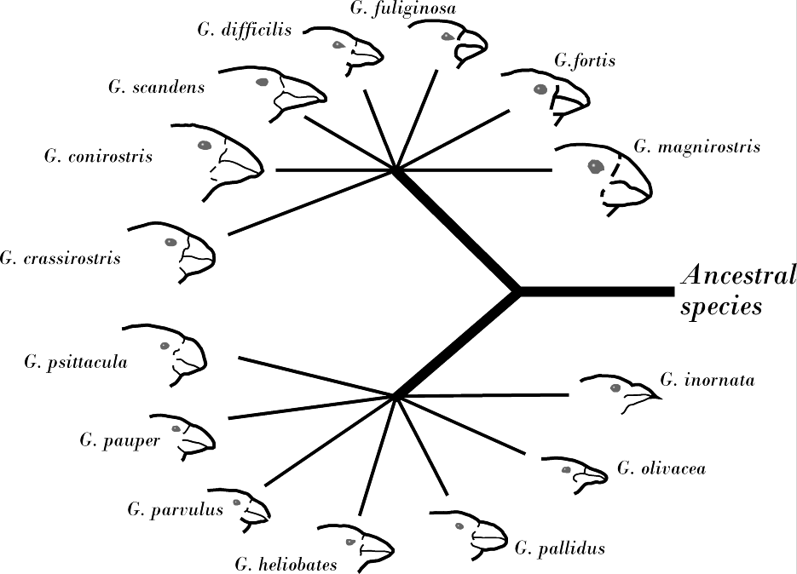
Galapagos Finches: 14 Geospiza species
“It occurred to me that it was as if one ancestral species had been taken and modified towards different ends.”
“At once it struck me: favourable variations would be preserved, unfavourable ones destroyed.”
– C. Darwin
Notes:
The 14 species of finches that are endemic to the Galapagos islands. An ancestral species from mainland South America colonized the islands about 1 million years ago. Species in the genus Geospiza are primarily seed eating ground finches. Most of the other species are insect eaters or fruit, seed and insect eaters.
After returning to England, Darwin sent his Galapagos finch specimens to an ornithologist. The ornithologist informed Darwin that what he had thought was just one species was actually a group of at least ten different species. This astonished Darwin and provided a major clue to his thinking about the origin of species. As Darwin later said, it appeared that an original ancestral species had been “modified towards different ends.”

Slide 18
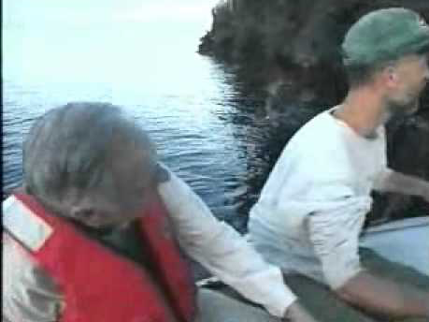
Video: Darwin’s Finches

Slide 19
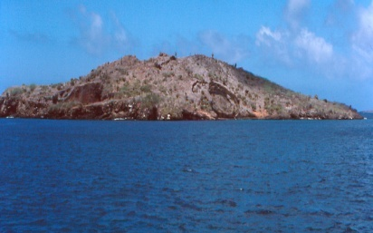
Video: Darwin’s Finches
youtube copy
Notes:
One of the Galapagos islands. The climate is fairly arid with great variation in total rainfall from year to year.

Slide 20
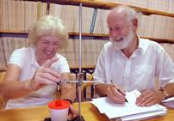
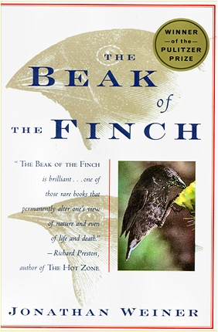
Research on Evolution in Geospiza
Rosemary & Peter Grant
The Grants’ work is regarded as the most significant study of evolutionary change in the past 30 yrs.
When they began they had 3 main questions:
  Do members of different species compete for food?
  How does such competition affect evolution?
  How are species formed?
Their ongoing studies aimed at answering these questions have greatly improved our understanding of evolution in natural populations
"The most exciting discovery is that natural selection occurs strongly & repeatedly in environments like the Galápagos where climatic fluctuations are severe.” - Peter Grant

Slide 21
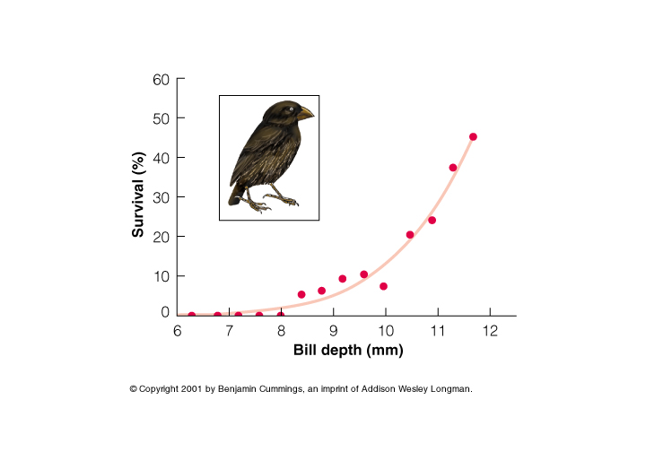
G. fortis
Survival during drought related to bill depth
Notes:
In a drought there are fewer small seeds and many more larger, hard seeds. Strong bills that can crack the seeds will be advantageous.

Slide 22
Homo sapiens male heights- genetic variation in a population is due to the fact that height is determined by multiple genes
60
40
Number of Men
20
0
60
65
70
Height (inches)
There are multiple genes involved in determination of human height. More than 15 different chromosomal locations have been discovered that cause height variation.
Notes:
Heights of male Homo sapiens. Recent studies indicate more than 15 genes as influencing human height. Even if there are only two alternative forms of each gene (alleles), we should expect a distribution similar to the normal distribution shown above. Accumulation of variants at any of the genes involved leads to a more diverse gene pool for height should one extreme or the other be necessary. In some environments larger is better but in many examples smaller varieties work best. Early horses lived in forests and their diet was vegetation from bushes and plants. There was little to no grass. As grass became available several evolutionary changes occurred due to decreased forest or competition for new resources. To live in grasslands, larger animals became more successful- couldn’t hide (run is better), change in stomach for digestive reasons. Complex genetic changes driven by adaptability to new environment.

Slide 23
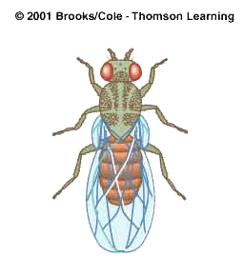
Drosophila wing length
20
15
Frequency
10
5
0
40.0
45.0
50.0
55.0
Wing Length (units)
Notes:
The length of Drosophila (fruit fly) wings. Why might it be better to have large wings or small wings?

Slide 24
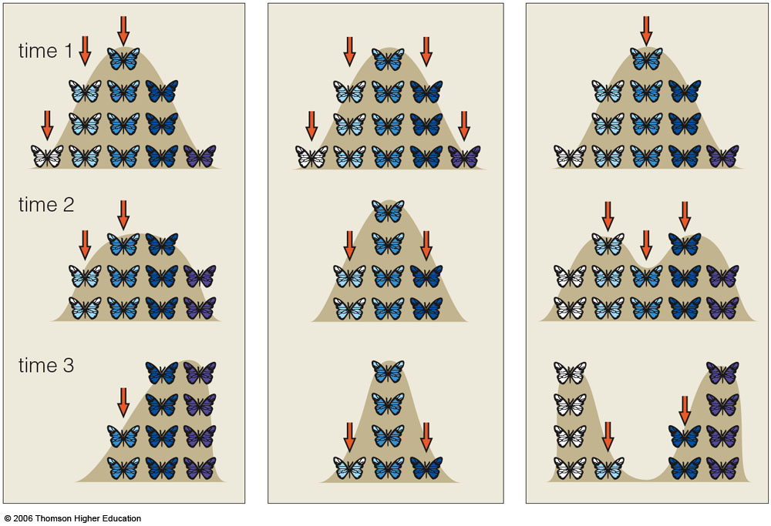
Phenotypic Consequences of Natural Selection
Directional selection fits the Finch example discussed for beak size/depth in relation to the environment and the source of food.
?
Directional Selection
Notes:
24

Slide 25
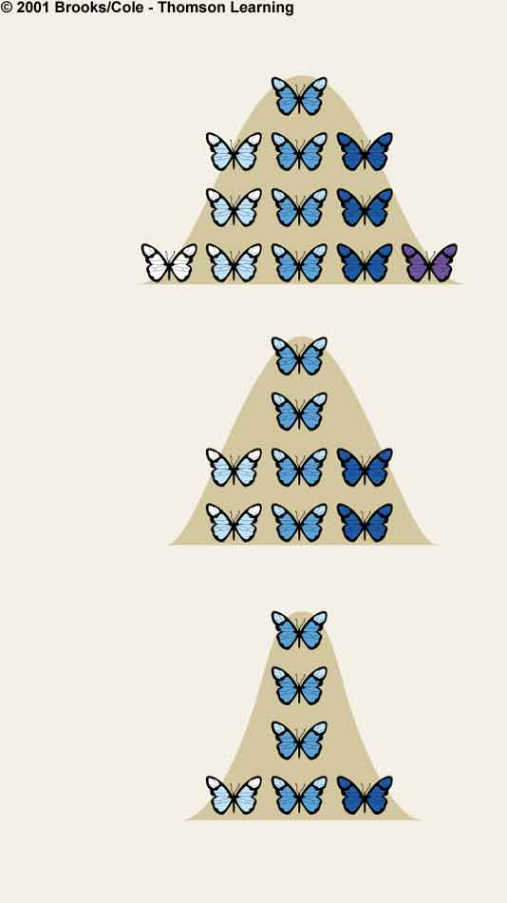
Stabilizing Selection
Phenotypic Consequences of Natural Selection
Number of individuals
in the population
Range of values for the trait at time 1
Intermediate forms are favored and extremes are eliminated
Range of values for the trait at time 2
Range of values for the trait at time 3

Slide 26
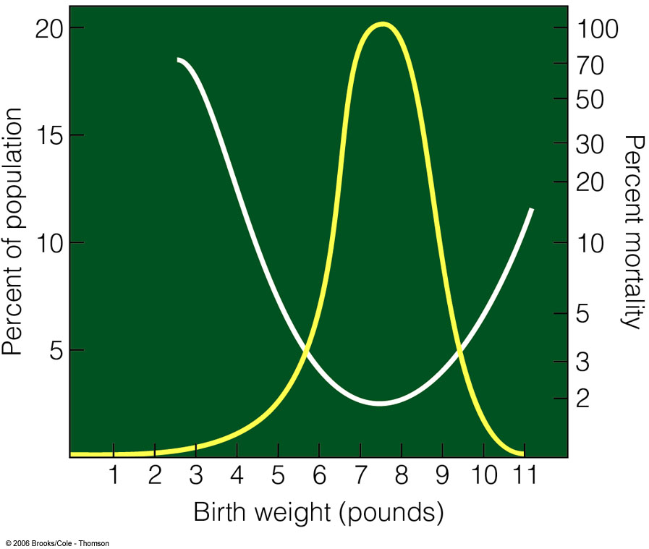
Example of Stabilizing Selection: Human weight distribution in newborns

Slide 27
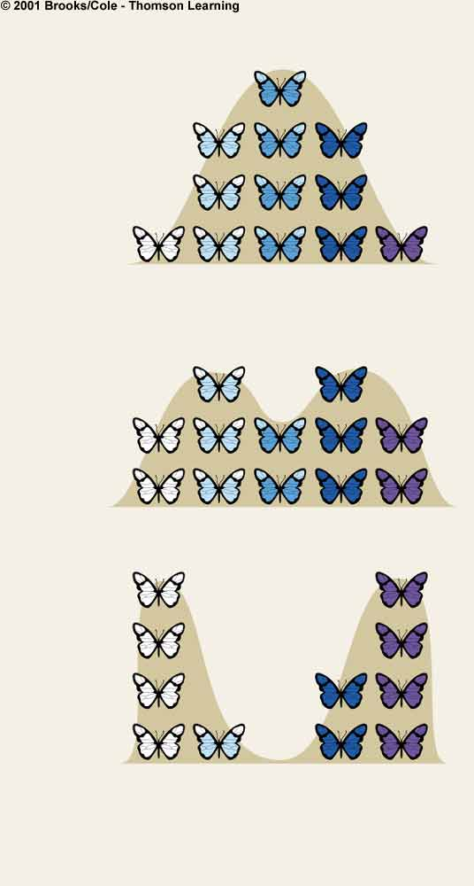
Disruptive Selection
Phenotypic consequences of Natural Selection
Number of individuals
in the population
Range of values for the trait at time 1
Number of individuals
in the population
Forms at both ends of the range of variation are favored
Intermediate forms are selected against
Range of values for the trait at time 2
Number of individuals
in the population
Range of values for the trait at time 3

Slide 28
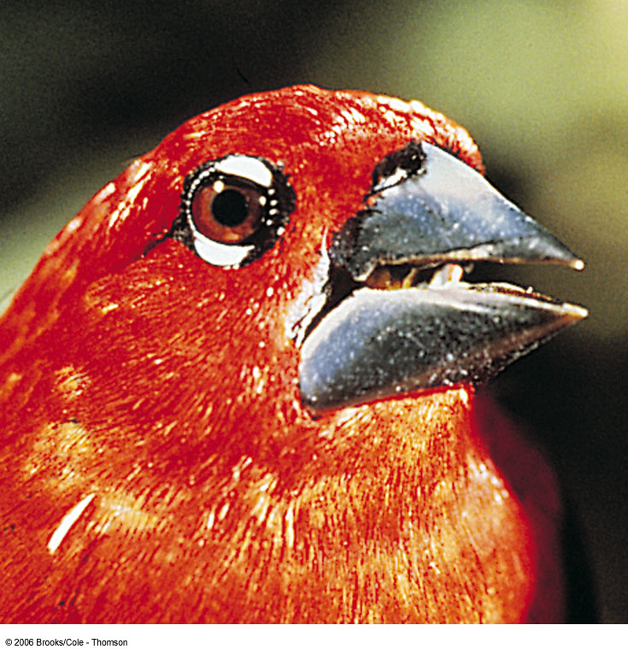
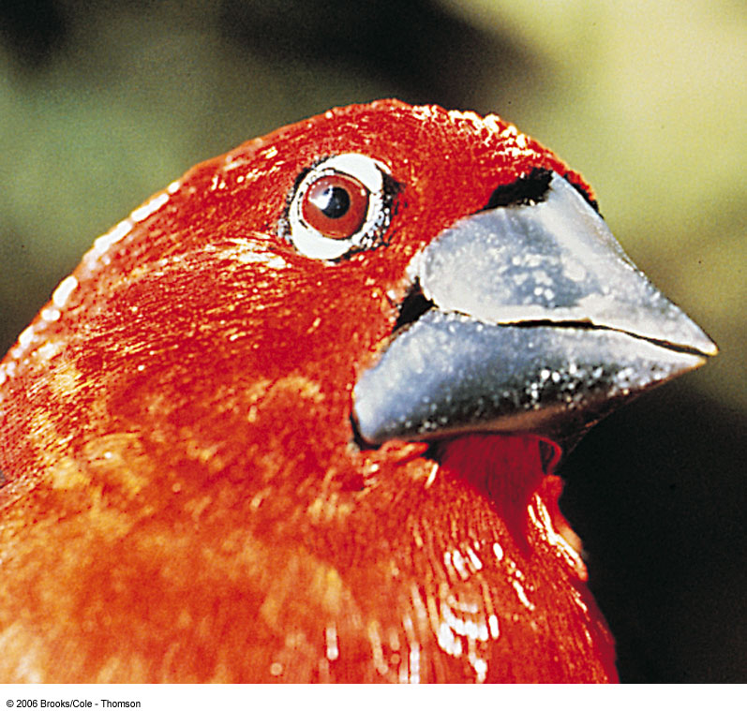
Selection for Gall Size
lower bill 12 mm wide
lower bill 15 mm wide
Fig. 18-11, p.291

Slide 29
Black bellied seed crackers of Cameroon
Live in environment that floods in the wet season and has numerous lightning-caused fires in dry season
Plants that survive are fire resistant sedges
Sedges are two types making either small seeds or large hard seeds
Birds prefer soft seeds but hard survive the fires.
Only two types of seeds thus mid-size beak is less adapted than the extremes.

Slide 30
Phenotypic Consequences of Natural Selection
?
?
?
Directional Selection
Stabilizing Selection
Disruptive Selection
Notes:
30

