Slide 1
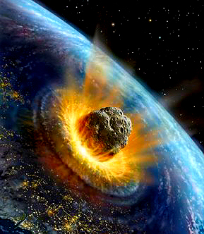
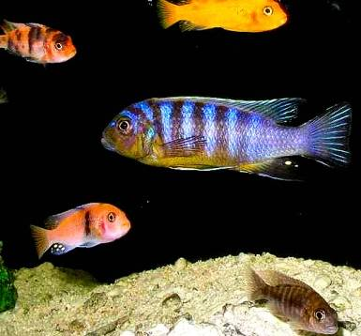
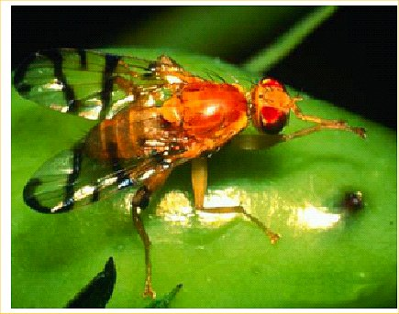
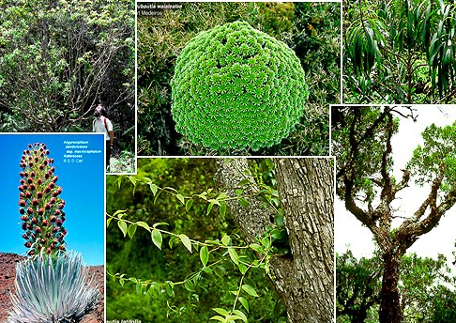
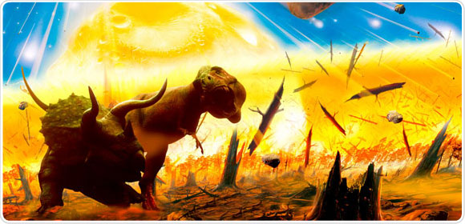
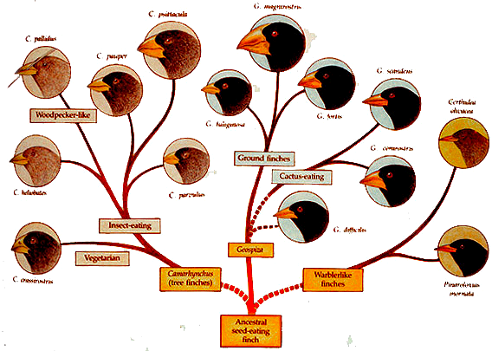
Speciation and Extinction
Notes:
In order, Rhagoletis speciation, extinction by asteroid 65 MYA hitting off coast of Mexico, Cichlid speciation, varieties of Silveswords that underwent adaptive radiation, an adaptive radiation in Darwin’s finches, extinction of dinosaurs in K-T extinction (65 MYA).

Slide 2
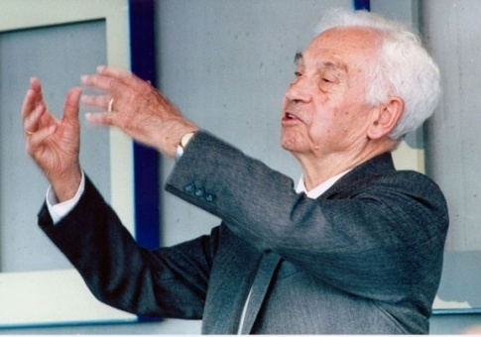
Biological Species Concept
“Species are groups of interbreeding natural populations that are reproductively isolated from other such groups.” - Ernst Mayr
It follows that:
each species has a unique set of alleles that forms the species’ gene pool
each species’ gene pool is isolated from other gene pools, i.e. alleles do not flow between species

Slide 3
Reproductive Isolation
Cornerstone of the BSC
Reproductive isolation results from genetic changes causing pre-zygotic or post-zygotic barriers to reproduction
Speciation is the attainment of reproductive isolation
How we recognize speciation in nature? Depends on definition of what a species is.
Notes:
Pre-zygotic is prior to formation of a zygote (fertilization) and post is after the fertilization event. Examples for pre-zygotic are temporal isolation where species reproduce at different times, behavioral with different types of mating displays (wolf and dog due to aggressiveness of wolf), and mechanical where things don’t fit. Post-zygotic includes hybrid inviability, hybrid sterility (mule is sterile and comes from female horse and male donkey), and hybrid breakdown which impacts next generation.

Slide 4
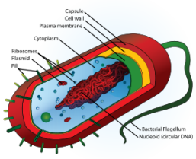
Problems with the BSC
Application of BSC to many groups problematic because of hybridization between clearly delimited species
BSC doesn’t apply & hence of no help in delimiting species in asexual populations (e.g. rotifers, euglenoids; some green algae, diatoms, self-pollinating plants & Daphnia).
Each individual and its descendents are isolated gene pools, so is each lineage a separate species?
In practice, BSC can’t be applied to delimit species: breeding experiments are definitive test of species membership & such tests often impossible with wild populations.
No widely accepted concept of species for prokaryotes - definitions based on DNA - rRNA sequence differences (> 70% DNA, >98.7% rRNA)
Notes:
With prokaryotes there is a lot of horizontal gene transfer between species. This confuses the analysis.

Slide 5
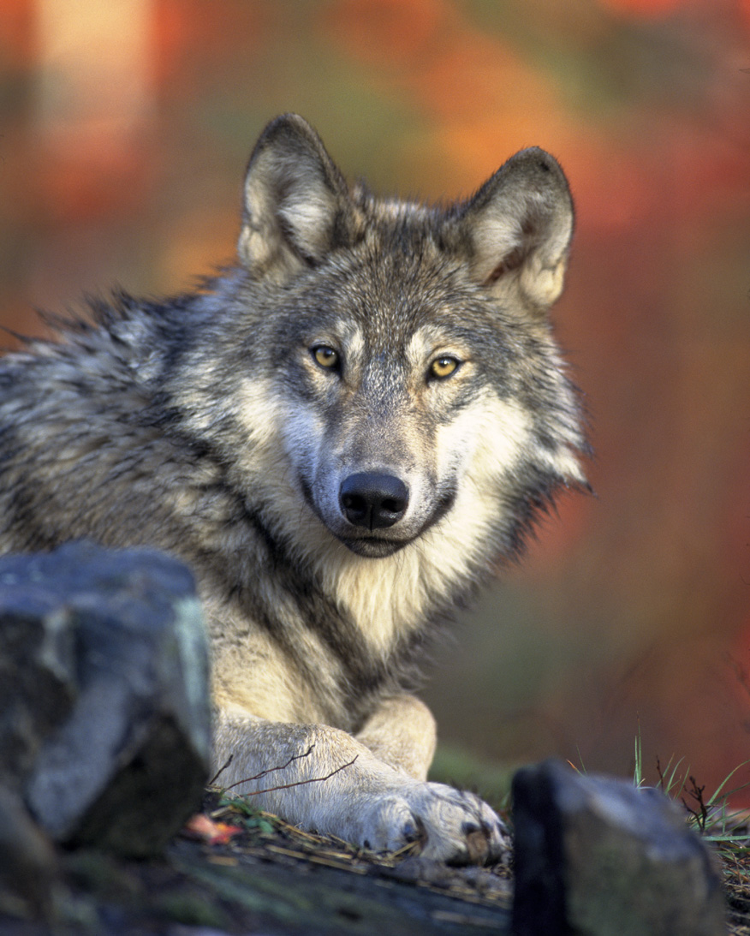
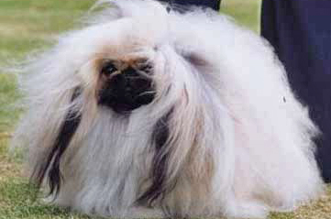
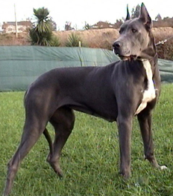
Breeding of Animals: Canis familiaris
Notes:
Images of wolf, Pekingese, Great Dane, and Chihuahua; all dogs are the same species: Canis familiaris. Human breeding of wolves led to these very different looking animals. “Domestic animals fascinated Darwin and continue to enthrall those of us who own pets. It is certainly curious how domestic dogs, which we know--because DNA bar coding has told us!--were raised by man from a wild gray wolf (Canis lupus) ancestor, can take on such a dramatic variety of forms. But among dogs, which are well known for their hybrid (or mongrel) varieties, different breeds can mate and have viable offspring, so they are all found under the umbrella of a single species, Canis familiaris.” from Scientific American http://www.scientificamerican.com/article.cfm?id=different-dog-breeds-same-species.

Slide 6
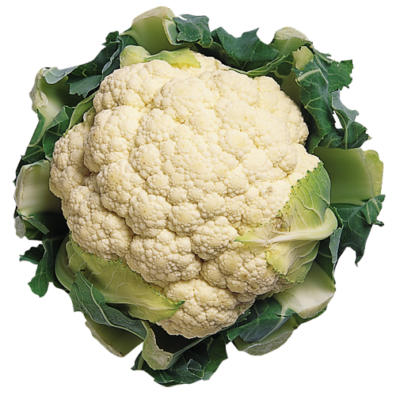
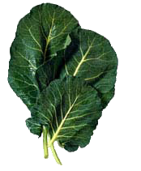
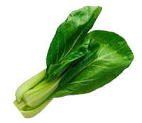
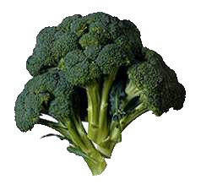
Breeding of Plants: Brassica oleracea
cauliflower
collard greens
Brussels sprouts
broccoli
bok choy
Notes:
Images of cauliflower, collard greens, broccoli, Brussels sprouts, and bok choy. note: Kale, Savory Cabbage, and kohlrabi, are also members of this one species, Brassica oleracea. Human breeding over many centuries produced these very different looking food plants.

Slide 7
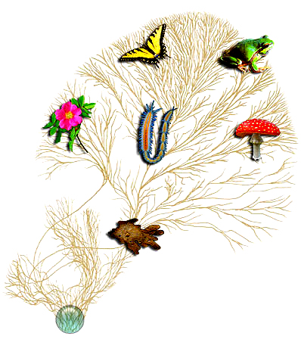
How Many Species?
Taxon | Known | Estimated
Mammals | 5,000 | 5,100
Birds | 10,000 | 10,500
Reptiles | 7,000 | 7,500
Amphibians | 5,500 | 6,000
Fish | 20,000 | 22,000
Insects | 1,000,000 | 7-10 million
Chelicerata (spiders etc) | 80,000 | 800,000
Nematodes | 20,000 | 400,000
Fungi | 50,000 | 1,500,000
Plants | 300,000 | 350,000
Eubacteria + Archaea | 7,000 | 2-50 million
Total | ~2,000,000 | ~10-100,000,000

Slide 8
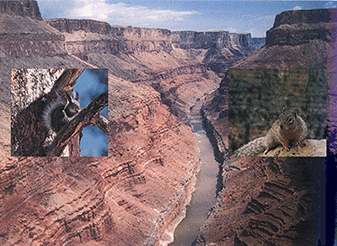
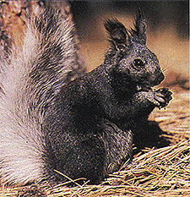
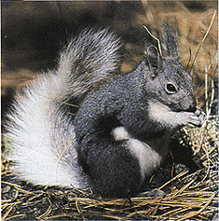
Mechanisms of speciation
North rim – Kaibab squirrel
South rim – Abert’s squirrel
Ancestral population divided by formation of Grand Canyon
Reduced gene flow between separated populations
Grand Canyon
Notes:
Both species inhabit the Ponderosa pine forests on either side. The canyon is desert-like with steep walls and not hospitable to the squirrel’s habits and survival. Over time there was divergence due to adaptation to different environments or genetic drift.

Slide 9
Allopatric Speciation
Speciation in geographically isolated populations
Some type of barrier exists that prevents/reduces gene flow
Effectiveness of barrier varies with species
A. harrisii- south rim and A. leucurus- north rim
Notes:
Amemospermophilus species- antelope squirrels

Slide 10
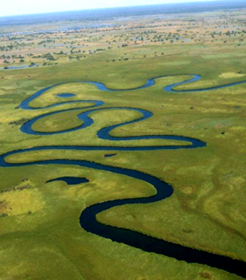
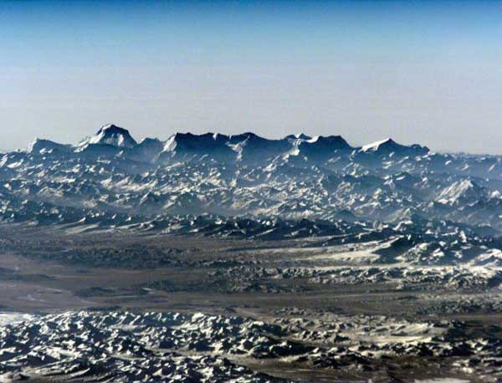
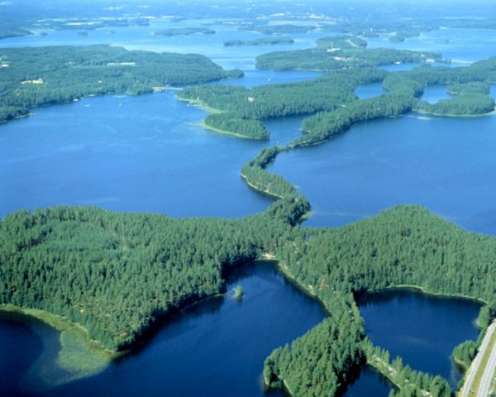
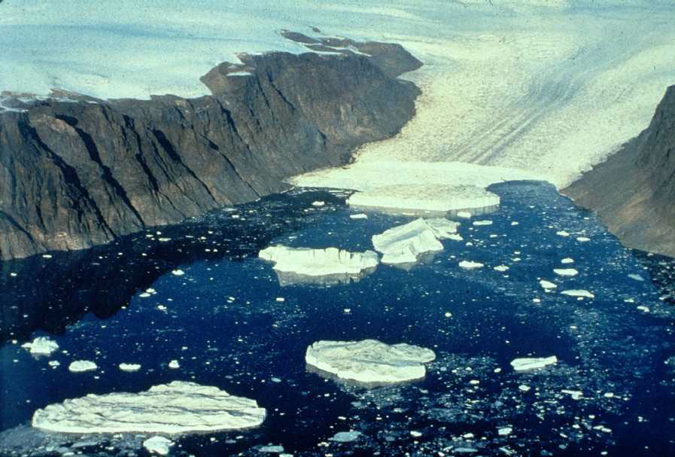
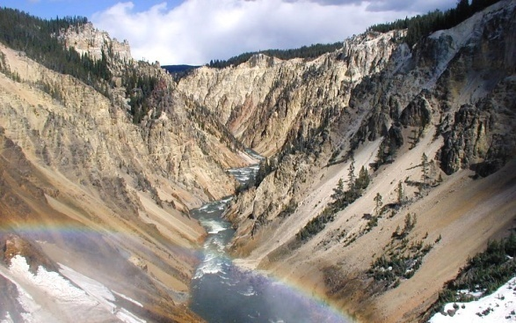
Barriers in Allopatric Speciation
Mountain ranges
Oceans & bodies of freshwater
Land (especially freshwater species)
Glacial masses
Valleys

Slide 11
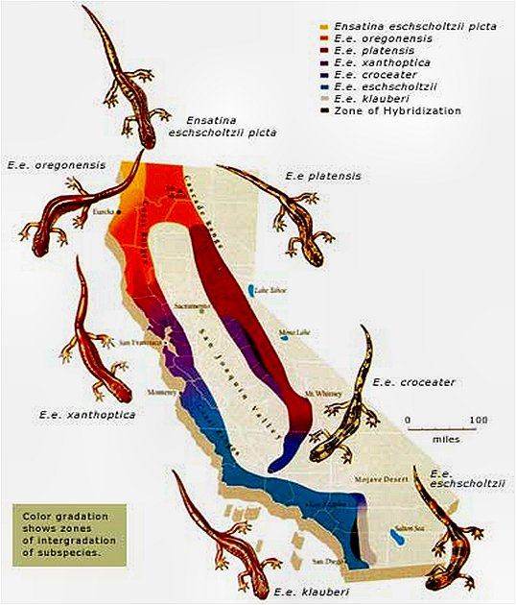
Parapatric Speciation
Adjacent populations evolve into distinct species
Maintain contact along common border
Often hybridize along contact zone
Ensatina salamanders:
Notes:
Ranges do not overlap but contact each other. At borders there may be interbreeding.
The various Ensatina salamanders of the Pacific coast all descended from a common ancestral population. As the species spread southward from Oregon and Washington, subpopulations adapted to their local environments on either side of the San Joaquin Valley. From one population to the next, in a circular pattern, these salamanders are still able to interbreed successfully. However, where the circle closes -- in the black zone on the map in Southern California -- the salamanders no longer interbreed successfully. The variation within a single species has produced differences as large as those between two separate species.
Credits: Illustration by Randy Schmieder. Reprinted from Life on the Edge: A Guide To California's Endangered Natural Resources by Carl G. Thelander. Copyright © 1994 by Ten Speed Press, Berkeley, CA. Available by calling 800-841-2665 or visiting www.tenspe

Slide 12
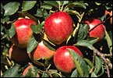
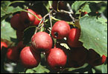
Speciation in Rhagoletis flies- Sympatric speciation
apples
Rhagoletis
hawthorns
1862 - farmer in Hudson River valley noticed Rhagoletis larvae eating his apples
Prior to 1862 only known food source was fruit of hawthorns
Rhagoletis had begun exploiting a completely new food source for its larvae.
Notes:
Model for sympatric speciation. Classic example of speciation while occupying same space.

Slide 13
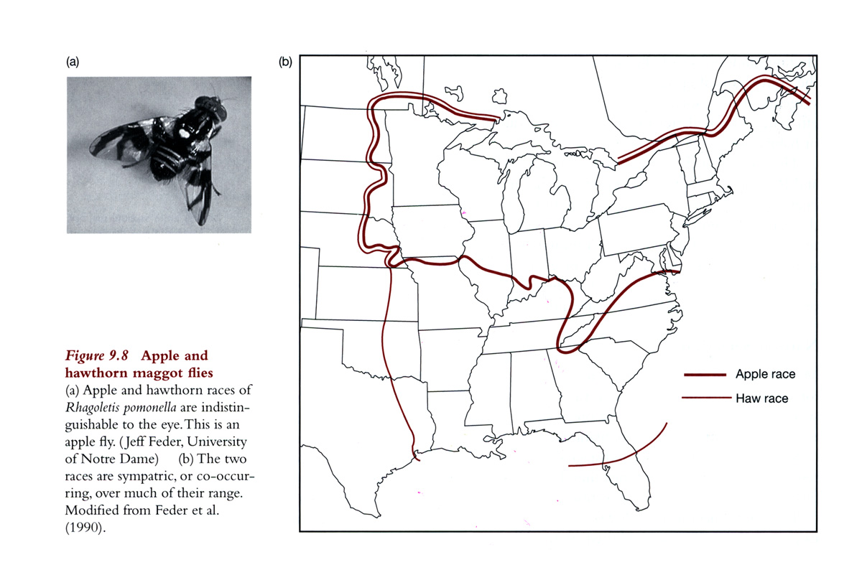
Differentiation of Races
Rhagoletis races
Chemical sensing of host altered by a mutation
Second mutation enhanced larval survival on apples
Genes promoting earlier emergence also selected for
Apple race
Hawthorn race
Notes:
Many use olfactory cues to distinguish between plants. Hybrids have been shown to not respond as well to chemical signals. Also appear to be chromosomal rearrangements when comparing genomes of both types.

Slide 14
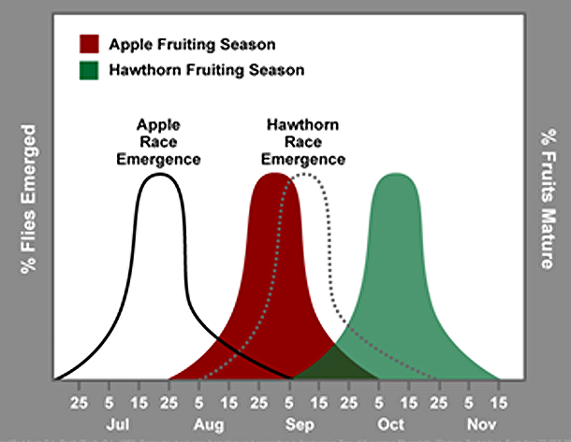
Rhagoletis Emergence Times

Slide 15
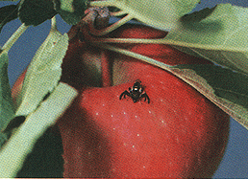
Speciation in Progress
Apple & hawthorn races have evolved reproductive barriers
Adults mate & oviposit on their birth fruit
Apple race emerges 3 weeks earlier
Leads to limited interbreeding
These differences between races mark early stages of sympatric speciation.
apples
hawthorns

Slide 16
Sympatric Speciation
“The divergence of a single interbreeding population of one species into two reproductively isolated populations without any barriers to gene flow.”
Formerly dismissed by biologists especially Ernst Mayr
But compelling evidence for existence & importance of sympatric speciation since 1960s study of Rhagoletis by Guy Bush

Slide 17
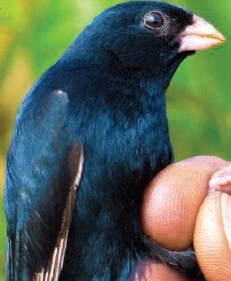
Sympatric Speciation in Progress
Blue indigobird lays eggs in nests of African firefinch & Black-bellied firefinch
Baby indigobirds learn songs of their respective “foster” finches & have developed two “races”
Females prefer males who know same finch song as they do & pass preferences on
Female indigobirds that grow up in African firefinch nests lay eggs in African firefinch nests rather than in Black-bellied firefinch nests.
Notes:
The indigobirds are brood parasites and lay their egg in other species nests, as described above. Matching with the host is driving the speciation.

Slide 18
Adaptive Radiation
A “burst” of speciation & evolutionary divergence
Single lineage gives rise to many new species
New species fill vacant “adaptive zones”
Adaptive zone is a new set of niches or “ways of life”
Notes:
Darwin’s finches in the Galapogos

Slide 19
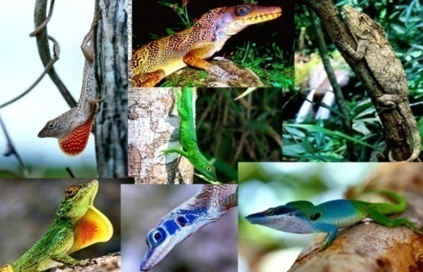
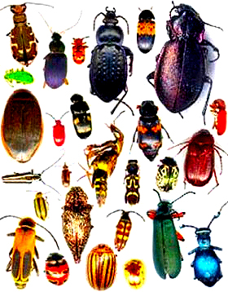
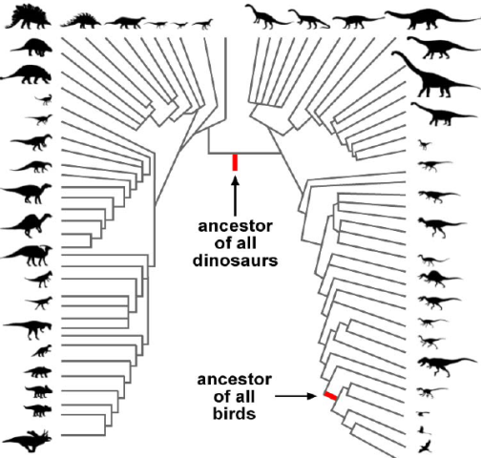
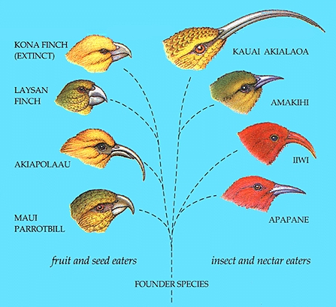
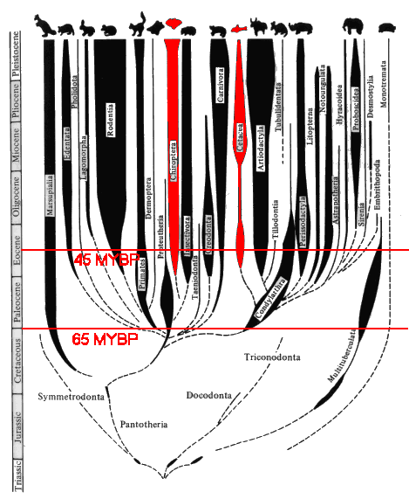
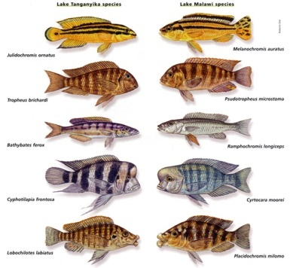
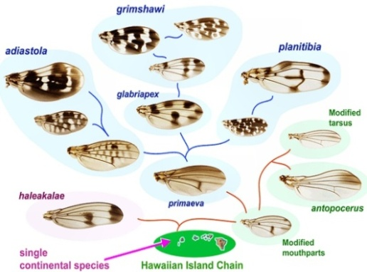
Examples: Adaptive Radiations
Hawaiian silverswords
Anolis lizards
Beetles
Dinosaurs
Hawaiian honeycreepers
Mammals
Geospiza
Hawaiian Drosophila
Cichlids
Notes:
The adaptive radiation of mammals occurred after the extinction of the dinosaurs. Mammals were present during the time dinosaurs lived but were small and a minor proportion of species. Extinction of dinosaurs lead to opening of new niches and rapid speciation of mammals.

Slide 21
Video: Mass Extinctions
youtube copy
Notes:
Extinction is common with 95-99% of all the species that have lived on the Earth going extinct. If you can’t adapt or compete you die out. Many factors impact environment- mountain range form from geological event, etc. After extinction other species may flourish. What about catastrophes? At end of Permian period (beginning of Triassic) 90% of species died out. Shown as a clear area in the fossil record. Possibly a comet or radical environmental change leading to die off of plant life and then the rest follows as a house of cards. Some few creatures survived- species of reptiles- orsinodonts. Dinosaurs survived and spread. First dinosaur was not likely as large as we think of them. Dinosaurs for 150 MY then extinction by an asteroid hitting Earth. Crater seen in Mexico. Over 50% of species went extinct. 4 MYA out of the trees leading to us.

Slide 22
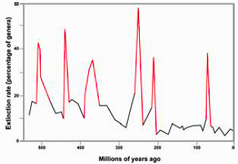
Mass Extinctions
Six major mass extinctions have occurred over past 600 million years

Slide 23
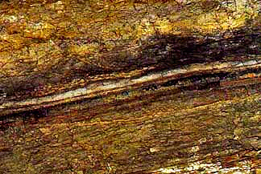
Cretaceous Extinction
Iridium much more common in asteroids & meteors than Earth rocks
Iridium layer at K-T boundary in soil fossil layer marks and separates age of reptiles & age of mammals
After several year search geologists found “smoking gun” – huge Chicxulub crater
120 miles in diameter, 8-10 miles deep
Controversy over what caused other mass extinctions
Notes:
Cretaceous to Tertiary boundary is the period where dinosaurs were wiped out. Occurred 65 MYA.

Slide 24
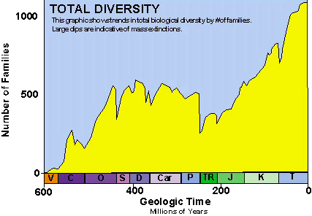
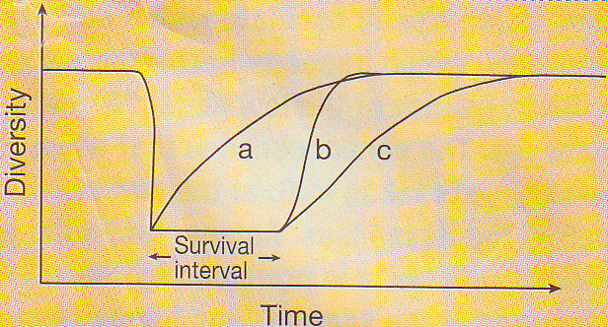
Recovery from Extinction
Over time species diversity recovers
3 models:
a. Recovery starts immediately - lasts few million yrs
b. Recovery has time lag - then rapid adaptive radiation through + feedback (new species & niches create more & more opportunities for more species)
c. Recovery starts and builds slowly following S-shaped logistic curve
Extensive fossil data for marine species favor model b
Time lag is ~10 MY

Slide 25
Major Radiations after Mass Extinctions?
Dinosaurs
Mammals
Notes:
Dinosaurs after the permian-Triasic extinction (251 MYA) and Mammals after the K-T extinction (65 MYA).

Slide 26
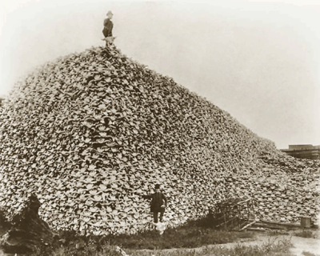
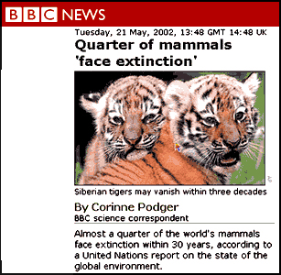
The Greatest Mass Extinction?
Over past 300 years Homo sapiens responsible for 100s of thousands of extinctions
Extinction rates now 100-1000 times “background” or normal levels of ~1-2 species per year
If increased rate continues we are heading towards greatest mass extinction in Earth’s history
1870-Hunters and pile of buffalo skulls

