Slide 1
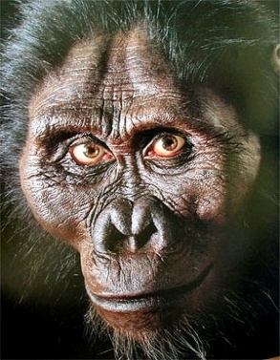
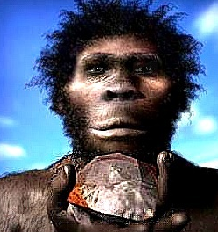
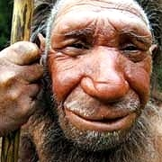
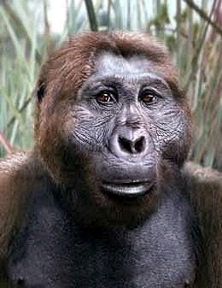
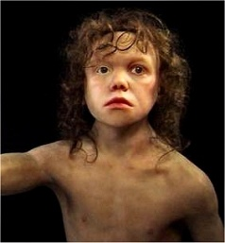
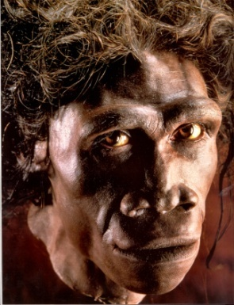
Human Evolution II
Notes:
Same cast of characters.

Slide 2
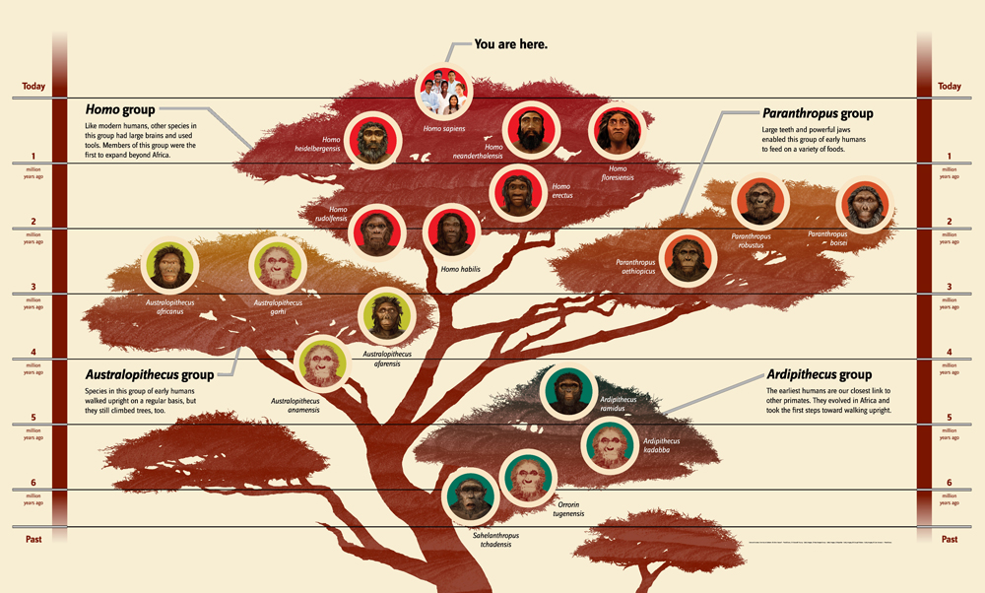
Notes:
Attempt to put Hominins in some form of evolutionary tree. Is it correct- not certain but it is a good faith attempt, plus the 4 individual branches do not have connecting lines. Lower lineages within each group have lower positions in their branch cluster.

Slide 3
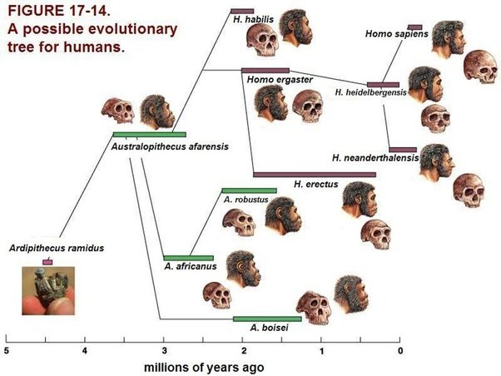
Notes:
Going further “out on a limb”. Some sites show H. erectus as leading to H. heidelbergensis and H. erectus is thought to be the first to take a long hike out of Africa about 200,000 YA. Plus H. neanderthalensis fossils have never been found in Africa, mostly in Europe and the middle east. H. heidelbergensis lived in Africa, Europe and western Asia.

Slide 4
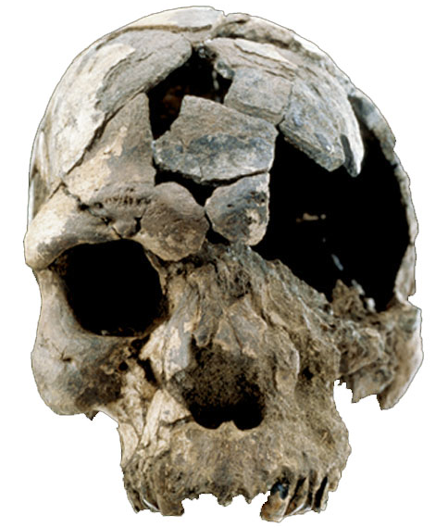
Earliest Homo Fossils Are African
Africa cradle of human evolution
No human fossils older than 2 million years exist anywhere but Africa
Homo erectus left Africa in waves from 2 million to 500,000 BC
Homo sapiens evolved in Africa ~300,000 yrs ago – left in waves beginning ~100,000 BC
H. sapiens
fossil from Ethiopia
160,000 years old

Slide 5
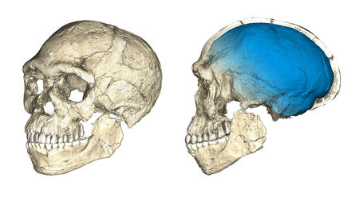
Homo Sapiens- older, multiple steps and a new location (still African)
Modern Moroccan~300,000 YA
http://www.sciencemag.org/news/2017/06/world-s-oldest-homo-sapiens-fossils-found-morocco
Notes:
As reported in Science, June 7, 2017 the blue tinted skull (blue tint is for diagrammatic reasons only- the skull was not actually blue) was found in previously know fossils from Morocco dated to approximately 300,000 YA and not in the Rift Valley in Ethiopia where most early H. sapiens were found starting ~200,000 to 150,000YA. Suggest possibilities of species changes or intermediaries over time with the flattened front face being an earlier change than the lack if an elongated skull in modern H. sapiens.

Slide 6
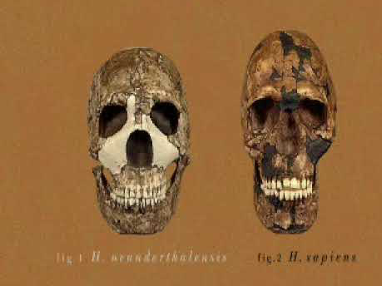
Video: Cave Man

Slide 7
Video: Cave Man
Youtube copy
Notes:
The video discusses Neanderthals and Homo sapiens in their interactions. It asks whether or not Neaderthals were subsumed or killed by Homo sapiens. There remains controversy but obviously H. sapiens are the survivors.

Slide 8
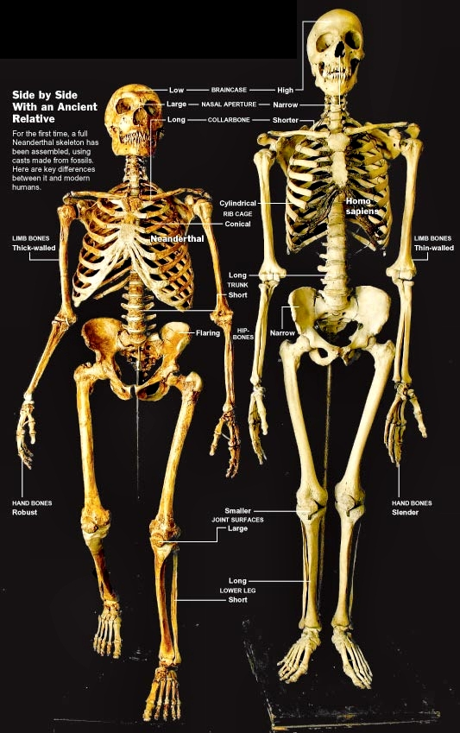
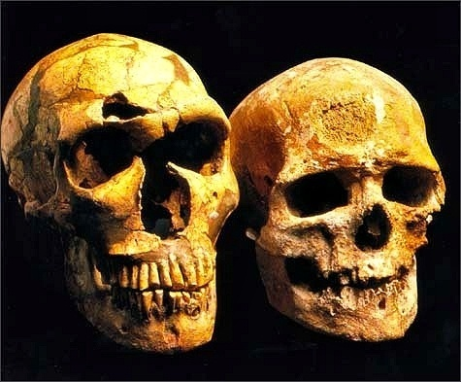
Neanderthals and Us
Although Neanderthals were big-brained
bipeds like us, there are many differences in skulls and skeletons.
Notes:
Follow the picture for skeletal differences.

Slide 9
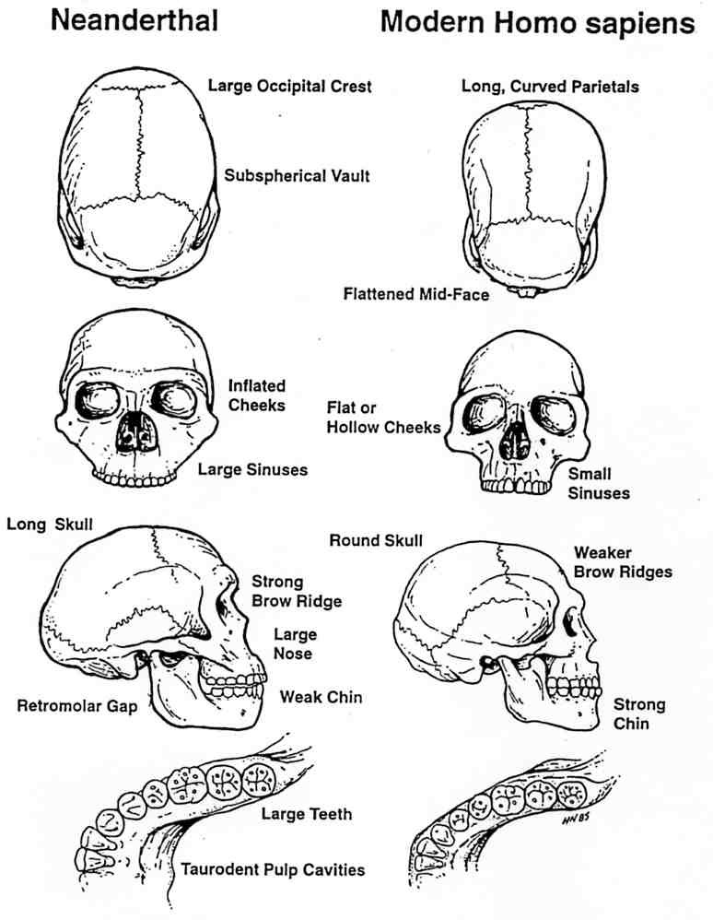
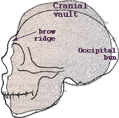
Neanderthal Cranial Features
Crania of Neanderthal & Modern Human - Klein (1999)
Human – 1200 cc
Neanderthal – 1350 cc

Slide 10
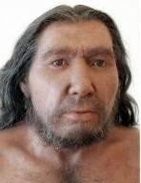
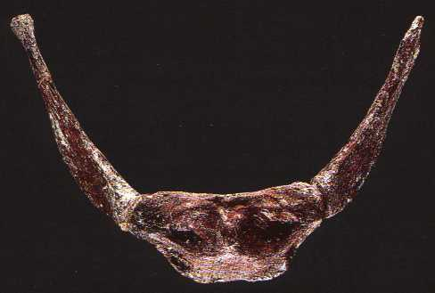
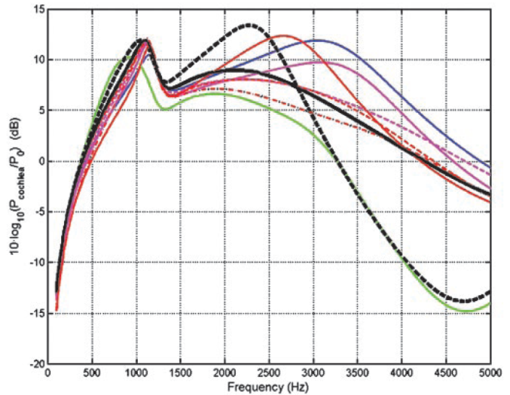
Neanderthal Language?
Hyoid bone identical to ours
Suggests Neanderthals had capacity for language.
Human ears tuned for 3-5 kHz sensitivity compared to other primates - adaptation for speech perception
Human-shaped middle ear in 400,000-year old Neanderthal ancestors.
Genetic traces of strong natural selection on middle-ear
FoxP2 gene
Human (blue)
H. heidelbergensis (red)
Chimp (green)
Notes:
FoxP2 gene is a transcriptional regulatory gene involved in speech by causing sounds not to be made correctly. Present in chimpanzee also but studies in brain show different patterns of expression resulting in human language abilities and lack of such in chimpanzees.

Slide 11
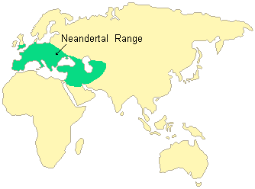
Homo neanderthalenis
~500,000 – 20,000 YBP
Notes:
Primarily in Europe and areas shown. Scavengers, tool makers and hunters. Language and culture.

Slide 12
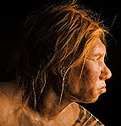
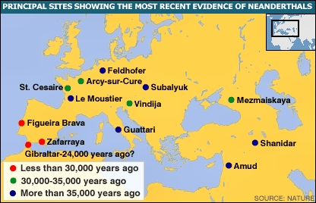
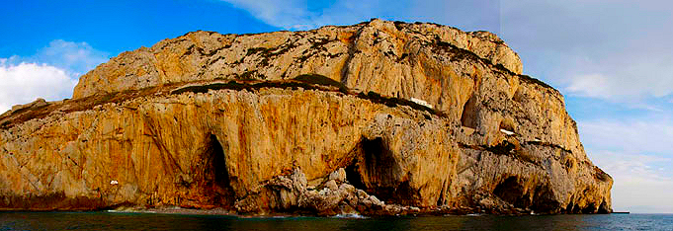
Neanderthal’s Last Stand
Range gradually shrank to coast of Spain
Last remains found in Gibraltar cave
Date to 23-24,000 YA
Why did they go extinct?
Notes:
Extinct because of significant sexual relationships with H. sapiens is not likely. Possible environmental problem because of extreme cold in Western Europe. Or they were outcompeted by H. sapiens- warfare? New theory is that continued waves of H. sapiens coming out of Africa in larger numbers would eventually have caused extinction.

Slide 13
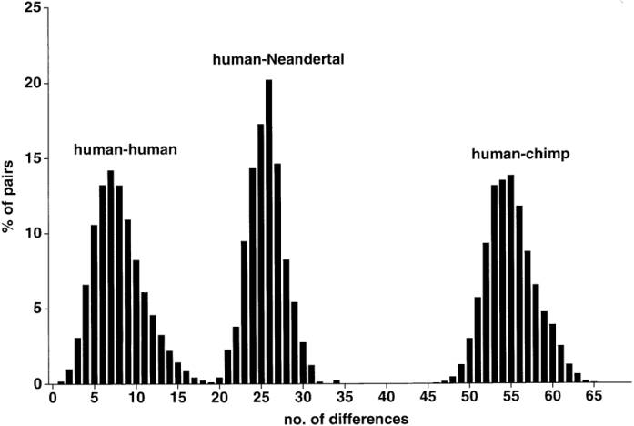
Sequence Differences: Humans, Neanderthals, & Chimpanzees
X = # of sequence differences
Y = % of pairwise comparisions
Notes:
Even between humans there are sequence differences at allelic locations and the fact that there are so few indicates a short lineage. There are greater differences between human- Neanderthal, with 99.5% genetic homology illustrating a longer time between speciation. These data are backed up by the human-chimp comparison with 98% homology and 6MY year divergence from common ancestor.

Slide 14
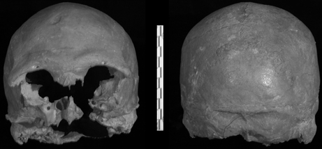
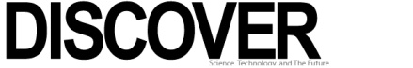

Odd Skull Boosts Human, Neanderthal Interbreeding Theory
Brian Handwerk
for National Geographic News
August 2, 2007
A human skull from a Romanian cave is shaking up ideas about ancient sex. The Homo sapiens skull has a distinctive feature previously found only in Neanderthals, providing further evidence of interbreeding between the species, according to a new study.
Notes:
At first analysis morphology and mitochondrial DNA contradict each other. The actual differences are modern human to Neanderthal at about 27.2 substitutions, human to human at about 8 substitutions and human to chimpanzee at 55 substitutions in mitochondrial DNA- still all very similar with divergence estimated at 550,00 to 690,000 YA.
14

Slide 15
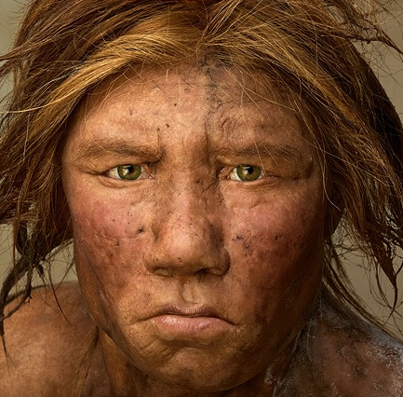
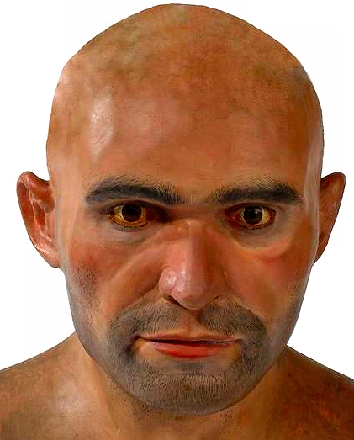
Humans & Neanderthals: Genetic comparison
1987 - paper in Nature analyzed human mitochondrial DNA - concluded humans evolved in Africa 200,000 years ago, separate from Neanderthals, spread to Asia & Europe
  - “Out of Africa” theory rejects Neanderthals as ancestors & supports idea we helped cause Neanderthal extinction
1997 - 378-letter mitochondrial DNA extracted from 40,000-year-old Neanderthal bone & compared to human mDNA
  - Concluded we are separate geographic & evolutionary branches that split from common ancestor 500-600,000 YBP
2007 - Analysis of Neanderthal DNA reveals we shared exactly same FoxP2 gene associated with language abilities
2008 - Human-Neanderthal DNA ~99.5% similar - suggests divergence ~700,000 YBP
  Human-chimp DNA 98.7% similar – divergence ~ 6 MYBP
2010 – Close analysis reveals a number of genes of Neanderthal origin which have been preserved in Eurasians but not Africans living today. In other words, Neanderthals and some modern humans did interbreed.
Neanderthal
Cro-Magnon man
Notes:
Follow timeline on slide which notes date of analysis plus date of origin of Homo sapiens. Note most recent item showing some retention of Neanderthal genes in certain populations of H. sapiens. Sequence of Neanderthal genes (genome has been sequenced) shows no overlap with African H. sapiens population, some with European H. sapiens population and more with Asian H. sapiens population. Neanderthal keratin genes seem to be preserved. Keratin is a protein component of skin and hair. Also maintained genes that involve immunological components to help fight disease. Interestingly there are no Neanderthal genes on the Y chromosome of modern humans there could have been hybrids but they would be sterile or that there were unknown incompatibility factors leading to a lack of male offspring between Neanderthal men and H. sapien women..

Slide 16
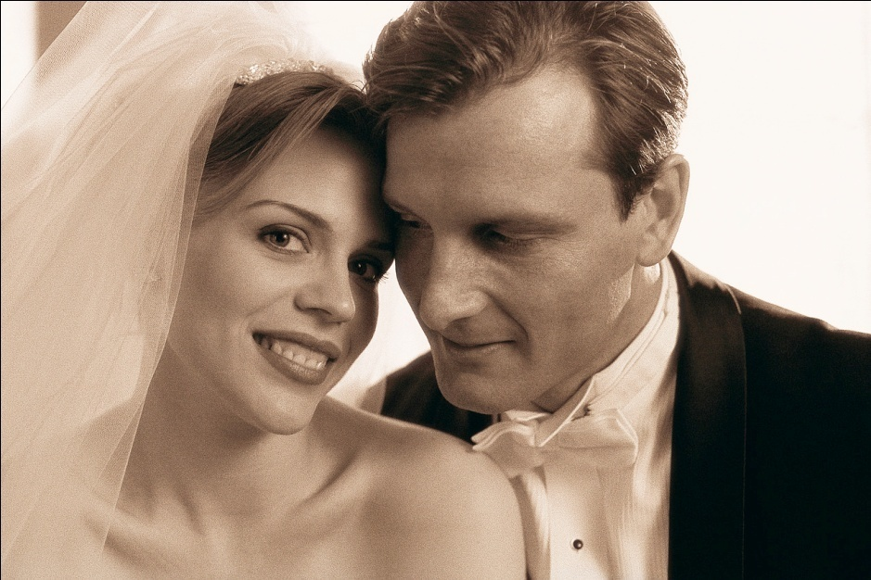

The latest news…
Stephen Stills
Love The One You're With
Science 7 May 2010:
Vol. 328. no. 5979, pp. 710 – 722
A Draft Sequence of the Neandertal Genome
Richard E. Green,^{1,*,,} Johannes Krause,^{1,,} Adrian W. Briggs,^{1,,} Tomislav Maricic,^{1,,} Udo Stenzel,^{1,,} Martin Kircher,^{1,,} Nick Patterson,^{2,,} Heng Li,^{2,} Weiwei Zhai,^{3,,||} Markus Hsi-Yang Fritz,^{4,} Nancy F. Hansen,^{5,} Eric Y. Durand,^{3,} Anna-Sapfo Malaspinas,^{3,} Jeffrey D. Jensen,^{6,} Tomas Marques-Bonet,^{7,13,} Can Alkan,^{7,} Kay Prüfer,^{1,} Matthias Meyer,^{1,} Hernán A. Burbano,^{1,} Jeffrey M. Good,^{1,8,} Rigo Schultz,¹ Ayinuer Aximu-Petri,¹ Anne Butthof,¹ Barbara Höber,¹ Barbara Höffner,¹ Madlen Siegemund,¹ Antje Weihmann,¹ Chad Nusbaum,² Eric S. Lander,² Carsten Russ,² Nathaniel Novod,² Jason Affourtit,⁹ Michael Egholm,⁹ Christine Verna,²¹ Pavao Rudan,¹⁰ Dejana Brajkovic,¹¹ eljko Kucan,¹⁰ Ivan Guic,¹⁰ Vladimir B. Doronichev,¹² Liubov V. Golovanova,¹² Carles Lalueza-Fox,¹³ Marco de la Rasilla,¹⁴ Javier Fortea,^{14,¶} Antonio Rosas,¹⁵ Ralf W. Schmitz,^{16,17} Philip L. F. Johnson,^{18,} Evan E. Eichler,^{7,} Daniel Falush,^{19,} Ewan Birney,^{4,} James C. Mullikin,^{5,} Montgomery Slatkin,^{3,} Rasmus Nielsen,^{3,} Janet Kelso,^{1,} Michael Lachmann,^{1,} David Reich,^{2,20,*,} Svante Pääbo^{1,*,}
Neandertals, the closest evolutionary relatives of present-day humans, lived in large parts of Europe and western Asia before disappearing 30,000 years ago. We present a draft sequence of the Neandertal genome composed of more than 4 billion nucleotides from three individuals. Comparisons of the Neandertal genome to the genomes of five present-day humans from different parts of the world identify a number of genomic regions that may have been affected by positive selection in ancestral modern humans, including genes involved in metabolism and in cognitive and skeletal development. We show that Neandertals shared more genetic variants with present-day humans in Eurasia than with present-day humans in sub-Saharan Africa, suggesting that gene flow from Neandertals into the ancestors of non-Africans occurred before the divergence of Eurasian groups from each other.
_____________________________________________________________________________________________________________
YouTube copy: Stephen Stills - Love The One You're With

Slide 17
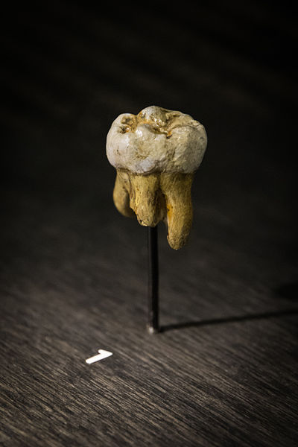
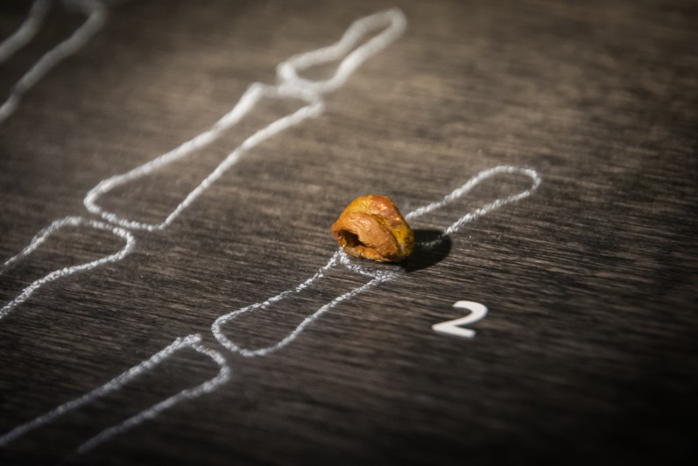
New on the scene from a finger- Denesovians
Genome was determined from finger bone
Notes:
Fossil and tooth found in Denisovia Cave in Siberia. Have complete genome. Distinct branch of Homo tree. A third group that was around simultaneously with H. sapiens and H. neanderthalensis. All are thought to come from an ancestral species leading to the three species mentioned here. They were divided geographically. Denesovans were more Asian with movement as far posssibly as Australia.

Slide 18
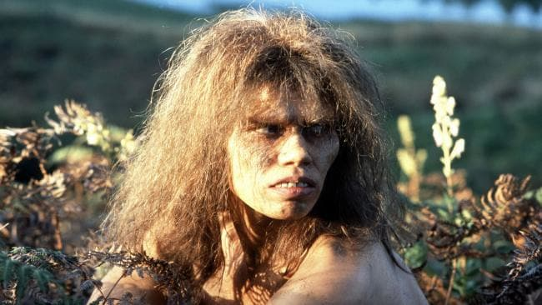
Combing ancient and modern genomes
Video: Modern humans may have interbred with Neanderthals and Denisovans
youTube copy
Local copy
Notes:
Exactly how this occurred is still debatable. Earlier forms of H. sapiens (~300,000 YA) may have started in Morocco and moved westward to Ethiopia with a significant population remaining in Africa. Neanderthals and Denisovans were likely to have moved out earlier or split from a different ancient Homo species. Neanderthals had broader range going slightly into Eurasia where there could have been interactions with Denisovan who moved much more into Asia over time. It remains possible to find migratory times where all three species could have interacted. Certainly Neanderthal genes and Denisovan genes are found in H. sapiens. None of these are found in the ancestral Africa H. sapiens. Greater overlap in H. sapiens and the other two are speculative but must have occurred.

Slide 19
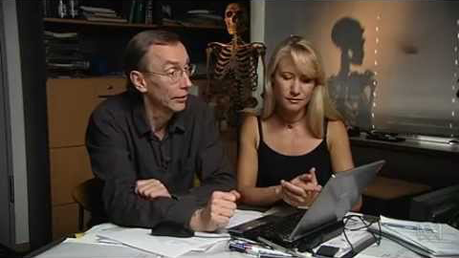
Modern humans may have interbred with Neanderthals and Denisovans (YouTube)

Slide 20
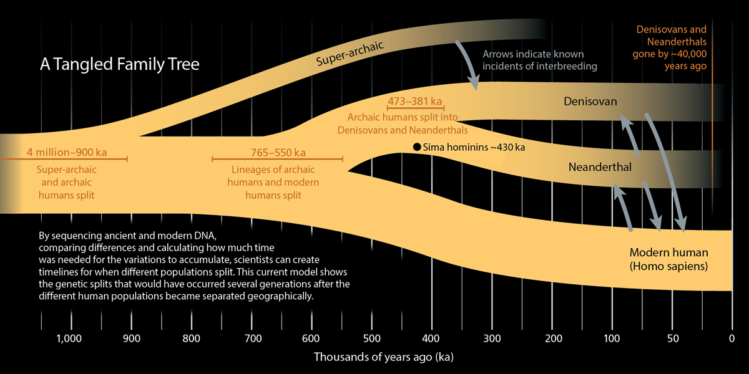
Notes:
Data based upon DNA comparisons and not precise fossil evidence but it fits fossil evidence. All out of Africa genome exchanges with higher percent of Denisovan in Southeast Asia and Oceania modern groups (up to 6%).

Slide 21
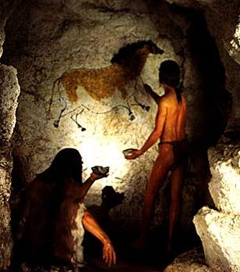
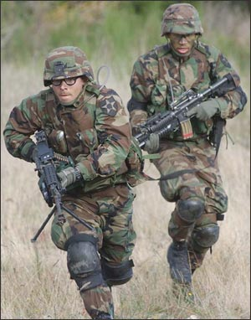

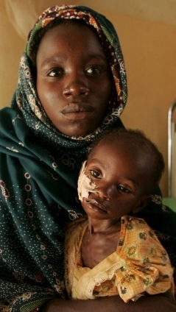
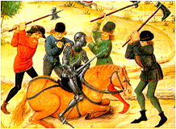
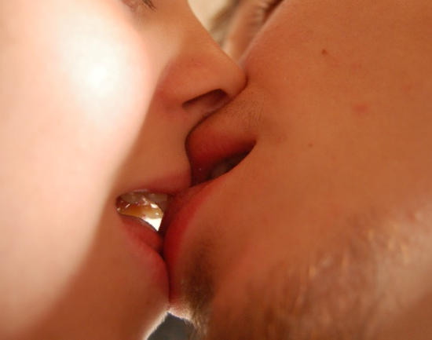
Evolution, culture and Human Nature

Slide 22
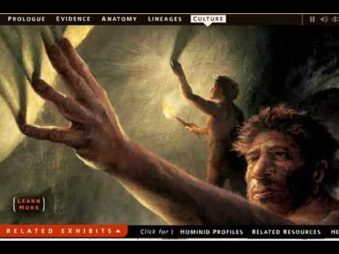
Video: Culture

Slide 23

Culture
Video: Culture
Original Source: Becoming Human
Navigate to:
Culture – Play the Documentary
(backup link)
Download the file and run application
youTube copy
Notes:
Culture from an evolutionary perspective.

Slide 24
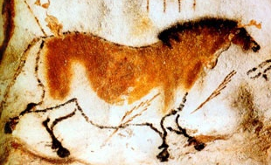
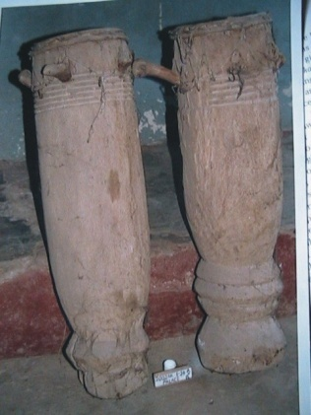
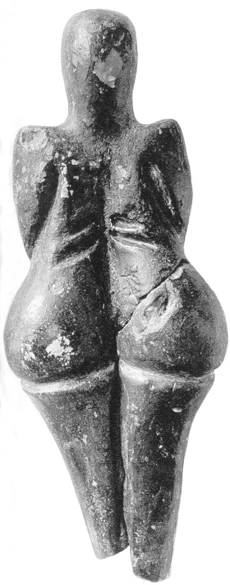
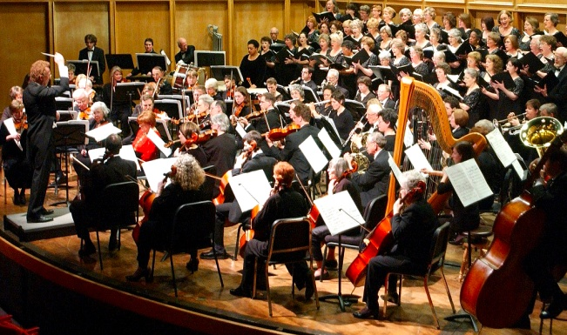
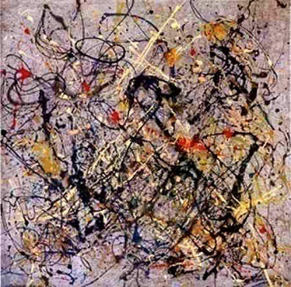
Art
Music
Neanderthal Bone Flute 45,000 BC
Lascaux cave painting 30,000 BC
Mesopotamian Drums 8000 BC
Venus figure 33,000 BC
Symphony orchestra 2008
Jackson Pollock painting 1953
Notes:
24

Slide 25
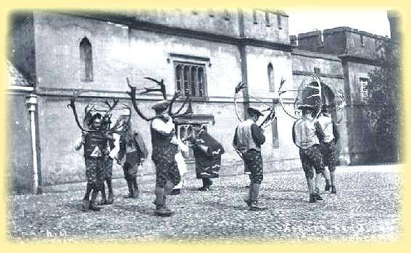
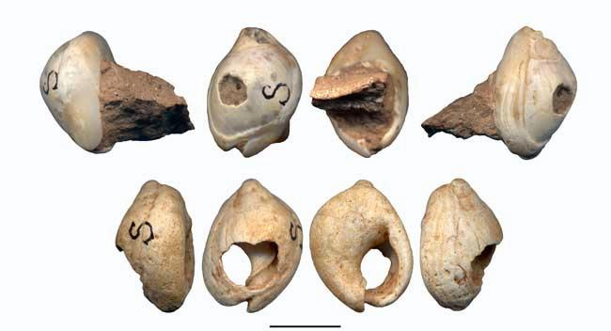
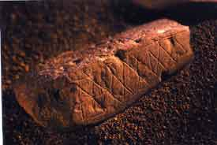
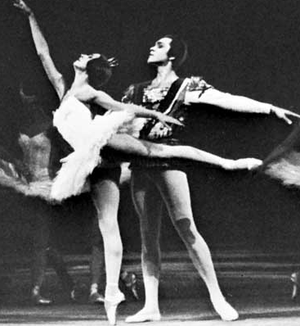
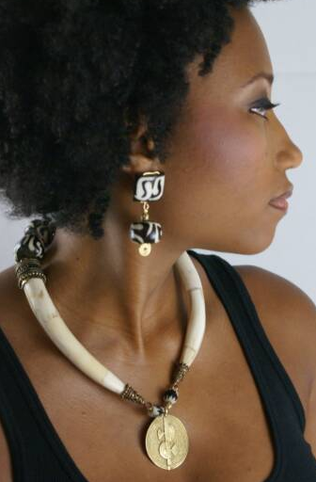
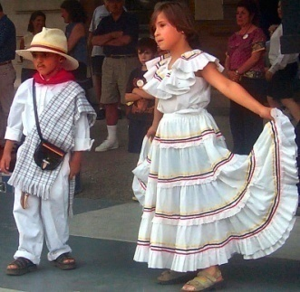
Dance
Decoration & Adornment
Necklace beads 100,000 BC
Hunting Dance Mongolia ~ 1880
Decorated block of red ochre 72,000 BC
Bolshoi Ballet 1970
Latin Dancing 2002
Fashion model 2007
Notes:
25

Slide 26




Another way of being human?
Exhibited care of others - altruism
Buried their dead.
Made sophisticated stone tools.
Made musical instruments
Made beads and other jewelery
Most likely had spoken language

Slide 27

Is culture exclusively hominin linked?
Non-genetic learned behaviors
  Tool Design
  Grooming
  Mating Display
39 behaviors distinct to a troop
Notes:
Consider the rudimentary elements of culture in chimpanzees: tool design, grooming, mating display, and 39 behaviors that have been identified to be distinct to a troop and to be taught.

Slide 28

Tool-making: Chimpanzees
Chimp cracking nuts with hammer & anvil stones
Use sticks and grass stems to harvest ants
Notes:
Chimpanzees make and use tools. Although no other animal uses tools to the extent that humans do, other animals do make and use tools, and these behaviors are taught.

Slide 29

Video: Cooperative hunting in Chimps

Slide 30

Video: Cooperative hunting in Chimps
local_copy
Notes:
Strategy shown by early Hominin lineages.

Slide 31




War & Violence
Cooperation & Altruism
Indian hunting party 1860
Barn raising 1890
Iraq 2008
Notes:
31

