Slide 1
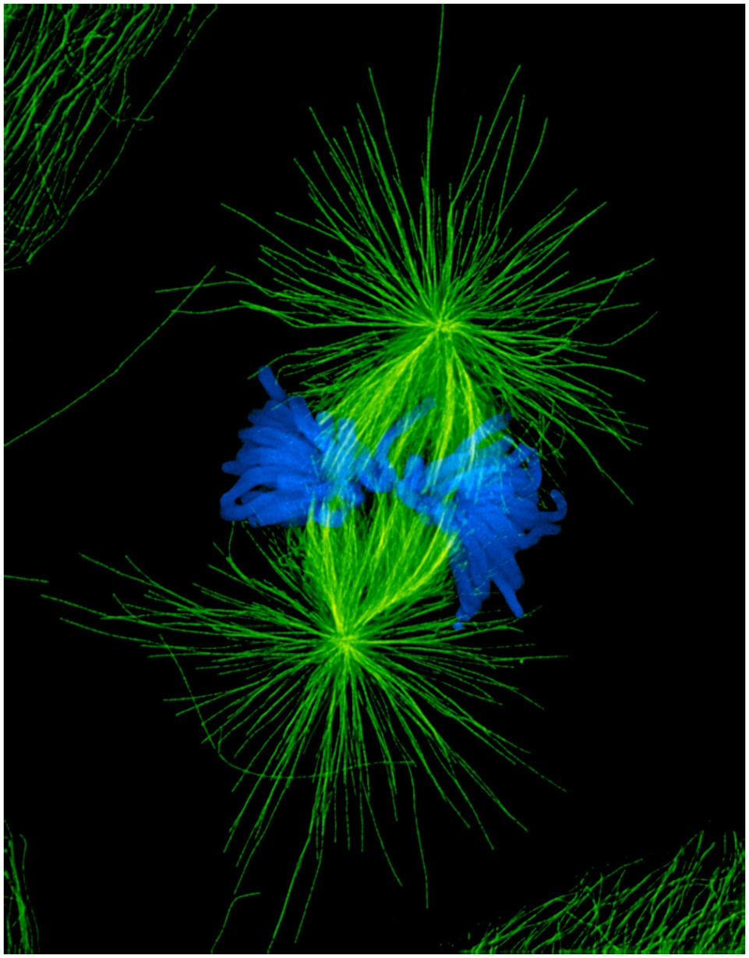
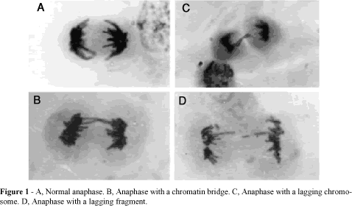
Genetics & Medicine 1. The Cell Cycle, Mitosis, and Cancer
Genet. Mol. Biol. vol.22 n.4 São Paulo Dec. 1999
Alexey Khodjakov
Wadsworth Center
Notes:
Picture on the left is a normal metaphase cell with chromosomes aligned at the metaphase plate. Picture on the right shows a normal cell in A and cells treated with various cancer-causing chemicals(B-D). In B-D note abnormal distribution of chromosomes during anaphase stage (B- chromosomal bridge; C- lagging chromosome; lagging fragment.

Slide 2
Karyotype of Pancreatic Cancer Cells
What do you notice that appears odd amongst these chromosomes? HINT: What should a normal karyotype look like?
British J. Cancer (1993), 67: 1106-1112

Slide 3
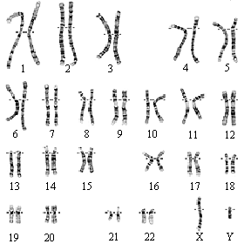
Normal cell karyotype
Notes:
Normal karyotype of a male because of both X and Y chromosomes. Diploid cell with two copies of each chromosome.

Slide 4
Attendance exercise
Normal Cancer
Point out two abnormalities with the cancer cell karyotype and explain how this might occur? Post to Bulletin board.

Slide 5
The pancreatic cancer cell karyotype shown was most likely a somatic/germ line cell and the abnormal chromosome distribution most likely occurred during mitosis/meiosis. Choose the correct answer from below for the information in red.
  A. somatic & mitosis
  B. somatic and meiosis
  C. germ line & mitosis
  D. germ line & meiosis
Clicker question
Notes:
Correct answer is A

Slide 6
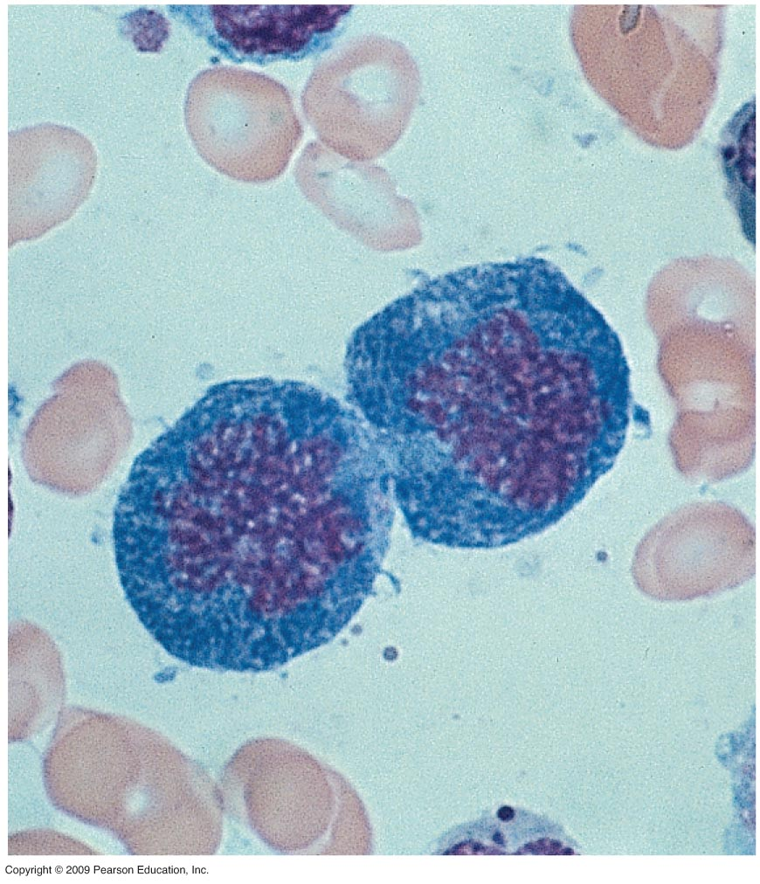
Why is cell division essential to life?
Basis of reproduction for every organism
Allows multicellular organisms to grow to adult size
Replaces worn-out or damaged cells
  Examples include wound healing, skin cell replacement, making new red blood cells
Cell replacement in bone marrow

Slide 7
What is the scale of cell division in humans?
Total number of cells in an average human is 100 trillion
Millions of cells divide every second to maintain the total
Rate that cells divide is dependent upon the type of cell
  Skin stem cells in dermal layer divide once per hour
  Differentiated muscle or nerve cells do not divide

Slide 8
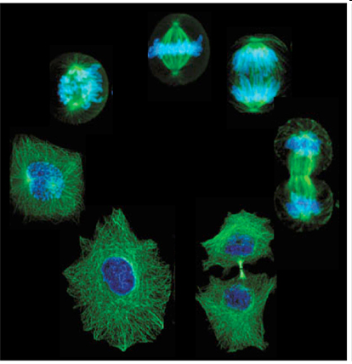
The cell cycle regulates the different rates of cell division
http://www.cbp.pitt.edu/faculty/yong_wan/

Slide 9
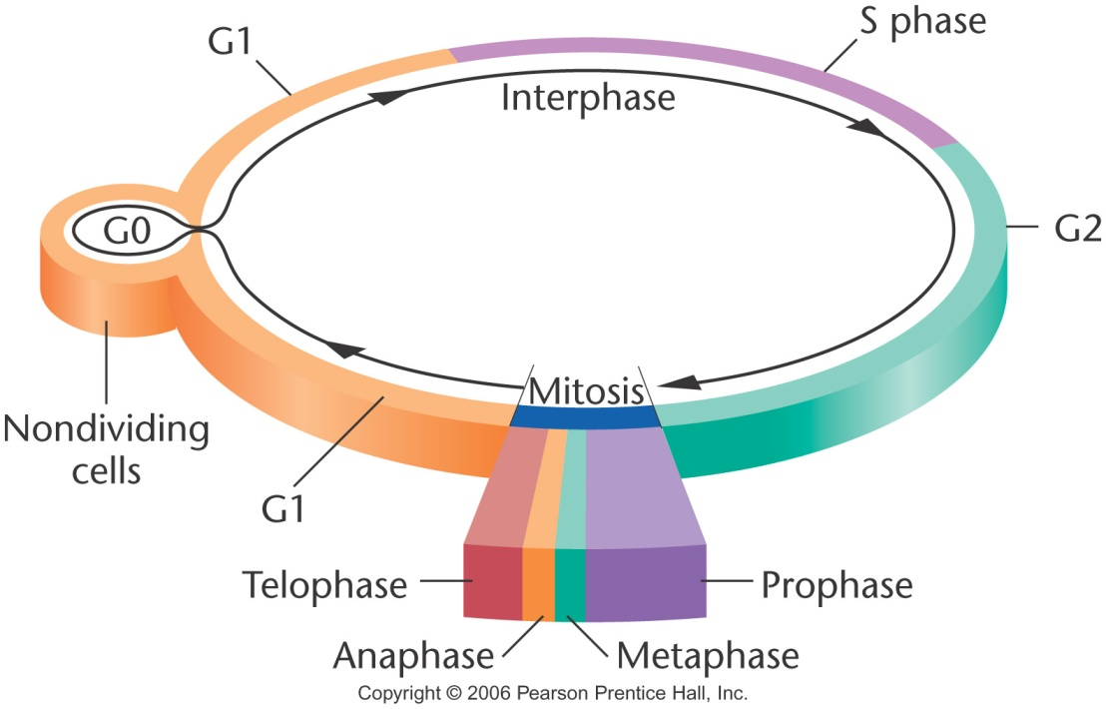
The Cell Cycle
•G1: interval (“Gap”) of cell growth prior to DNA replication.
biosynthesis of proteins, CHO, and lipids
•S: DNA replication is completed & chromosomes duplicated.
•G2: interval after DNA replication. Cell prepares to divide.
•Mitosis or M Phase
•Cytokinesisis or Cytoplasmic Cleavage
•Each of 2 daughter cells enters Interphase.
Notes:
Follow explanation in slide to name the periods of the cell cycle.
Length of cell cycle ~same for same cell types, but may differ greatly from one cell type to another. Ex: Neurons remain in G0 and do not divide. Bone marrow, mucosa of gut, and skin epithelial cells show rapid turnover. DNA replication in S phase is similar in all cells of a species. DNA is doubled in S phase & chromatid # is doubled. The cell continues to growth throughout all of these phases except M (and possibly G0).

Slide 10
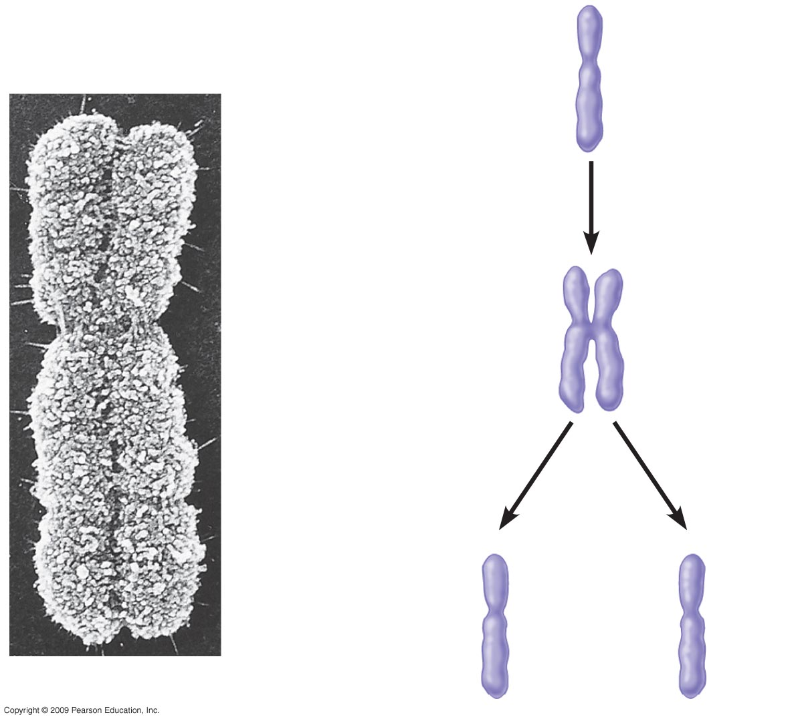
At the end of S phase and prior to Mitosis
Sister chromatids
Chromosome
duplication
Centromere
Mitosis
Sister chromatids held together by cohesins.
Notes:
Chromosome shown is in mitosis as it is the most visible and highly condensed form of the chromosome. This is an early mitosis because each chromosome has two chromatids. For karyotype analysis, only mitotic chromosomes are used.

Slide 11

The Cell Cycle
G1: Cells increase in size, produce RNA, & synthesize proteins. The G1 Checkpoint is activated and ensures everything is ready for DNA synthesis.
DNA synthesis phase
⇩
G2: Cell continues
to grow and produce new proteins required
for cell division.
At the end of G2, the G2 Checkpoint
determines if cell is ready to enter Mitosis.
G0: There are times
when cells leave the cycle
& quit dividing. May be a
temporary resting period
or more permanent such as
at end of development and no
longer dividing.
Interphase = G1 + S + G2
Notes:
For the G1 checkpoint growth factors and/or cell size may be involved. Without growth factors cells may be pulled out of cycle into G0.

Slide 12
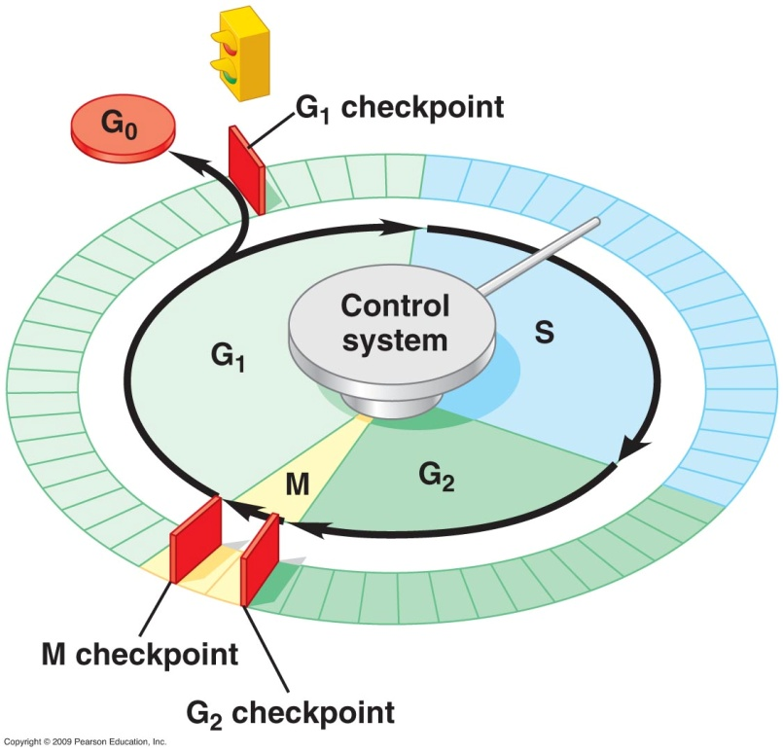
The Cell Cycle
•There are checkpoint mechanisms at each stage that tell the
cell to wait or proceed to the next phase.
•Checkpoint surveillance mechanisms ensure
accuracy & fidelity in chromosome replication & segregation.
Notes:
The cell cycle control system, identified in the diagram as the central control knob, acts much as the control device on a washing machine. There is a cyclical set of control molecules that trigger and coordinate cell cycle events. The red barriers indicate check points. If the cells are not ready to proceed they are blocked at these checkpoints until such time as they have acquired the appropriate capabilities. Messages come from internal and external, or environmental, sources. The M checkpoint is used to be certain that all chromosomes are attached to spindle fibers and aligned at the equator. This allows for equal distribution of chromosomes. “Separation of the sister chromatids depends on the breakdown of the cohesin that has been holding them together.

Slide 13
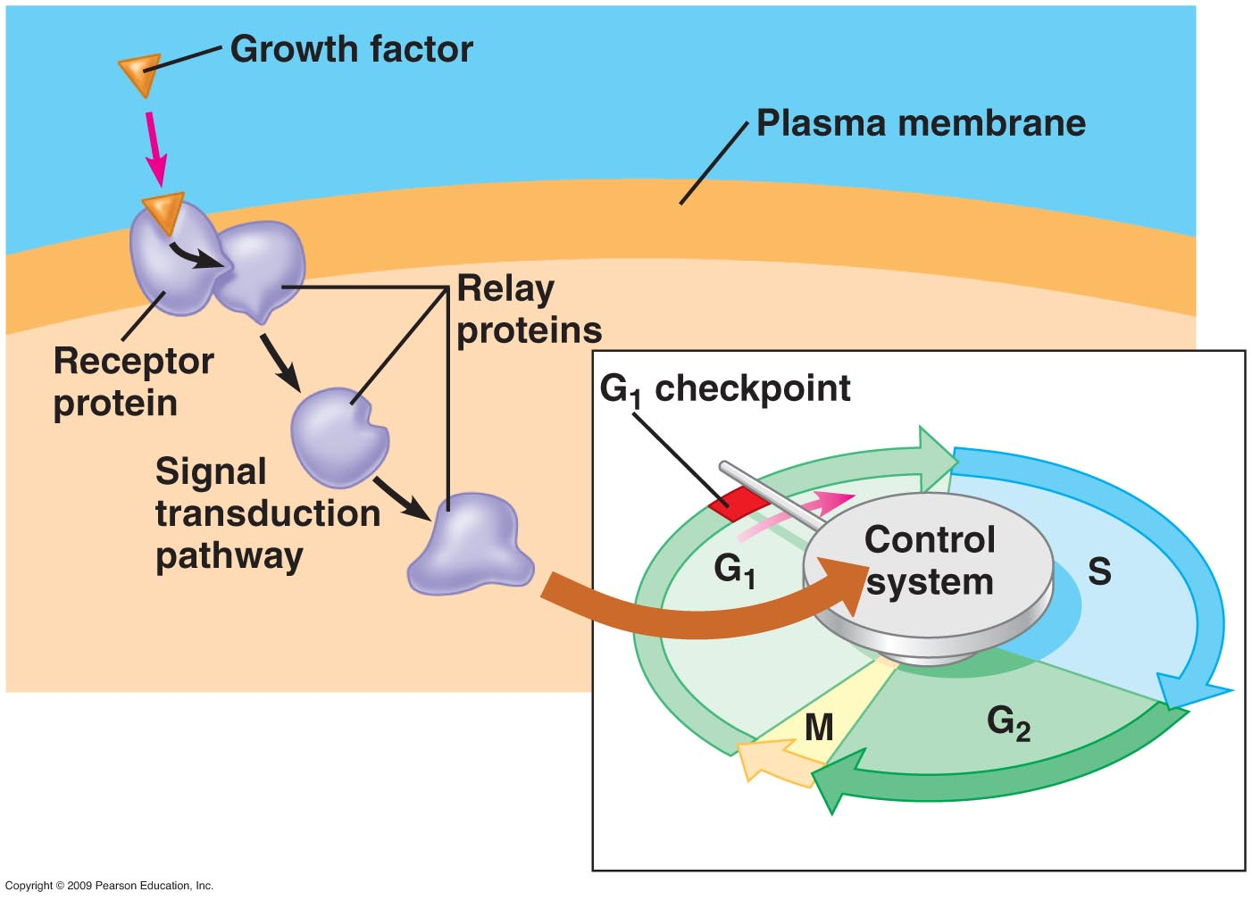
G1 checkpoint is regulated by growth factors
Notes:
Growth factors stimulate cell division and come in many types depending upon the type of cell involved. Typically a cell will complete its cycle once stimulated to go beyond G1. The growth factor is an external stimulator that binds to the cell surface causing a cascade of signal transduction through a relay system. The end result is that cell growth overrides the block to division.

Slide 14
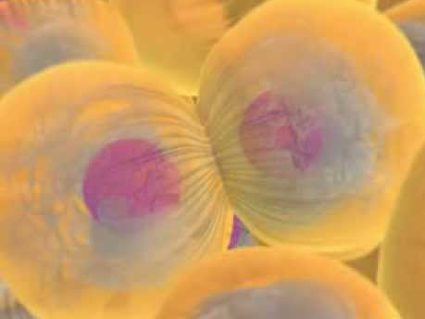
BioFlix Mitosis- 3D animation
copy
Notes:
Book chapter 8, 8.5 (p. 129)

Slide 15
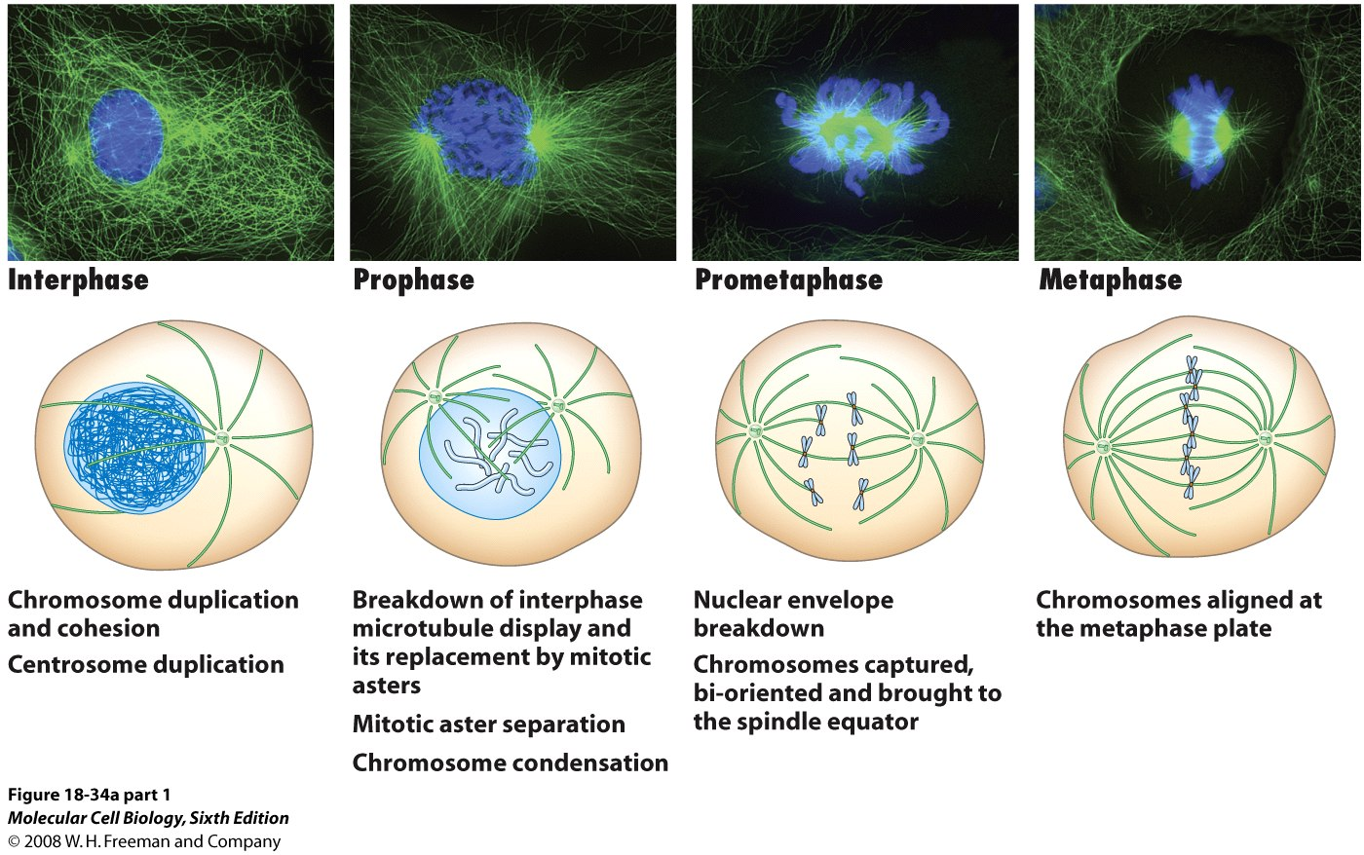
Stages of Mitosis
↑
Checkpoint

Slide 16
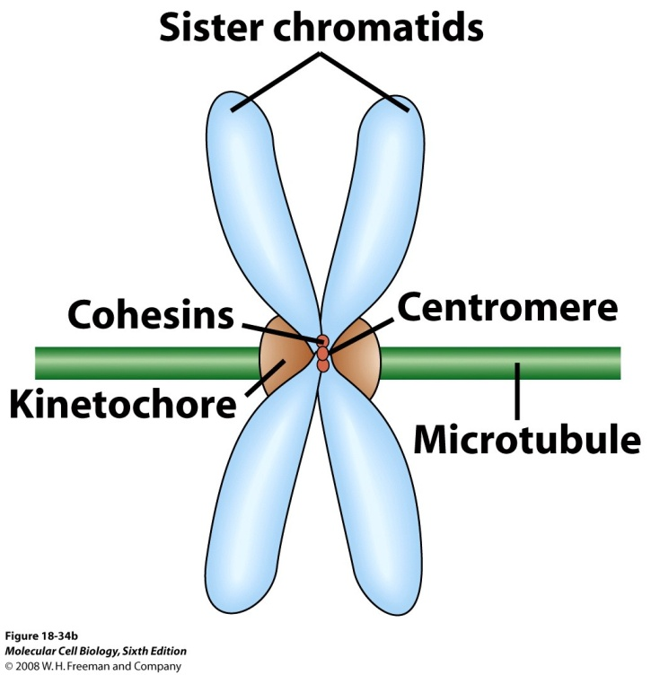
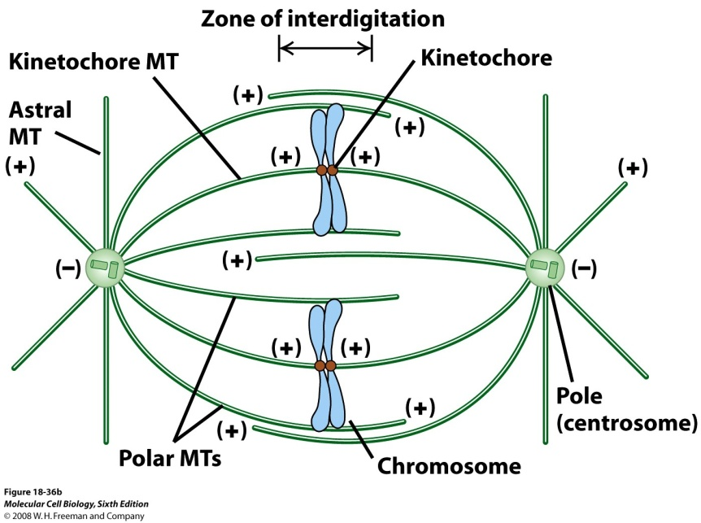
Mitosis

Slide 17
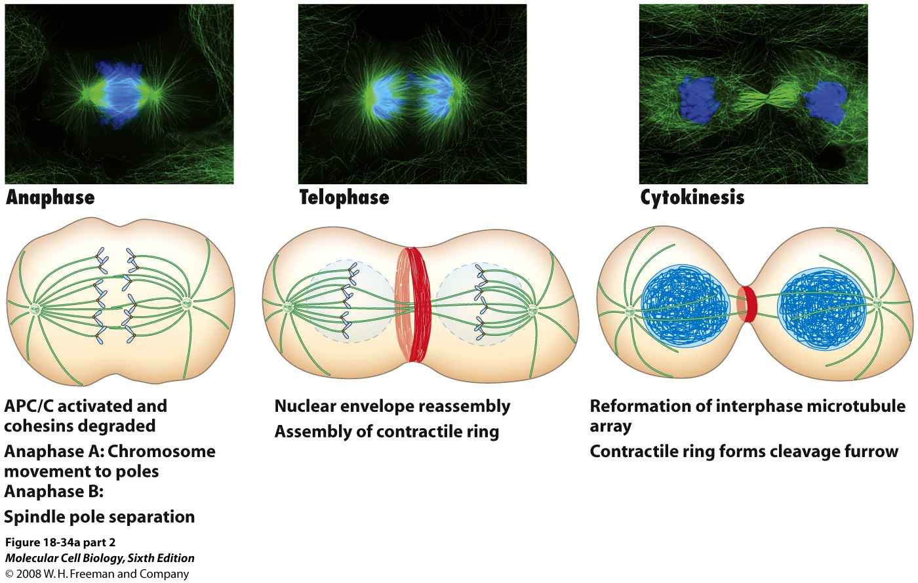
Stages of Mitosis
actomyosin-mediated

Slide 18
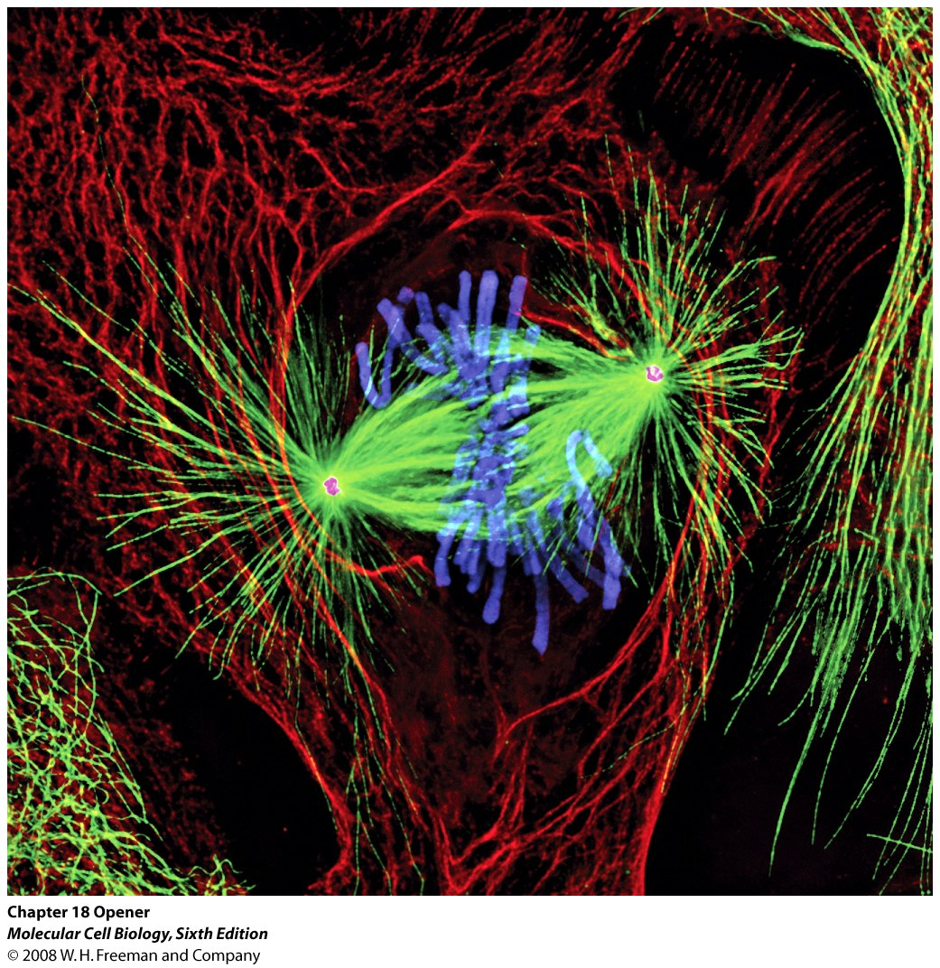
Mitosis
Somatic Cells
2n to 2n
One division
Constitutive activity
No genetic sorting
growth
cell replacement
asexual reproduction
Newt lung cell
Khodjakov Nature 408, 423-424.

Slide 19
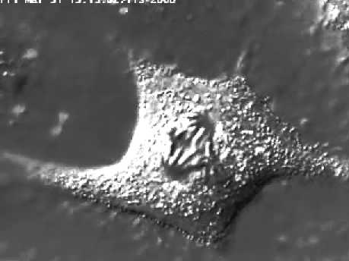
Mitosis
Mitosis in a vertebrate somatic cell (Rat kangaroo kidney).
Differential Interference Contrast (DIC) microscopy.
Alexey Khodjakov
local copy
YouTube copy

Slide 20
Normal Cancer
Is it easier to explain the abnormalities in the cancer cell chromosome distribution?
Notes:
First, it would appear that there are problems with the M phase check system that makes certain that chromosomes align properly. This will explain 4 chromosomes as other daughter cell would have none of that chromosome type. It does not explain translocations (movement of pieces of one chromosome to another. There are wandering chromosomes shown between 20 and 21 that most likely did not attach properly to the spindle. Chromosome breakage is not explained. Triploid state most easily explained during meiosis where one gamete is still diploid and the other is haploid. It is suggested that initially cancer cells have a growth advantage from a chromosomal rearrangement and that they outcompete. They also have decreased regulation leading to additional abnormalities as shown in the example above..

Slide 21
Cancer
As shown previously there are chromosomal abnormalities associated with cancer.
There is also a loss of growth control of cells because these cells (transformed cells) stop responding appropriately to cell cycle controls
Notes:
Cancer claims the lives of 1 out of 5 in US and developed countries. Often, mutations within the normal cell cycle control mechanisms lead to uncontrolled growth which leads to tumor formation. Transformed cells may be destroyed by our normal immune system but if the cells escape the system they may proliferate to form a tumor. Cancer cells are not density inhibited. They proceed past check points in the absence of growth factors.

Slide 22
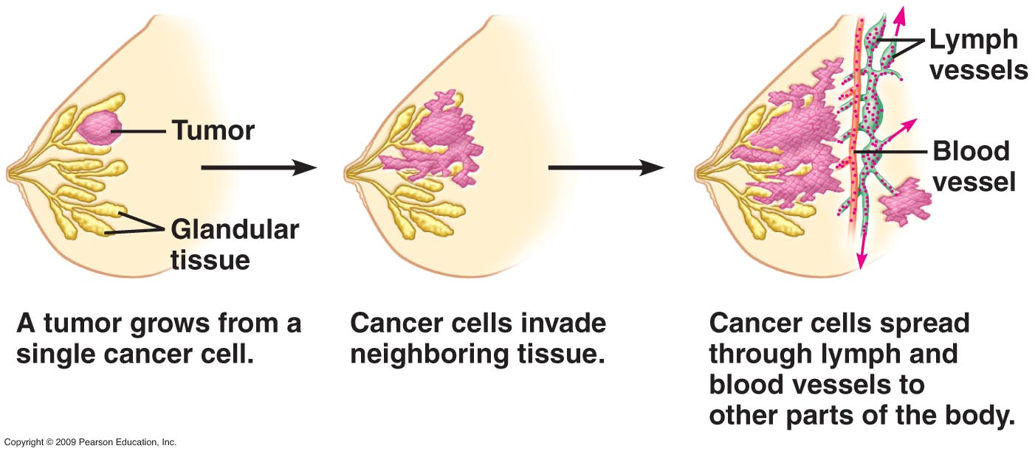
Malignant tumor of the breast
Notes:
The first step is the transformation of a cell or cells to release them from the cell cycle controls. These cells grow to form a tumor. Tumors may be benign or malignant. Benign may still need to be removed to stop them from interfering with normal function. Malignant tumors are shown in the second and third steps in the figure. A malignant tumor has the ability to spread or invade other tissues and cells. Often they secrete signal molecules causing blood vessels to grow to them and then malignant cells can escape into the blood stream and impact other tissues.

Slide 23
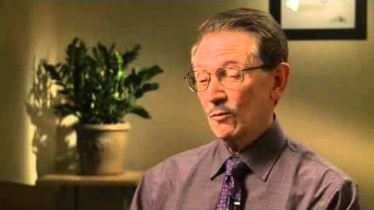
Video: Cancer Treatment
YouTube copfy of the video

Slide 24
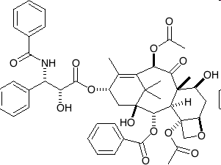
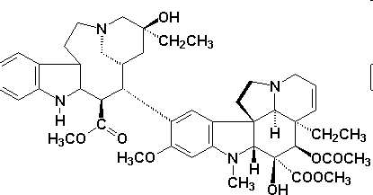
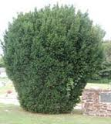

Cancer chemotherapy
Taxol: freezes mitotic spindle in actively dividing cells
Vinblastine: stops formation of spindle
Madigascar perriwinkle
Pacific Yew
www-jmg.ch.cam.ac.uk
www.himpharm.com
Notes:
Two drugs commonly used to inhibit cell growth of cancer cells. They work on the normal mitotic apparatus. Taxol was originally isolateed from the bark of the Pacific Yew tree. It is now made synthetically. Vinblastine was found in a periwinkle plant in Madagascar. Do you see a reason to protect native species? These drugs cause side effects because they target growing cells and not all growing cells in an individual with cancer are malignant.

