Slide 1
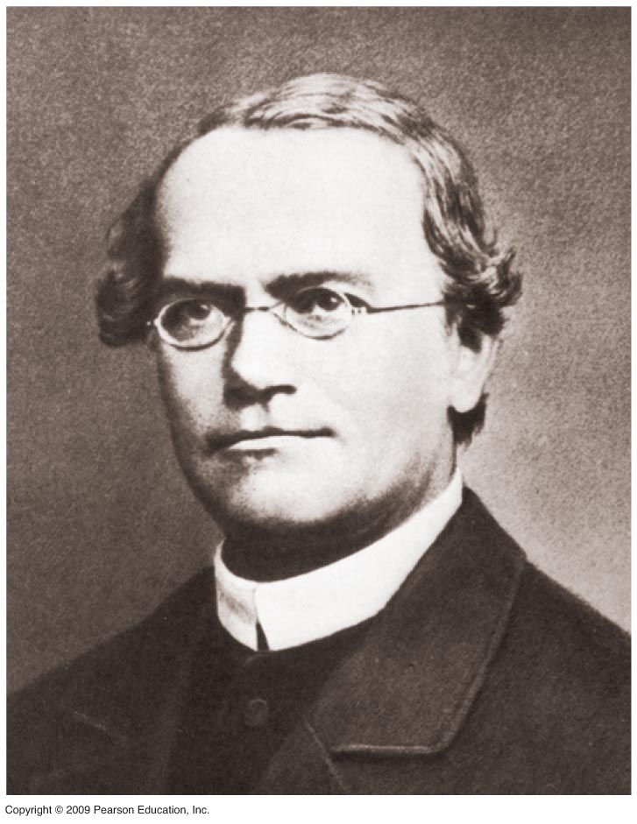
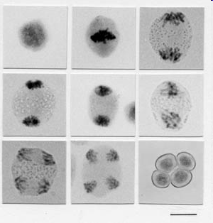
Human Genetics I: Meiosis and Mendel
biologywithsaxe.blogspot.com
Notes:
Mendelian thought and meiosis are tightly coupled and easy to understand if studied together. The picture on the left is of meiosis and on the right is Gregor Mendel (1882-1884). Mendel was an Augustinian monk and scientist. His main work with peas was done during the time period from 1856-1863 at the Augustinian Abbey of St Thomas in Brno, Austria (now Check Republic). He cultivated and tested ~29,000 pea plants in the monastery’s experimental garden plot. He published his work in 1866 but it was not recognized until much later in the 1930’s. Darwin was unaware of his work.

Slide 2
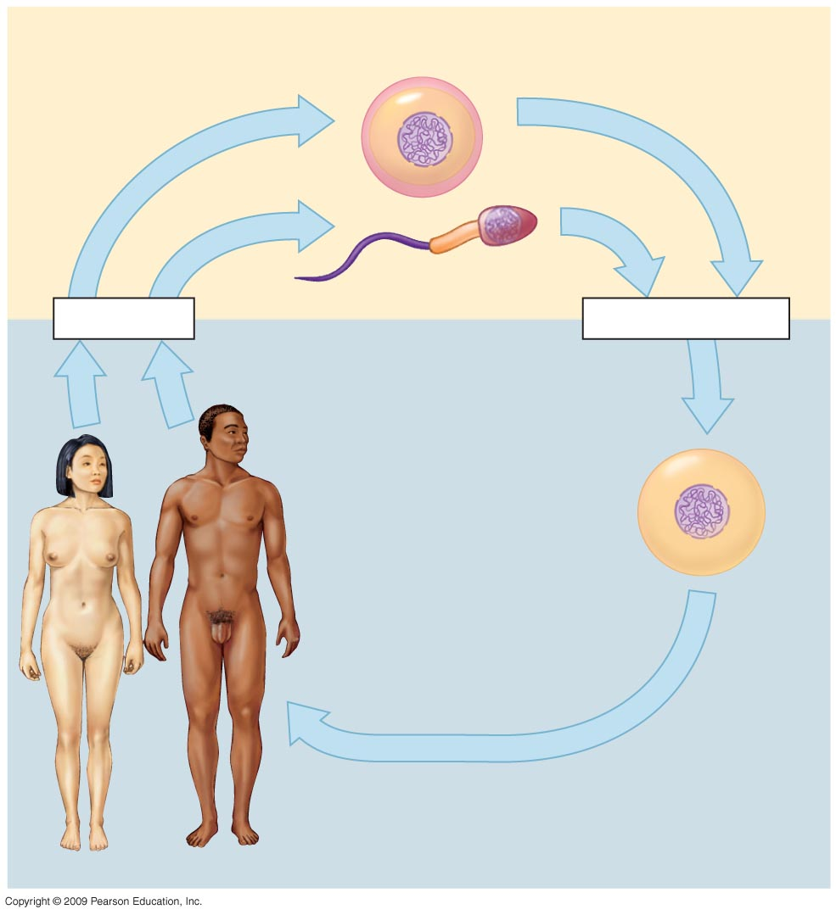
Meiosis
Haploid gametes (n = 23)
Haploid gametes:
22 autosomal chromosomes
1 sex chromosome, either X or Y
Meiosis
Fertilization
Diploid
zygote
2n = 46
Multicellular diploid adults
2n = 46 chromosomes
23 pairs
Mitosis & Development
Notes:
2
Meiosis is the basic biological process where the number of chromosomes shifts from diploid to haploid. This is the process used in formation of gametes. Gametes are the only cells that can be used to propagate the species of sexually reproducing organisms.

Slide 3
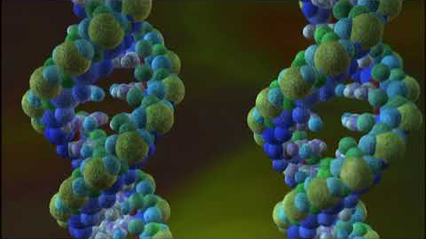
Passing on your DNA: It’s all about sex, if you believe in evolution (PBS Video)

Slide 4
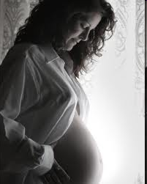
Passing on your DNA: It’s all about sex, if you believe in evolution
Passing on your DNA
NOVA video
YouTube copy
_ src _ local src

Slide 5
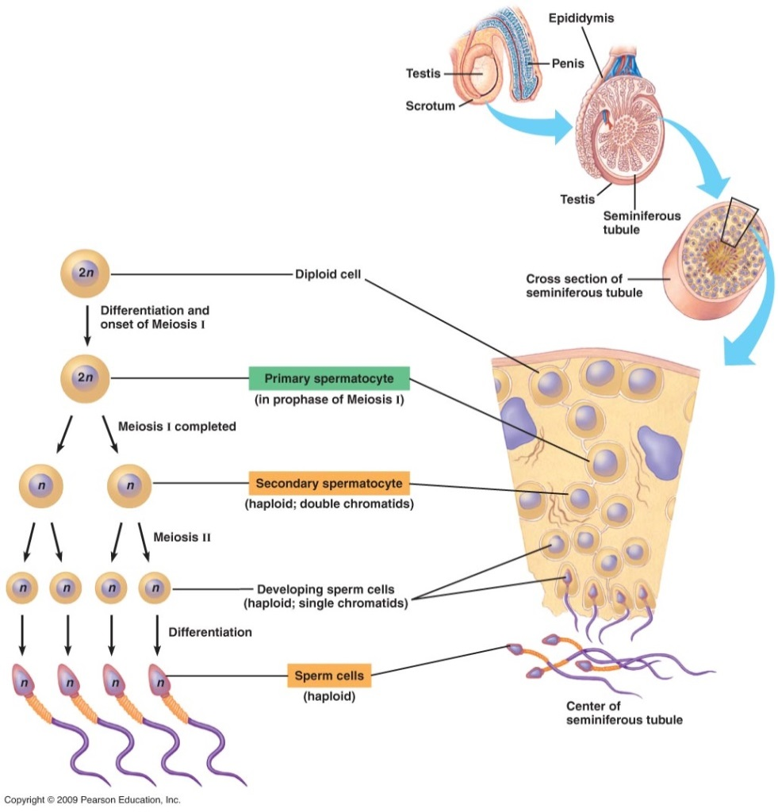
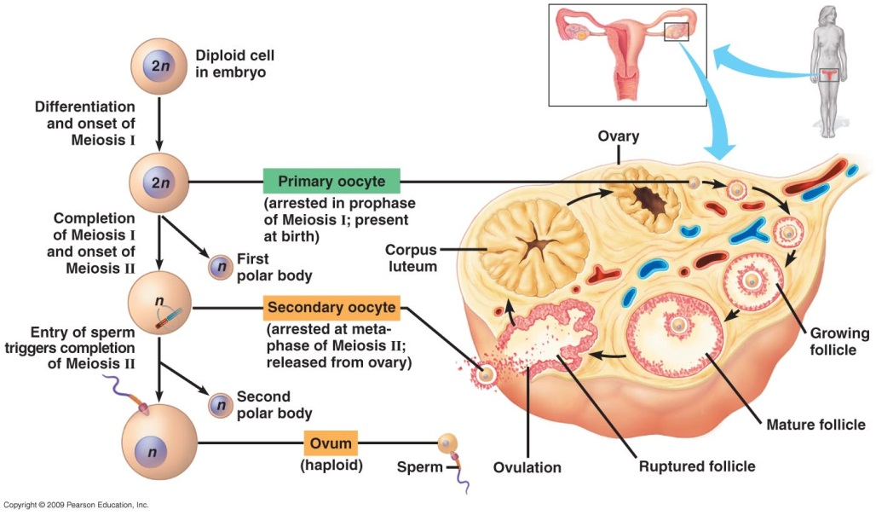
Meiosis: Major Principles
1. When and where does meiosis occur?
Reproductive organs: Animal; testis & ovary: Plant; anther & ovules
Oogenesis
Spermatogenesis
Notes:
Spermatogenesis occurs in the testes. The anatomy shown is of the seminiferous tubule in the testes. The immature cells that will become sperm are at the outer edge of the tubule and are diploid. These constantly multiply and ~3 million differentiate into primary spermatocytes. The spermatocytes undergo meiosis as diagramed briefly in the left hand diagram. Fully developed sperm are haploid and are released into the lumen of the seminiferous tubule. Note the secondary spermatocyte is haploid (end of meiosis I). Oogenesis begins prior to birth in the female when developing follicle starts meiosis. Meiosis is arrested in prophase I in the primary oocyte. After puberty the primary oocyte, or one follicle, is triggered hormonally by FSH (follicle-stimulating hormone from pituitary) to re-enter meiosis and enlarge. Meiosis I is completed with unequal cytoplasm division (smaller is polar body cell- dead end). Meiosis is again halted at Meiosis II metaphase. This is the secondary oocyte which is released during ovulation and enters the oviduct. If a sperm penetrates it, Meiosis II is completed, again with unequal cytoplasmic division. Sperm and egg (ovum) nucleus fuse.

Slide 6
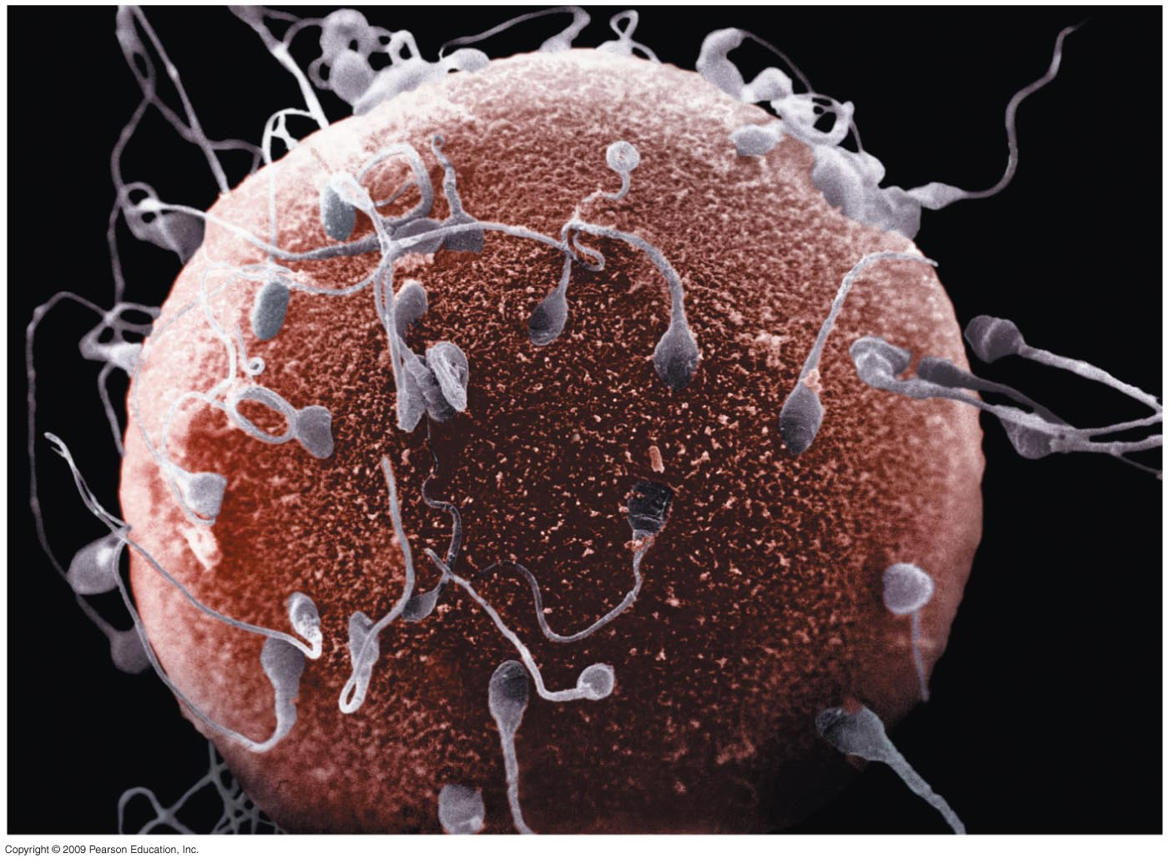
Meiosis: Major Principles
Meiotic division and fertilization are the key to understanding the inheritance of chromosomes:
Fertilization
Somatic cells are diploid.
•Gametes are specialized to contain a haploid set of chromosomes.
•Fusion of two gametes at
fertilization results in a
diploid zygote.

Slide 7
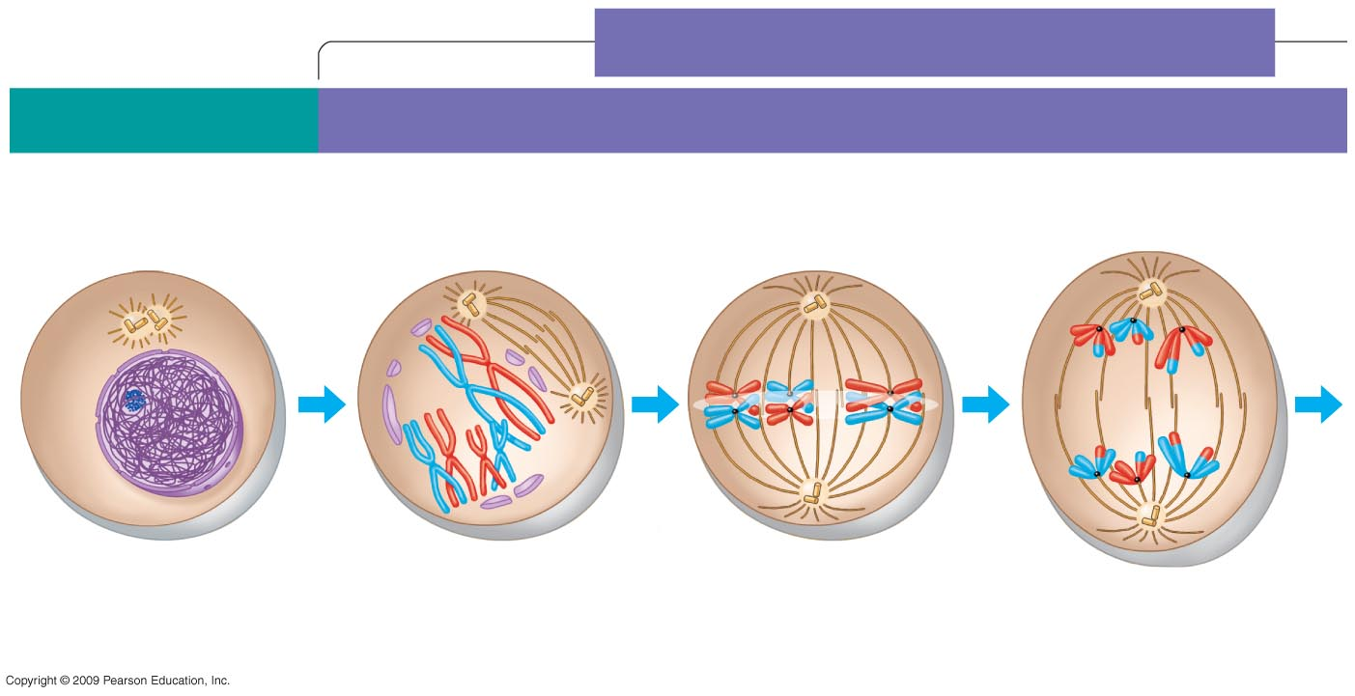
Bioflix animation of meiosis
MEIOSIS I: Homologous chromosomes separate
INTERPHASE
PROPHASE I
METAPHASE I
ANAPHASE I
Centrosomes
(with centriole
pairs)
Microtubules
attached to
kinetochore
Metaphase
plate
Sister chromatids
remain attached
Sites of crossing over
Spindle
Nuclear
envelope
Sister
chromatids
Tetrad
Centromere
(with kinetochore)
Homologous
chromosomes separate
Chromatin
Pearson Bioflix animation of meiosis
Approaching haploid state
Movie file
Notes:
DNA synthesis occurs during interphase before beginning of meiosis I but does not occur again before meiosis II. Meiosis I & II each have prophase, metaphase, anaphase, & telophase stages. Recombination occurs in Prophase I after tetrads form. Tetrad formation is another term for homologous chromosomes aligning. Chromosomes are less condensed than in mitosis. Centromeres holding each pair of sister chromatids together do not divide in mitosis I. One pair of each tetrad pulled to each pole in Anaphase I resulting in reduction of the amount of genetic material by one-half.

Slide 8
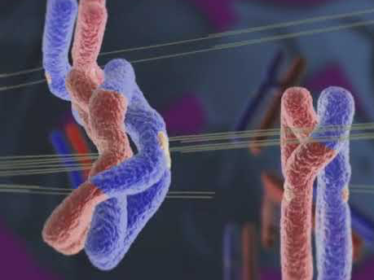

Slide 9
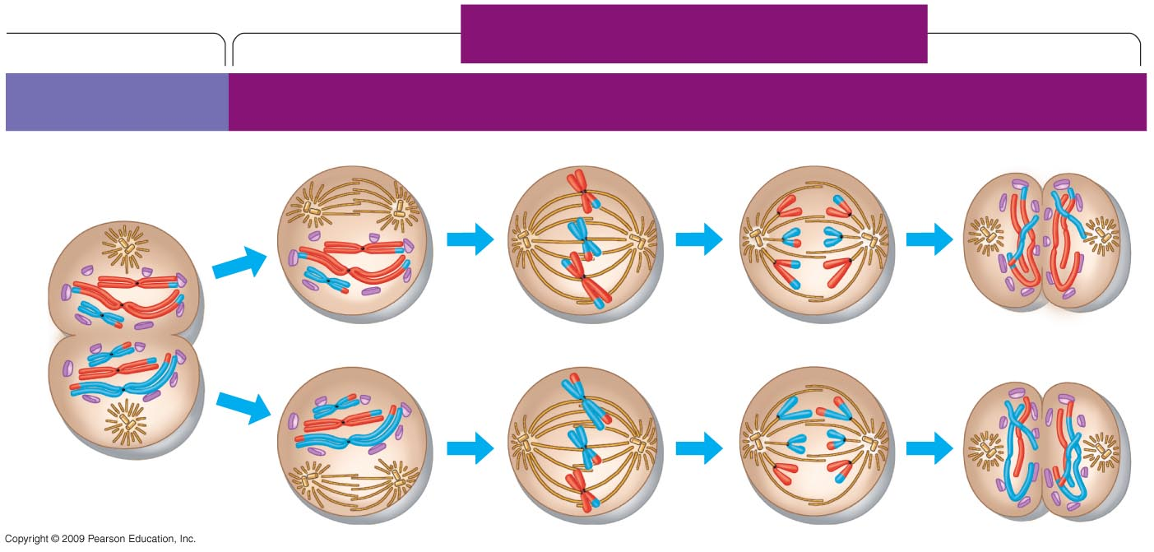
Meiosis II
MEIOSIS II: Sister chromatids separate
TELOPHASE I
AND CYTOKINESIS
PROPHASE II
METAPHASE II
ANAPHASE II
TELOPHASE II
AND CYTOKINESIS
Cleavage
furrow
Sister chromatids
separate
Haploid daughter
cells forming
Notes:
Meiosis II is simply mitosis with half the number of chromosomes. Sister chromatids in each dyad are separated to opposite poles. Each haploid daughter cell from meiosis II has one member of each pair of homologous chromosomes.

Slide 10
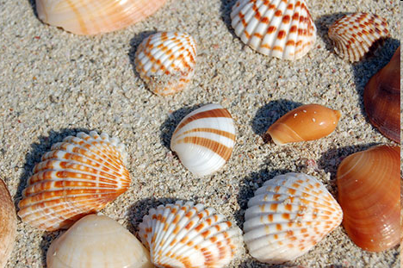
Meiosis: Major Principles
3. Meiosis and fertilization provide genetic variation
Homologous chromosomes carry different versions of genes.
Independent orientation of chromosomes at metaphase.
Crossing over at Prophase I.
Fertilization: random
Notes:
Shells are a visualization of diversity. Diversity is dependent upon many different features as described in the slide. There are 2^{n} variations of gametes where n is the number of haploid chromosomes. Recombination adds a significant rearrangement of the parental chromosomes. Fertilization provides twice this variation by bringing together two haploid cells to create a diploid fertilized egg.

Slide 11
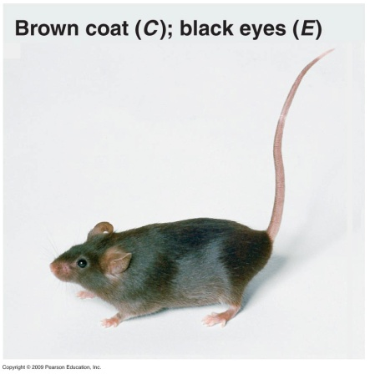
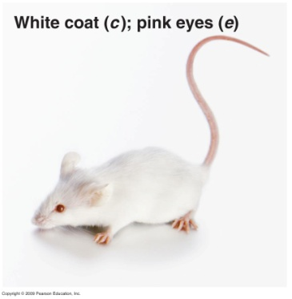
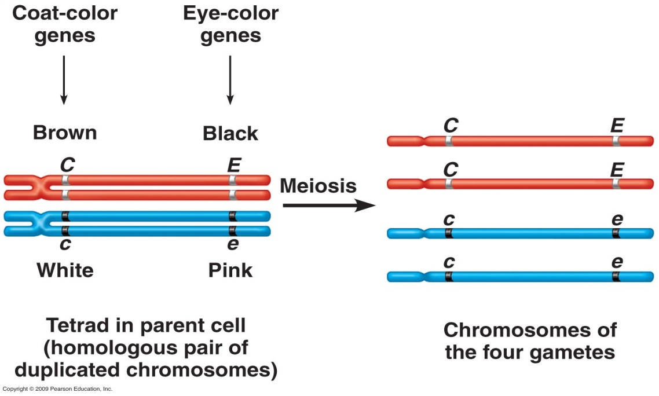
Applying meiosis to Mendelian genetics: Mendel’s Law of Segregation
Homologous chromosomes may carry different versions of genes or alleles.
Homozygous recessive- chromosomes not shown
Heterozygote chromosomes
Notes:
Genes can be described as a physical location or by their trait name (brown vs white for coat color and black versus pink for eye color). Because the dark colored mouse is heterozygous it carries both the dominant and recessive alleles for each trait. During Meiosis the dominant and recessive alleles segregate into different gametes and thus they are not lost. The chromosomes from the white, pink eyed mouse are not shown because they are identical or the phenotype would not be as expressed.

Slide 12
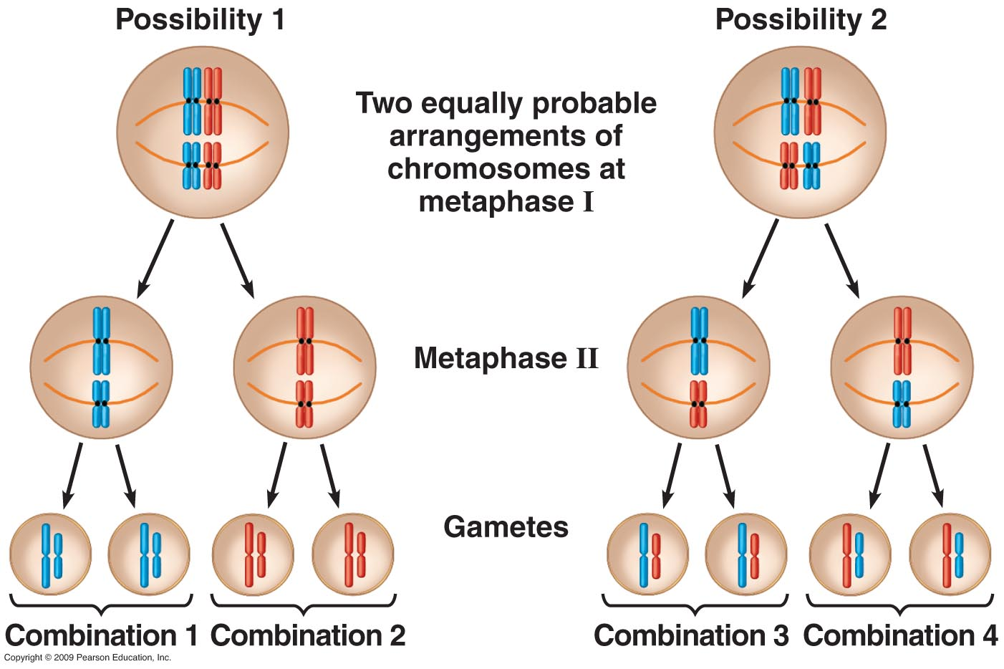
Applying meiosis to Mendelian genetics:
Mendel’s Law of Independent Assortment
If genes for different traits are on different chromosomes, they are inherited independently.
Notes:
A chromosomal look at Independent Assortment based upon orientation of a cell in meiosis with haploid number of 2. There are 4 possible combinations in the gametes because of independent assortment. In humans where n=23 there are 2²³ possible combinations.

Slide 13
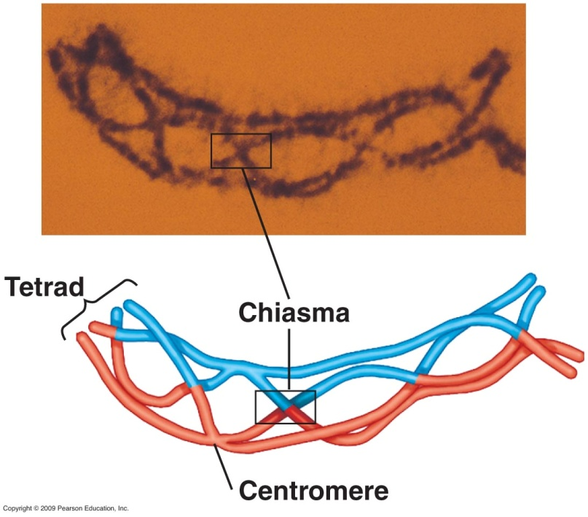
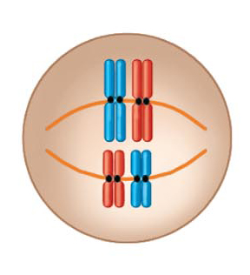
Crossing Over - Prophase I
•Crossing over occurs between homologous chromatids.
nonsister chromatids
•Centromeres holding each pair of sister chromatids together
do not divide. Sister Chomatids stay together.
•Homologous chromosomes align randomly.

Slide 14
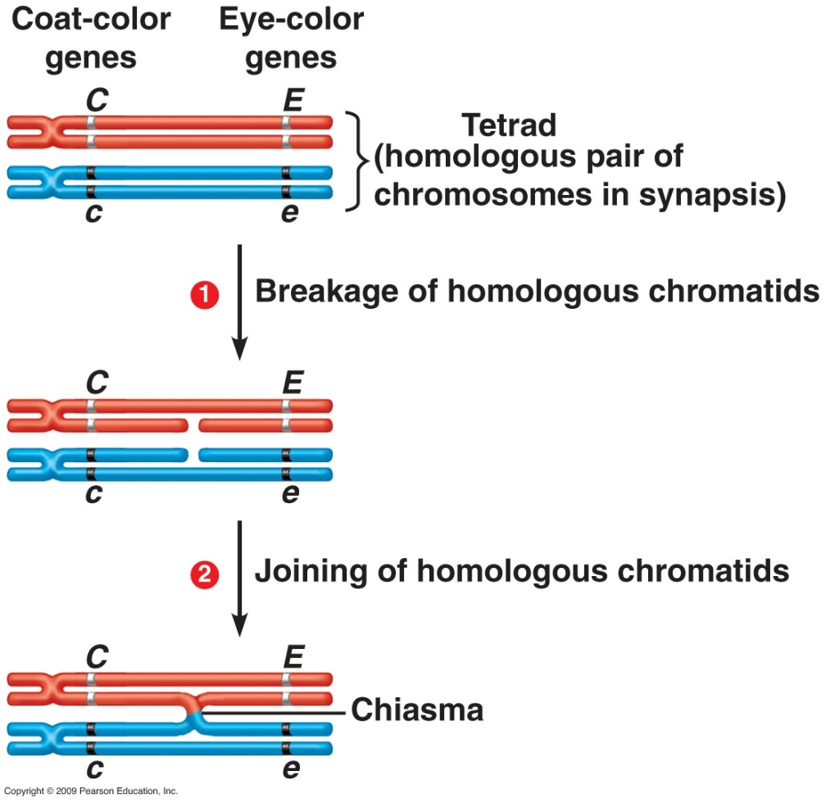
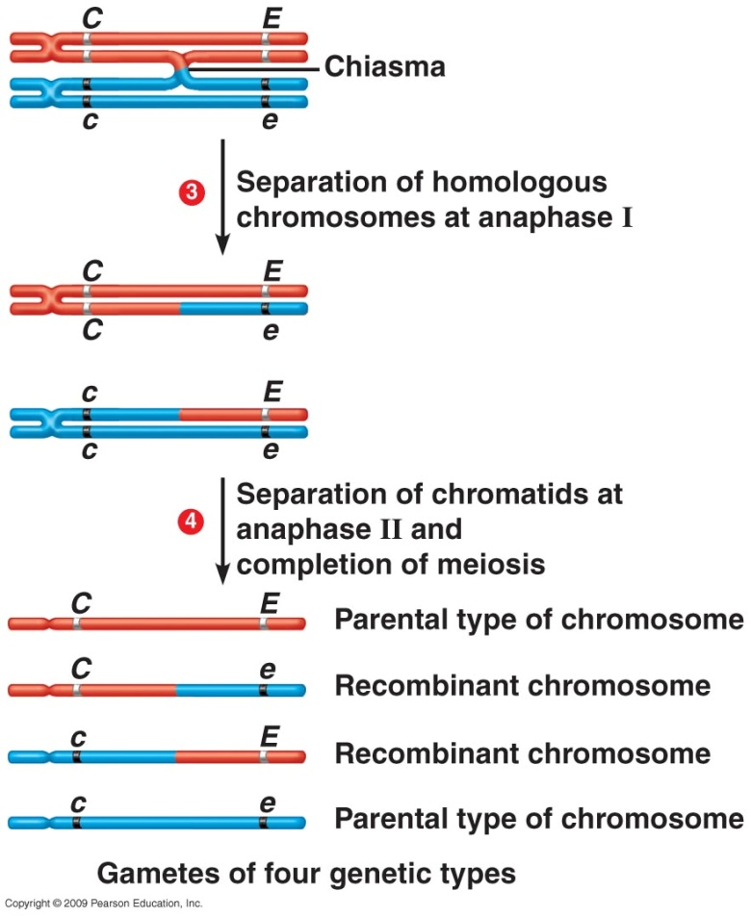
Crossing over leads to genetic recombination.
Notes:
Each gene on one homolog is aligned precisely with the corresponding gene on the other. Maternal red, paternal blue. Genetic recombination results from crossing over.
14

Slide 15
Meiosis is critical for Diploid Sexual Reproduction
•Gametes receive either the maternal or the paternal
chromosomes from each homologous pair.
•Crossing over adds further genetic variation.
The chromosome has mixture of maternal & paternal derived
DNA.
•Meiosis is responsible for
-Maintenance of a consistent genomic complement in
successive generations.
-Genetic variation within populations.
Notes:
With 23 chromosomes there are 2²³ possible arrangements of the chromosome. With gametes from both parents the new variation is 2²³x2²³. If you add in crossing over or recombination there is an even greater variation.

Slide 16

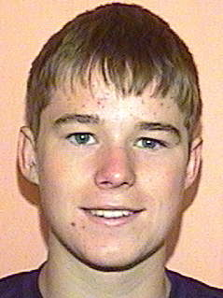
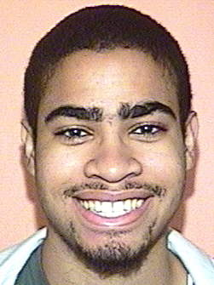

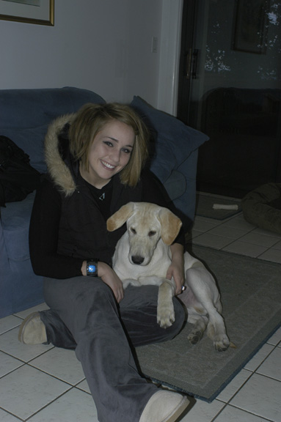
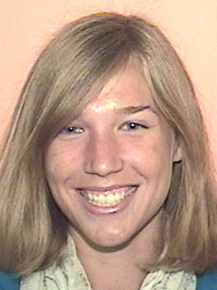

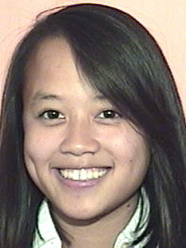
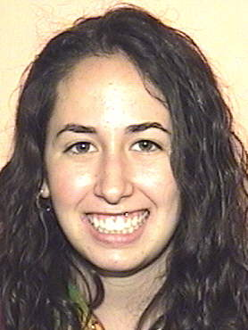
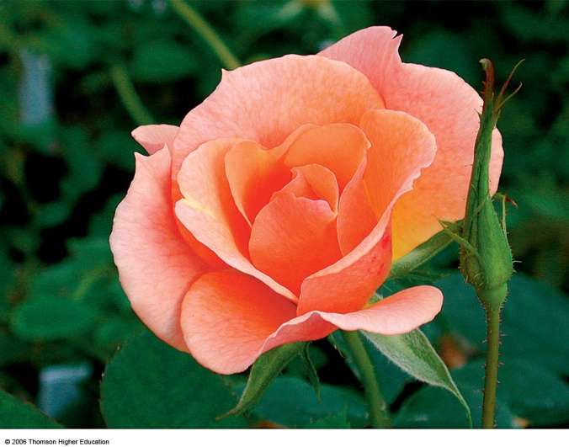
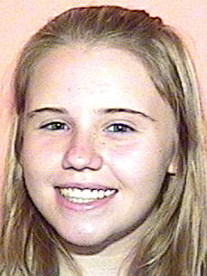
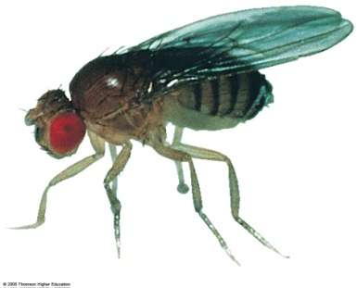
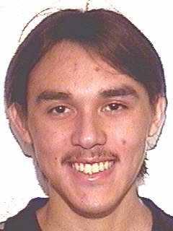

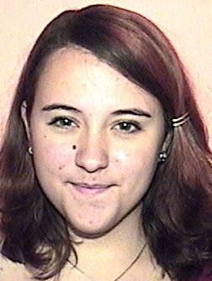
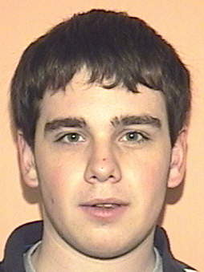
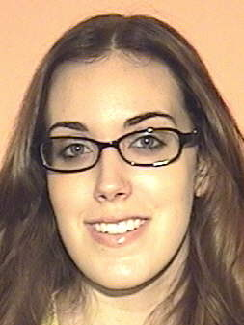

Mendelian Genetics
There is a connection among all these individuals.
Rules of Mendelian genetics apply to all.
But with a bit extra.
Notes:
16
Darwin – 1859 Origin of Species. Mendel published 7 years later. Darwin unaware of Mendel’s work. Not all genetic processes can be understood using Mendelian genetics but classical studies defined genes and how they distribute. Most of this material is better covered in lab where you will do problems.

Slide 17
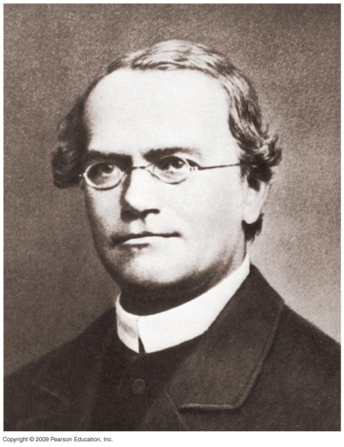
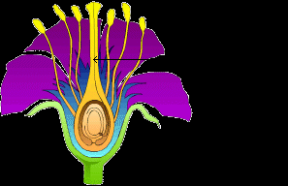

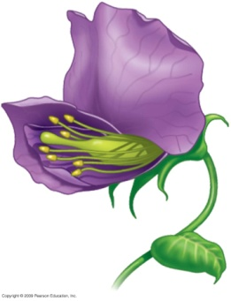
Gregor Mendel
Pea plant sexual structures
Discovered the fundamental principles of genetics.
Invented quantitative approach for the study of inheritance
Used the garden pea as an experimental model.
Critical findings: 1) heritable factors (genes) retain their individuality and do not blend
and 2) genes permanently retain their identities.
Darwin published the first edition of The Origin of Species in 1859, 7 years before Mendel’s paper was published.
Notes:
Why use pea plants? Short generation times; Mendel could control the mating because the sex organs were enclosed. Thus self-fertilization was possible and cross fertilization required human intervention to mix pollen from one plant with the ovules of the female plant. Anthers can be cut off and moved away or used to distribute them to another plant.
17

Slide 18

Mendel’s Law of Segregation
There are alternative versions of a trait (which today we call alleles of a gene).
If two alleles of an inherited pair differ, one can determine the appearance (phenotype) and the allele related to this phenotype is called dominant; the other allele is called recessive.
3 Each individual has two alleles of a given gene. Thus an individual can have two identical alleles (i.e. is homozygous) or two different alleles (i.e. is heterozygous)
Each parent contributes only one of its two alleles to each of the offspring of a cross between two parents. This is called the law of segregation. We now know this is due to the separation of homologous chromosomes during meiosis, but Mendel did not know about meiosis.

Slide 19
Practical example of segregation of alleles: dominance vs recessive in a monohybrid cross
Click on the image for an animation illustrating the results of a Mendelian experiment on a single gene with two alleles showing a dominance/recessive relationship.
Notes:
Uses Mendaliens.

Slide 20
Mendel’s Second Law:
Independent Assortment
In addition to these groundbreaking ideas, Mendel also found that genes controlling different traits in the organism, such as height and flower color, are inherited independently of one another.
This is called the law of independent assortment. It depends on genes being on different chromosomes or being far apart if they are on the same chromosome.
For many genes this law does not hold, because some genes are in fact closely linked to each other and are inherited together more often than not.
Notes:
The independence is illustrated in that the tetrads for chromosome 1 do not have to line up in the same parental orientation as those of chromosome #2. Remember your meiosis. Thus the behaviors of each pair of chromosomes are independent of the other pairs. However, genes that are close physically on the same chromosome will most often be inherited together while genes on the same chromosome that are a distance apart will behave as if on different chromosomes because the frequency of recombination between the two genes is high. Return to slide #5 to illustrate this point.

Slide 21
Multiple traits where genes are on different chromosomes: a dihybrid cross
Click the image for an animation on what happens when we have to think about more than one gene at a time.
Notes:
Be certain that you can complete this exercise and understand the genotypes, phenotypes and reason for the crosses.

Slide 22
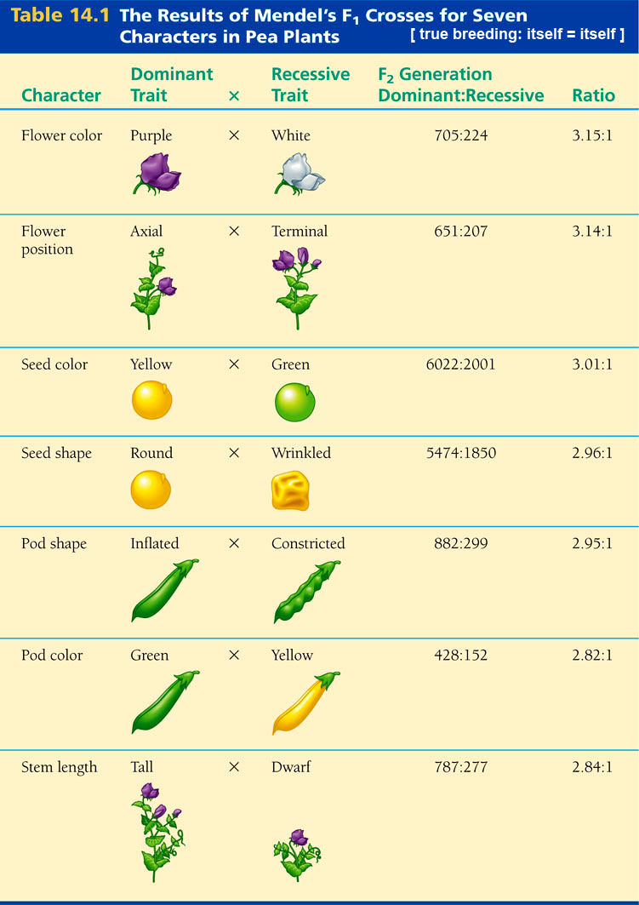
Suppose you have constructed a hybrid pea plant from a homozygous strain that has the dominant traits round (R) and yellow (Y) in its seeds, and another homozygous strain that has the recessive traits wrinkly (r) and green (y) in its seeds.
If you cross this F₁ hybrid with this same wrinkly green strain what would you get for offspring.
Provide the genotypic ratio and the phenotypic ratio.
Notes:
22

Slide 23
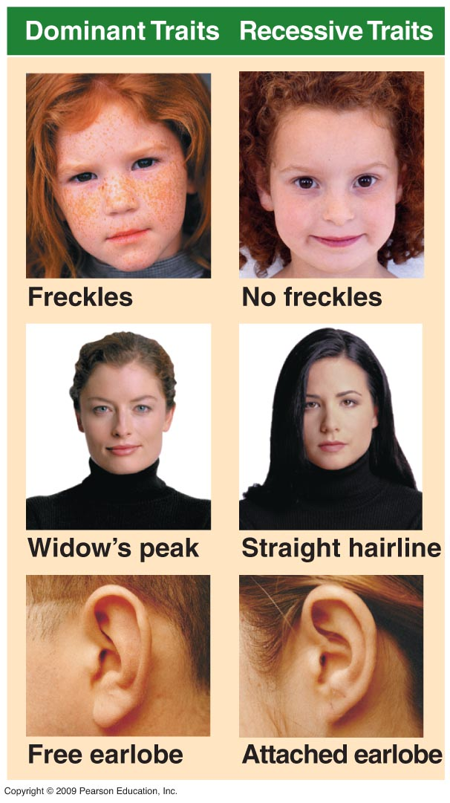
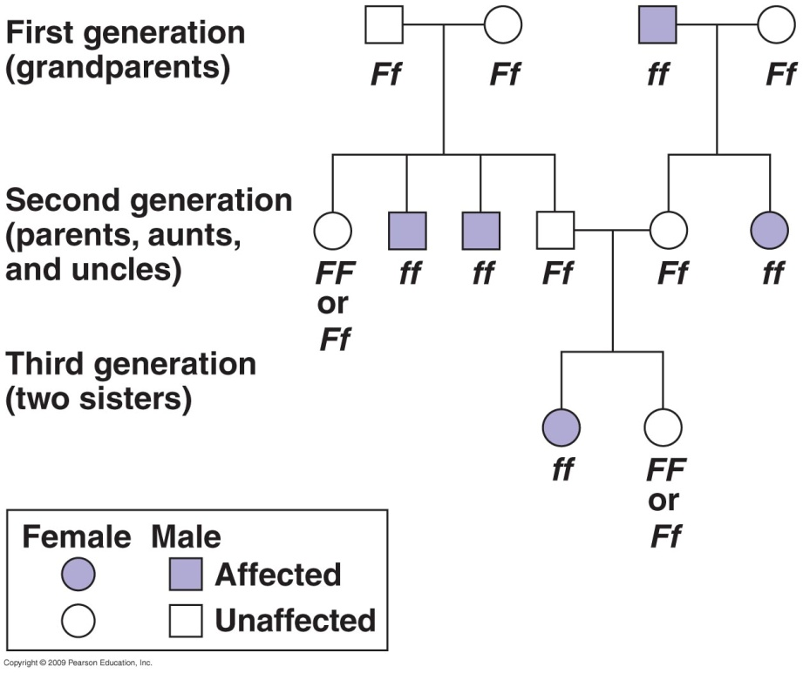
Genetic traits in humans can be tracked through
family pedigrees.
Attached versus free ear lobes
Dominant phenotype: FF or Ff
Recessive: ff
A dominant phenotype could be due to two different genotypes.

Slide 24
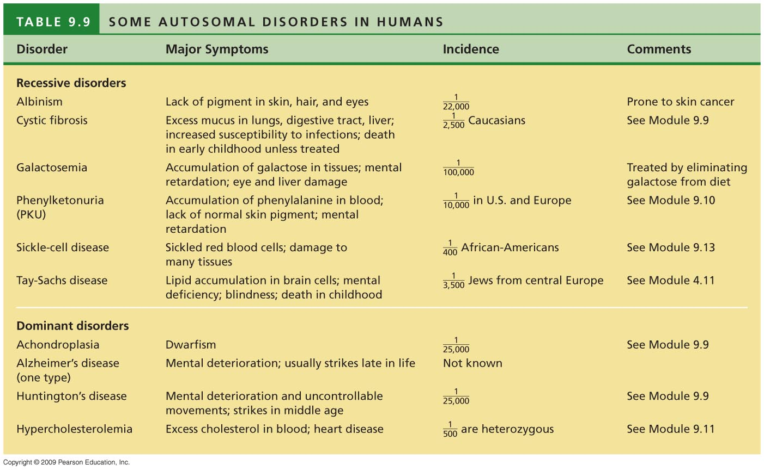

Slide 25
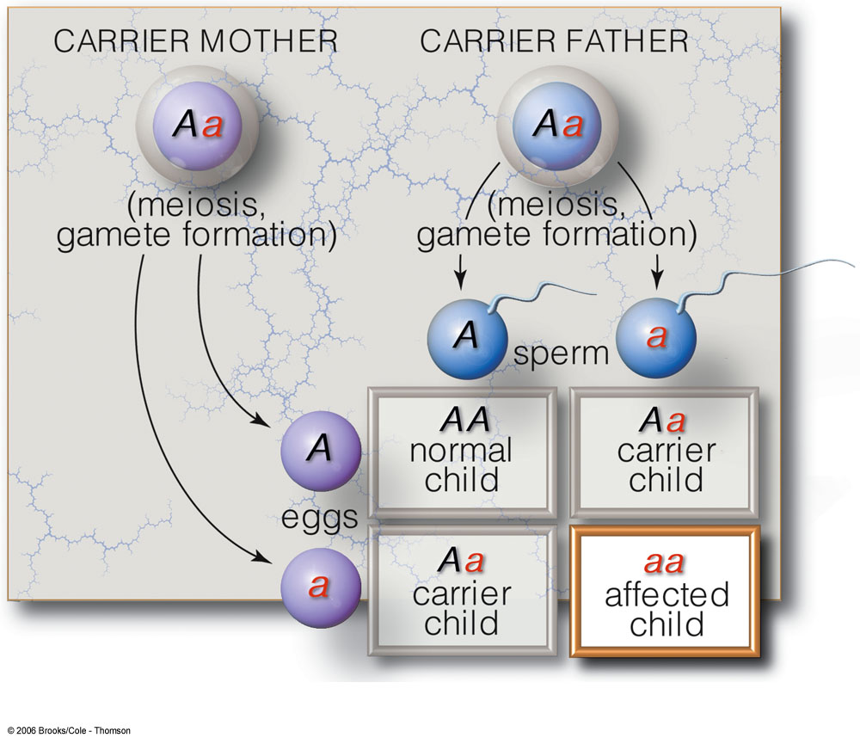
Autosomal Recessive Inheritance
50% probability of being heterozygous: not expressed.
25% probability of homozygous recessive: expressed.
Both parents aa, each child will exhibit same phenotype.
Ex. Tay-Sachs Disease
Notes:
This cross illustrates that an autosomal recessive disease can be hidden in the heterozygous condition. Typically only the homozygous recessive expresses the disease but the heterozygotes are carriers of the disease gene. To see the recessive disease both parents must be carriers.

Slide 26

Video: Tay sachs disease
Notes:
Homozygote deficient in hexosaminidase A and appears recessive at the genotype level. Deficient in sphingolipid metabolism causing fats to build up in the brain. Brain degeneration: signs apparent by 1 year old and death: 3-7 years old. Blood test for amount of hexosaminidase present can determine differences between carriers, normal, and children with the disease. Blood can be obtained from a vein, the umbilical cord after birth or from amniotic fluid or placental cells.

Slide 27
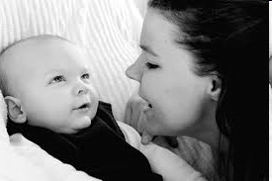
Video: Tay sachs disease
_ source Local copy _
Notes:
Homozygote deficient in hexosaminidase A and appears recessive at the genotype level. Deficient in sphingolipid metabolism causing fats to build up in the brain. Brain degeneration: signs apparent by 1 year old and death: 3-7 years old. Blood test for amount of hexosaminidase present can determine differences between carriers, normal, and children with the disease. Blood can be obtained from a vein, the umbilical cord after birth or from amniotic fluid or placental cells.

Slide 28
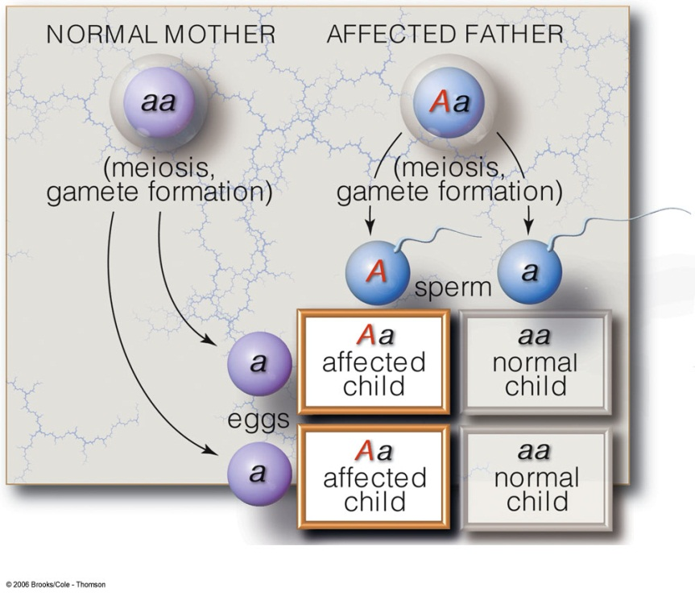
Many inherited disorders are controlled by a single gene.
Autosomal Dominant Inheritance
The allele is expressed in heterozygotes even though it is abnormal.
Trait if present in a parent is likely to appear in offspring.
50% probability of being heterozygous.
Example: Huntington’s disease
Notes:
In this situation the non-disease phenotype is recessive and only shows in the homozygous condition.

Slide 29

Video: Huntington’s Disease
Notes:
Tests for Huntingtin’s Disease look at alterations in the gene that codes for the protein huntingtin. The gene for this protein has repeats of a 3 nucleotide sequence CAG, that occur in normal cells 10-26 times. In the disease condition there are often >40 repeats of the trinucleotide. Normal huntingtin helps in vesicular traffic for transport of material out of cells. The larger diseased protein is cut into fragments that bind together and accumulate. In neurons of the brain. Normal function of neurons, particularly in the basal ganglia of the brain- the center for movement, emotion and cognition, is affected. As much as 25% of the brain cells may be killed during the course of the disease.

Slide 30
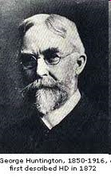
Video: Huntington’s Disease
YouTube copy
Notes:
Tests for Huntingtin’s Disease look at alterations in the gene that codes for the protein huntingtin. The gene for this protein has repeats of a 3 nucleotide sequence CAG, that occur in normal cells 10-26 times. In the disease condition there are often >40 repeats of the trinucleotide. Normal huntingtin helps in vesicular traffic for transport of material out of cells. The larger diseased protein is cut into fragments that bind together and accumulate. In neurons of the brain. Normal function of neurons, particularly in the basal ganglia of the brain- the center for movement, emotion and cognition, is affected. As much as 25% of the brain cells may be killed during the course of the disease.

