Slide 1
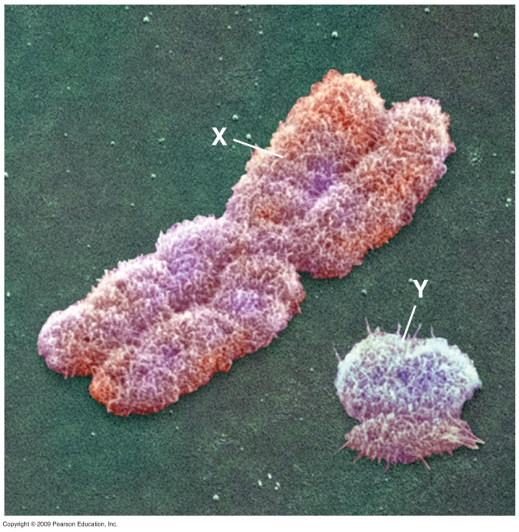
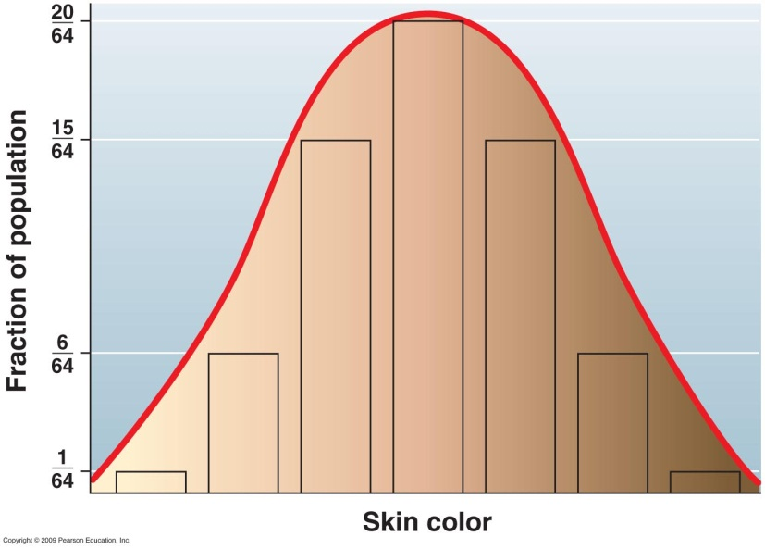
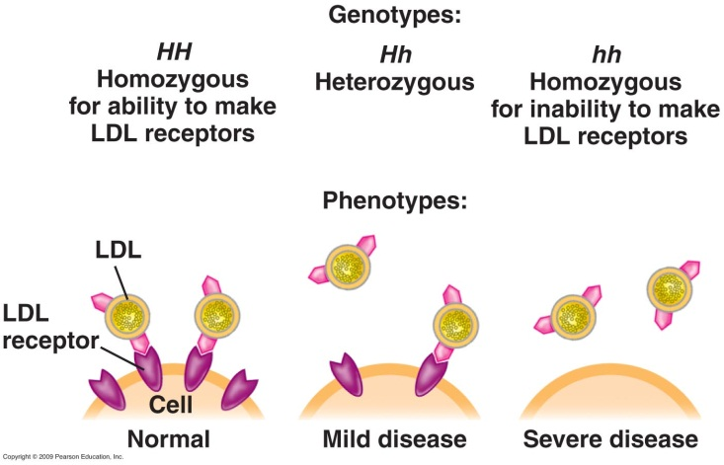
Human Genetics II: Non-Mendelian Examples
Notes:
Above are examples of three different types of non-Mendelian behavior in genetics. Upper left is a photomicrograph of the human sex chromosomes which have no gene-specific homology and determine the sex of the individual. Upper right is a chart of skin color which is one character that is impacted by several different genes. The lower example is an example of incomplete dominance in a human condition called hypercholesterolemia.

Slide 2
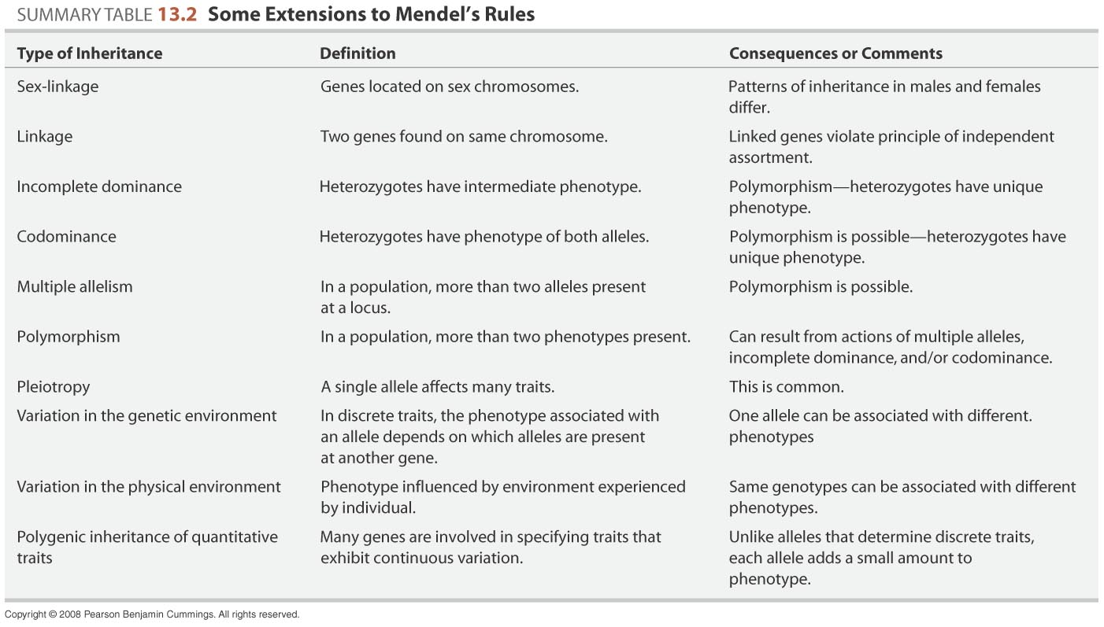
What Mendel could not have known in 1866.
Notes:
Not all genes and traits behave in a strict mendeelian sense as this represents the most simplistic cases. Follow the slide to mention other types of information. Not all forms will be covered in class but all are covered in the readings from Chapter 9.

Slide 3
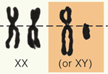
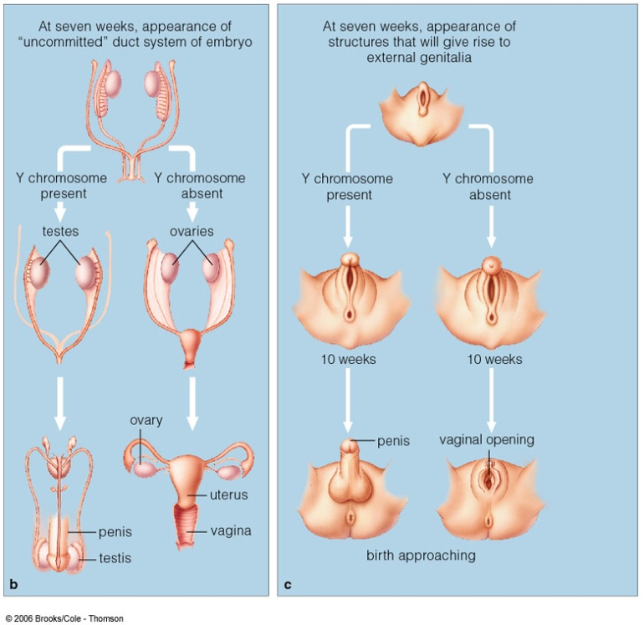
Sex Determination in Humans
Female egg: X
Male sperm: X or Y
Y chromosome:
SRY gene is one of 307 genes on Y
Master gene for male sex determination.
SRY gene triggers testosterone synthesis.
Early embryo neither male or female.
XX embryo: no SRY gene.
much less testosterone
ovaries, estrogen.
X chromosome carries 1,336 genes.
Few are involved in sexual traits.
Notes:
SRY genes encodes a transcription factor that turns on many genes and leads to male sex. In the absence of this transcription factor, female is the default condition. In females the X chromosomes are homologous chromosome and behave as such during meiosis. What about the Y and X chromosomes in males? There are similarities at the opposite ends that allow the X and Y chromosomes to pair without much contact between the majority of the two chromosomes.

Slide 4
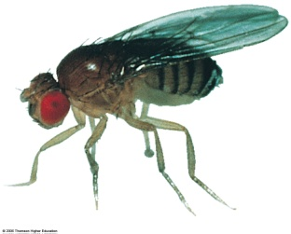
X-linked Inheritance
Mendel died in 1884, but chromosomes were not discovered until 1900’s.
Thomas H Morgan – Drosophila melanogaster.
Each gene has specific location on a chromosome.
Discovered gene for eye color on X-chromosome.
Drosophila as model system:
Female lays hundreds of eggs in a few days.
< 2 weeks, flies emerge.
Amenable to rapid genetic analysis.
•Think about how inheritance would differ for a recessive gene found on the Y vs the same gene found on the X chromosome.
Notes:
Nettie Stevens discovered sex chromosomes in insects. She died within a few years. Her former mentor, TH Morgan, wrote about her in 1912: "Modern cytological work involves an intricacy of detail, the significance of which can be appreciated by the specialist alone; but Miss Stevens had a share in a discovery of importance, and her work will be remembered for this, when the minutiae of detailed investigations that she carried out have become incorporated in the general body of the subject". — Thomas Hunt Morgan, following Stevens' death in 1912
This somewhat lukewarm praise fails to catch the magnitude of Stevens’ accomplishment. All the more curious because it was Stevens herself who brought the study of Drosophila into Morgan’s laboratory. She was a pioneer of science.

Slide 5
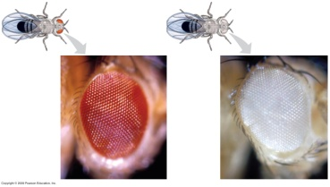
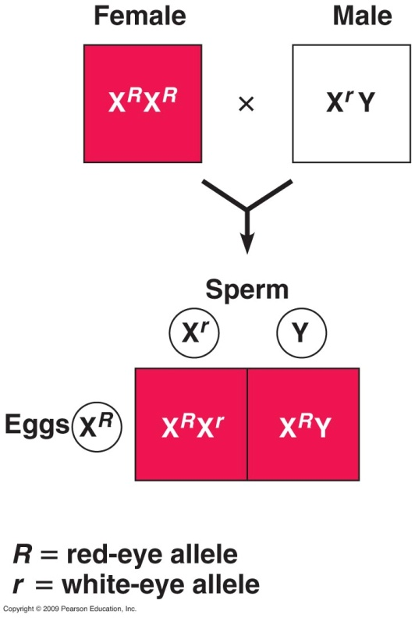
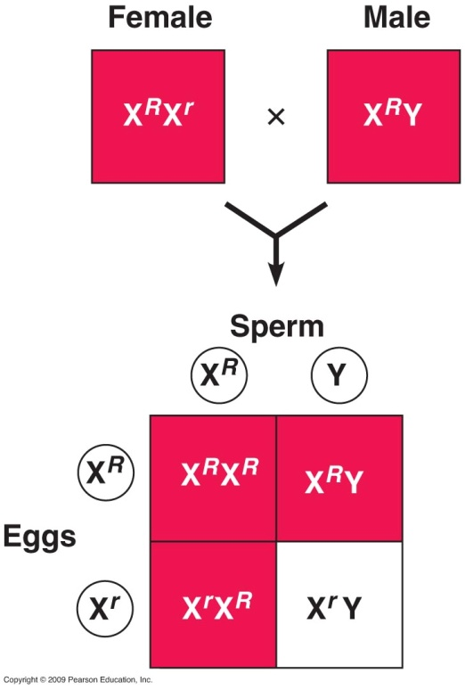
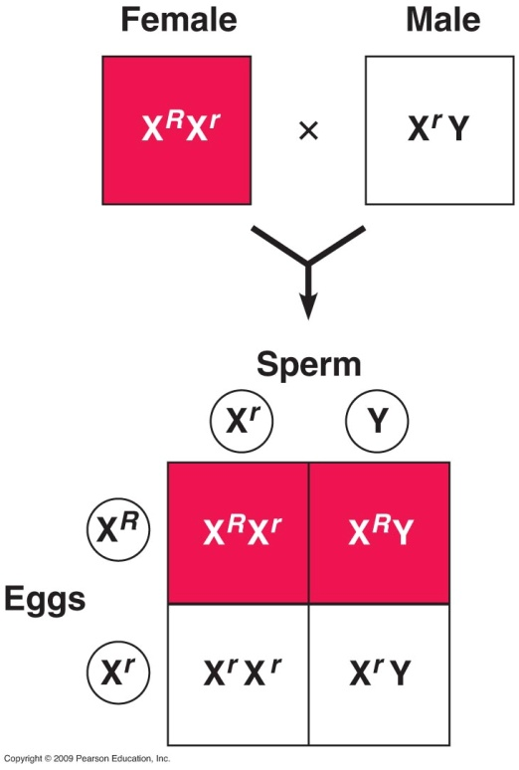
Morgan’s Analysis of Eye Color
Eye color alleles carried on X-chromosome.
Phenotype dependent upon X. Normal Mendelian expression
in female because there are two copies of X.
Male is hemizygous and demonstrates whatever phenotype
is on the X chromosome.
Notes:
First cross on the left is a homozygous dominant female vs. a hemizygous recessive male. The middle cross is a heterozygous female versus a hemizygous dominant male. In this cross the female can contribute the dominant or recessive allele to either male or female offspring. The male offspring will be 50% red eyed and 50% white eyed. All females have red eyes and males show both phenotypes. Differences in ratios such as this are indicative of a sex-linked gene. The far right is a heterozygous female versus a hemizygous recessive male. What would you get if you crossed a homozygous recessive female versus a hemizygous dominant male?

Slide 6
Practice problem
What would be the eye colors and ratios if you crossed a homozygous recessive female (white eyes) versus a hemizygous dominant (red eyes) male?
Explain these ratios as they are not Mendelian.
♂ ♀
Notes:
Answer: All of the females will be heterozygous with red eyes. All of the males will be white eyed because they all got a recessive from their mother. The female ratio is explainable as Mendelian if the father were homozygous or hemizygous dominant (of course males can only be hemizygous for X-linked chromosomes). The male ratio cannot be explained using normal Mendelian genetics because you would expect the father to have at least one red gene and at least half of the males would get the dominant gene. This cross truly indicates a distinction between sex linkage and normal Mendelian genetics.

Slide 7
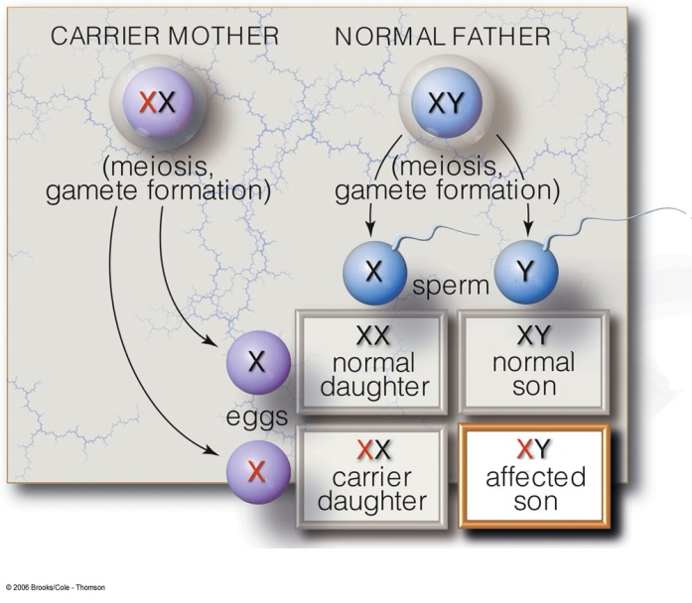
X-linked Inheritance Patterns and Human Disease
•Examples of human diseases or conditions that are X-linked recessive include:
Hemophilia,
variations of Color-blindness,
Duchene muscular dystrophy.
There are >300 examples of disorders associated with X-linked genes.
•X-linked disorders, often called sex-linked disorders, affect mostly males. Why?
Notes:
Duchene muscular dystrophy. Dystrophin gene anchors cell cortex to plasma membrane. To answer the question asked in the last phrase, look at the figure with the carrier mother and normal father.

Slide 8

Video: Gene therapy in Muscular Dystrophy
Notes:
Use a form of the gene that has been shortened- assume the introns have been taken out possibly a cDNA since dystrophin is such a large gene (>2500 kb with 79 exons which account for 0.6% of the gene). Disease is 1/3500 male births and typically it is a deletion product within one of the long introns.

Slide 9
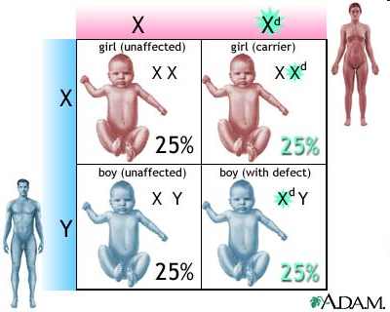
Video: Gene therapy in Muscular Dystrophy
Local copy
Notes:
Use a form of the gene that has been shortened- assume the introns have been taken out possibly a cDNA since dystrophin is such a large gene (>2500 kb with 79 exons which account for 0.6% of the gene). Disease is 1/3500 male births and typically it is a deletion product within one of the long introns.

Slide 10
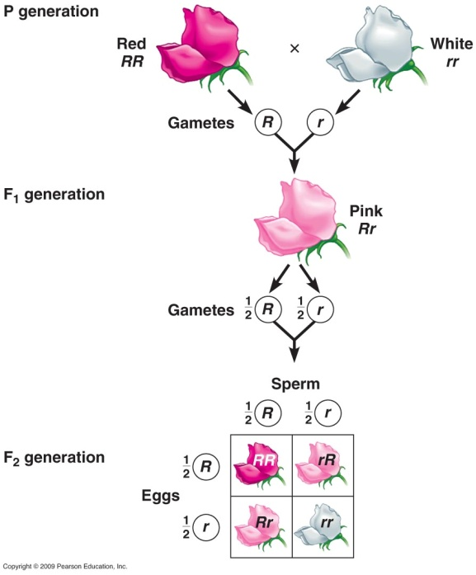

Incomplete dominance results in intermediate phenotypes.
Snapdragon color.
Hypercholesterolemia
Notes:
Snapdragon flower color is the classic example as the F1 generation above behaves as if characteristics were blended- an idea common when Mendel was working out his laws. Good thing he didn’t study snapdragons first. The fact that the alleles are not blended comes from the F2 generation where both parental phenotypes are shown in the homozygotes. In hypercholesterolemia the normal situation is to make LDL receptors. LDLs are cholesterol carrying proteins that deliver cholesterol to the receptor where the cholesterol is internalized and metabolized. In heterozygotes there are half the LDL receptors and blood cholesterol levels are 2x higher. Much higher risk of arteriosclerosis. In homozygous recessive situation, the blood cholesterol level is 5x higher with severe disease.

Slide 11
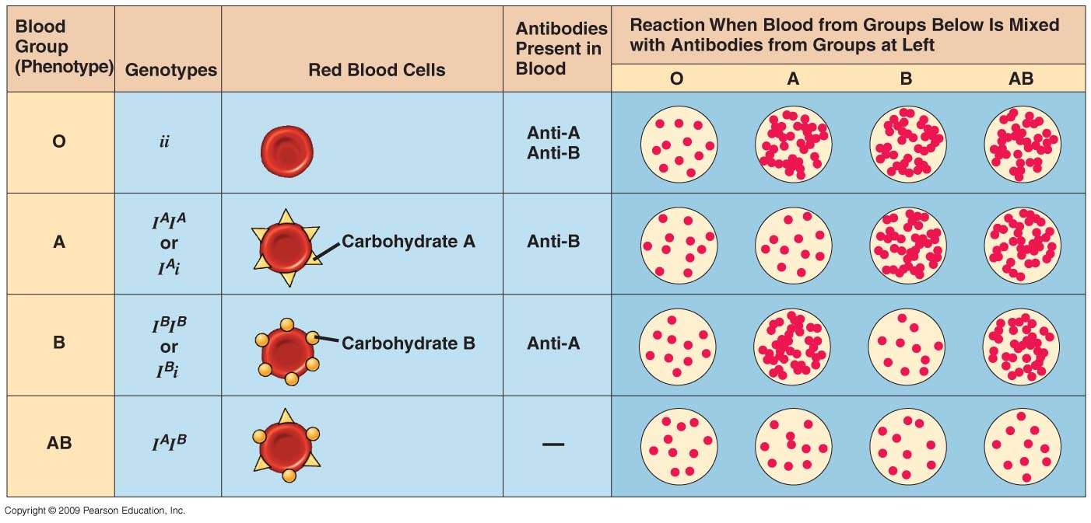
Multiple alleles at the same locus
Many genes have more than two alleles in the population whereas what we have discussed thus far are genes with only two differing alleles.
ABO blood group phenotype.
3 alleles of a single gene.
6 possible genotypes.
Both A and B alleles are expressed if present and the A and B alleles are Codominant.
Notes:
The A and B alleles code for glycosyltransferase enzymes that add a different carbohydrate to the H antigen present on the surface of red blood cells. The H antigen is a series of carbohydrates or a chain that is attached primarily to proteins in the membrane. The addition of a different monosaccharide causes a change in the immunological recognition of the cell surfaces of A or B type blood cells. If both A and B are expressed, the cell is in blood type AB. Both A and B are also dominant to the O allele which is a form of the glycosyltransferase enzyme that is inactive and adds no carbohydrate to the H antigen. AB individuals can receive blood from any other type because A and B are recognized as self. Type O is universal donor.

Slide 12
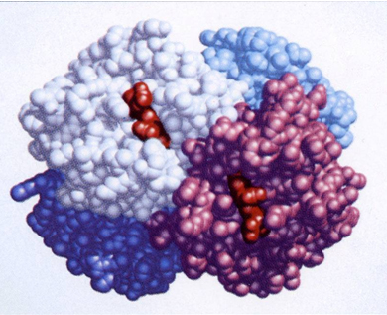
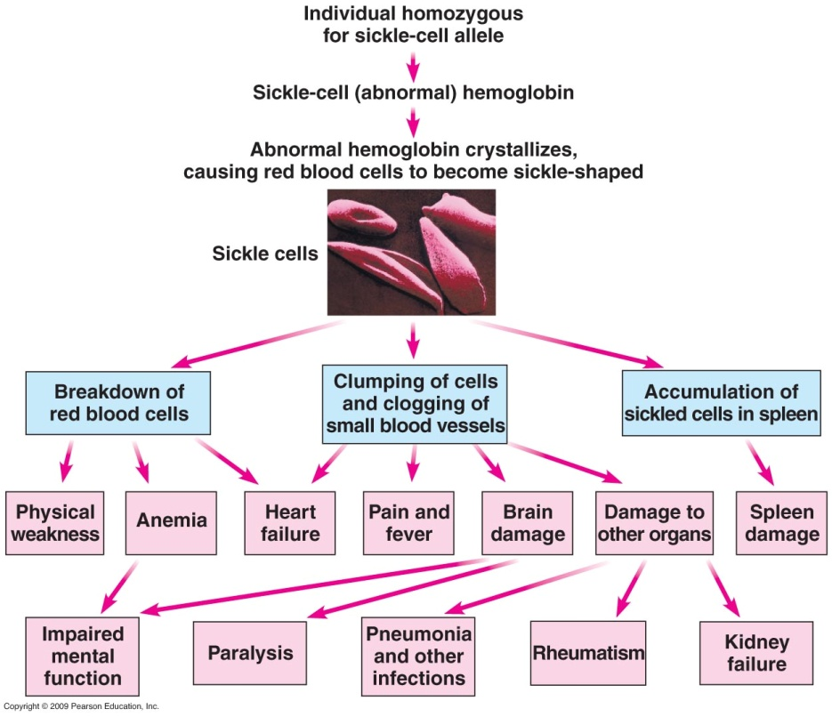
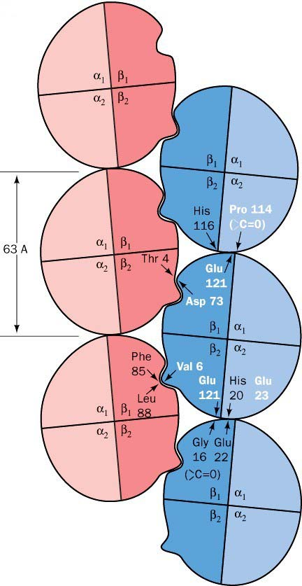
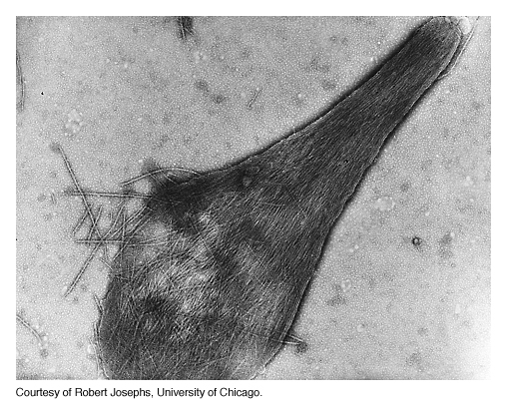
Pleiotropy
A single gene may affect many phenotypic characters.
Example: Sickle Cell Anemia
Hb
Hb A to Hb S: single amino acid substitution. Glutamate β6 ➔Valine
Notes:
This defective gene has a saving grace in that it confers resistance to Malaria, an infectious disease. At far left is the proposed fibril formation of hemoglobin molecules that causes them to precipitate in the cell. Normal hemoglobin does not form this polymer. The middle panel illustrates the impacts of Hb S on various organs. Above right is abnormal structure of a single Hb S molecule. Below right is illustrated the destruction of RBC with Hb s concatamers.

Slide 13
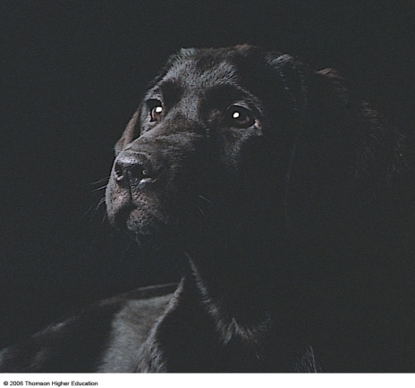
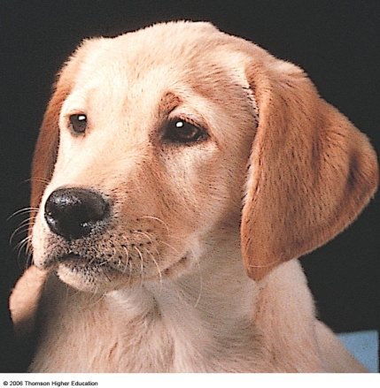
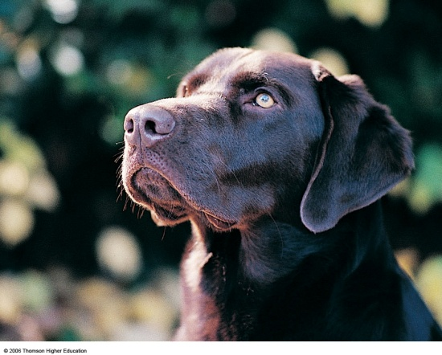
Epistasis: Interactions between more than one gene impacting a single trait
Two genes involved: pigment formation (B and b) and pigment deposition (E and e).
The pigment genes encode B for black which is dominant to b for brown.
The pigment deposition genes are E for maximum deposition of pigment into the hairs and e for minimal pigment deposition.
Notes:
On the left is a Black Lab with E_B_ genotype. In the middle is a yellow lab with eebb genotype. On the right is a chocolate lab with EEbb genotype

Slide 14
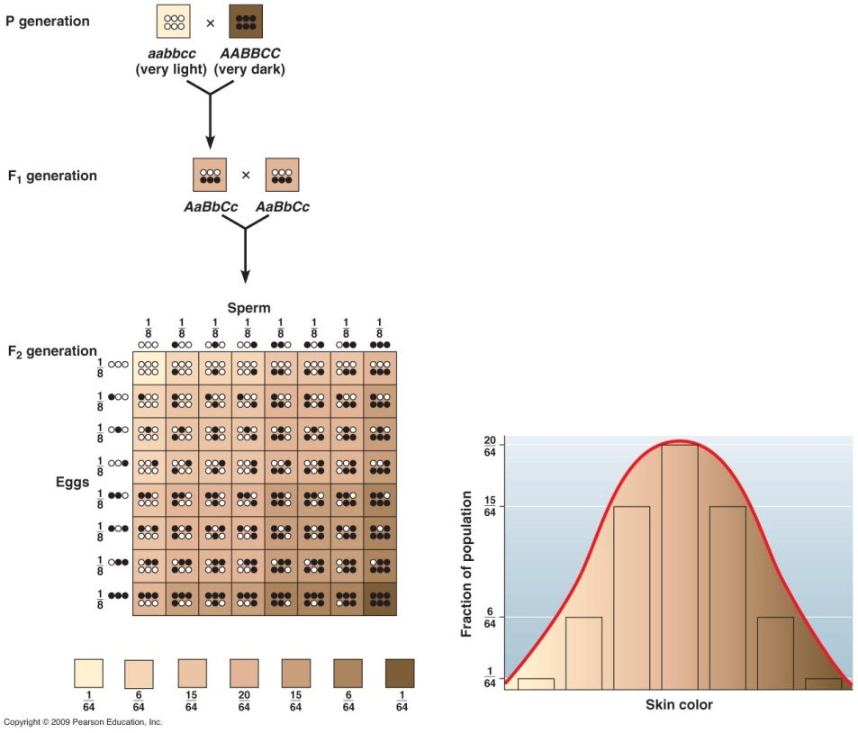
Polygenic inheritance
A single character may be influenced by many genes.
Examples:
Human skin color, height, and eye coloration
Ex. skin color
Notes:
Vary in a population along a continuum. There are additive effects of two or more genes. At least three separate genes impact skin color. Modeled above in Punnett square assumes three separate genes where the dark coloration is incompletely dominant to the other alleles. There are several ways to achieve the same coloration as there are six alleles for any expression. For example AABbcc may have the same degree of coloration as AaBbCc.

Slide 15
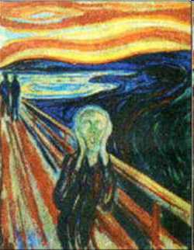
Polygenic Involvement in Human Neurological Disease
Neurobiological disorders:
depression, schizophrenia, bipolar disorder
Schizophrenia: mutant alleles
chromosomes 1, 3, 5, 6, 8, 11-15, 18, 22
Environmental factors may contribute
Video: Strange Genes, Richly Tortured Minds

Slide 16
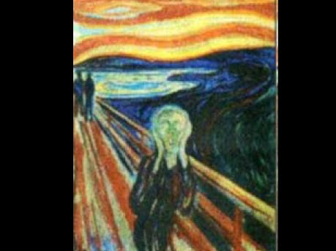
Video: Strange Genes, Richly Tortured Minds
(flash movie)

Slide 17
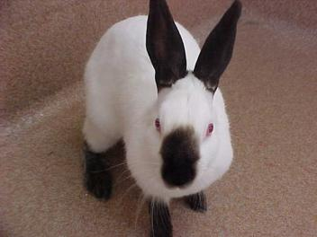
Environmental Influence
Hair patch color
> 34°C: White
< 25°C: Black
Black pigment enzyme inactive above 34°C
Himalayan rabbit: C gene
Notes:
Himalayan rabbits carry the C gene that has an impact on fur coloration, skin and eyes at temperatures indicated on slide. But many traits are modulated by the environment (nature vs nurture argument). In humans the red and white blood cell count can vary depending upon altitude, physical activity level over time and other factors. Do you have a tan? Does that affect your skin color? However, you do not pass a tan on to your offspring- only your genes are passed on.

Slide 18
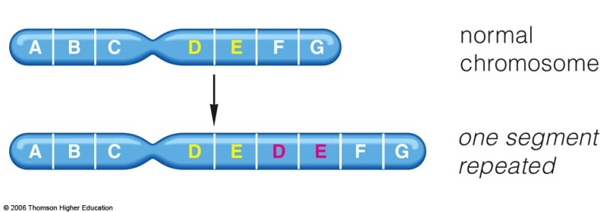
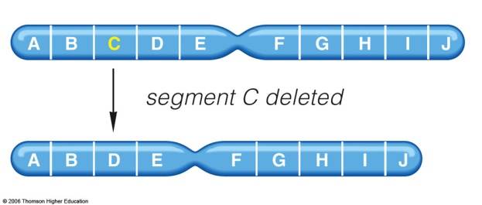
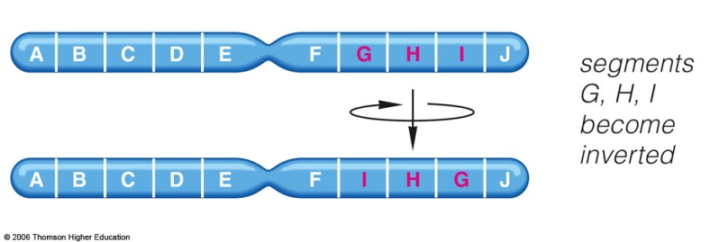
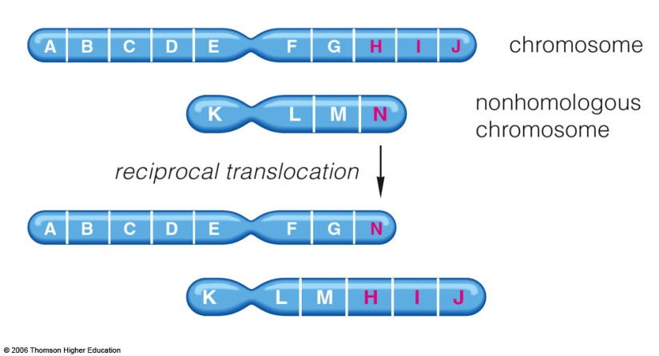
Changes in chromosome structure & number can
be inherited.
a.
Structural change:
a. duplication
b. deletion
c. inversion
d. translocation
b.
c.
d.
Notes:
Duplications may occur during unequal crossing over in meiosis I where DNA sequences are repeated. Deletions are the reverse of duplications as above or caused by chemical or physical (X-rays) exposures. Inversions may involve repeated regions of chromosomes. Translocations are physical movement of part or all of a chromosome to another non-homologous chromosome (often reciprocal if partial).

Slide 19
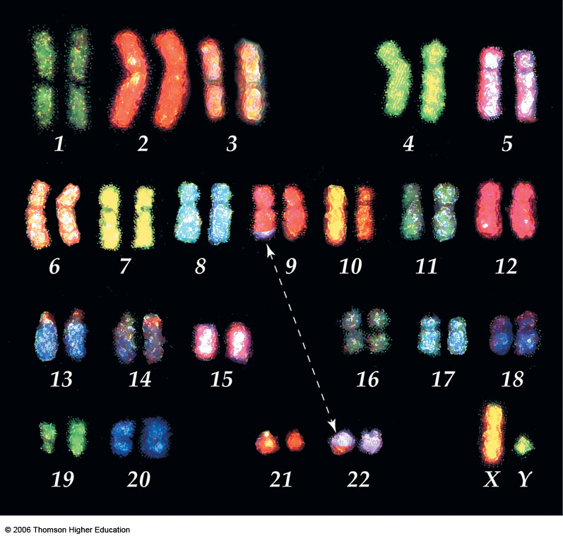
Spectral karyotyping as a diagnostic tool.
Fluorescent dyes interact with regions of chromosome differently.
Reveal abnormalities not otherwise visible.
“Philadelphia chromosome”- example of a translocation
Fused gene transcribed more often→uncontrolled gene expression.
Chronic myelogenous leukemia (CML): too many WBCs.
Malignancy in bone marrow.
Notes:
Translocation or exchange of genetic material on chromosomes 22 and 8. This was the first example of a malignancy that was tied to a chromosomal change. The change on chromosome 22 caused deregulation or unregulated transcription of a tyrosine kinase and stimulating cell growth in bone marrow (10-25x increase in number of white blood cells). This signaling system protein, if blocked, can stop the cancer phenotype. Knowledge of the type of protein led to discovery of a drug that inhibits the kinase activity- Gleevec (imatinib mesylate).
Method of staining chromosomes is called SKY. SKY uses chromosome sequence specific DNA probes with attached flourescent dyes. The dye for each chromosome is different (as are the probes). Referred to as “painting the chromosome.

Slide 20
Additional examples of structural changes
Approximately half of fetuses spontaneously aborted in first trimester have chromosomal abnormalities.
Cri-du-chat- small deletion in chromosome 5
  Abnormal larynx and mental impairment
Fragile X syndrome- small part of chromosome is lost
  Mental impairment, more frequent in boys
Norrie disease- inversion in X chromosome
  Blindness in males due to incomplete development of the retina, developmental delays

Slide 21
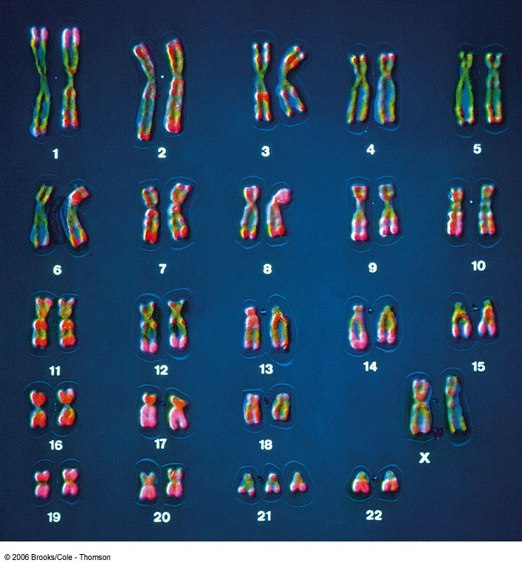
Aneuploidy: one extra or one less chromosome
Trisomy chromosome #21- Down Syndrome
Can be caused by translocation of 21 to another chromosome also

Slide 22
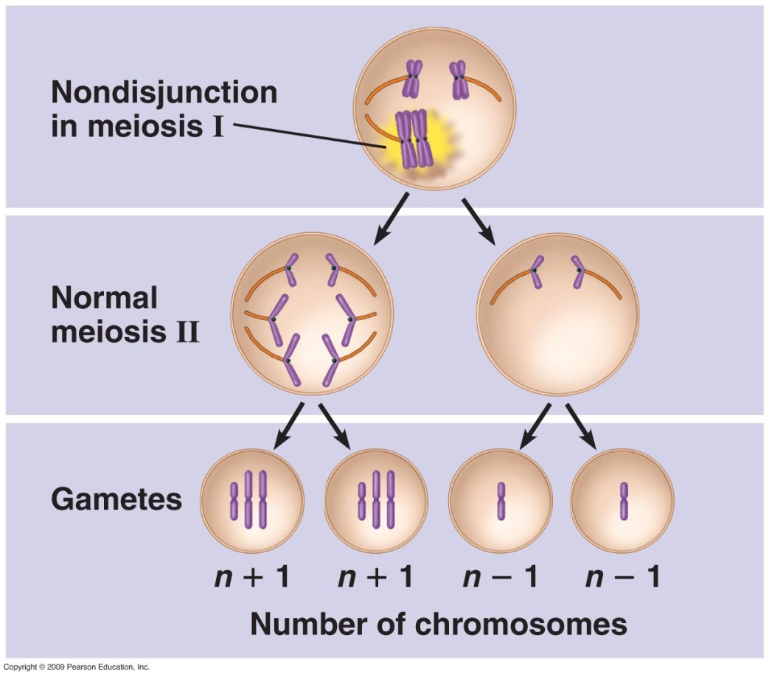
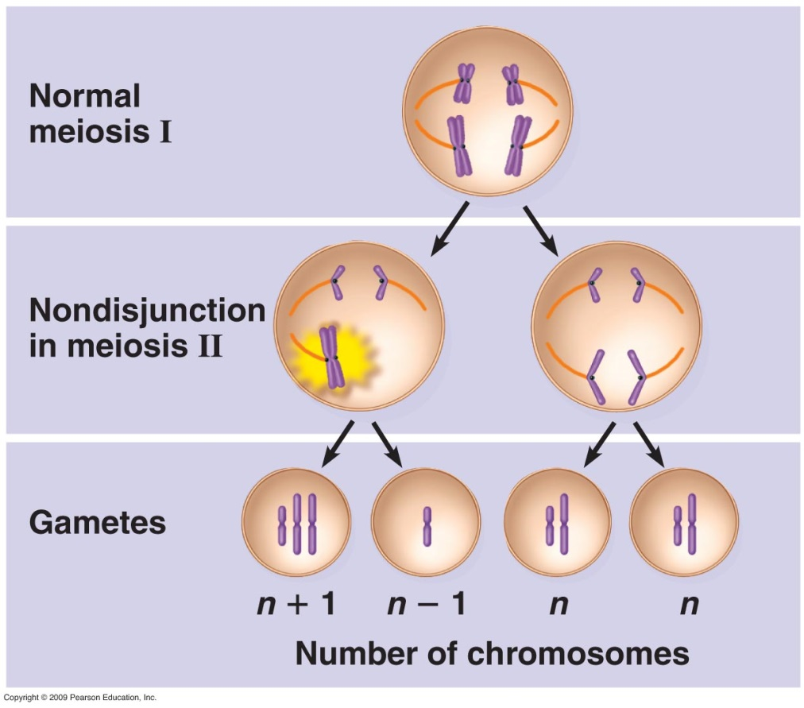
Nondisjunction during meiosis
Notes:
If nondisjunction occurs during meiosis I all of the gametes have abnormal chromosome numbers. In this simplified example, the gametes would have either 3 or 1 chromosome (equal numbers of gametes)- the result of not separating sister chromosomes from Prophase I. If the nondisjunction occurs in meiosis II there are two normal gametes, one with an extra chromosome and one with a loss of chromosomes. Assume that in this example we are looking at a female and the X chromosome is either lost or doubled due to nondisjunction. If it is lost, a male sperm carrying the X chromosome would yield an individual with Turner Syndrome. If the mating is with an egg that has two X chromosomes you get an individual with XXX Syndrome. The nondisjunction occurs randomly but is more frequent in eggs of older mothers. It can happen in males during spermatogenesis.

Slide 23

Down syndrome facts
Most frequent chromosome number alteration disorder, 1/800 births*
Visible characteristics include- upward slant to eyes, flattened facial structure, skin creases on appendages
Variable level of mental retardation
Heart problems
Slow reflexes
*Often the result of non-disjunction during meiosis of the ovum
Notes:
Follow slide. Variability may be due to which alleles of genes are in the triploid copies of chromosome #21 and in the penetrance of those alleles. Alleles do not always do the same thing in different individuals. Variability may be due to which alleles of genes are in the triploid copies of chromosome #21 and in the penetrance of those alleles.
Variability may be due to which alleles of genes are in the triploid copies of chromosome #21 and in the penetrance of those alleles. Alleles do not always do the same thing in different individuals. Test include amniocentesis with karyotyping but a newer method is available. Fetal blood is found in a women’s blood (cF DNA). With a screen involving either sequencing of specific fragments or use of methylation patterns (quantitative differences between autosomes and trisomy) the presence or absence of Down trisomy is ~99% accurate. Can test for two other chromosomal abnormalities also.

Slide 24
