Slide 1
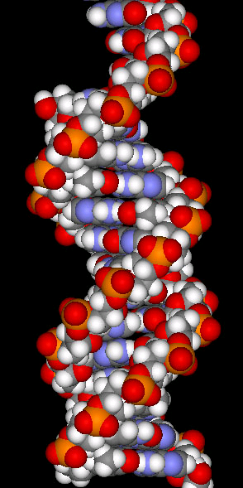
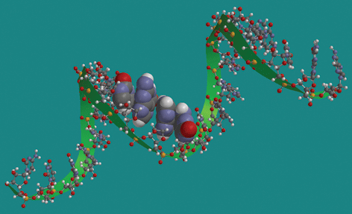
Comparison of DNA and RNA structures
RNA
DNA
Notes:
DNA is typically double stranded except in a few viruses. DNA is the genetic information and has no other role in the cell. It is copied in the S phase of the cell cycle. RNA is single stranded but can fold back onto itself to make internal regions that are double stranded. RNA plays multiple roles in cells. Messenger RNA provides a copy of the DNA to be used to convert the DNA sequence information into the language of amino acids to build proteins. RNA also has two functions in protein synthesis. Ribosomal RNA is a physical part of the ribosome where polypeptides are made. In addition to the structure of ribosomes it participates in catalysis of bonds between amino acids. Another form of RNA, transfer RNA is responsible for decoding the information in DNA and converting it into amino acids. These last two types of RNA are stable and have significant secondary structure whereas mRNA is typical linear.

Slide 2
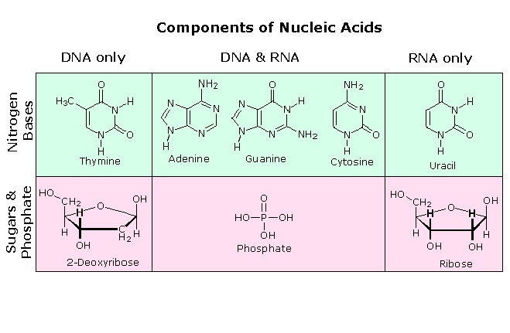
What’s the difference between DNA and RNA?
Same basic components: base, sugar, phosphate.
DNA is double stranded, RNA single stranded.
Purines: adenine & guanine
Pyrimidines: cytosine, thymine, and uracil.
[Purines] in DNA is equal to [Pyrimidines]

Slide 3
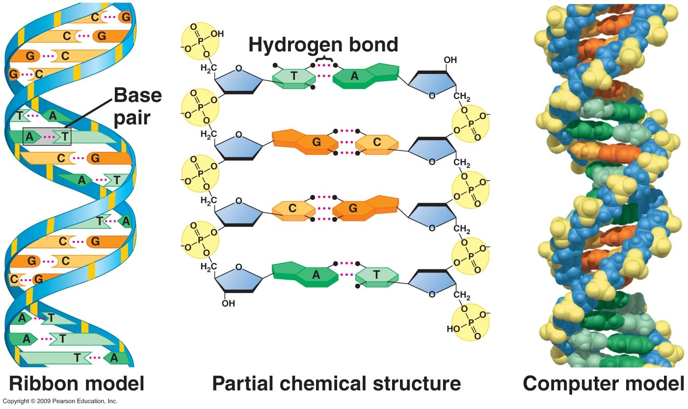
Structural representation of DNA molecule
Nucleic acid strands are polar, i.e, they have directionality.
Notes:
Rosalind Franklin & Maurice Wilkins: X-ray diffractions studies on crystalline forms of DNA revealed periodicity of 0.34 nm & 3.4 nm along with other physical details such as rod shape, spiral or helical and uniform diameter of 2.0nm. Erwin Chargaff determined the chemical composition of many different DNA molecules. In each case: [A] = [T] and [C] = [G]. James D. Watson & Francis H. C. Crick – model building hypothesized that DNA coiled along its length
1953 – Watson & Crick proposed the Double Helix Model. This model used no data that they were directly responsible for. The x-rays were done by Franklin and some by Maurice Wilkins to predict shape and Chargaff determined the chemistry showing that the ratios of nucleotides were the same within cells of a particular organism but varied between organisms.
Look at middle diagram first for details. Each strand has a backbone made of repeating units of pentose-phosphate with bases extending as side groups. The 5’ end- has phosphate on the 5′-carbon of the terminal sugar. The 3′-end has hydroxyl group on 3′-carbon of terminal sugar. By convention, nucleic acid sequences are written in the 5′ → 3′direction. The linkage between sugars is a phosphodiester bond. Orientation of strands is antiparallel.
Held in register through precise H-bonding (noncovalent). hydrophobic & van der Waals interactions between the bases help stabilize. Watson-Crick Base pairs: A•T and G•C. Natural or B-DNA: adenine• thymine & guanine•cytosine. No one H-bond is strong, but it is the large number that provides stability. Stability also obtained from stacking of the base pairs: hydrophobic & van der Waals interactions.
The left diagram (ribbon model) illustrates base pairing and the uniformity of the spiral structure with specific base pairing (A-T and G-C). The space filling model is more accurate in that each atom is drawn to relative scale.

Slide 4
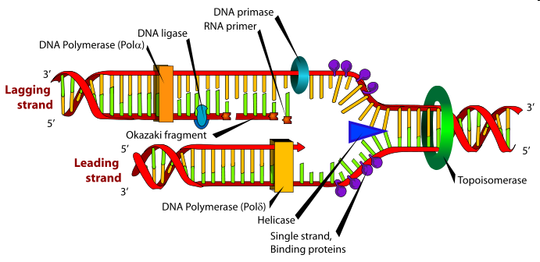
Animation of DNA replication
http://www.dnai.org. Code-Copying the code- Putting it together- DNA synthesis animation
backup copy
Notes:
The lower diagram labels the components/enzymes present at an area where DNA is being copied. The enzymes involved include a DNA polymerase (actually two DNA polymerases) which stitch the sugar-phosphate components of the nucleotides together to make the backbone of each strand, a helicase enzyme which opens up the two DNA template strands, and several other enzymes that are used to copy one of the two strands that are not really required to copy the other. There is a leading strand and a lagging strand. The leading strand is the lower one and the lagging strand is the upper one. Because the DNA strands are antiparallel and DNA polymerases polymerize in one direction only, the lagging strand must be made in pieces that are then stitched together. This complication requires a greater number of enzymes to make the strand and takes a bit more time- thus the lagging strand. The animation shows the process in relatively real time which indicates the dynamics of the enzymes.

Slide 5
Animation of DNA replication
http://www.dnai.org
Code-Copying the code- Putting it together.
backup copy
source

Slide 6
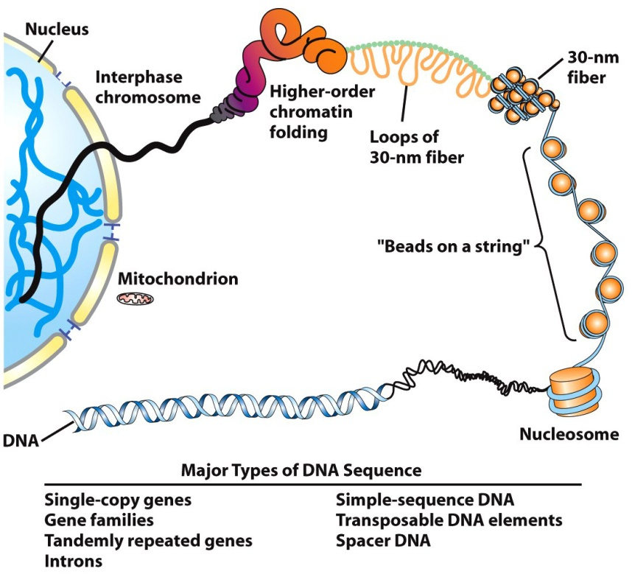
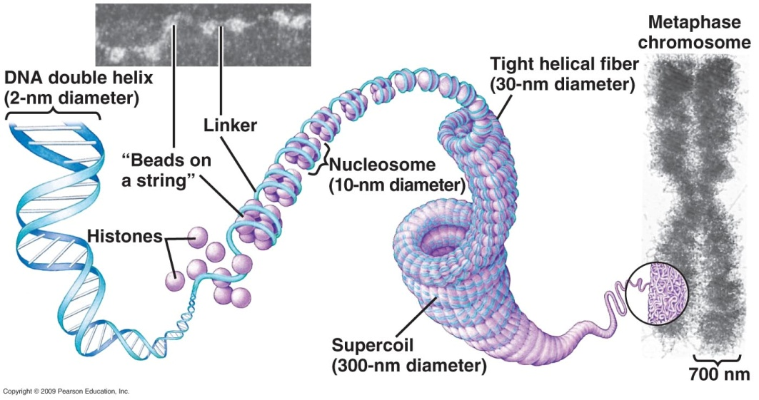
The Challenge of Packing
Movie
DNA Packaging
Fig. 11-3
Notes:
DNA of single human is 2 meters long. Cell diameter is about 10 μm, i.e. 10 millionths of a meter. DNA is folded and organized within the cell nucleus. Yet, it must be readily accessible for transcription, replication, & repair, and integrity must be maintained through cell division.

Slide 7
Movie: DNA Packaging
backup link
Notes:
DNA of single human is 2 meters long. Cell diameter is about 10 μm, i.e. 10 millionths of a meter. DNA is folded and organized within the cell nucleus. Yet, it must be readily accessible for transcription, replication, & repair, and integrity must be maintained through cell division.

Slide 8
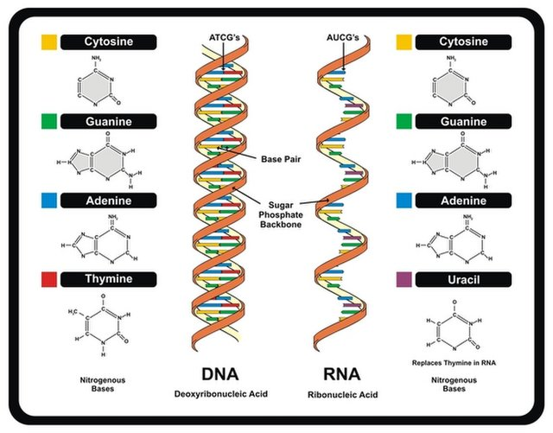
Templating RNA from DNA
Notes:
All RNA molecules have DNA templates regardless of their function. RNA molecules are copied from one of the two strands of the DNA molecule but not both strands of the DNA in the same exact region of the chromosome. Again, base pairing rules are followed (template is DNA) except that RNA has uracil base pair with adenine instead of thymine.

Slide 9
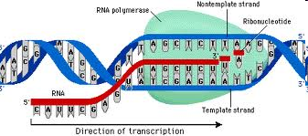
How does transcription work?
http://www.dnai.org
Code, copying the code, putting it together, transcription video
Notes:
Video animation of RNA polymerase in action from the DNAi site. The animation is of eukaryotic transcription. Concepts in the animation are: the start of a gene, the direction of transcription, cluster of factors at the start, blue molecule in the animation is RNA polymerase, local unzipping of DNA helix and copying one of the two strands, yellow chain is mRNA, match the ribonucleotides to the DNA sequence as with DNA replication except uracil instead of thymine, the process is called transcription, transcript ends but not exactly randomly. There is a need to know the beginning and ending of genes. Review features from the web animation using the diagram at the bottom of the slide.

Slide 10
How does transcription work?
http://www.dnai.org
Code, copying the code, putting it together backup link
Notes:
Video animation of RNA polymerase in action from the DNAi site. The animation is of eukaryotic transcription. Concepts in the animation are: the start of a gene, the direction of transcription, cluster of factors at the start, blue molecule in the animation is RNA polymerase, local unzipping of DNA helix and copying one of the two strands, yellow chain is mRNA, match the ribonucleotides to the DNA sequence as with DNA replication except uracil instead of thymine, the process is called transcription, transcript ends but not exactly randomly. There is a need to know the beginning and ending of genes. Review features from the web animation using the diagram at the bottom of the slide.

Slide 11
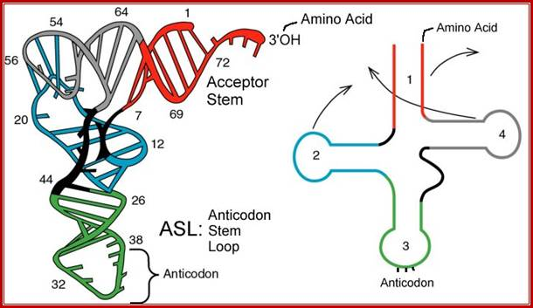
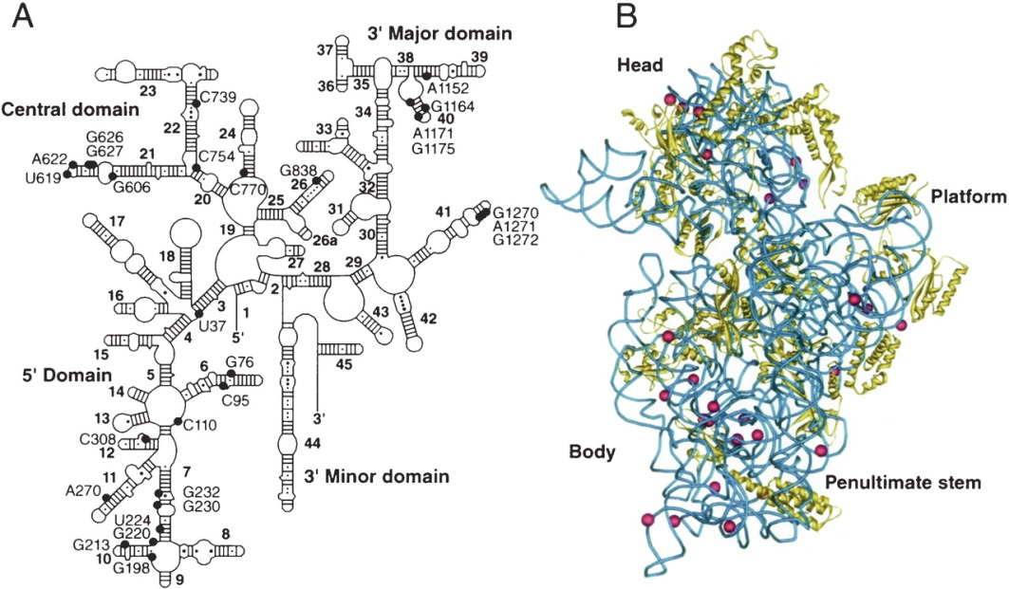
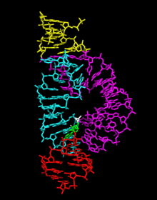
Varieties of structures of RNAs
Transfer RNA
16S ribosomal RNA
ribozyme
Notes:
All RNAs shown are single stranded if pulled apart. The secondary structures indicate that these perform functions that require a shape much more so than a messenger RNA which has very little beyond the primary linear sequence of nucleotides. Transfer RNA’s (tRNA) bring amino acids to the ribosome, fit into a precise space of hole in the ribosome and read the mRNA code. The 16S RNA is used to determine phylogenies of bacteria and it is a structural component of the bacterial ribosome. The ribozyme shown (many exist) is the hammerhead ribozyme is capable of precise cutting and rejoining of other RNA substrate molecules

Slide 12
What Are Genes?
Unit of heredity, either RNA (for some viruses) or DNA
Controlling elements sometimes included in definition
May be surrounded by sequences of unknown function
Found in all cells, in the nuclei of eukaryotic cells, and in mitochondria and chloroplasts of eukaryotes.
Notes:
physical & functional unit of heredity, carry information transmitted from parents to offspring, specific location in chromosomal DNA, entire DNA sequence of a gene includes exons, introns, and transcription-control regions necessary to produce functional polypeptide or RNA, noncoding DNA: ~98.5% of human chromosomal DNA, may appear to be junk, is not. Mitochondria & chloroplasts also contain DNA that encodes proteins essential to organelle function.

Slide 13
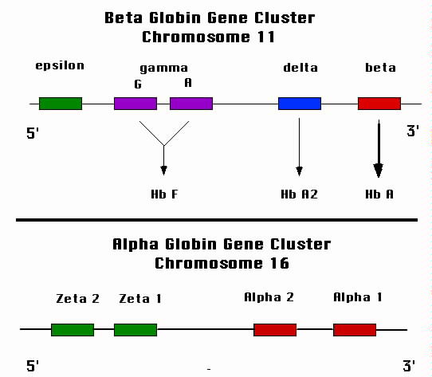
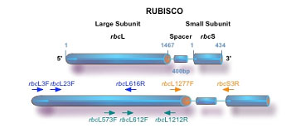
Protein-coding genes may be solitary or belong to a gene family.
Gene for rubisco, the most abundant protein on earth.
Other examples are protein kinases, immunoglobulins, olfactory receptors (hundreds of family members) cytoskeletal proteins (actin, tubulin), molecular motors (Kinesin, myosin, dynein superfamilies)
Notes:
~25-50% solitary genes: represented once in haploid genome; Lysozyme (Hu tears, cleaves bacterial cell walls): ~50-75% duplicated genes: close but non-identical sequences, such as gene families with related proteins, examples are protein kinases, immunoglobulins, olfactory receptors with hundreds of family members. cytoskeletal proteins (actin, tubulin), molecular motors (Kinesin, myosin, dynein superfamilies). Some arose through gene duplication of ancestral gene. Redundancy, diversity - results in tuning of specific function, backup can prevent lethality if there is a mutation – this permits divergence of function to evolve

Slide 14
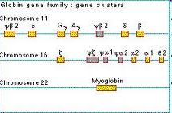
How are genes organized on a chromosome?
http://www.dnai.org. Choose “flyover” and look at all 4 animations (1, 2, 3, 4) of a portion of chromosome 11
Notes:
What is shown includes families of genes- the globin genes, ubiquilin genes, TRIM genes and olfactory genes. There are 28 genes in this segment of chromosome 11. Genes are complicated because they have intervening sequences in the middle of the coding information- the introns and exoms. There are large regions of DNA that are in between the genes that do not code for anything. Some of these regions include repeated DNA sequences that can be large (multiple copies of sequences 100 nucleotides or longer) or short (2-50 nucleotide repeats) repeated sequences and other include ~500 copies of transposons or regions of DNA that can jump or move from one chromosomal location to another. Many of these transposons are stuck where they are because they are old and have lost the ability to move.

Slide 15
How are genes organized on a chromosome?
http://www.dnai.org. Choose “flyover” and look at
all 4 animations (1, 2, 3, 4) of a portion of chromosome 11
Notes:
What is shown includes families of genes- the globin genes, ubiquilin genes, TRIM genes and olfactory genes. There are 28 genes in this segment of chromosome 11. Genes are complicated because they have intervening sequences in the middle of the coding information- the introns and exoms. There are large regions of DNA that are in between the genes that do not code for anything. Some of these regions include repeated DNA sequences that can be large (multiple copies of sequences 100 nucleotides or longer) or short (2-50 nucleotide repeats) repeated sequences and other include ~500 copies of transposons or regions of DNA that can jump or move from one chromosomal location to another. Many of these transposons are stuck where they are because they are old and have lost the ability to move.

Slide 16
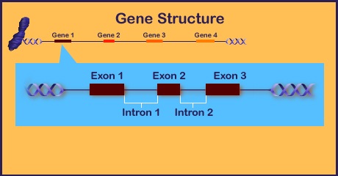
Exon and introns
WORD VERSION OF EXONS AND INTRONS
THEFOXVGLOHDSRANTOOIWSCHGTELLFAR
Notes:
Most eukaryotic genes have intervening sequences of nucleotides within the message that they carry. This makes no sense in terms of reading the information (see example of word sequence). Getting the meaning out requires precision. The transcript of these genes must be processed in order to get the correct information. There are evolutionary reasons for introns- Noncoding introns favored evolution of multi-domain proteins. Rapid evolution new combinations of functional domains.

Slide 17
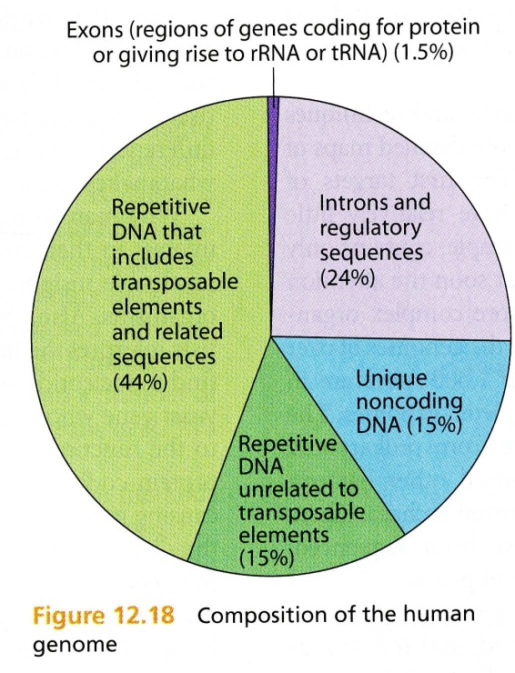
Surprises
Notes:
As many pseudogenes as genes. Pseudogenes: inactivated, nonfunctional copies of genes. Intriguing question: Whose genome was sequenced?

Slide 18
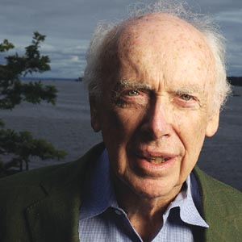
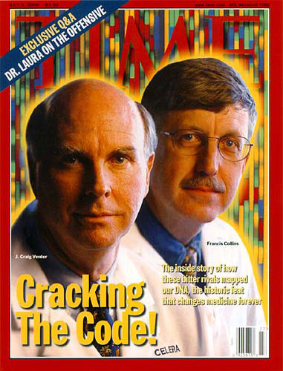
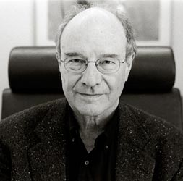
Watson
Venter, Collins
Gilbert
The Rise of Genomics:
Genome-wide Analysis of Gene Structure & Expression.
Notes:
The first genes to be sequenced were chosen on the basis of their particular interest or the fact that they could be isolated easily. Walter Gilbert, shown here, and Frederick Sanger were the first to develop methods for sequencing DNA. The methods initially were slow and expensive.
The idea of sequencing the genome of a whole organism, be it a bacterium or a human being, only came about later, with the development of more and more efficient techniques. How do you sequence 3.2 billion base pairs rapidly & efficiently?
At first the Human Genome Project was exclusively a government-funded operation with James Watson serving as director (1988). There were 20 government funded research centers in 6 countries. He was followed by Francis Collins in 1993. In 1992 Craig Venter-started Celera Genomics, a private company, to compete with the government program.
The sequence was completed in 2003. The question then became what to do with all the data?

Slide 19
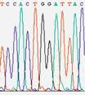
Automated DNA sequencing- the details
http://www.dnai.org.
From the web site follow the boxes: Techniques, Manipulation, sorting and sequencing, cycle sequencing animation. Run the animation.
Notes:
Illustration through the animation of the automated process of DNA sequencing. Discuss dideoxynucleotides and fluorescent nucleotides. Should be familiar with gels or will be soon.

Slide 20
Automated DNA sequencing- the details
www.dnai.org: Techniques, Manipulation, sorting and sequencing, cycle sequencing animation. Run the animation.
Notes:
Illustration through the animation of the automated process of DNA sequencing. Discuss dideoxynucleotides and fluorescent nucleotides. Should be familiar with gels or will be soon.

Slide 21
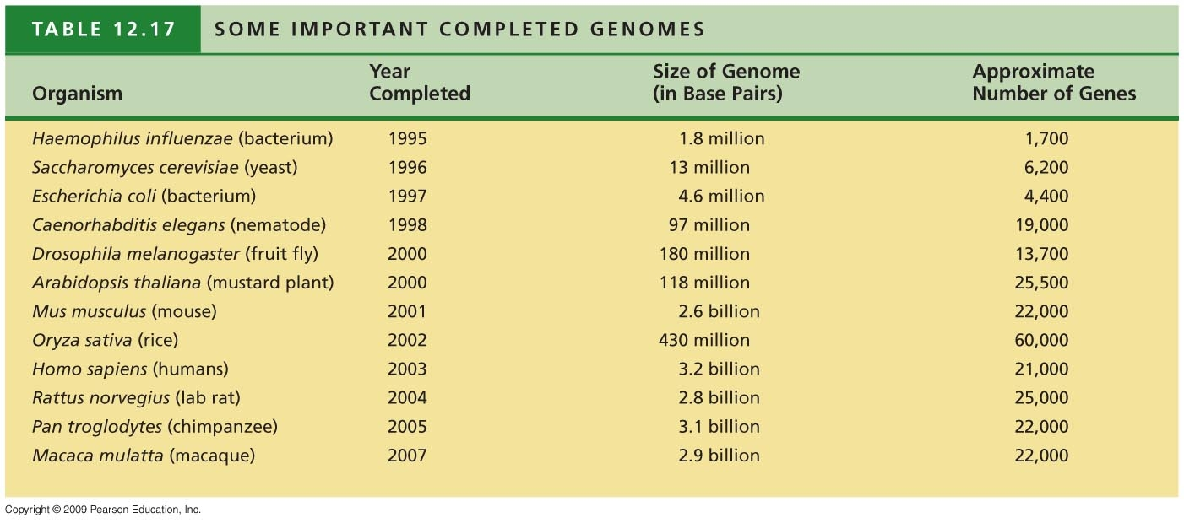
Notes:
This is a partial list but with some important organisms. Very few bacterial or archeal genomes are represented but many have been sequenced. H. influenza was the first to be sequenced because it has a very small genome.

Slide 22
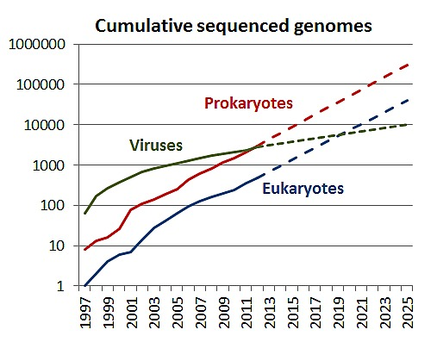
Notes:
The pace picks up. Data come from GOLD- Genomes Online Database and NCBI- National Center for Botechnology Information database

Slide 23
A mechanism for studying individual genes or DNA regions based on a special DNA replication technology
Whole genome sequencing is laborious, but provides the basis for use of the Polymerase Chain Reaction (PCR) to amplify a gene or region of interest in the genome.

Slide 24
Need to amplify the sample DNA
Some DNA samples are small in quantity and the particular region of interest is a small portion of the DNA.
A single hair has been sufficient to amplify DNA regions to allow comparisons between crime suspects.
Viruses can be detected in large genomes- HIV
To help in diagnosis of genetic disorders when gene is known.

Slide 25
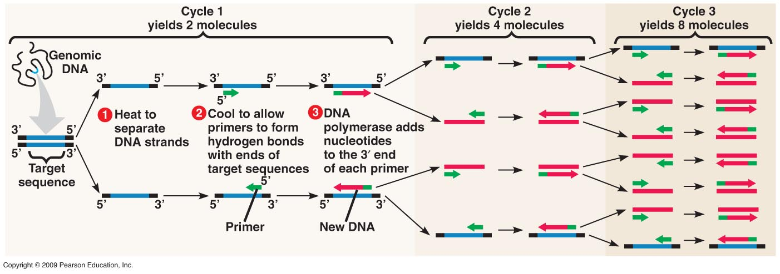
How does PCR work?
http://www.dnai.org/b/index.html
Manipulation, Techniques, amplifying, PCR amplification, Kary Mullis interviews: 1, 2 and 3
Manipulation, Techniques, amplifying, making many copies, amplification graph

Slide 26
How does PCR work? Kary Mullis interview 1
dnai.org/b Manipulation, Techniques, amplifying, PCR amplification, Kary Mullis interview 1

Slide 27
How does PCR work? Kary Mullis interview 2
dnai.org/b Manipulation, Techniques, amplifying, PCR amplification, Kary Mullis interview 2

Slide 28
How does PCR work? Kary Mullis interview 3
dnai.org/b Manipulation, Techniques, amplifying, PCR amplification, Kary Mullis interview 3

Slide 29
How does PCR work? Amplification Graph
http://www.dnai.org/b Manipulation, Techniques, amplifying, making many copies, amplification graph

Slide 30
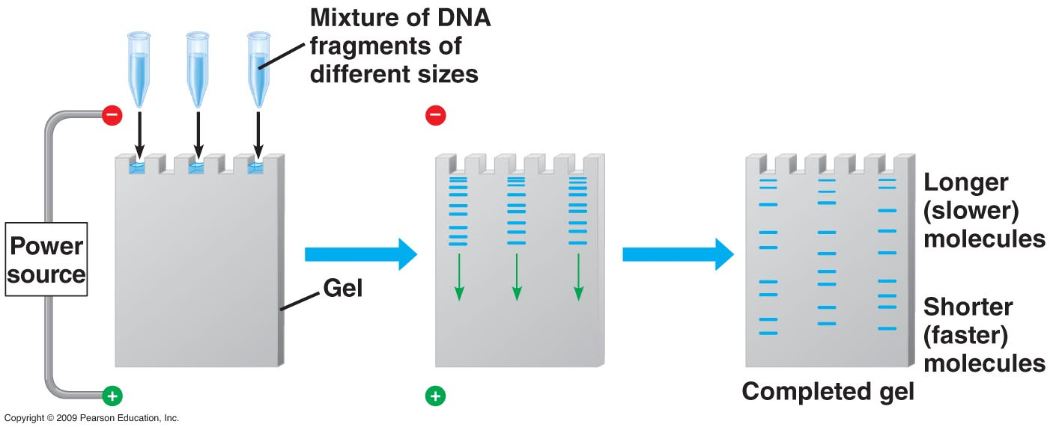
Agarose gel electrophoresis to separate pieces of amplified DNA by size
Notes:
Used this technique in lab to separate DNA pieces by size. Since DNA is negatively charged due to sugar-phosphates it will migrate toward the positive electrode. Visualization techniques vary from staining to autoradiography to measuring fluorescence dyes which may be attached to small DNA segments complementary to the gene or region of interest.

