Slide 1
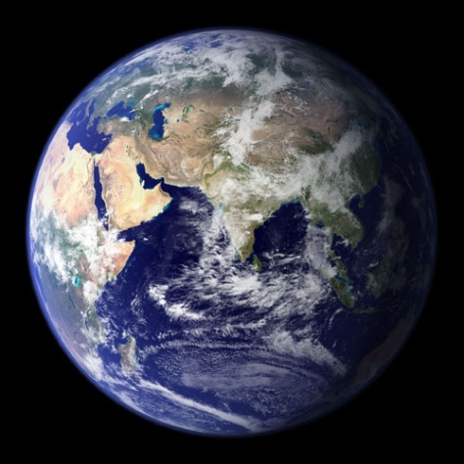

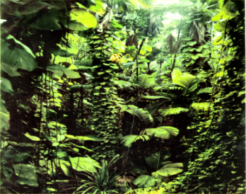
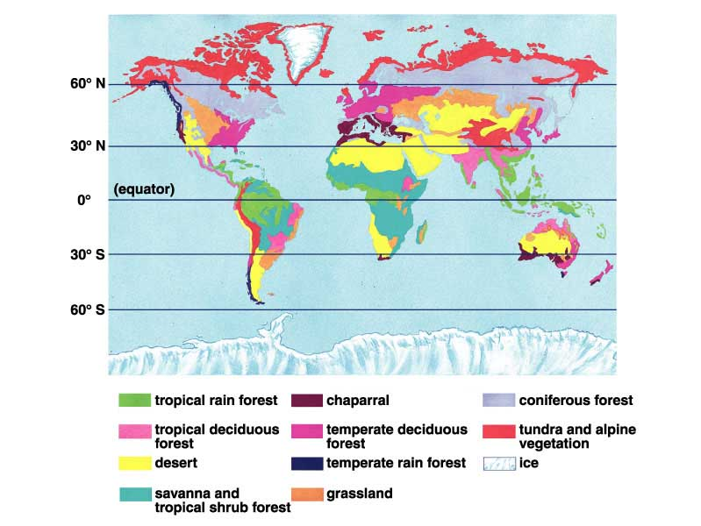
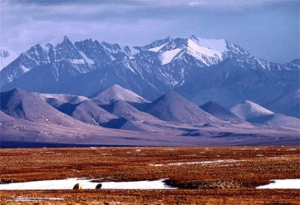
TU 3
Unit 3: Ecology
The Biosphere
Notes:
The biosphere extends several kilometers above Earth to the depth of the ocean. Examples here are the Earth from space, a tropical rainforest, the frozen tundra, world biomes and clouds (as an indicator of climate). All impact or are examples of the biosphere.

Slide 2
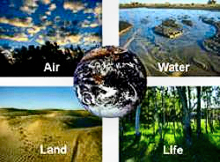
What is the Biosphere?
“All regions of the Earth’s hydrosphere, lithosphere, & atmosphere in which organisms can live.”
Earth Systems Science- the interactions between the biological, physical and chemical processes at multiple scales.
Notes:
All regions of the Earth have been shown to have life forms so life is highly adaptable. Ecology is the study of systems and it brings in the field of earth science in characterizing most of the abiotic world.

Slide 3

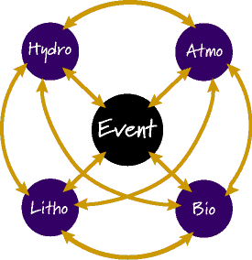
The Biosphere is a Dynamic System
What is a “Dynamic System”?
“A group of connected, interdependent elements that affect each other and change through time.”
Natural events can cause changes in one or more spheres
Interactions amongst the spheres can also cause changes
e.g. a change in the atmosphere can cause a change in the hydrosphere & vice versa.
Notes:
Lithospere is the outer surface of the Earth. There is significant connection between all of the “spheres”. Where have we seen examples of this? How about oxygen evolution early in evolution from cyclic photosynthesis. The oxygen affected the lithospere- banded iron formations, the atmosphere by increasing the oxygen and generating the ozone, the hydrosphere by changing the dissolved oxygen in the water, and the biosphere by selecting for organisms that were aerobic and relegating anaerobes to smaller niches.

Slide 4

Ecology and abiotic factors
Ecology is the study of the distribution, abundance, and diversity of life on the planet, and the effects that human activity has had and will have on the biosphere.
Abiotic factors affecting biomes and the diversity of life include:
the Earth’s climate (temperature, rainfall),
energy source (photosynthesis or chemosynthesis),
nutrient distribution,
soil and wind for terrestrial systems,
dissolved oxygen, salinity, current and tides for aquatic systems.

Slide 5
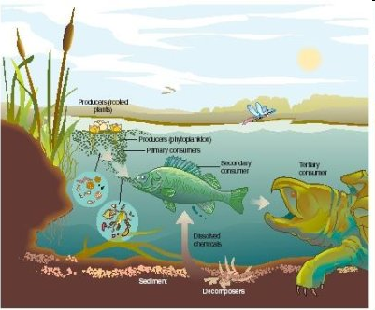
Biotic factors of biomes
Defined as the organisms that make up an ecosystem
  They compete for resources such as food, light
  They interact in many ways: predator prey relationships as well as other community relationships with organisms in the biome

Slide 6
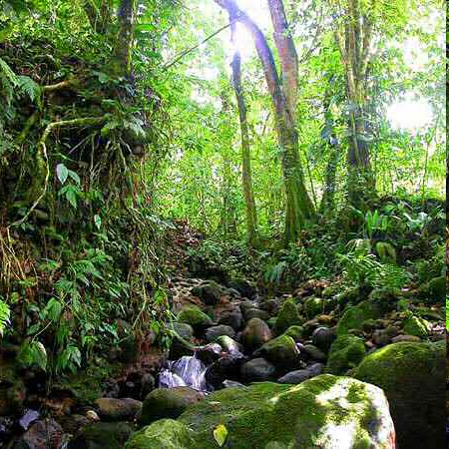
The Rainforest as an example of the biosphere
Discovery channel video
“Rain Forests”
Notes:
Video describes a Peruvian rainforest- an area supporting over 1,000 bird species and over 300 trees. The resources and climate are ideal for life in that there is plenty of rain, it is warm and sunny. The environment is a canopy because trees grow so tall that most of the food is up in the trees and the animals adapt, particularly the monkeys. The food web can be studied by observation and for the purpose of preservation.

Slide 7
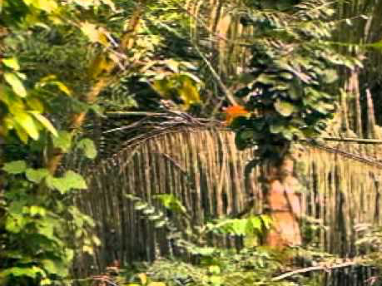
Discovery channel video: “Rain Forests”
_backup copy of the video_
Notes:
Video describes a Peruvian rainforest- an area supporting over 1,000 bird species and over 300 trees. The resources and climate are ideal for life in that there is plenty of rain, it is warm and sunny. The environment is a canopy because trees grow so tall that most of the food is up in the trees and the animals adapt, particularly the monkeys. The food web can be studied by observation and for the purpose of preservation.

Slide 8
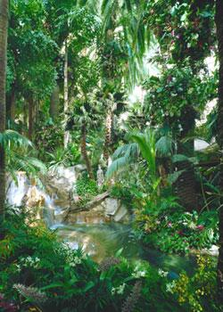
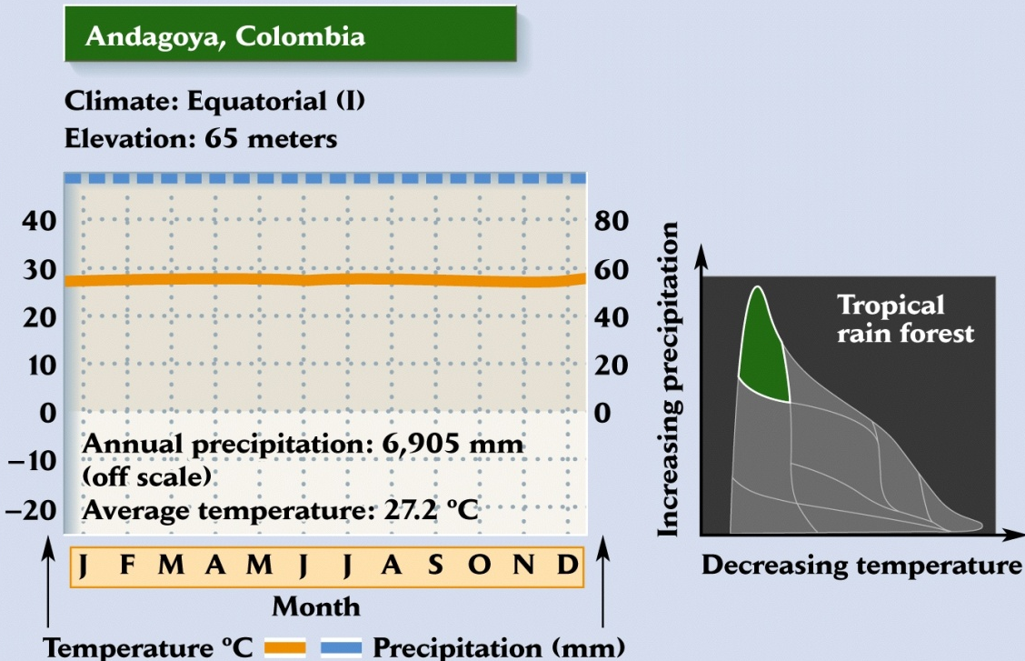
Rainforest biome- conditions affecting the biome
Climatic variation
Notes:
The rainforest biomes climate conditions are indicated in this slide. Both temperature and rainfall are fairly constant and high.

Slide 9
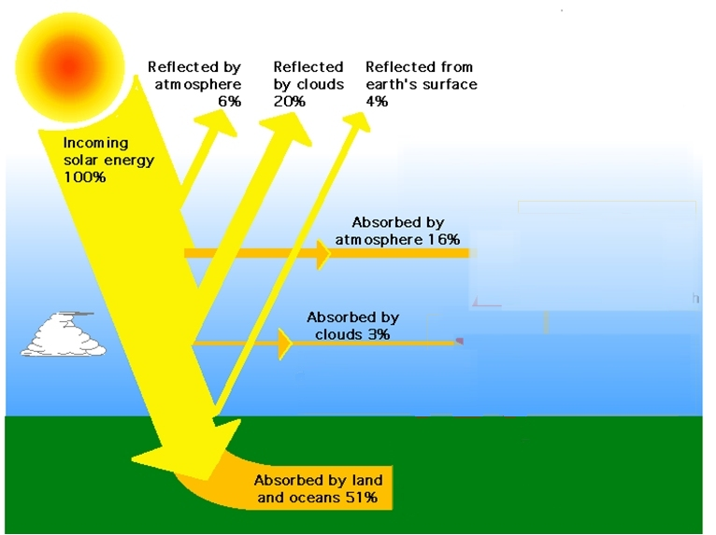
Earth’s Energy Budget from the sun
30%
~ 340 W/m²
19%
~ 170 W/m²
Notes:
Sunlight in most systems and particularly terrestrial systems is the major input of energy into our system which impacts all aspects of the living systems. In addition to the energy source, the sun impacts the temperature and the seasons. Obviously not all of the energy from the sun is captured. The energy is a byproduct of the fusion of H atoms to produce He atoms.

Slide 10
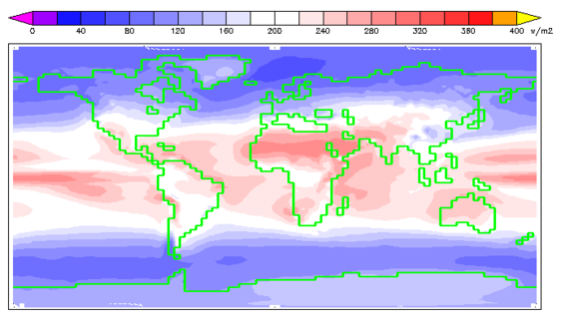
Average Annual Insolation at surface of Earth
Notes:
“Insolation is a measure of solar radiation energy received on a given surface area in a given time.” Winkipedia. It is measured in watts/square meter. Some will be absorbed and some reflected as shown in the previous slide. Where the sun directly hits the equatorial regions you can see that more radiant energy is reaching the surface. At greater latitudes the suns energy is spread over a more angled Earth surface which reduces the amount per surface area.

Slide 11
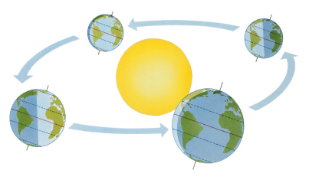
Seasons and climate
Video: Earth’s Orbit, the Seasons &
the Distribution of Solar Energy
Notes:
Seasonal climatic effects are due to the tilt of the Earth. If no tilt, no seasons and day and night time are equal. At summer solstice, north pole is oriented toward the sun and we have our longest day in the northern hemisphere. Note the amount of light hitting the equatorial region versus other regions for further understanding of insolation impacts. At autumnal equinox (fall) and vernal equinox (spring) neither pole is oriented toward the sun and day time equals night. The winter solstice is opposite of the summer solstice with the south pole getting greater light.

Slide 12
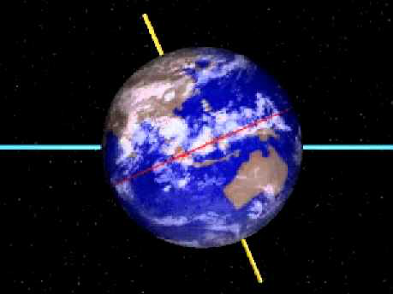
Video: Earth’s Orbit, the Seasons & the Distribution of Solar Energy
_backup copy of the video_
Notes:
Seasonal climatic effects are due to the tilt of the Earth. If no tilt, no seasons and day and night time are equal. At summer solstice, north pole is oriented toward the sun and we have our longest day in the northern hemisphere. Note the amount of light hitting the equatorial region versus other regions for further understanding of insolation impacts. At autumnal equinox (fall) and vernal equinox (spring) neither pole is oriented toward the sun and day time equals night. The winter solstice is opposite of the summer solstice with the south pole getting greater light.

Slide 13
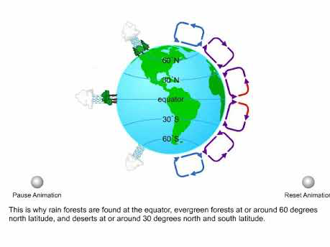
Atmospheric Circulation of Air (animation)
video file
animation source
Notes:
Diagram shows atmospheric circulation which affects winds, rainfall, temperature. These defining abiotic factors provide a general expectation for the latitudinal display of biome climates.

Slide 14
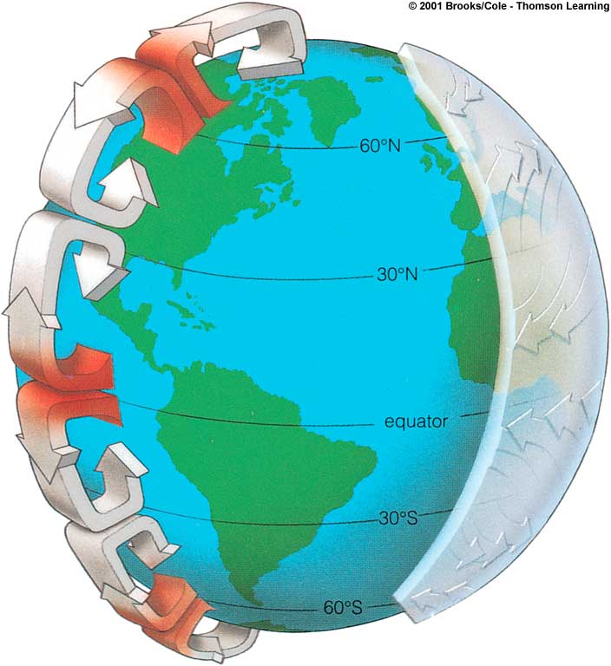
Atmospheric Circulation of Air (animation link)
cooled, dry air descends
air warms, picks up
moisture, rises
cooled, drier air
descends
air warms, picks up
moisture, rises
Click to view animation
original animation source
Notes:
Diagram shows atmospheric circulation which affects winds, rainfall, temperature. These defining abiotic factors provide a general expectation for the latitudinal display of biome climates.

Slide 15
What causes major wind patterns?
Cooled air descends at 30⁰ N & S
Disperses N & S along surface
To preserve angular momentum:
  Air flowing south must slow down relative to Earth’s surface
  Causes air to get behind Earth’s rotation & veer left
  Air flowing north must speed up relative to Earth’s surface
  Causes air to get ahead of Earth’s rotation & veer to right
easterlies
westerlies
northeast
tradewinds
© 2001 Brooks/Cole Thomson Learning
UDL 49.4b
Notes:
15
This slide builds on the previous slides on atmospheric circulation. It explains the major patterns of wind on the Earth’s surface. For example, the diameter of Earth’s surface at the equator is greater than at other latitudes. This rapidly moving surface deflects vertically circulating air and trade winds blow east to west. As air moves north or south it must maintain its angular momentum. If an air mass is moving towards an area of the Earth that is spinning faster than the air mass itself is moving, the air must slow down relative to the surface. If the air mass is moving towards an area that is spinning slower than the air mass itself, the air must speed up relative to the surface. This conservation of angular momentum causes air moving south in the northern hemisphere to veer to the left and air moving north to veer to the right.

Slide 16
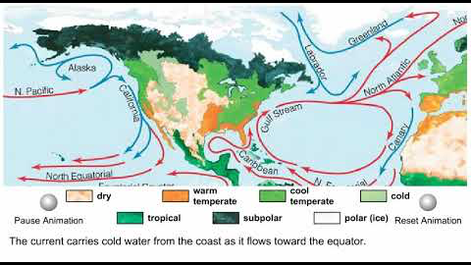
Ocean currents and climate (animation)
video file
original animation source
Notes:
16
Diagram of ocean currents with link to the circulation animation. Water is in constant motion in currents that influence regional climate. Wind is responsible for surface currents. Water circulates counter clockwise in southern hemisphere and clockwise in northern hemisphere. Coastal climates are affected by water movement. If cold water is flowing near the coast, winds approaching coast give off heat to the cold water and winds cool down. Warm waters can give up heat to the prevailing winds.

Slide 17
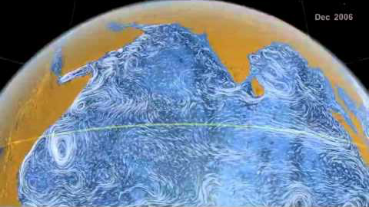
Visualizing Earth's Ocean Currents Video
local copy

Slide 18
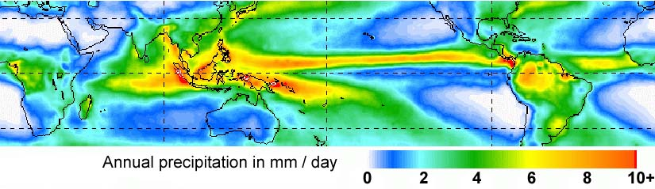
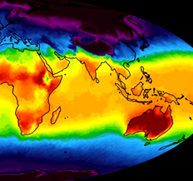
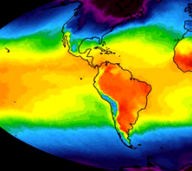

Global Precipitation & Temperature
Mean Annual ppt ’98 – ’03
Temperature
January ‘03
Notes:
Composite maps of global precipitation and temperature data. If these factors are the same in different areas of the Earth, the same type of biome may occur. The species that live here may not be identical but they are adapted to the same conditions.

Slide 19
Biomes are _____?
“Largest definable regional ecosystems characterized by distinct types of vegetation, animals, and microbes that have developed under specific soil and climatic conditions.”

Slide 20
Biomes of the World
mediterranean
taiga
mid-latitude forest
tundra

Slide 21
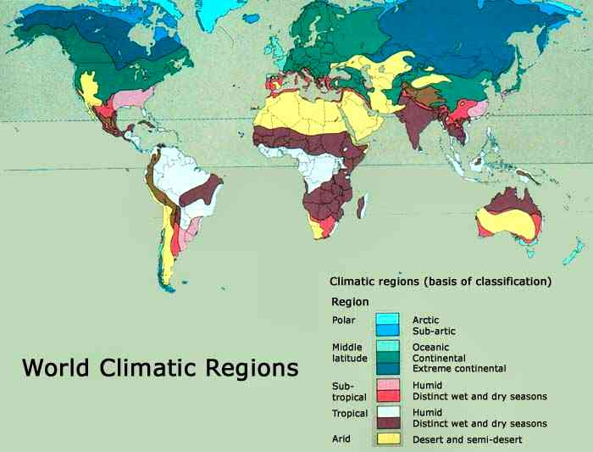
Climate & Biomes
World Biome Regions
Geographic distributions of biomes correspond closely to major climate zones.
Notes:
This general comparison might suggest that changing climates in well established biomes will have a major impact on the organisms currently living in that biome.

Slide 22
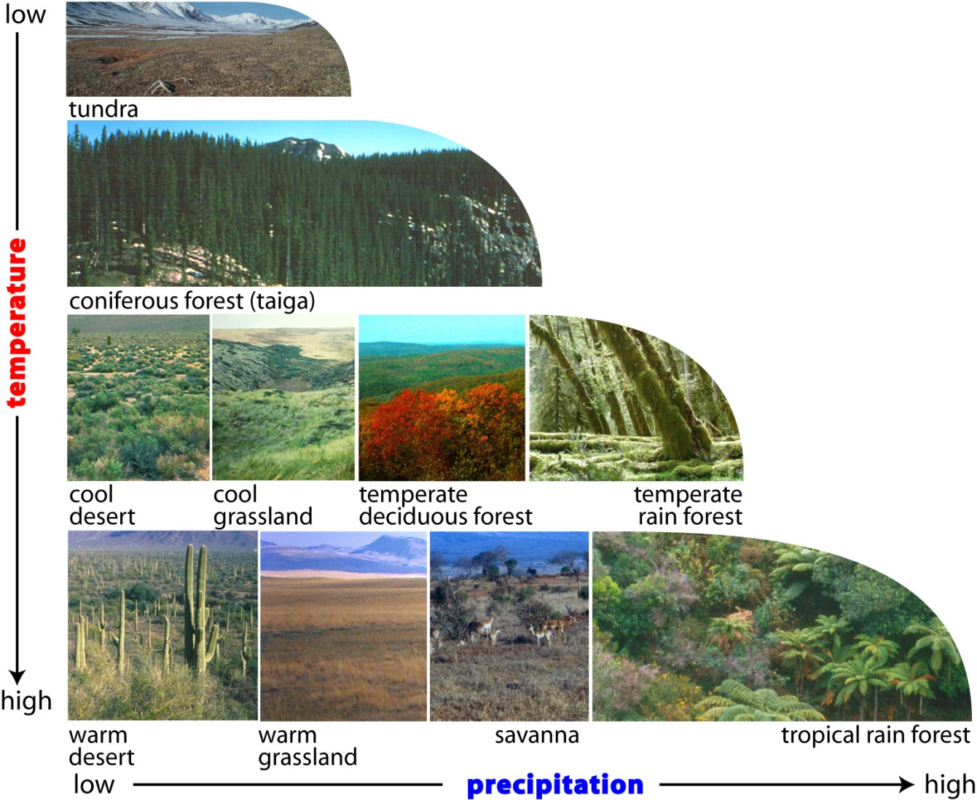
Temperature and precipitation impacts on biomes
Notes:
22
This slide illustrates how temperature and precipitation can have major impacts on the biomes.

Slide 23
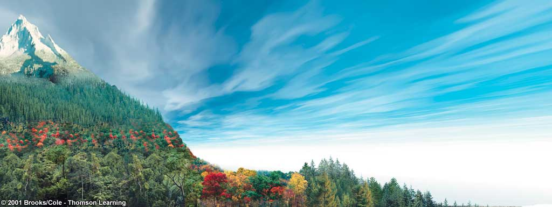
Biome: latitudinal and elevational gradients
High
Changes in plant form along environmental gradients
Alpine Tundra
Montane Coniferous Forest
Elevation
Deciduous Forest
Tropical Forest
Low
Tropical Forest
Temperate Deciduous
Forest
Northern Coniferous Forest
Arctic Tundra
Low
Latitude
High
UDL fig 49.10
Notes:
23
Diagram illustrating latitudinal and elevational gradients of biome type. Poles to equator: tundra to rainforest. While we have not previously discussed elevational impacts the temperature is impacted from low to high which produces an additional effect. For the current discussion, focus on sea level.

Slide 24
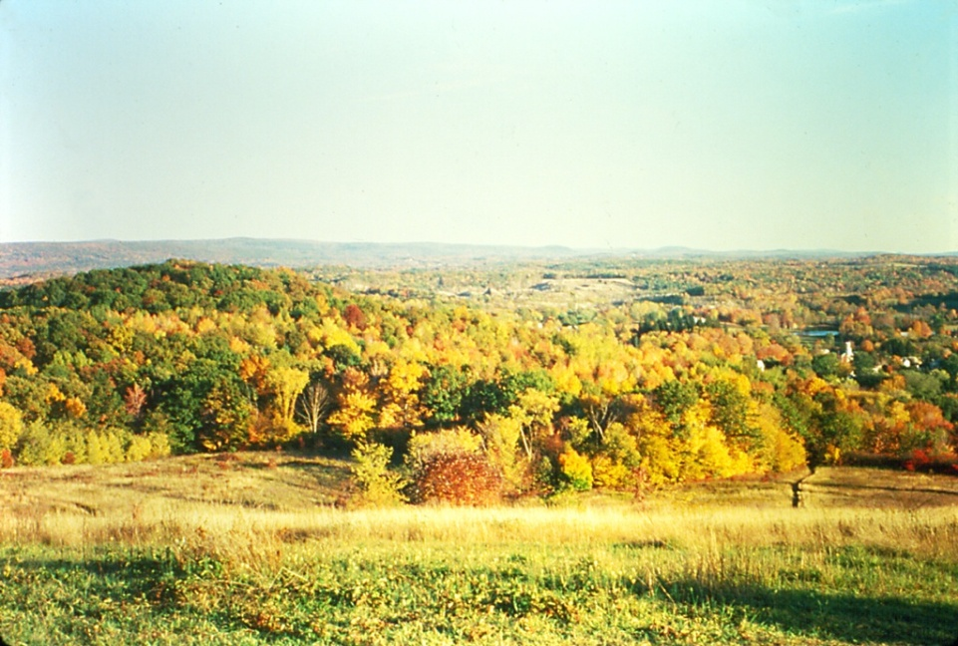
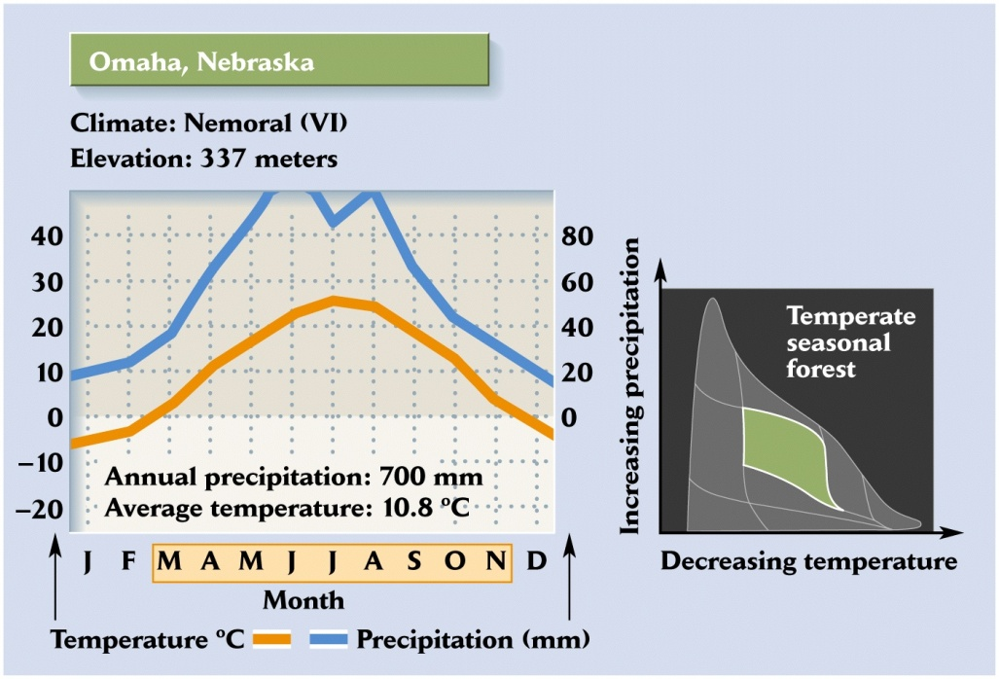
Mid-Latitude Forest (Temperate Deciduous Forest)
Biome?
Notes:
Variable precipitation with most in spring to fall and 30C range in T over the year.

Slide 25
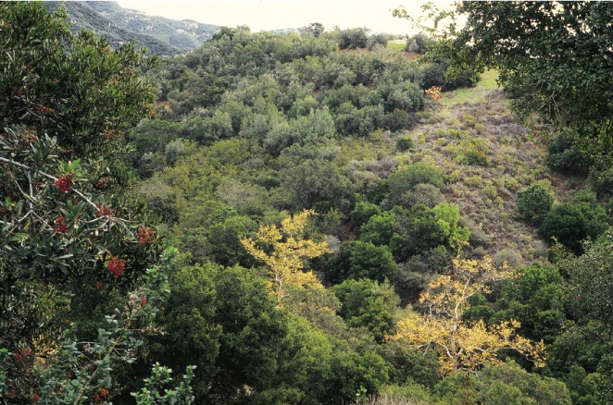
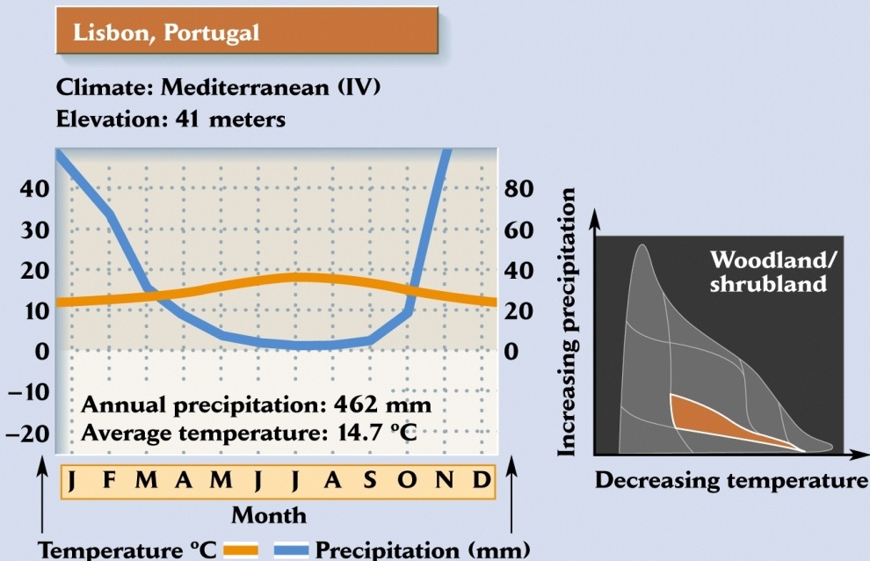
Mediterranean (Chaparral)
Biome?
Notes:
Most rainfall in winter and moderate temperatures.

Slide 26
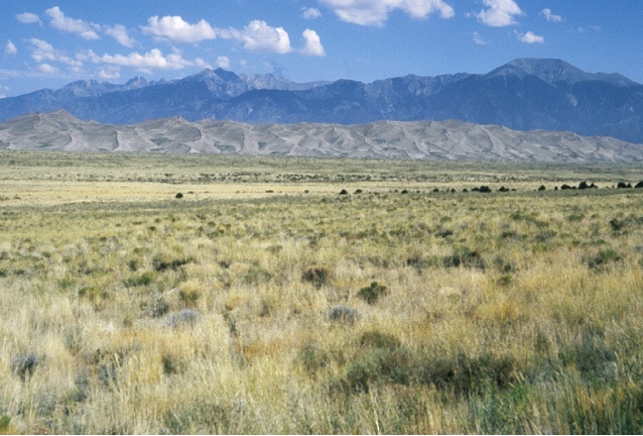
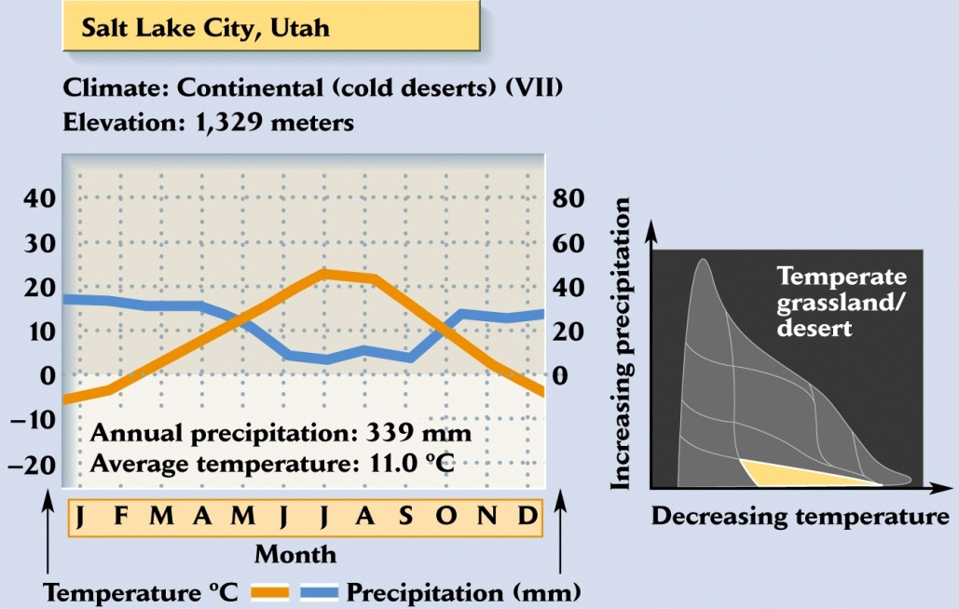
Grassland
Biome?
Notes:
Cold winters, hot summers with low precipitation but less in summer.

Slide 27
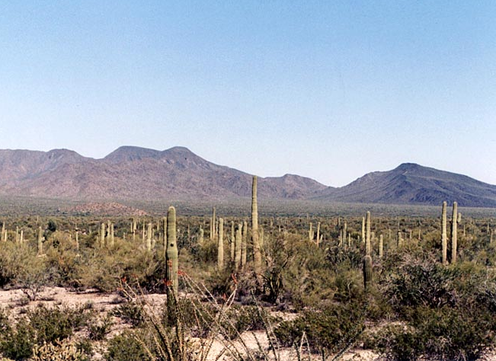
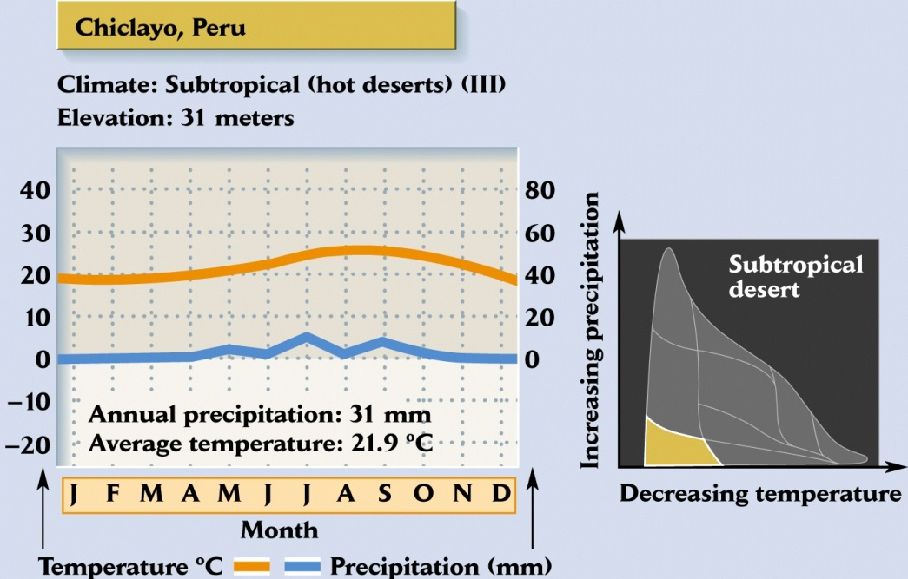
Warm Desert: Sonoran Desert
Biome?
Notes:
Hot always and little precipitation.

Slide 28
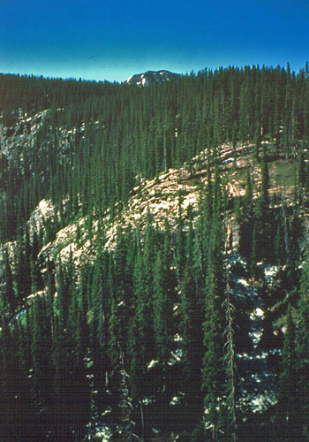
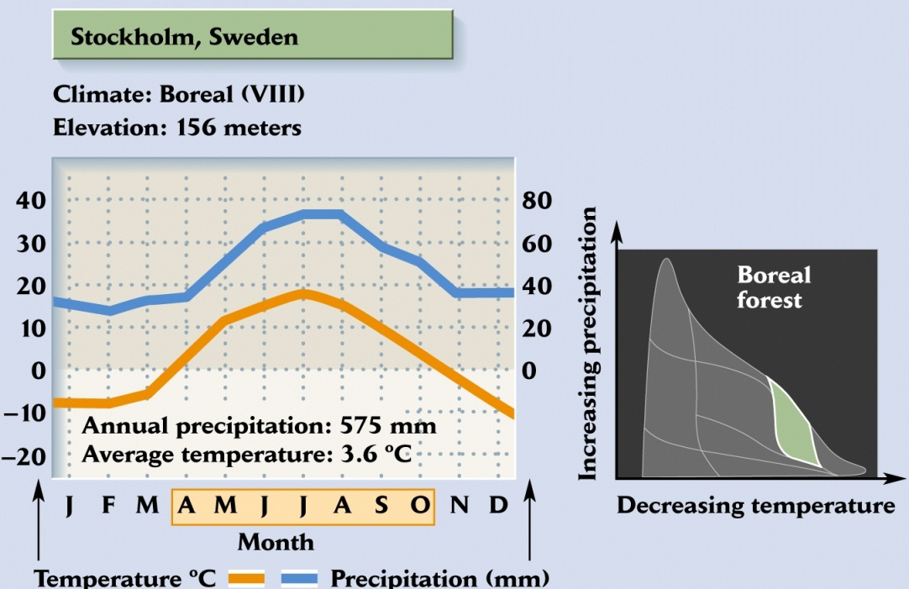
Taiga (Boreal Forest)
Biome?
Notes:
Long cold winters and short wet summers. Very large biome.

Slide 29

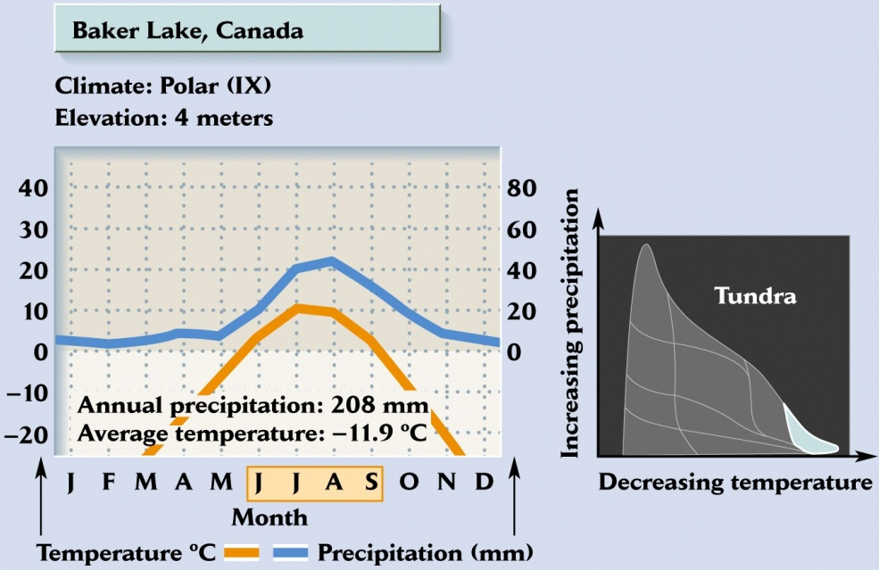
Tundra
Biome?
Notes:
Bitter winters with little light and constant light in summer with higher precipitation.

Slide 30
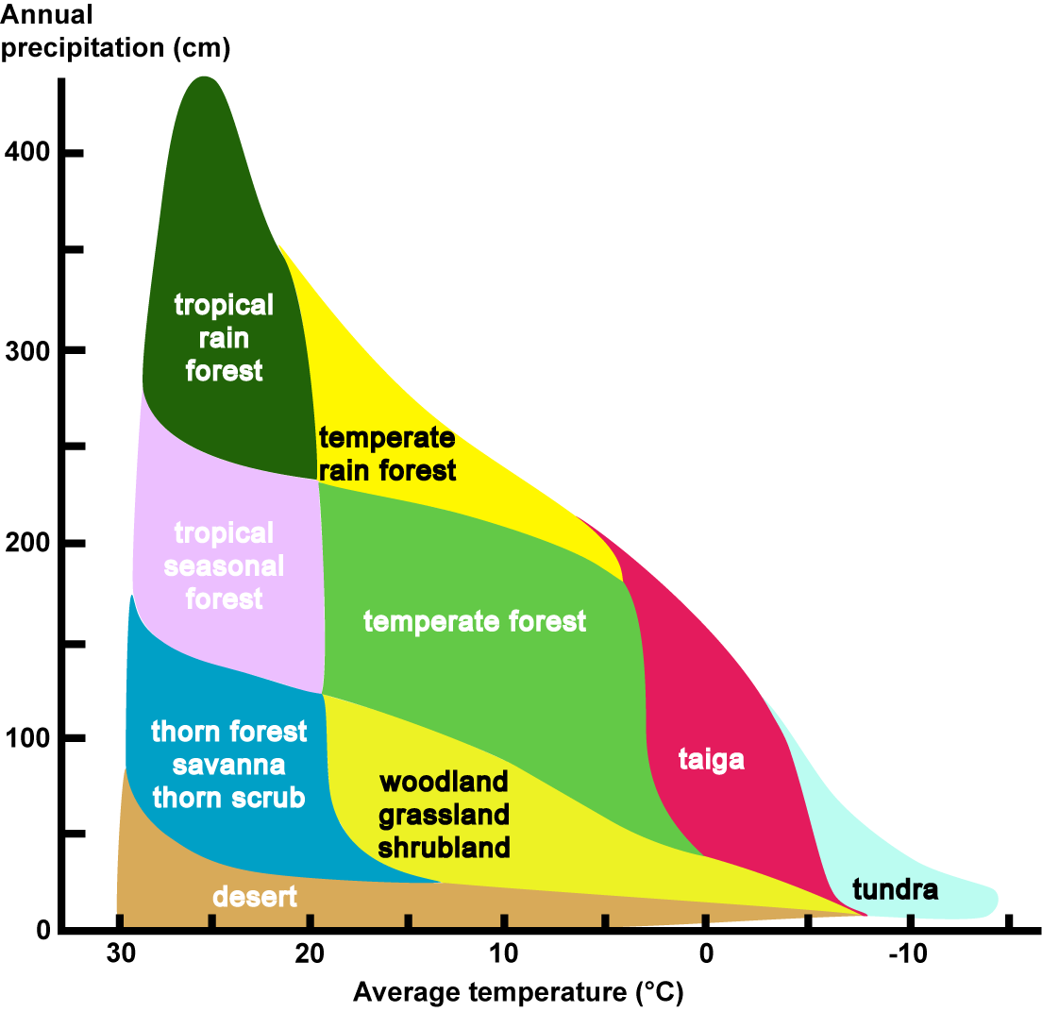
Whittaker’s classification of biomes
Notes:
Robert Whittaker was a plant ecologist, proposed the five kingdom taxonomy and a biome type classification based upon temperature and precipitation. This is useful for a quick check even though other factors can have additional impacts on climate (proximity to mountains, etc.).

Slide 31
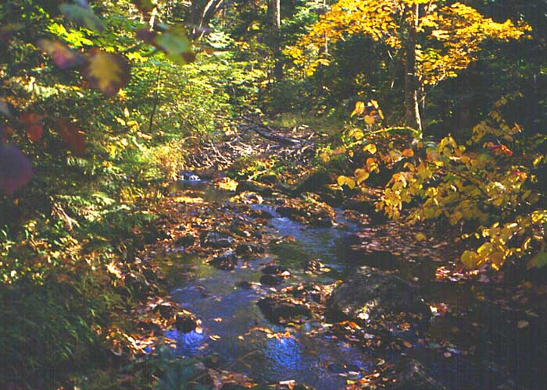
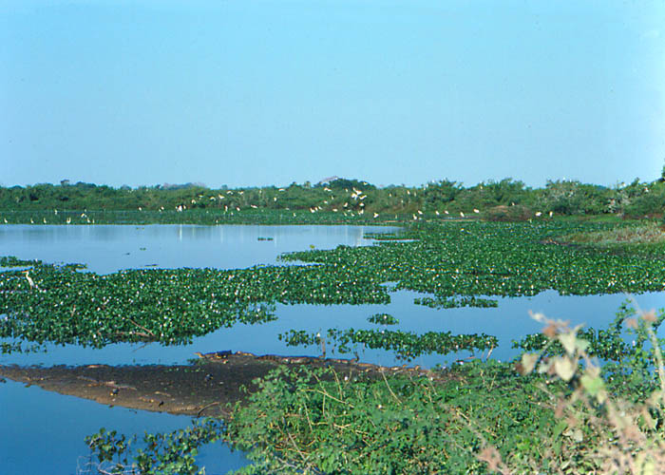
Freshwater aquatic ecosystems: Streams and wetlands
Notes:
31
Image of stream and wetland ecosystems where aquatic meets terrestrial (stream in Adirondack Mts, NY and swamp in Brazil).

Slide 32

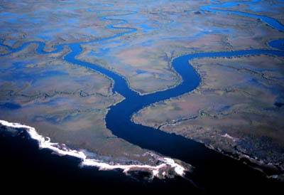
Intertidal or estuary where marine meets land or freshwater
intertidal
estuary
Notes:
32
Intertidal is from Monterey County coast in CA. East coast estuary where salinity varies but nutrients from rivers are high. Very productive region in biological terms and destruction of these biomes in aquatic systems has major impacts on the ecosystem and surrounding biomes.

Slide 33
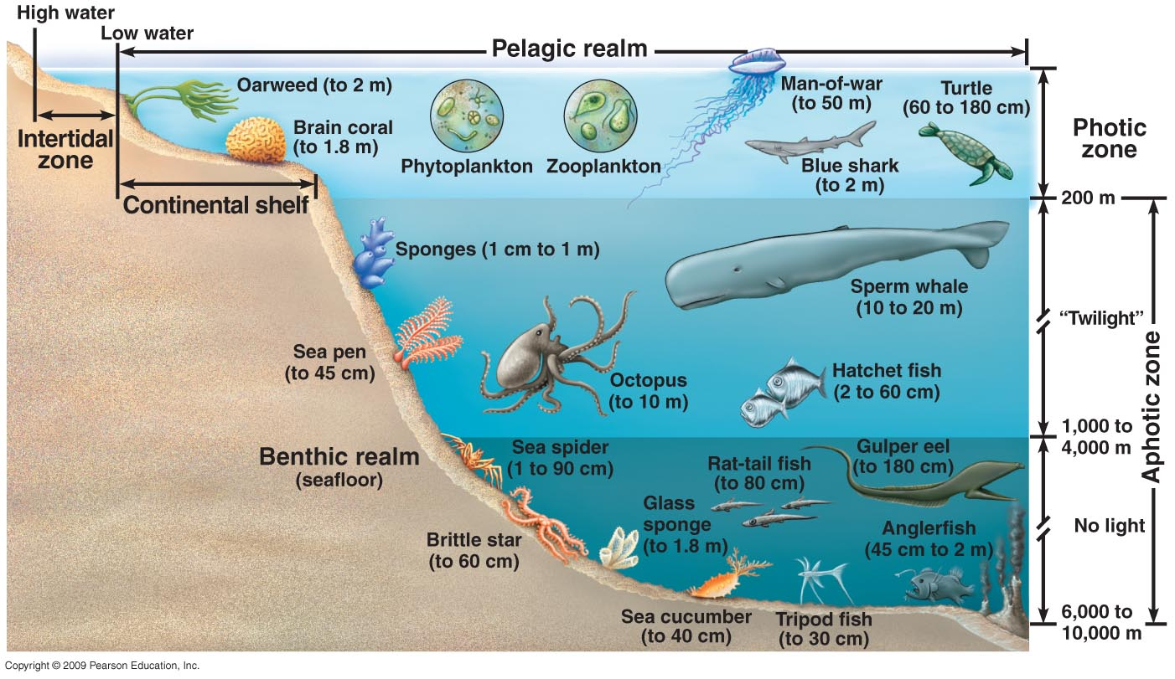
Oceanic Ecosystem
Notes:
33
Ocean is not a uniform ecosystem. Sunlight and substrates have a marked influence on what seems to be one vast ecosystem. Habitats near shore are very ddifferent from those further away as those close to shore receive sunlight (photic zone) and those that have deeper waters show dcreasing light to the point where below 1000m there is no light. The photic zone is where the light penetrates and includes the Intertidal zone, continental shelf and part of the benthic realm (light decrease with increasing depth from twilight to no light which is referred to as the aphotic zone. As the depth of the water increases and the amount of light decrease the biota change significantly.

Slide 34

Deep Sea Hydrothermal Vents as an example of the biosphere
_backup copy of the video_
Notes:
Deep sea hydrothermal vents where life was unexpected have provided a new biome. VIDEO (5.5’). Recently discovered in association with hydrothermal vents. No light reaches these depths and the chemicals spewing out of the vents would normally be considered toxic as would the temperatures.

Slide 35
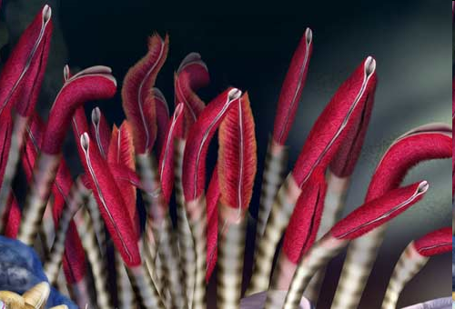
Hydrothermal vent biome- conditions affecting the biome
Sunlight is not a factor
Chemoautotrophic mechanism using sulfur compounds as an energy source to convert CO₂ into organic food molecules for nutrition of hosts
Bacteria provide the nutrients for the other members of the community
What does one consider climate in this biome?
Notes:
First hydrothermal vents discovered off Galapagos on a rift formation by an expedition looking for hydrothermal activity on the ocean floor. Found sharp temperature spike and had cameras to take pictures. What they discovered shocked them. There were smoking vents that were several stories high spewing toxic chemicals into the water but there were communities living around these vents where temperature could reach 760⁰F. Examined clams and found smelly (H₂S) and red mass of tissue. This was due to bacteria that had taken over the clam and had figured out how to get energy from the Earth through chemosythesis. These bacteria may be the most abundant biomass on the planet and they make the biome function by providing energy from chemicals, such as sulfur, and fixing CO₂

Slide 36
Biome gradients and latitude
High
Changes in plant form along environmental gradients
Alpine Tundra
Montane Coniferous Forest
Elevation
Deciduous Forest
Tropical Forest
Low
Tropical Forest
Temperate Deciduous
Forest
Northern Coniferous Forest
Arctic Tundra
Low
Latitude
High
UDL fig 49.10
Notes:
36
Diagram illustrating latitudinal and elevational gradients of biome type. Slide was shown previously but used as lead in to impact of latitude on biodiversity.

Slide 37
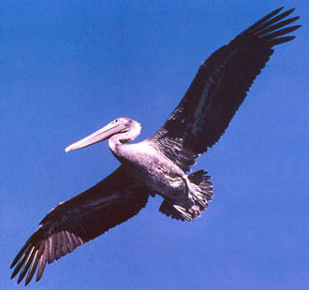
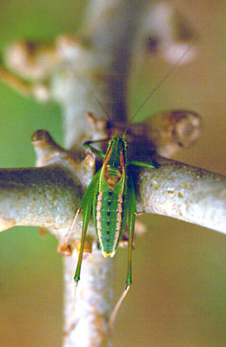
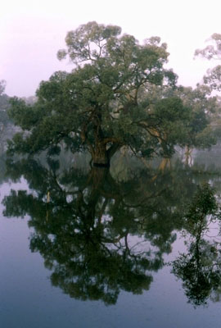
Biodiversity is impacted by latitude
pelican
grasshopper
deciduous tree
Notes:
Images of bird, insect, and deciduous tree (not conifer) to illustrate the many taxonomic groups that will exhibit a substantial increase in species richness (number of species present per unit area) going from high to low latitudes (north/south poles to equator).

Slide 38
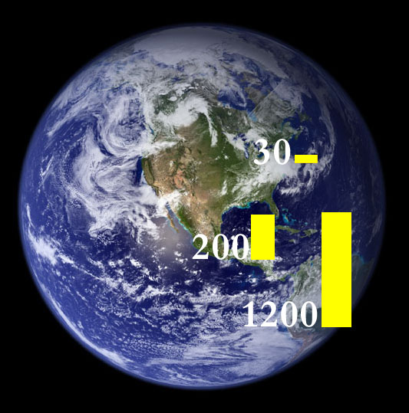
# of bird species and latitude
Notes:
Illustration of latitudinal gradient of bird species on an image of Earth from space. The center of the image is North America. We find about 30 species in upstate New York, 200 species in Central America, 1200 species in Colombia, SA.

Slide 39
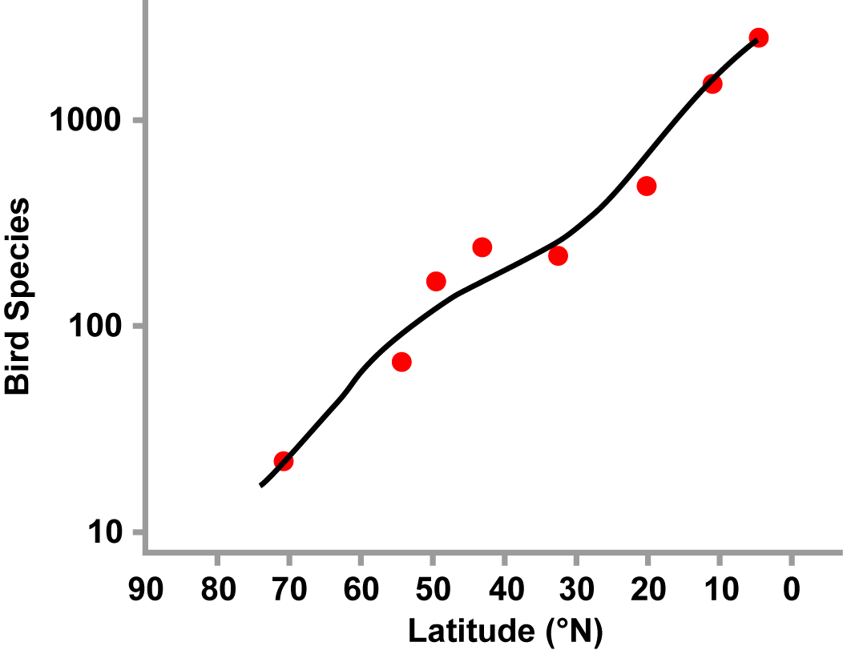
Graphic Illustration of Latitudinal Diversity of Bird Species

Slide 40
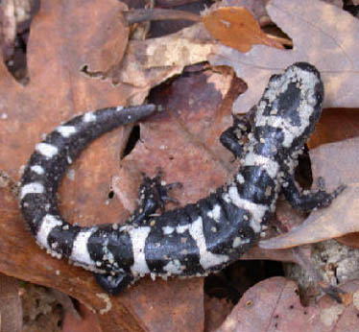
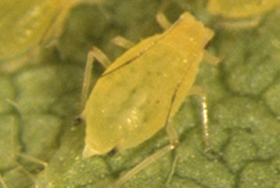
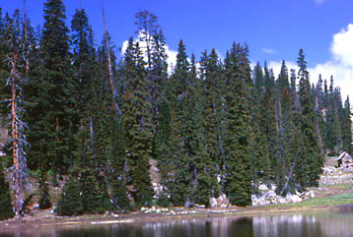
Not all taxa follow latitudinal diversity gradient
aphid
salamander
conifers
Notes:
Images of salamander, aphid, and conifer trees to illustrate that a few taxonomic groups do not exhibit maximum species richness in the tropics. Emergent properties in biology such as patterns of species richness, however, have exceptions. This complexity is an important characteristic of biological systems and makes unequivocal prediction difficult. Salamanders are present in intermediate elevations in greatest amount. Conifers are pretty much in boreal forests, and aphids associate with the biome of the plant species which they feed on- parasitic.

