Slide 1
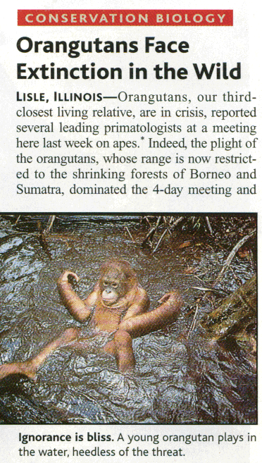
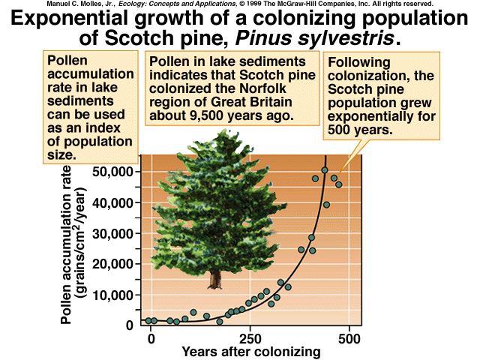
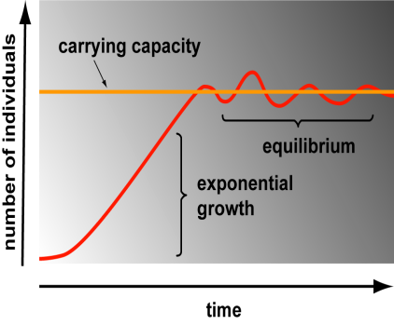
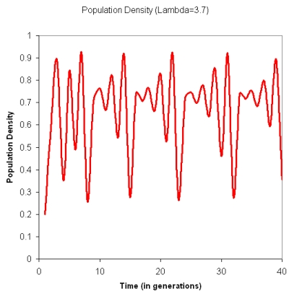
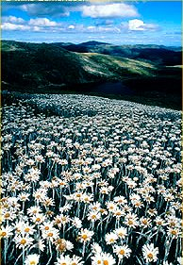
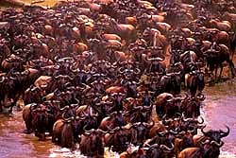
Populations: Growth & Extinction
Notes:
In the previous session we looked at the physical environment and characteristics of the multiple types of biomes that impact the biodiversity of the Earth. In this session we look at additional features involving the population of a species and how different populations grow and the characteristics of that growth. The pictures show exponential growth, extinction, carrying capacity, a population of daises, a herd of wildebeests, and chaotic growth patterns.

Slide 2
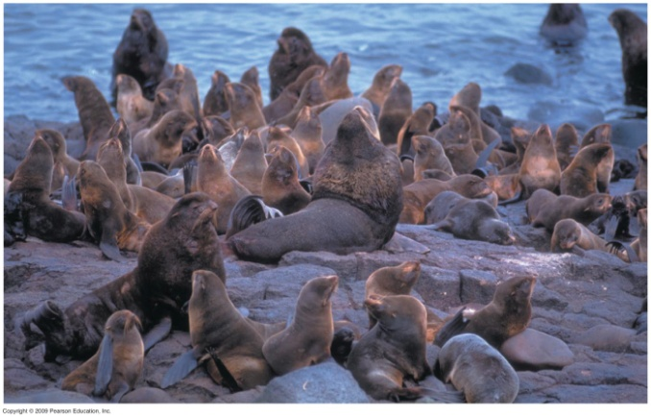
Population Ecology
What is a population?
“A group of individuals of the same species living together in the same place at the same time.”
Notes:
2
Fur seals and daisies are the pictures. Population ecology is the study of populations in relation to their environment. How do biotic and abiotic factors influence the size of populations, their stability and their growth?

Slide 3
Major Questions in Population Ecology
What factors determine the distribution & abundance of individuals in a population?
Why are some populations stable while others exhibit regular oscillations or chaotic fluctuations?
Why are some populations extinction prone while others survive much longer?
Notes:
3
Shown is a gray-sided vole which is a classic example of a species with chaotic growth patterns. Some evidence that predation has an impact.

Slide 4
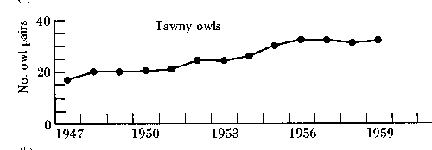

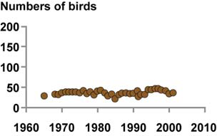
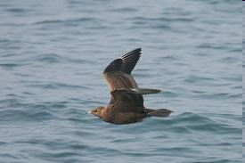
Population Density
Some populations have stable abundances
Northern Skua
Notes:
Why is tawny owl population stabile? Some evidence that their territorial behavior tends to keep the size of the population relatively constant while climate may have an impact. There is a density-dependent impact. For the skua there is again evidence that the territory size is relevant in maintaining the stability of the population.

Slide 5

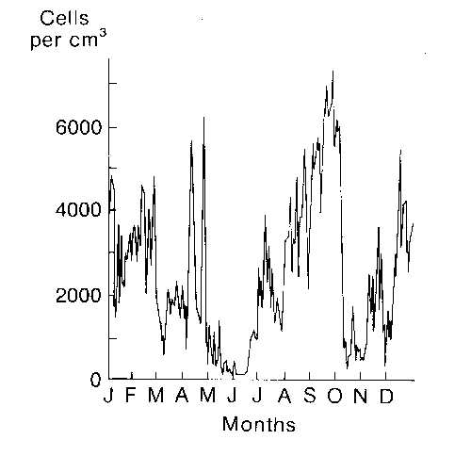
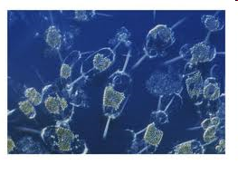
Population Instability
Flour beetle
Other populations are variable, undergoing major fluctuations in abundance from year to year or in briefer intervals.
Phytoplankton
Notes:
The flour beetle has an interesting association with a bacterium that causes carriers to be infertile in mating with non-carriers which may be expected to decrease fertility if overcrowded. Additionally, nutrient limitation may have an impact on population size. Phytoplankton are highly sensitive to the environment from temperature, to sunlight, to nutrients, to dissolved oxygen in the water.

Slide 6
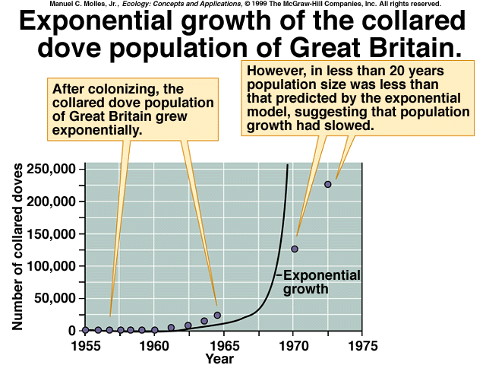
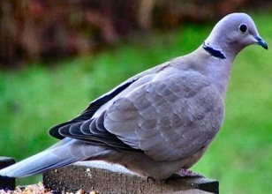
Population Growth
Some populations show exponential growth but this is not sustainable under normal conditions
Notes:
These two examples show the standard J-shaped curve for exponential growth to be described in the upcoming slides. Exponential growth assumes ideal conditions.

Slide 7
What factors affect population size?
Biotic factors
Food
Habitat
Interactions:
  Predation
  Competition
  Parasitism
  Disease
Abiotic factors
Light
Nutrients
Water
Temperature
Space
pH
Notes:
7
Review of environmental resistance factors: biotic and abiotic.

Slide 8
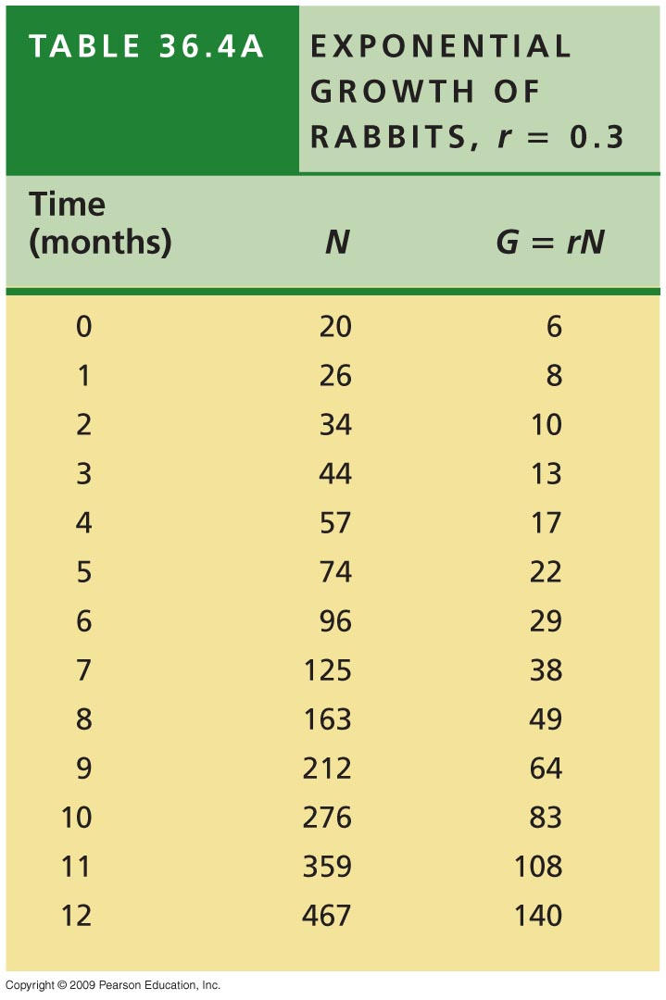
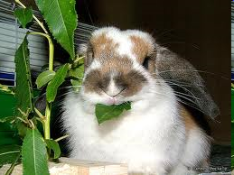
Exponential Growth in a rabbit population: per capita rate of increase
In this example r (per capita rate of increase) is 0.3. This value for r is due to # of births minus the # of deaths. For these rabbits with r = 0.3, there were 50 births and 20 deaths in one month with an initial population of 100 or r = 30/100 = 0.3.

Slide 9
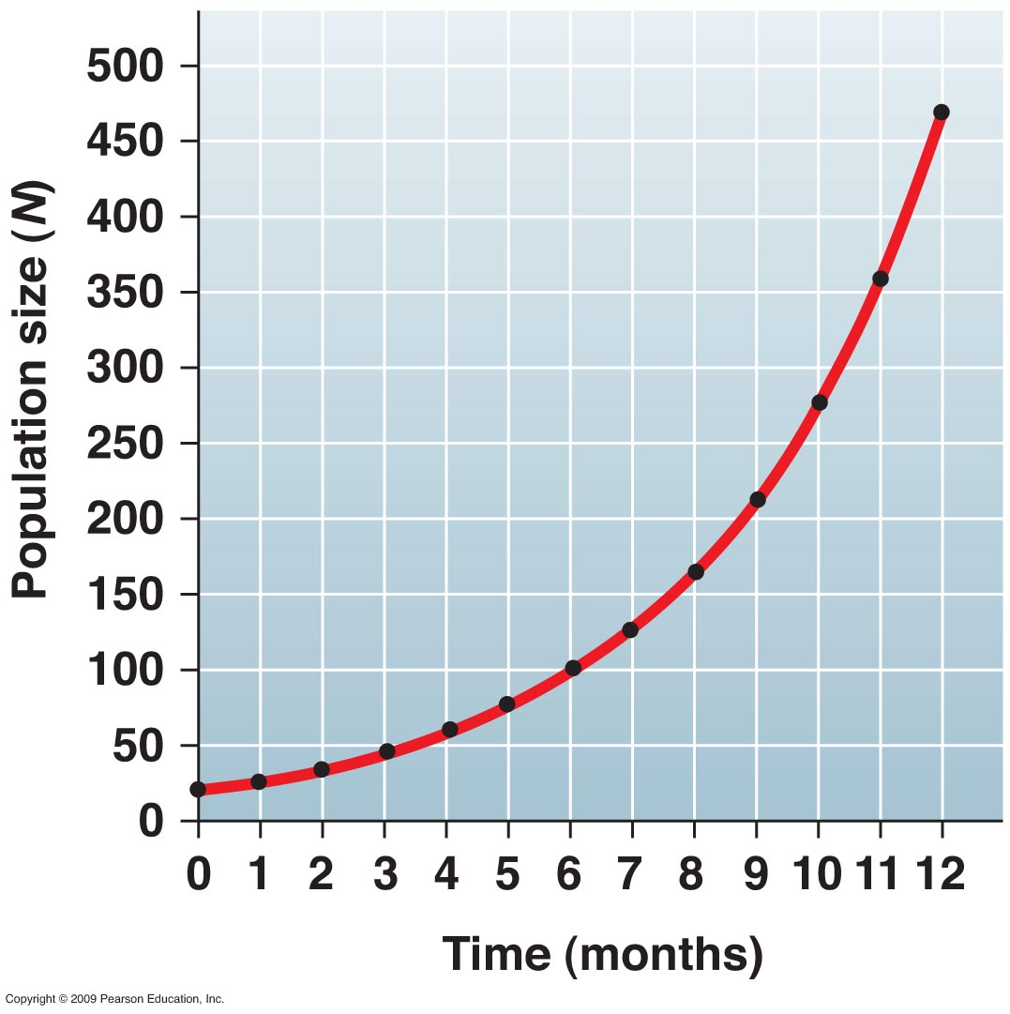
Exponential Growth Model assumes ideal growth conditions and r is at the maximum capacity of the members to reproduce
Equation to calculate the rate of population increase is:
G = rN
G is the growth rate of the population (# of new individuals added per time interval)
N is the population size at a particular time
r is the per capita rate of increase
Notes:
With ideal conditions, r remains constant and the rate of growth is dependent on the number of individuals present already in the population. As these numbers increase we get this classical J-shaped curve.

Slide 10
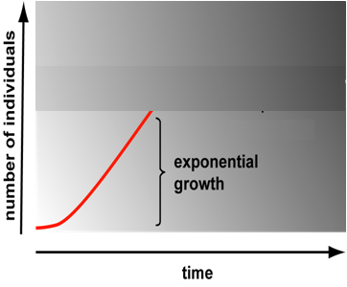
Exponential Growth
Growth under conditions of unlimited resources
All populations capable of exponential growth
Rate of change in numbers:
dN/dt = r_{max}N
or N_{t} = N₀ e^{rt}
Doubling time = time until N_{t}/N₀ = 2
  N_{t}/N₀ = e^{rt} = 2
ln(N_{t}/N₀) = ln(e^{rt} ) = ln(2)
rt = .7
t ~ .7/r
If r = 10%/yr then doubling time = ?
t = .7/.10 = 7 yrs
Notes:
10
The growth rate can be expressed mathematically as dN/dt or change in number over an interval of time. This provides a more traditional mathematical representation of G. The doubling time is the amount of time it takes for the population size to double. Playing with the math indicates that the doubling time is equal to ~0.7/r or 0.7 divided by the per capita growth rate. Thus if the per capita growth rate is 10% the doubling time will be 0.7/0.1 or 7 years.

Slide 11
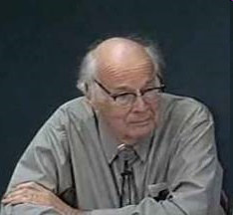
“The greatest shortcoming of the human race is our inability to understand the exponential function.”
Video
Professor Emeritus Al Bartlett of Colorado University at Boulder
Notes:
In this video Professor Emeritus Al Bartlett shows how simple arithmetic can help us in understanding population growth or growth of any kind and compare this growth to the results of the finite amount of natural resources present on the Earth. His most important mathematical point is that we should convert % growth rates into doubling times in order to more easily understand the implications of the topic being discussed- whether it is prison population growth or human population growth. He uses the example of bacterial growth in bottles to illustrate doubling and to ask at what point, or how many more doublings can we have, before we run out of resources. His bacterial example has a population that runs out in an hour and he asks at 5 minutes before we run out (6% of the bottle is used up) or the equivalent of 5 more doublings, would we recognize that we are in trouble? His discussion of resources, mostly confined to energy but applicable to other resources, is to remind us of the limit of our resources and his candid statement to not believe anything that you have not calculated is wiry and accurate. We are a growth loving culture and as we know from most other systems growth has limitations. Might these limitations cause economic changes as we proceed?

Slide 12
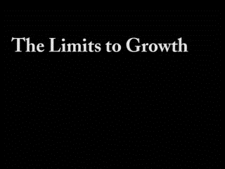
Video: Professor Emeritus Al Bartlett
backup copy of the video

Slide 13
Al’s Table of Options
Increase populations
Procreation
Motherhood
Large families
Immigration
Medicine
Public health
Sanitation
Peace
Law and order
Scientific agriculture
Accident prevention
Clean air
Ignorance of problem
Decrease populations
Contraception
Abortion
Small families
Stopping immigration
Disease
War
Murder/violence
Famine
Accidents
Pollution
Notes:
If one looks at the options in the left hand column, one finds things that we want and actively aim toward. All of these things will make the population grow. If one looks at the items in the right hand column, all are tings that we do not want or are controversial. They will decrease populations. However, at a constant rate of growth of the human population of 1.7% in 600 years the population as of 1986 of 5 billion people will grow such that each person will have a square meter of terrestrial space. If we do nothing, nature will choose for us. All of these relate to the carrying capacity for human growth and the finite level of resources on the Earth.

Slide 14
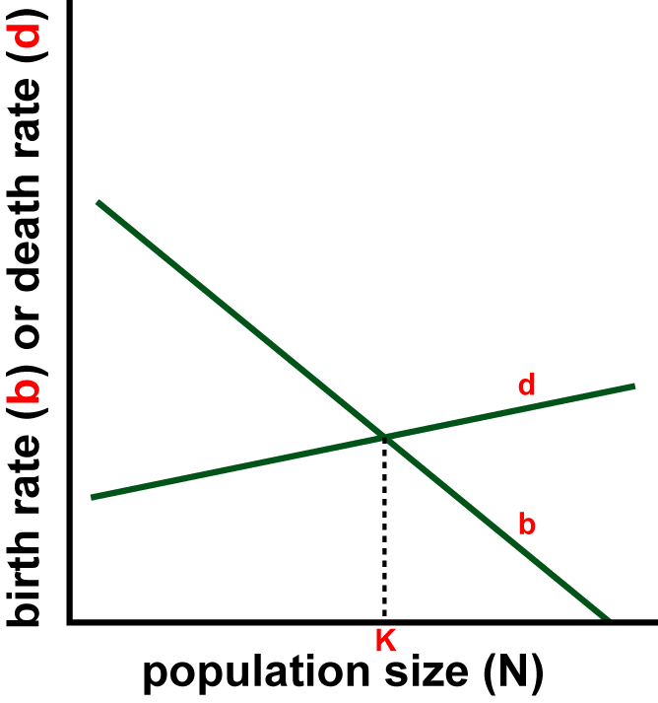
What sets population size?
Biotic potential
Environmental
resistance
Notes:
The biotic potential and environmental resistance establish birth and death rates that result in the population size at a particular time. The value K is the carrying capacity which is established when the birth rate equals the death rate. The carrying capacity is the environmental resistance factor.

Slide 15
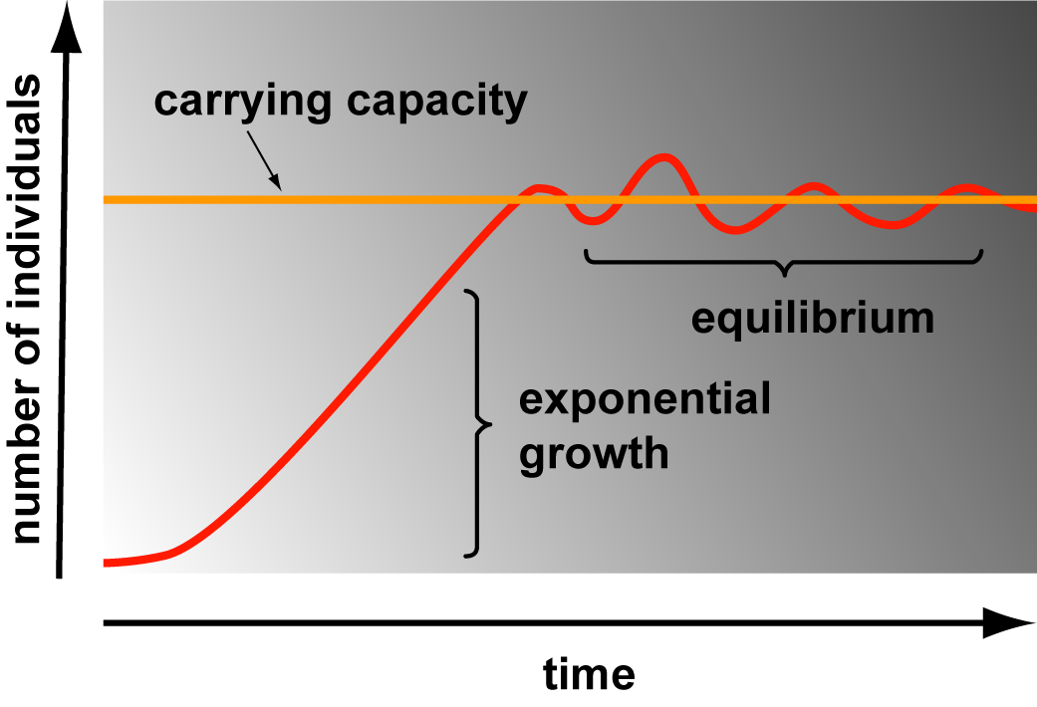
The Logistic Equation
Simplest model of limited growth
K = carrying capacity = maximum population that can be sustained in a given habitat at a given time.
Continuous growth form most common:
dN/dt = rN
What happens as N approaches K?
= K
*(1 – N/K)
Notes:
15
Exponential growth must be modified as the population reaches the carrying capacity. Equation shown as the variation on the simpler exponential dN/dt is the logistic variable which adds an expression that reduces the per capita rate of increase as N increases. The per capita rate, r, approaches zero as the population approaches the carrying capacity. If max population sustainable is K then K-N is the number of additional individuals that can be supported and (K-N)/K is the fraction of K available for population growth (from Campbell and Reece, Biology 8th Ed). When N=K the population stops growing. There will still be births and deaths but no net change.

Slide 16
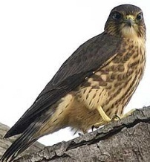
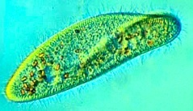
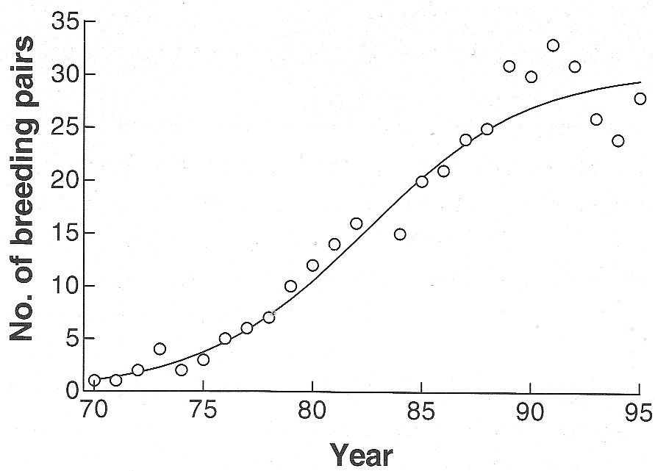
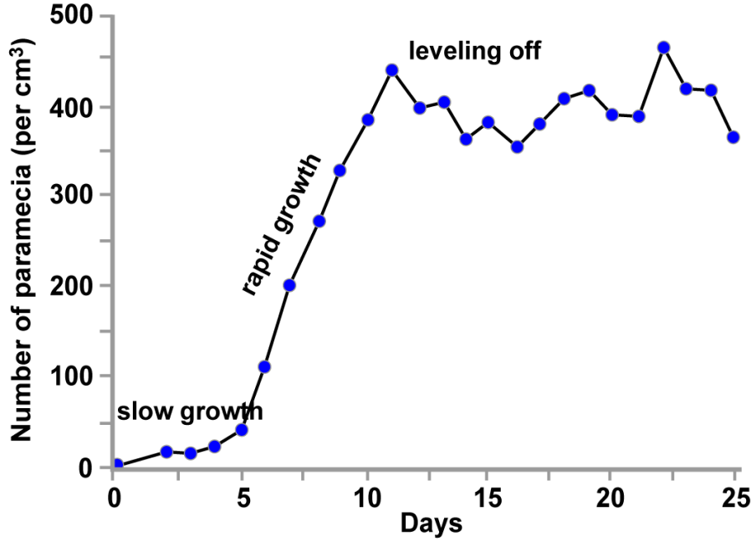
Logistic Growth Examples
Merlin
Paramecium
Notes:
16
Merlin is a bird (Falco columbarius) or pigeon hawk and its growth kinetics seem to over shoot the carrying capacity and then self-correct during the following time intervals (years). Paramecium reach a leveling off with similar fluctuations in number at the carrying capacity. The time frame here is days for self-correction.

Slide 17
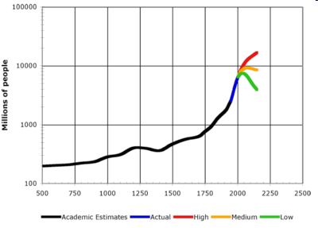
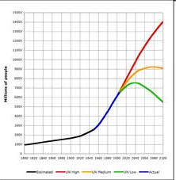
Growth of Human Population
A
B
http://www.answers.com/topic/demography
http://en.wikipedia.org/wiki/World_population
Notes:
Figure A shows the historical demographics of the human population. From 1900 to 1999 the population grew from 1.7 billion to 6 billion- average rate of 1.3% (54 year doubling) but was as high as 2.3% between 1965-1970 (30 year doubling). At earlier times growth rate doubled ~every 1,250 years. Europe increased first mostly due to improved sanitation and nutrition as death rates declined. In B is a prediction curve from Wikipedia based upon UN 2004 projections and US census historical data. Birth rates have reduced from 140 million from a high of 173 million in late 1990s. Death rates are at 57 million per year and predicted to increase to 90 million per year by 2050. Population is expected to be around 8-10.5 billion by then (yellow line for medium growth).

Slide 18
Fluctuating Environment- density dependent factors
d_{high}
d_{average}
b
Birth or Death Rate
d_{low}
K_{low}
K
K_{high}
Population Size
Notes:
In fluctuating environments or when there are density dependent impacts, the carrying capacity can seem to vary as shown in this graph where the death rate changes. What could cause the death rate to change? Increased predation because they are easier to catch when present in large numbers, ease of spreading disease, changes in behaviors in overcrowded populations (mice due to stress have delayed birth and become more aggressive).

Slide 19


Fluctuating Environment
Merlin
Paramecium
K_{high}
K_{high}
K_{low}
K_{low}
At K_{high} there is ____ feedback from environment that increases ____ & decreases ______.
At K_{low} there is ____ feedback from environment that increases ____ & decreases ______.
Notes:
19
Answers are: At K_{high} there is negative feedback from environment that increases the death rate and decreases the birth rate.
At K low there is positive feedback from the environment that increases the birth rate and decreases the death rate.

Slide 20
r & K Selection: The Logistic Model and Life Histories
Notes:
20
From an evolutionary perspective, organisms that can compete for limited resources and conserve their resources will be more successful at or near their carrying capacity. These are K-selected or density dependent species. Selection for traits that maximize reproductive rates when at low densities or uncrowded are r-selected species.

Slide 21
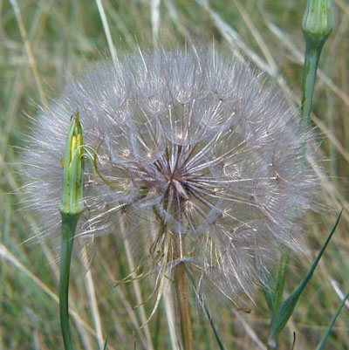
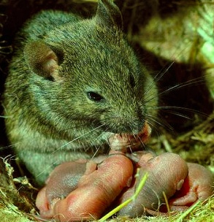
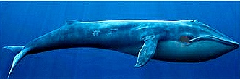
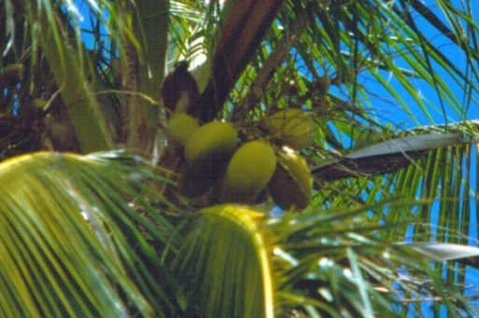
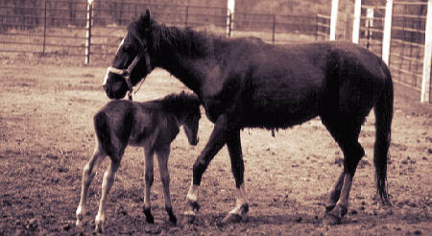
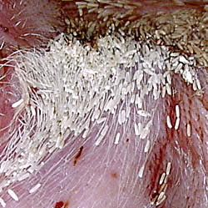
Many offspring - high r
r & K Selection: examples
Few offspring - low r
House mouse
Blue whales
Dandelions
Horses
House flies
Coconut trees
Notes:
21
The “many offspring” are r-selected an the “fewer offspring” are K-selected. These are extremes and there is much variation between these extremes.

Slide 22
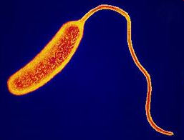

Per capita rate of increase varies with the organism
r_{bacterium} > r_{rabbit} > r_{elephant}
Notes:
Bacteria can reproduce up to three times per hour. Rabbits are sexually mature at 3-4 months and produce ~10 young/year with life span of 1 year in the wild. Elephants have as few as 4 offspring during a 60 year lifetime beginning about age 10-11 with gestation time of 22 months and average interval between births of 4-9 years.

Slide 23
Characteristics of Opportunistic (r) & Equilibrial Species (K)
Characteristic
Opportunistic Species (r)
Equlibrial Species (K)
Homeostatic capability
Limited
Often extensive
Maturation time
Short
Long
Lifespan
Short
Long
Mortality rate
High
Low
# of young/reproductive episode
Many
Few
# of reproductions per lifetime
~ one
Several
Age at 1st reproduction
Early
Late
Eggs or offspring size
Small
Large
Parental care
None
Extensive
Notes:
23
List of characteristics associated with opportunistic species that express an r reproductive strategy and equilibrial species that express a K reproductive strategy.

Slide 24
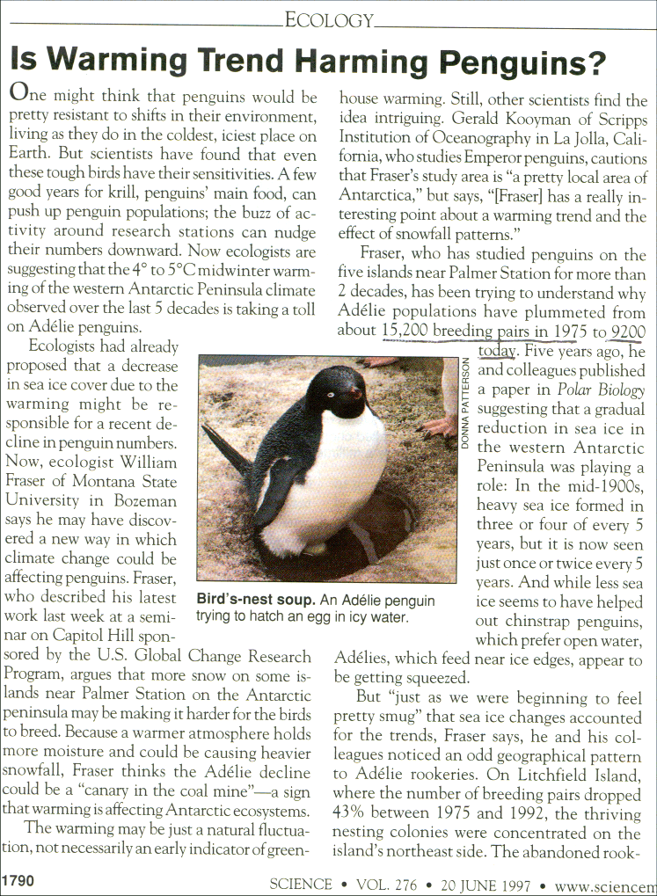
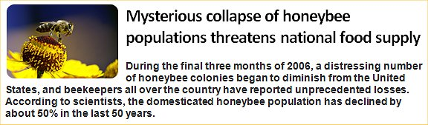
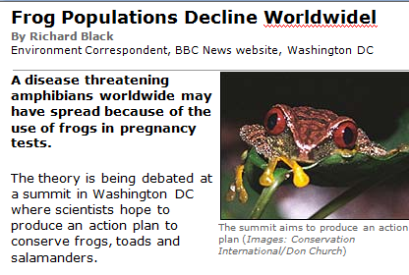
Population Declines
Notes:
Orangutan example: Reproduce slowly with births at about once every 6-7 years. In 100 years have lost 91% of their population. Habitat destruction is the major factor- fires both natural and set for agricultural purposes, logging, mining and human settlements. Also, pet trade with baby orangutans. Major habitat is in Indonesia- small pockets on Borneo and Sumatra.

Slide 25


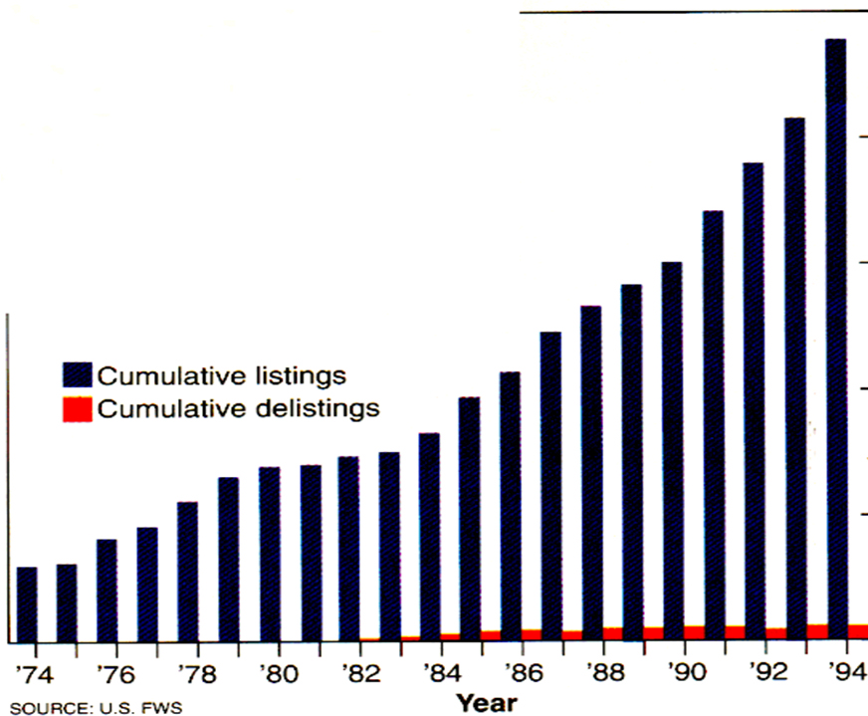
Endangered Species Act
Goal: “Restore species to where they are viable, self sustaining components of the ecosystem.”
1200
‘04
Notes:
Signed into law 1973. Directs Fish & Wildlife Service to create list of endangered or threatened species. Endangered - “A species that is in danger of extinction throughout all or a significant portion of its range.” Threatened - “A species likely to become endangered in the foreseeable future.”

Slide 26
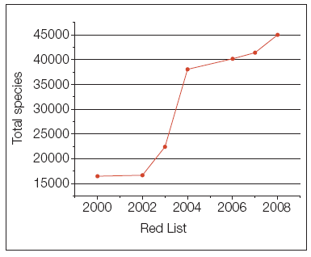

Global Estimates Endangered Species
From the International Union for the Conservation of Nature (IUCN) RED LIST of endangered species (http://www.iucn.org/)
2008 Red Species List
Over past year many mammal species have been added to the Red List
Notes:
“Many species are declining to critical population levels, important habitats are being destroyed, fragmented, and degraded, and ecosystems are being destabilized through climate change, pollution, invasive species, and direct human impacts.” from http://iucn.org/about/work/programmes/species/red_list/about_the_red_list/. Organization has a Species Survival Commission to assess global scale conservation of species. This is the most comprehensive inventory of plant and animal species.

Slide 27
Endangered Species Listings
Global Estimates Threatened Species
% threatened has grown from 32 to 38%
Notes:
Threatened are species likely to become endangered within the foreseeable future whereas endangered are those species in danger of extinction in all or a significant range of their habitats.

