Slide 1
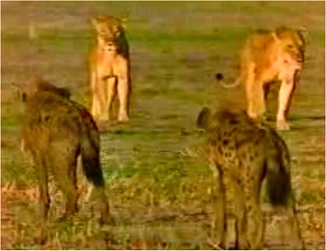
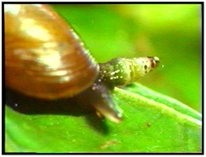
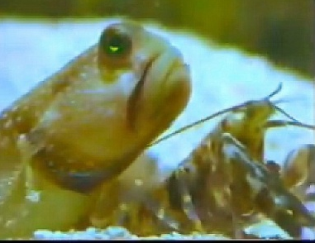
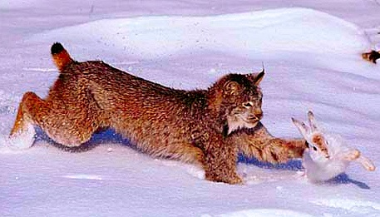
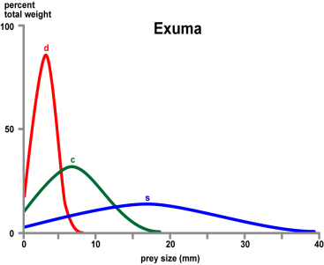
Species Interactions
Notes:
Species interactions help define communities and ecosystems. Competition can come in many different forms (lions and hyenas in upper right) or food partitioning in Anolis lizards (lower left). In upper right is an example of parasitism of snail species where the parasite is in the tentacle. Lower right is predation of a lynx on a snowshoe hare and lower middle shows a mutualistic interaction between a blind shrimp and a Gobi fish.

Slide 2
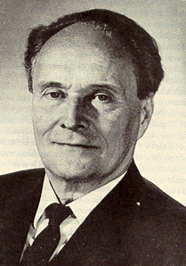
Gause’s Principle of Competitive Exclusion
“In light of the evidence, we claim that if two or more species live in stable association, they must possess different ecological niches.”
G.F. Gause, 1939
Notes:
Best examples of this exist in the laboratory and some in natural systems. BUT many natural situations can not be explained using this exclusion principle. For example, many species of plankton coexist in water systems sharing very limited group of resources- sunlight and minerals. However, Darwin’s finches follow the pattern well.

Slide 3
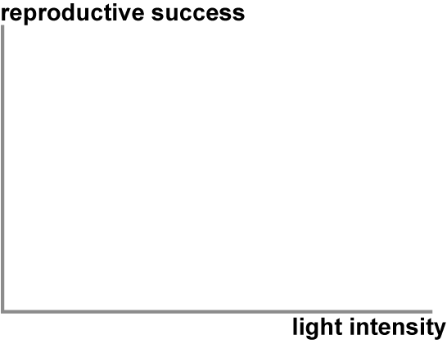
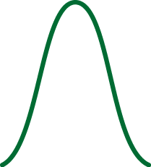
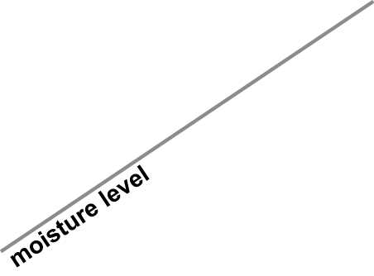
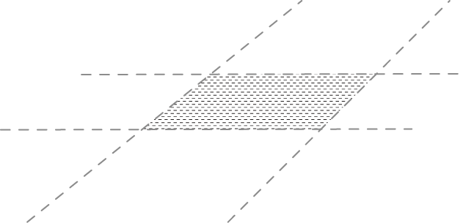
What is meant by a species’ “niche”?
“A species’ niche is the set of environmental conditions under which it can survive & reproduce, including the resources it exploits for food and the range of physical conditions it can tolerate.”
The niche of any species is thus multidimensional
What would be additional factors in determination of a niche that might be important for this and other plant species?
Equisetum
Nutrients (N,P)
pH
N-dimensional
Notes:
Image of equisetum plant (reproduces by spores and an ancient lineage) and two dimensions of a plant’s niche. The slide builds so the instructor can engage the class in a discussion of a plant’s ecological niche. An organism’s fundamental niche comprises all elements that optimize reproductive success. Here two dimensions are considered: first light intensity and then moisture level. Reproductive success is possible only when both conditions are satisfied (hatched area between axes). Many other dimensions of a plant’s niche must also be met for reproductive success. Optimal reproductive success requires all niche dimensions to be satisfied in an n-dimensional optimum.

Slide 4
Competition is a significant determinant in species diversity
“Any use or defense of a limited resource by members of one population that reduces the availability of that resource to other members of the same or different species.”
Population consequences?
Both species have lower
abundances when living together

Slide 5
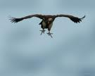
Video: Competition
Jackal vs. Ostrich Eggs vs Vulture
http://www.youtube.com/watch?v=5AAftQIro7Y.
Local copy
Notes:
Three different birds of prey are competing for the same resource- an ostrich egg. First is the Egyptian vulture, second is a Tawny Eagle, and third is a lapid faced vulture. Additionally, the pre-class video provides numerous examples of competitive interactions- such as lions & hyenas.

Slide 6
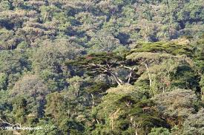
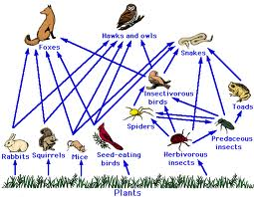
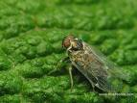
Types of competition
Interference competition- direct interaction between species as in fighting over limited resources
Exploitative competition- one species uses resources more efficiently than other species
Apparent competition- two species in the same habitat share a higher tropic level predator
Scramble competition- where several share resources but with detrimental impact on all.
Notes:
Interference competition can be detrimental to both species but is common amongst predators fighting for the same prey as we have seen in the video examples. Exploitative example is the taller trees which gather more of the sunlight than the shorter trees. Apparent competition is almost the opposite where the prey are trying to avoid being eaten. Scramble competition is often intra-species specific but examples of inter-species include planthopper insects where the density of individuals of two species can cause a change from the non-flying form to the flight form. In this example changing to a flying form helps distribution and survival by finding a new niche that is less populated.

Slide 7
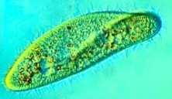
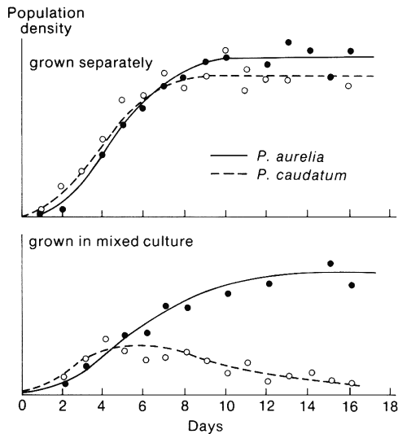
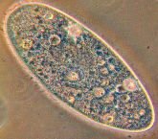
Gause Competition Experiments
Time
Paremicium sp. growth curves for two species grown separately?
Notes:
Some of the earliest studies of competition were done by GF Gause almost 80 years ago. He worked with species of paramecium and his results are shown on the next two slides. The first slide shows growth of P. aurelia and P. caudatum grown under identical conditions but separately. They show a standard growth curve where they reach the carrying capacity of the environment. This is an example of exploitative competition.

Slide 8
What happened when the two species were grown together?
Notes:
However, when the species are mixed together for growth, P. aurelia always out competes P. caudatum. P. aurelia starts more slowly but seems to annihilate the P. caudatum. Does one exploit the resources better?

Slide 9
Competitive Exclusion Principle
Central principle of ecology
Key to understanding:
Resource partitioning
Distribution & abundance
Evolution & adaptive radiation
Community structure & diversity

Slide 10
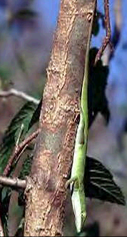
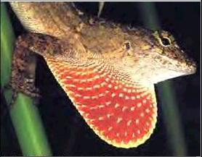
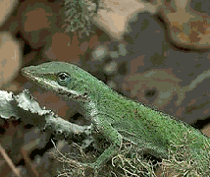
Resource Partitioning: Anolis Lizards
Similar species living in same habitats utilize different resources
Segregate by:
food
space
Notes:
Talking points for instructor to explain resource partitioning. Images of Anolis lizards. Competition and resource partitioning has been extensively studied in this diverse group of lizards that inhabit islands in the West Indies. The Anolis practice both food and space partitioning

Slide 11
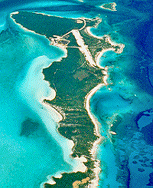
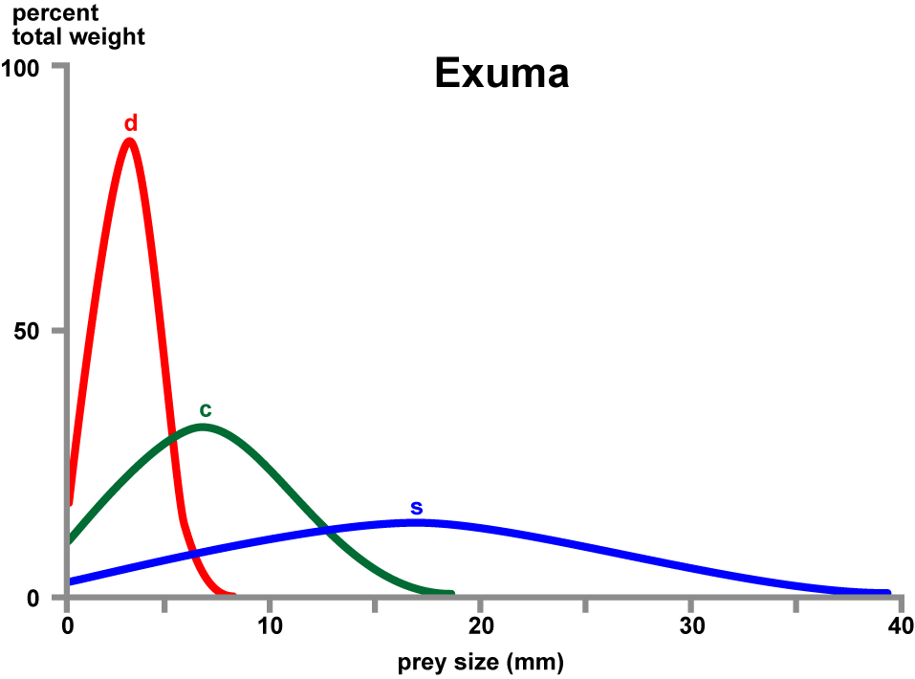
Food Partitioning: Anolis Lizards
Notes:
Diagram of food partitioning by these three species of lizards on the island of Great Exuma, Bahamas.

Slide 12
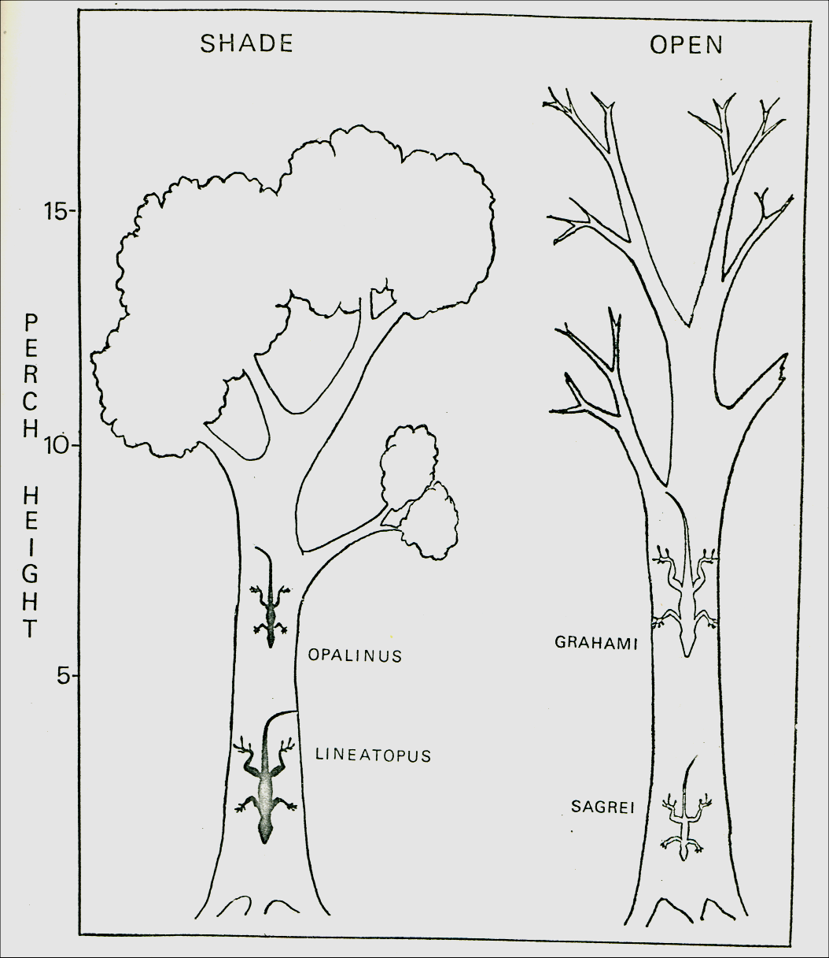
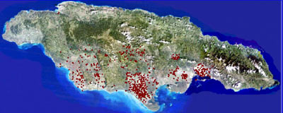
Space Partitioning: Anolis lizards
Jamaica
Notes:
Space partitioning is based upon heights and types of branches and include movement to the ground in some instances.

Slide 13
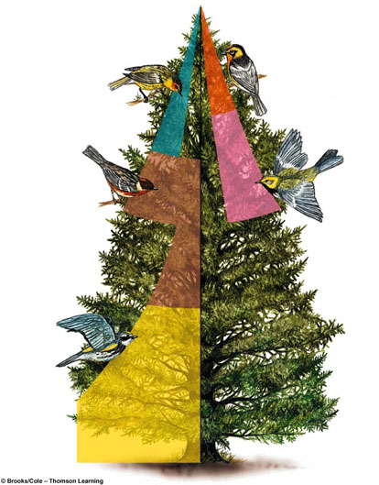
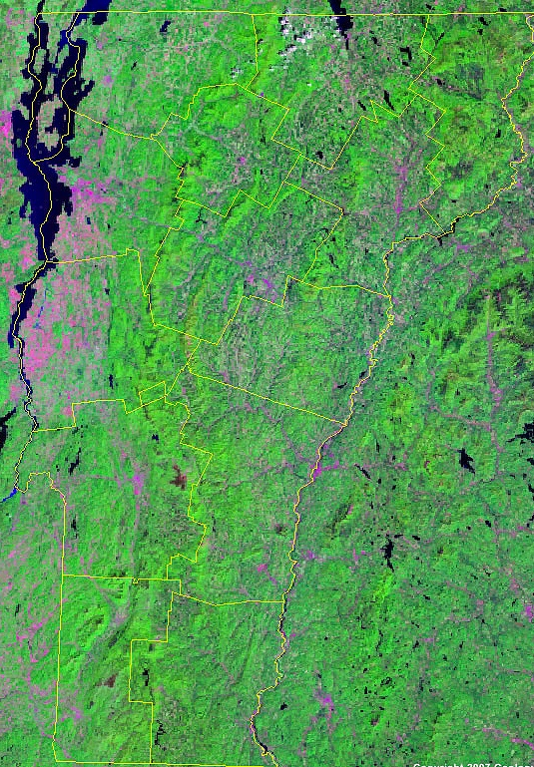
Microhabitat Partitioning
Blackburnian
Cape May
Bay-breasted
Black-throated
Yellow-rumped
Vermont
Notes:
Diagram of five species of warbler inhabiting the coniferous forests of Vermont. When living in the same place, they utilize different feeding zones in conifer trees as a result of competition. (based on the classic work of Robert MacArthur)

Slide 14
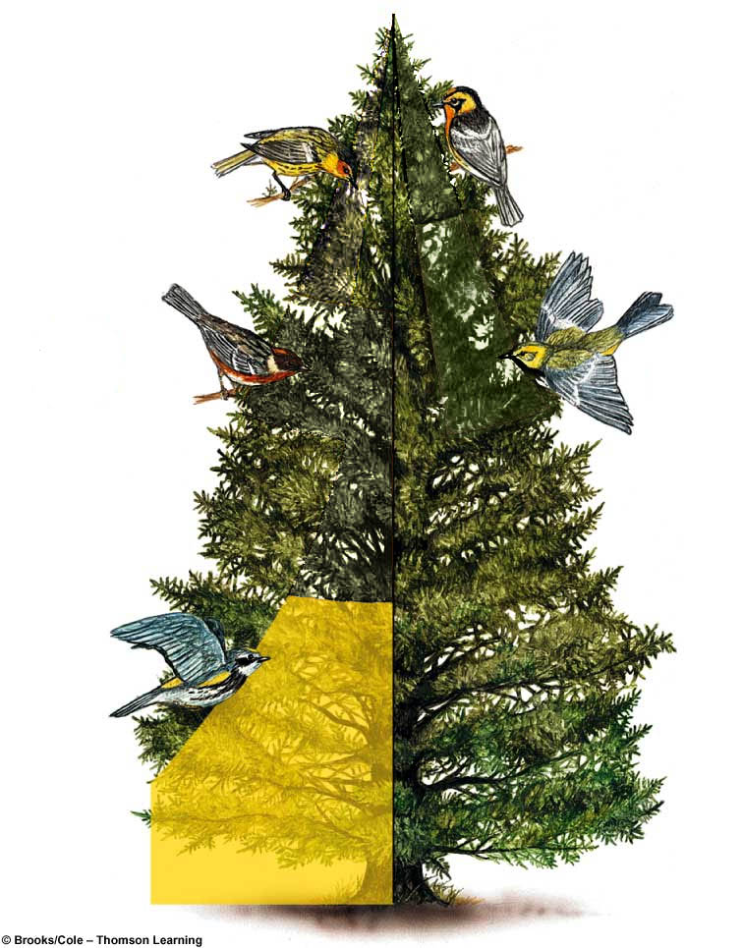
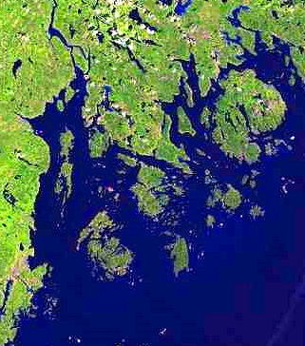
Competitive Release
×
×
What happens where Myrtle exists without the other species?
×
×
Niche expansion
Myrtle
Notes:
Diagram showing that, when competitors are absent, the feeding zone of the remaining warbler species expands into the absent species’ feeding zones. This phenomenon is called niche expansion and represents some of the best evidence for the importance of competition in ecosystems.

Slide 15
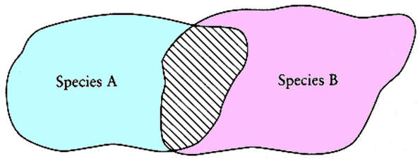
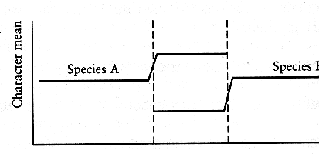
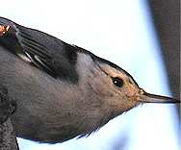
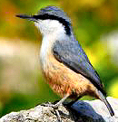
Character Displacement
Species A
Species B
Bill Size
Species A
Species B
Western Rock Nuthatch
(Sitta tephronota)
Eaestern Rock Nuthatch
(Sitta neumayer)
Notes:
A pattern in which two species with overlapping ecological requirements differ more when they co-occur than when they do not. This would allow the species to distinguish themselves from each other and decrease interspecific competition. In this example the trait is bill size.

Slide 16
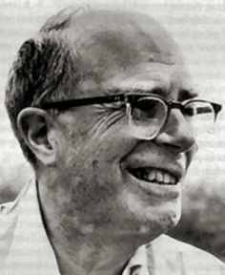
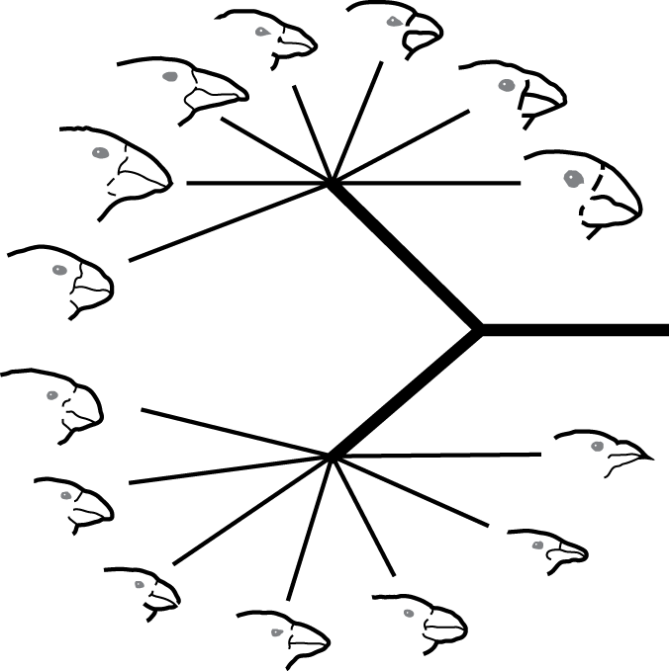
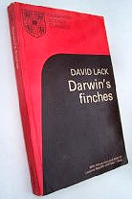
Adaptive Radiation: Darwin’s Finches
David Lack’s Darwin’s Finches - synthesis of ecology & evolution
Competition drives niche displacement and radiation
Competitive Exclusion Principle: Key to understanding species diversity
Adaptive Radiation: 14 Species
Notes:
Diagram of adaptive radiation of Darwin’s finches to illustrate the connection between competition, niche displacement, competitive exclusion, and adaptive radiation as major processes leading to species diversity.

Slide 17
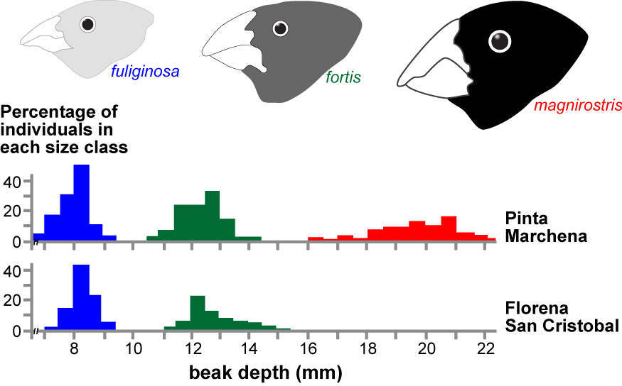
Competition & Character Displacement
Notes:
Diagram illustrating niche displacement with three species of Darwin’s finches. When a species is found isolated from the others on one island, the ranges of beak depth (size) are broader when compared to the ranges when two or more species are found on an island. Larger beaks are better for eating bigger and harder seeds, while smaller beaks are better for eating smaller and softer seeds. As a result, the range of beak size for a species changes over generations (evolves) in response to availability of seed and type of seed with competition from the bird species with similar size beaks.

Slide 18
Competition & Character Displacement
Notes:
Diagram illustrating niche displacement with two species of Darwin’s finches. When the two species are found on one island, the ranges of beak depth (size) are narrower for the smaller beak population and displaced when compared to the ranges when only one species is found on an island.

Slide 19
Competition & Character Displacement
Notes:
Diagram illustrating niche displacement with three species of Darwin’s finches. When the three species are found on one island, the ranges of beak depth (size) are narrower and displaced when compared to the ranges when only two or one species are found on an island.

Slide 20
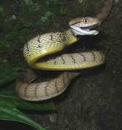
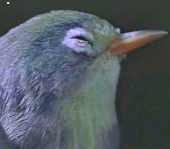
Predator-Prey Coevolution and Invasive Species
Brown snakes & birds on Guam
Bats & moths. A 55 million year arms race
Notes:
20
Examples that have been presented previously in the Evolution section- co-evolution of bats & moths and in the ecology section- the reason that Guam has no birds is due to invasion of island by brown snakes which ate all the birds leaving an abundance of insects and spiders.

Slide 21
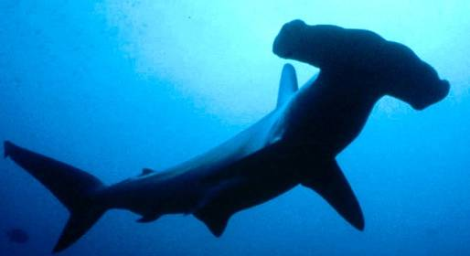
Video: Predators & Prey
Notes:
21
Video overview:
Hammerhead shark: detects slight electrical field as in the breathing from a Gobi fish. Just the fishes metabolism is sufficient that if the shark is close enough it can focus on the location. The hammer claw head has thousands of electrical detectors on its under surface that sense and send information to the brain. Shark uses figure eight swimming once it detects (scans as it swims) to focus on source of electrical charge.
Star nosed mole lives completely underground and has no eyes. Uses star shaped nose to “see” textures. There are 22 tentacles surrounding internal tentacles. Each has tiny buttons for sensing texture. When nose is in contact with surface, the mole can see and eat what it sees. The system is sensitive enough to pick a grain of salt from a pile of sand.
Great Grey Owl uses hearing to detect prey (lemming in this case). Face acts as an antennae with stereo hearing to channel sound to tiny ears sitting next to the eyes. Focuses on sounds, rustling, and orients by head movement until source is located. Then, even during flight, it stays focused and zeros in on prey.

Slide 22
Video: Predators & Prey
local copy
Notes:
22
Video overview:
Hammerhead shark: detects slight electrical field as in the breathing from a Gobi fish. Just the fishes metabolism is sufficient that if the shark is close enough it can focus on the location. The hammer claw head has thousands of electrical detectors on its under surface that sense and send information to the brain. Shark uses figure eight swimming once it detects (scans as it swims) to focus on source of electrical charge.
Star nosed mole lives completely underground and has no eyes. Uses star shaped nose to “see” textures. There are 22 tentacles surrounding internal tentacles. Each has tiny buttons for sensing texture. When nose is in contact with surface, the mole can see and eat what it sees. The system is sensitive enough to pick a grain of salt from a pile of sand.
Great Grey Owl uses hearing to detect prey (lemming in this case). Face acts as an antennae with stereo hearing to channel sound to tiny ears sitting next to the eyes. Focuses on sounds, rustling, and orients by head movement until source is located. Then, even during flight, it stays focused and zeros in on prey.

Slide 23
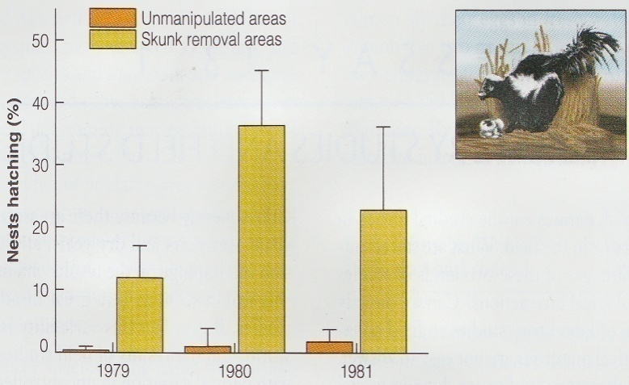
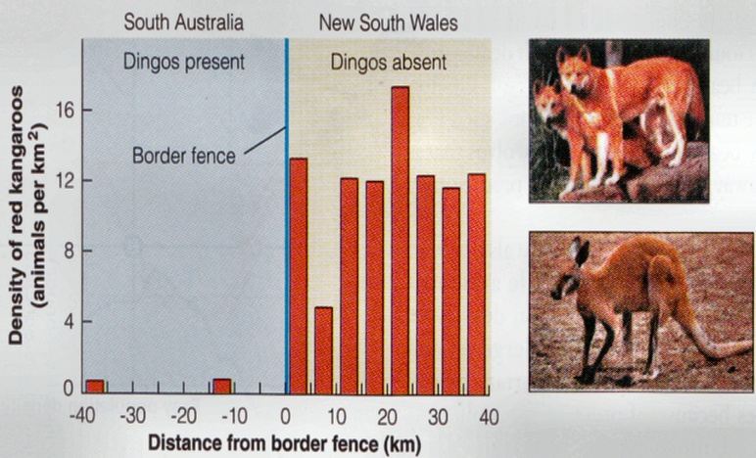
Effects of Predators on Prey Abundance
Removal & exclusion experiments indicate major impact of predators on prey survival & abundance
Removal of skunks from duck nesting areas in North Dakota dramatically improves hatchling survival
Abundance of red kangaroos in southern Australia 10-30x higher when dingo predators excluded
Notes:
23
With skunk removal the number of nests that have chicks hatching goes up considerably as shown in upper graph. Similarly in lower graph, removal of predators (dingoes) leads to increase in the red kangaroo population. Dingoes eat the adults and others and keep the population low. In the absence of dingoes, the kangaroo population is more resource limited based upon grassland which is affected by precipitation level. When protected by fence, recovery from drought is much faster.

Slide 24
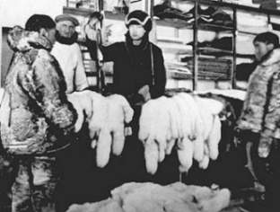
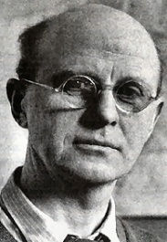
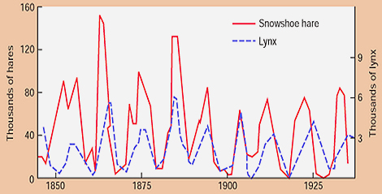
Predator-Prey Cycles
Charles Elton – British ecologist
Analyzed lynx & hare pelt returns from Hudson’s Bay company 1845-1935
Discovered 10 year predator-prey cycle
Initiated 60 yr effort to understand forces behind such cycles
Notes:
24
Observe that the lynx (predator) increases in number either right after hare numbers increase or concurrently with the increase in hares. When hares decrease the lynx population is not maintained at high levels and comes close to crashing. Of course, this is data base upon pelts and not actual observations of animals. Charles S Elton had access to these records because he worked with the Hudson Bay Trading Company. Famous ecologist who made contributions to animal behavior and ecology, niche, pyramid of numbers for structuring ecosystems and niche theory. Later interests included invasive species.

Slide 25
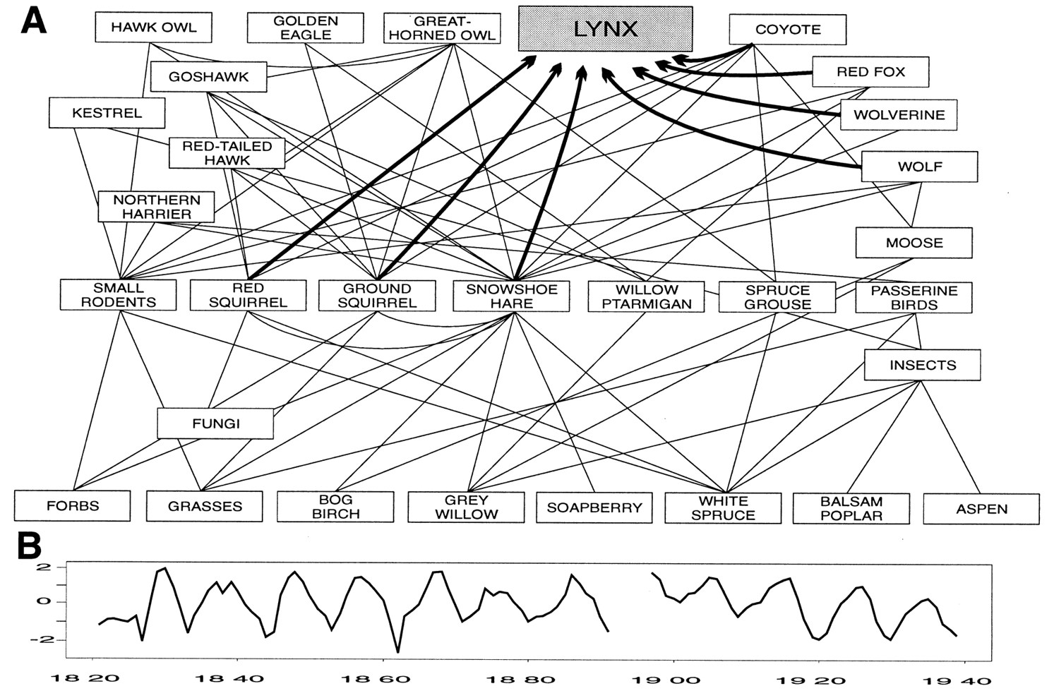
Food web of the boreal forest ecosystem: the food web links directly influencing the lynx are highlighted
Stenseth N C et al. PNAS 1997;94:5147-5152
©1997 by The National Academy of Sciences of the USA
Notes:
(A) Food web of the boreal forest ecosystem: the food web links directly influencing the lynx are highlighted (see Fig. 1). (B) Yearly lynx abundances (log-transformed and standardized; see text) (2). Data for 1821–1891 represent fur returns from the North Central district (L10) and for 1897–1938 represent fur returns from the combined James Bay and Lake Districts (L13) (which corresponds to the geographic location of the hare series shown in Fig. 1B).

Slide 26
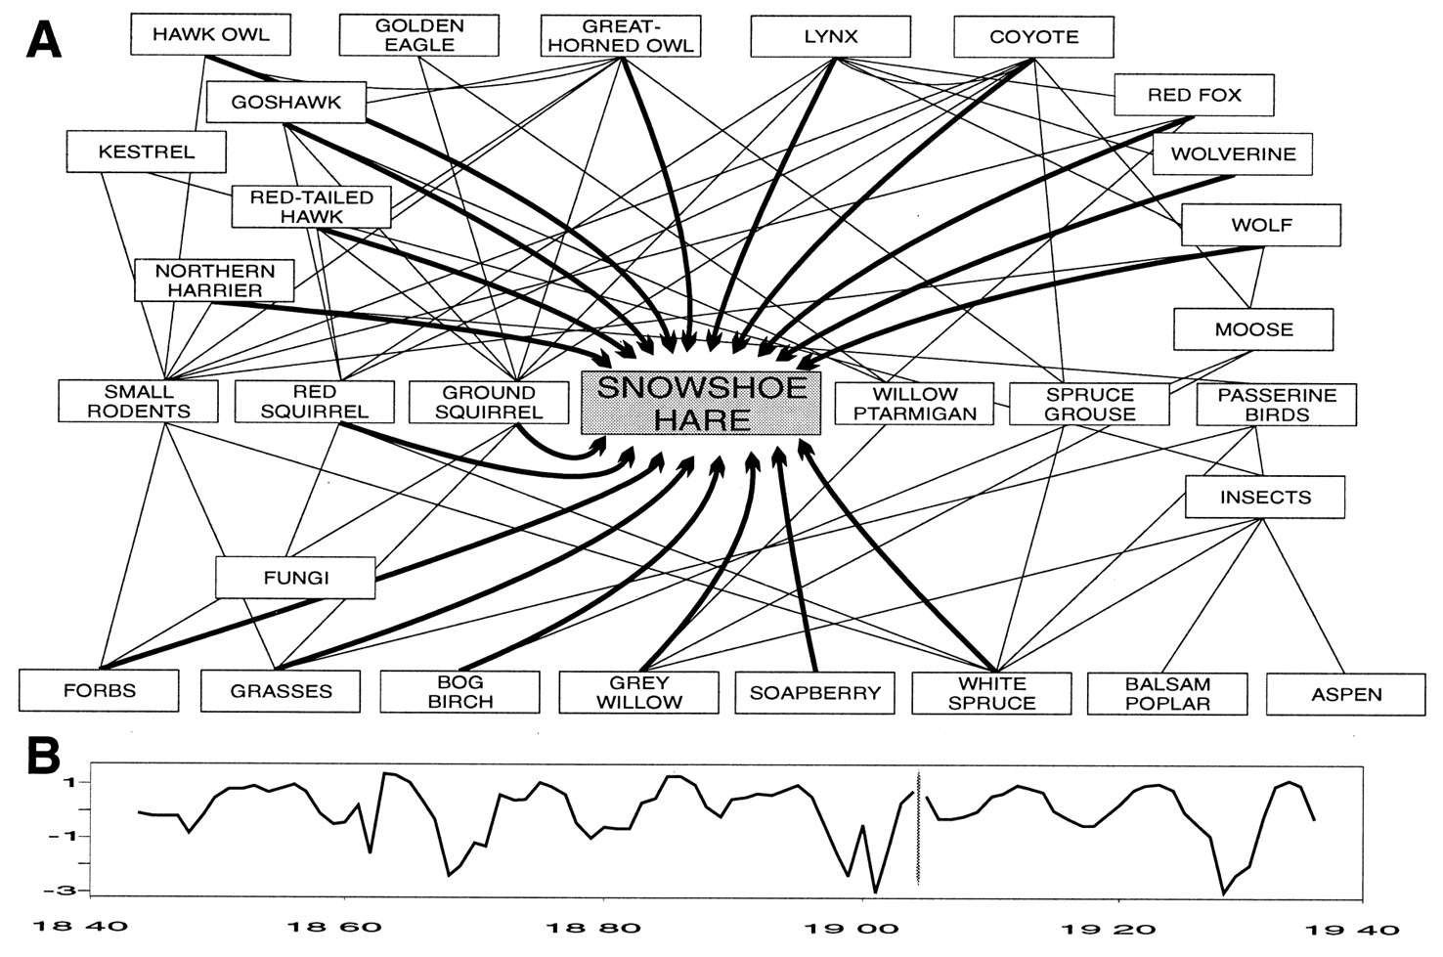
Food web of the boreal forest ecosystem: the food web links directly influencing the hare population are highlighted
Stenseth N C et al. PNAS 1997;94:5147-5152
©1997 by The National Academy of Sciences of the USA
Notes:
(A) Food web of the boreal forest ecosystem: the food web links directly influencing the hare population are highlighted [based upon Boutin et al. (16), Krebs et al. (4), and C. J. Krebs/Kluane team, unpublished results]. Only the major dietary items are shown. (B) Yearly hare abundances (log-transformed and standardized; see text) for the main drainage of the Hudson Bay (17): 1844–1904 represents data on fur returns and 1905–1935 represents data from trapper questionnaires.

Slide 27
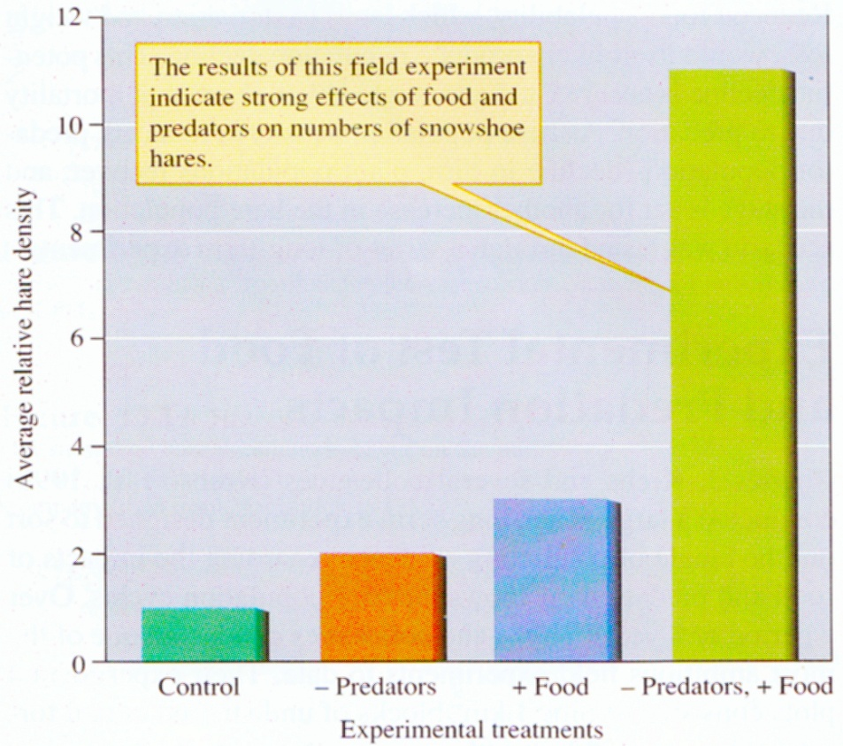
Multilevel Control of Hare Abundance
Long term 10 year experiments
1 km² plots in Canadian taiga
Removed predators
Added food
Removed predators + added food
So what controls hare abundance?
Top down control by predators AND bottom up control by food

Slide 28
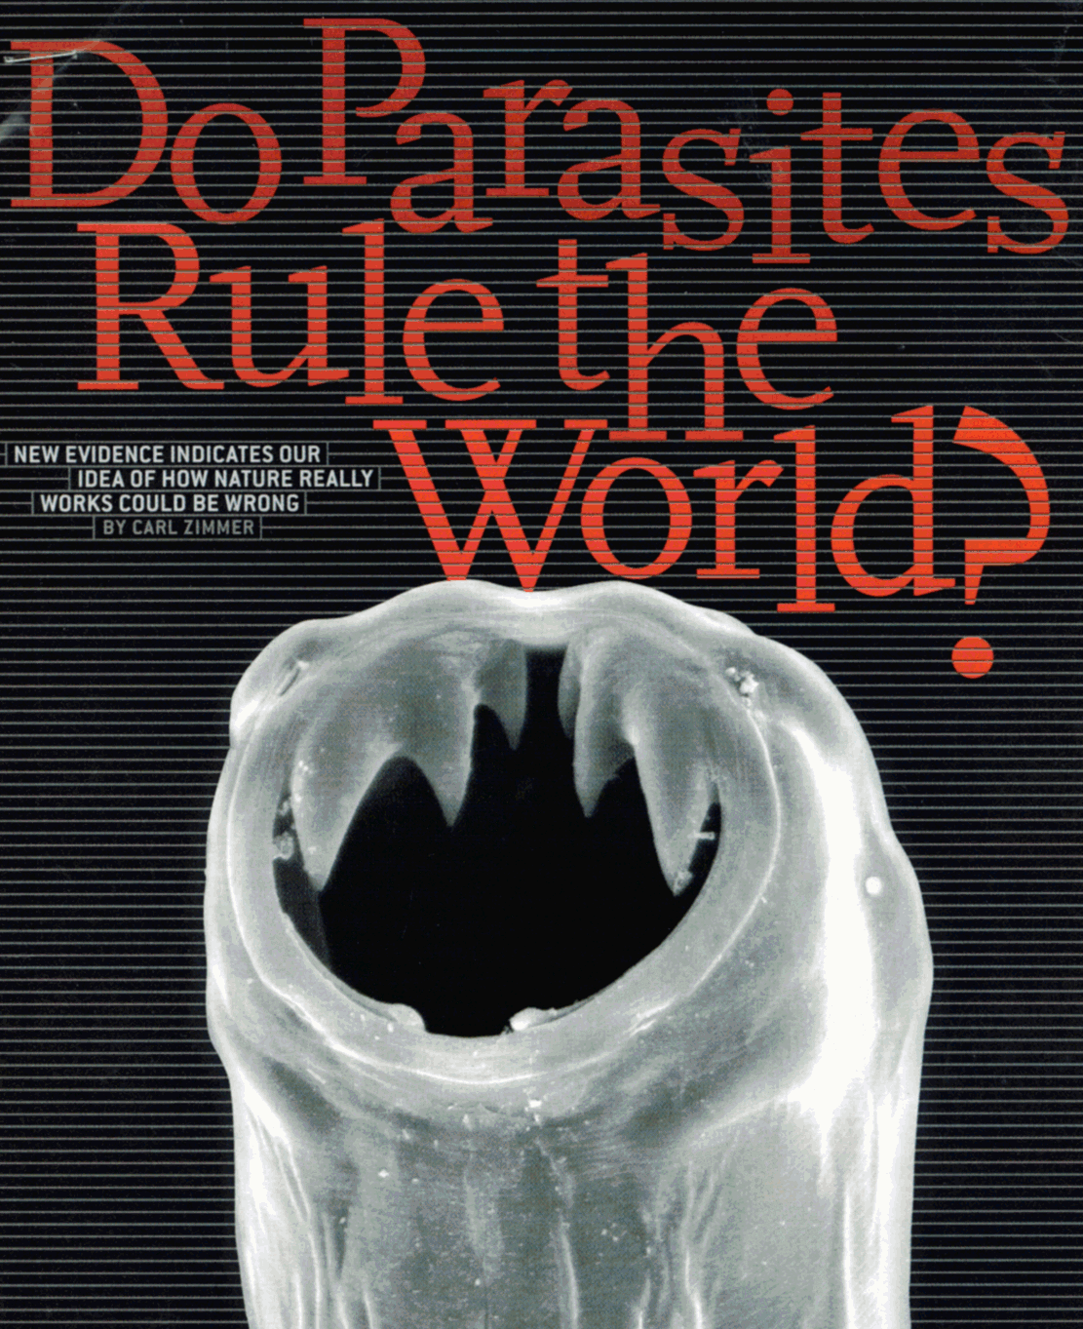
Ecological Impact of Parasitism
Behavior of the host that is parasitized which may include feeding, exposure, and reproduction.
Distribution & abundances of hosts
Species diversity of communities
Notes:
Fluke and snail are excellent examples of the effect on behavior. Distribution and abundances of host is important as the host may be driven from the population. A good example of this is the chestnut blight (caused by a protist) that virtually wiped out all chestnut trees in first half of 20th century. This fact in itself changed the diversity of the forest community as the chestnut was a large canopy tree whose removal allowed oak and hickory trees to become more abundant. The diversity of tree species actually increased.

Slide 29
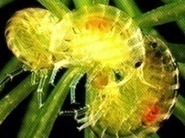
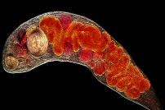
Parasites & Host Behavior
Parasite effects on behavior?
Flat worm parasite causes amphipods to swim near surface during day
Trematode causes periwinkles to move up out of water onto rocks where they are more readily visible and easily eaten by sea gulls
What’s mechanism behind control?
Snail & flat worm
Amphipod & flat worm
Littorina & trematode

Slide 30
Effects of Parasites on Host Abundance
Ticks increase mortality of cattle egret nestlings by 300-500% compared to tick free chicks treated with insecticide
# of ticks can reach 25 per chick
Mange in Sweden reduced fox population abundance 5x
Hare population quickly increased 6x as the red fox is a direct predator of Hares.

Slide 31
Parasites Can Drive Host Cycles
Number of Grouse
Anti-parasite drug given to red grouse in control areas
Science 18 December 1998: Vol. 282. no. 5397, pp. 2256 - 2258
Notes:
Parasite is Trichostrongylus tenuis and the drugs given were anti-helmenthich (kill worms). The drugs are effective if given before a cyclic crash. Breeding is negatively impacted by parasitic infection.

Slide 32
Parasites & Host Behavior
Wasp injects larvae into host
Spider is induced to make new web that serves as wasp larvae cocoon.
Web weaving routine is similar to early stages of normal web building routine by the spider but later steps in web weaving are inhibited
W.G. Eberhardt in Nature 406, 255-256 (20 July 2000)

Slide 33
Mutualism
Interactions among two or more species where all partners benefit.
Coral Polyps
- -
Competition
Predation
Parasitism
Mutualism
- +
- +
+ +
Notes:
Reef building coral pair with photosynthetic dinoflagellates (unicellular algae). Millions of algae live within the coral polyps and half of the energy utilized by the coral come from the sugars produced by photosynthesis of the algae. Algae receive shelter and nutrients from coral waste (CO₂ and ammonia (NH₃). This is an obligate interaction as coral that expel the algae will bleach and die.

Slide 34
Obligate:
Two Types of Mutualism
Each species benefits from association, but can’t survive independently of its partner(s).
Facultative:
Each species benefits from association, but can survive independently of its partner(s).

Slide 35
Types of Benefits
Trophic:
One or more of partners gains water, energy, nutrients, refuge
Defensive:
Partner defends against predators, parasites, herbivores, or competitors
Dispersive:
Partner transports your pollen or seeds

Slide 36
Video: Mutualism
Notes:
36
Video summary: Ants and acacia work together to provide nutrients for the ants (nectar) or food for the ant progeny (protein packets). The ants provide a vigorous defense of the tree from giraffes, insects and even kill surrounding plants to decrease nutrient competition of tree. Gobi fish/blind shrimp- shrimp digs and Gobi serves as lookout. The coral need energy to build reef and obtain at least half of this from photosynthetic dinoflagellate algae that live in the polyp, ~one million per polyp. The sugars produced by the algae provide energy to the coral and the coral by products or wastes provide CO₂ and NH₃ for the algae. Jellyfish/algae- since the jellyfish water system is cut off there are no fish to sting and eat. The tentacles convert to homes for the algae and at sunlight the jellyfish move to the surface of the water. The photosynthetic byproducts provide energy to the jellyfish. At darkness, the jellyfish retreat to the bottom where the detritus provides nutrients for the algae. The caterpillar/ant story is that the ants get nectar from the caterpillar and provide it with defense and shelter or protection from predation. The anemones and Hermit crab are defensive interactions by the anemones (3 per crab) which discourages preddators like the octopus and the anemones get the detritus from the food caught and consumed by the crab who is a messy eater.

Slide 37
Video: Mutualism
local copy
Notes:
37
Video summary: Ants and acacia work together to provide nutrients for the ants (nectar) or food for the ant progeny (protein packets). The ants provide a vigorous defense of the tree from giraffes, insects and even kill surrounding plants to decrease nutrient competition of tree. Gobi fish/blind shrimp- shrimp digs and Gobi serves as lookout. The coral need energy to build reef and obtain at least half of this from photosynthetic dinoflagellate algae that live in the polyp, ~one million per polyp. The sugars produced by the algae provide energy to the coral and the coral by products or wastes provide CO₂ and NH₃ for the algae. Jellyfish/algae- since the jellyfish water system is cut off there are no fish to sting and eat. The tentacles convert to homes for the algae and at sunlight the jellyfish move to the surface of the water. The photosynthetic byproducts provide energy to the jellyfish. At darkness, the jellyfish retreat to the bottom where the detritus provides nutrients for the algae. The caterpillar/ant story is that the ants get nectar from the caterpillar and provide it with defense and shelter or protection from predation. The anemones and Hermit crab are defensive interactions by the anemones (3 per crab) which discourages preddators like the octopus and the anemones get the detritus from the food caught and consumed by the crab who is a messy eater.

Slide 38
Summing Up by an authority in ecology
And NUH is the letter I use to spell Nutches, Who live in small caves, known as Niches, for hutches. These Nutches have troubles, the biggest of which is The fact there are many more Nutches than Niches. Each Nutch in a Nich knows that some other Nutch Would like to move into his Nich very much. So each Nutch in a Nich has to watch that small Nich Or Nutches who haven't got Niches will snitch.
Dr. Seuss - On Beyond Zebra (1955)

