Slide 1

Video: Critical Biodiversity`
_video backup copy_
Notes:
Biodiversity is the sum total of 3.5 BY of evolutionary experience. Our lives depend on it as well as our economies. It is a fundamental asset. Humans are a very small part of the biodiversity- just one species. And what will we do without the remaining species? It seems that we have no conscious understnding of the value of biodiversity as we see species disappear within our life times. Extinction is a normal part of evolution but we are witnessing this over decades and not half a million years. Is it safe to think that we are at the top of the food chain so impacting other species, while it will cause changes, will not cause hardship or our own extinction?

Slide 2
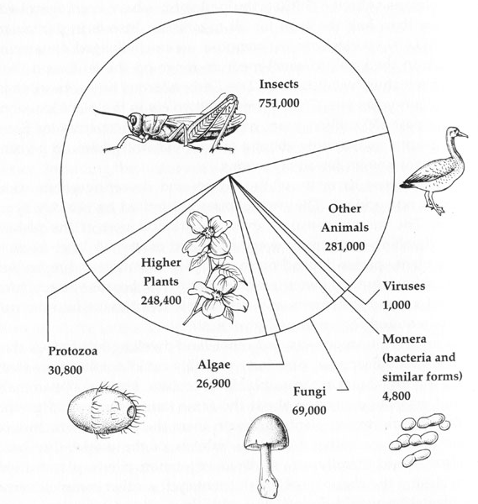
Named species: 1,800,000
Notes:
What do we have now?

Slide 3
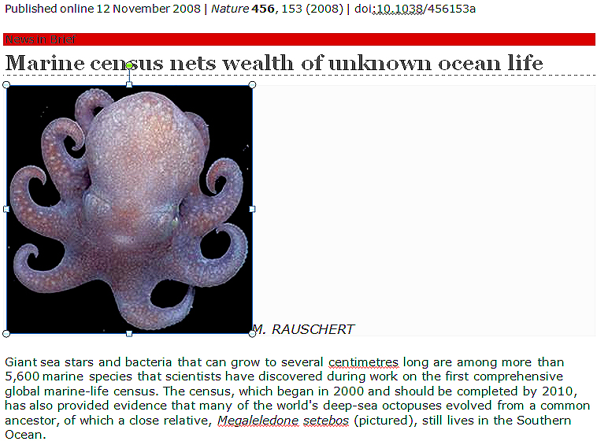
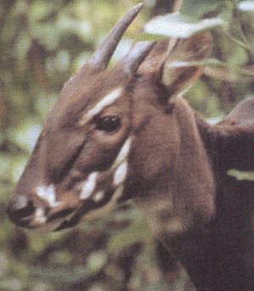
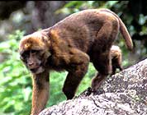
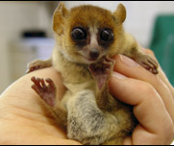
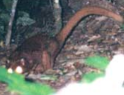
Discovery of New Species
Vietnam 1996
India 2004
Macaca munzala
Pseudoryx nghetinhensis
Madagascar 2004
Borneo 2005
Civet cat?
Microcebus lehilahytsara
Notes:
Pseudoryx nghetinhensis or Saola is an unusual species that has caused considerable taxonomic disagreement but may belong in the ungulates. It is a large mammal. Macaca munzala is a macaque or an old world monkey found in India that dwells at high altitudes (~5,000-11,5000 ft above sea level). Microcebus lehilahytsara is a mouse lemur discovered in 2005 in eastern Madigascar. Lemurs are only found in Madagascar in the wild and there are now 49 species. Many have gone extinct. Their evolutionary significance is as an ancient link to the primate lineage that evolved into humans. The civet cat does not have a distinct classification- only shown in a few photographs- and is commonly referred to as the cat-fox. A marine census has turned up many highly unusual forms (~6,000) from bacteria to ancestral octopus relatives. Work of 2,700 researchers over 10 years and from 80 countries.

Slide 4
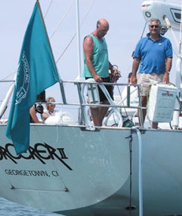
Discovery of New Species
Sampled 900 L of sea water
Sequenced genetic material
Estimated 40,000 new microbial species
Craig Venter 2004
Notes:
Part of the Microbial Genome Sequencing Project launched in 2004. Supported by the Gordon and Betty Moore Foundation and coordinated by the J. Craig Venter Institute. For reference see http://www.moore.org/microgenome/index.aspx. The field is called metagenomics where the genomes are recovered directly from environmental samples. To appear in the analysis the bacteria do not have to be grown in the lab. Venter is again using shotgun sequencing methods.

Slide 5
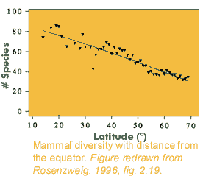
Latitudinal Gradient in Mammal Species
Notes:
The previous example was quite specific but exciting as an approach. Where have we seen distributions previously- a latitudinal gradient for bird species and now we show that a similar gradient for mammals exist.

Slide 6
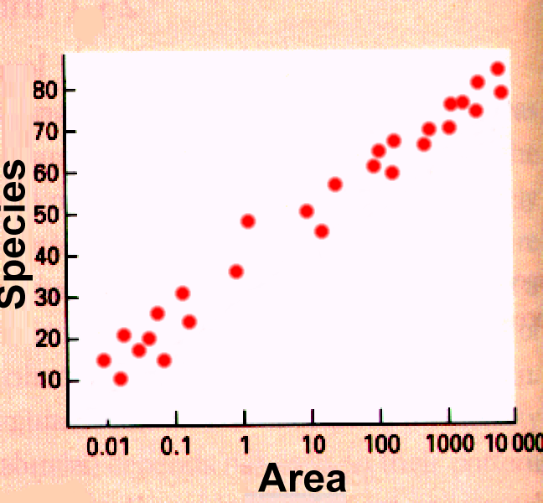
Species Diversity on Islands
Increasing area 10x
increases species 2x
S = cA^{z}
Notes:
The mathematical formula has to do with the species richness in an area and in this form with the actual size of the space. Defining the terms: S=number of species, A=area in hectares ( a hectare is), c and z are constants that are species specific. C is the species richness factor?? And z is the species accumulation factor??

Slide 7
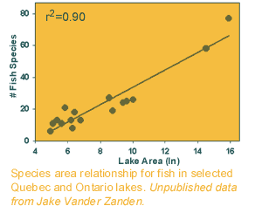
Fish Species Diversity in Lakes
Increasing area 10x
increases species 2x
Notes:
7
Instead of islands, more broad use of island would be isolated territory and the same system applies for fish species diversity in lakes of different area.

Slide 8
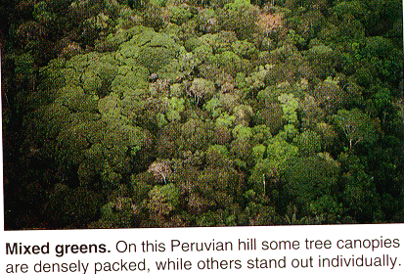
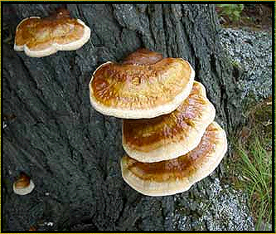
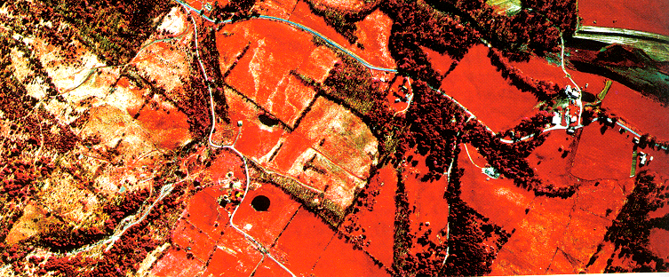
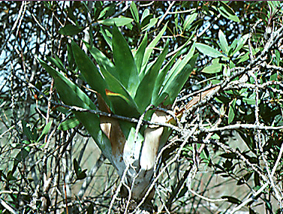
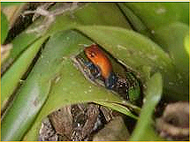
The World is Patchy.
Notes:
Because the world is patchy each territory can be considered as an island if it is an area of suitable habitat surrounded by unsuitable habitat areas. See Wikipedia on Island biogeography.

Slide 9
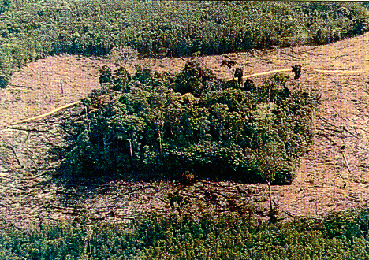
Habitat Fragmentation
Small is vulnerable.
Isolated fragments of rain forest
soon suffer from exposure to the elements.
Notes:
Habitat fragmentation is a result of human habitation and the processes that go along with that. Studies show that the border regions are the most vulnerable in fragmentation of habitats (vegetation on rim is different than further inside) and that species diversity decreases in smaller fragments (how many territories will fit in the patch).

Slide 10
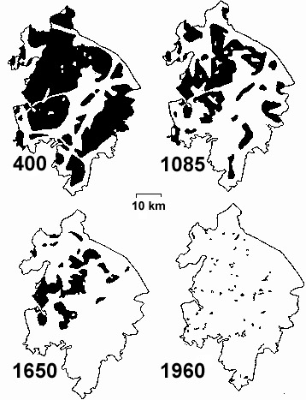
Habitat Fragmentation of Forests
Warwickshire, England
400-1960
http://darwin.eeb.uconn.edu/eeb310/lecture-notes/fragmentation.pdf
Notes:
This slide shows the changes in forest over a long human time period. What impact will fragmentation have on the native populations of species? Total area decreases, # of patches increases while area of remaining patches decrease, and less connectivity which will effect emigration. Each species has different area requirements for survival.

Slide 11
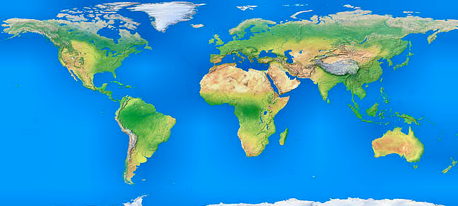
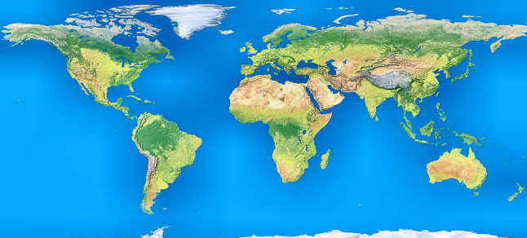
Global Deforestation 8000 BC - 2000 AD
60% of original forest gone
½ of remaining badly degraded
Annual deforestation rate 1.4%
½ life of remaining forest? 50yrs.
Last rain forest tree will fall by 2040
If 90% of rain forest area gone by 2025, what % of species will remain?
8000BC
2000 AD
Notes:
11

Slide 12
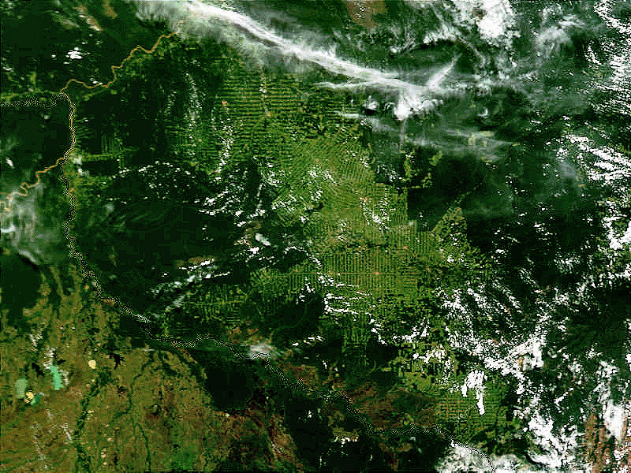
Logging Roads in Amazon
Based upon what you have heard, what impact would patchiness have in the rainforest? Would the impact here be less or greater than the impact in Warwickshire?
Notes:
Patchiness in the rain forest. What affect might this have on species diversity?

Slide 13
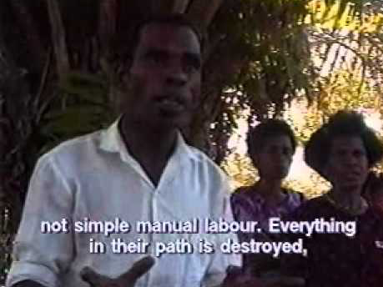
backup copy
Video: Deforestation
Notes:
13
VIDEO is 8’. New Guinea is the second largest island on the Earth and holds the largest rainforest in Asia. The land mass was never connected directly to Asia thus it has countless new life forms not found anywhere else and not described or cataloged. Humans first settled the area 50,000 years ago and there are hundreds of indigenous people who have lived in concert with nature. Examples of this include their use of Sago palm trees for source of starch and fishing in a methodical and environmentally sensitive manner. The threat is now from the government and logging industry that cuts the Sago palm down and turns it into nutritional supplements used in the western world. The loggers destroy all in their paths and are forcing the indigenous people to change their ways and destroying the biodiversity of the island.

Slide 14
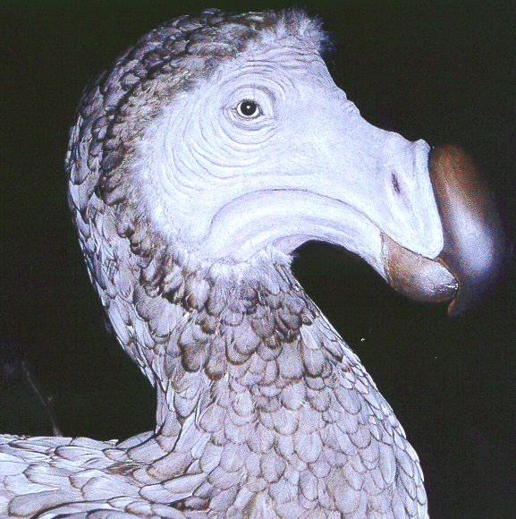
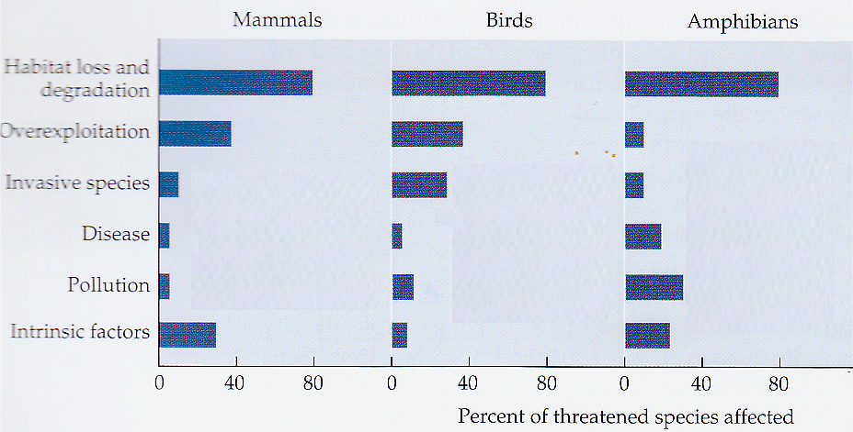
Greatest Threats to Biodiversity?
Notes:
Habitat destruction, invading species, global warming
Habitat loss and degradation we have shown previously during the ecology sessions. Overexploitation would be hunting or fishing species to extinction or cutting down trees for wood. Invasive species are bringing in new species to an ecosystem where they did not occur and them upsetting the ecological balance. Disease could be new or movement due to global warming. Pollution is obvious but highly toxic to amphibians as in the example of polluted water and decrease in frog populations. Intrinsic factors are those particularly relevant to the specific organism related to their genetic capabilities.

Slide 15
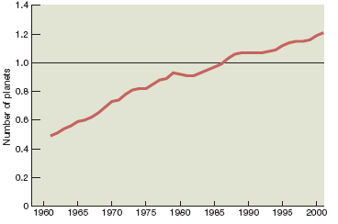
Humanity’s Ecological Footprint 1961-2004
30% overshoot
Area of land required to provide the resources & absorb the emissions for the human population.
http://www.youtube.com/watch?v=KwTd9kUehvA.
Notes:
The words above define our ecological footprint. The video shows the amount of land being used to sustain our current usage of our resources. As you can see we are approximately 30% over what we need to sustain things as they are now. This overshoot will require adjustments in our current method of operation. The populations of other vertebrate species have declined by over 35%.

Slide 16
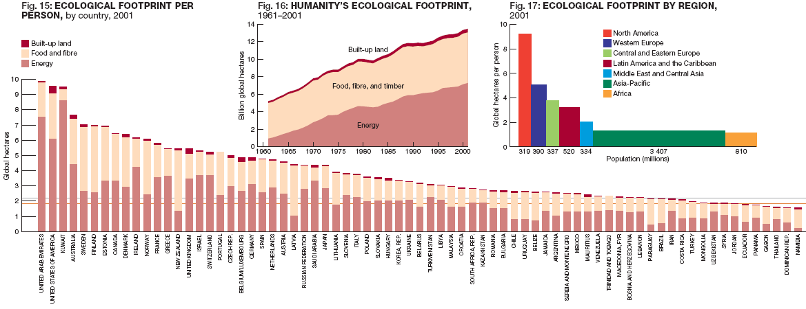
Ecological Footprint by Country & Region 2001
Notes:
The ecological footprint is not shared equally. The US, Japan, UK, and UAR are all in ecological deficit using more global hectares than their own land mass (http://www.sustainablescale.org/conceptualframework/understandingscale/measuringscale/ecologicalfootprint.aspx.)

Slide 17

An Alternative Viewpoint for Anyone?
Video
Hans Rosling, former professor and physician
Notes:
Hans Rosling (born July 27, 1948^{[1]} in Uppsala, Sweden) is Professor of International Health at Karolinska Institute and Director of the Gapminder Foundation, which developed the Trendalyzer software system. From 1967 to 1974 he studied statistics and medicine at Uppsala University, and in 1972 he studied public health at St John's Medical College, Bangalore. He became a licenced physician in 1976 and from 1979 to 1981 he served as District Medical Officer in Nacala in northern Mozambique. Trendalyzer converts statistics into a more mobile form as shown in the video. http://en.wikipedia.org/wiki/Hans_Rosling.

Slide 18

Video: Hans Rosling's 200 Countries,
200 Years, 4 Minutes. The Joy of Stats
local copy

Slide 19
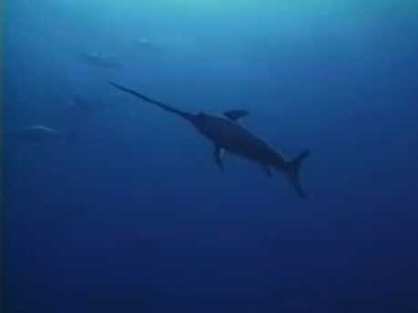
Video: Empty Oceans, Empty Nets
backup copy
Notes:
Video 8’

Slide 20
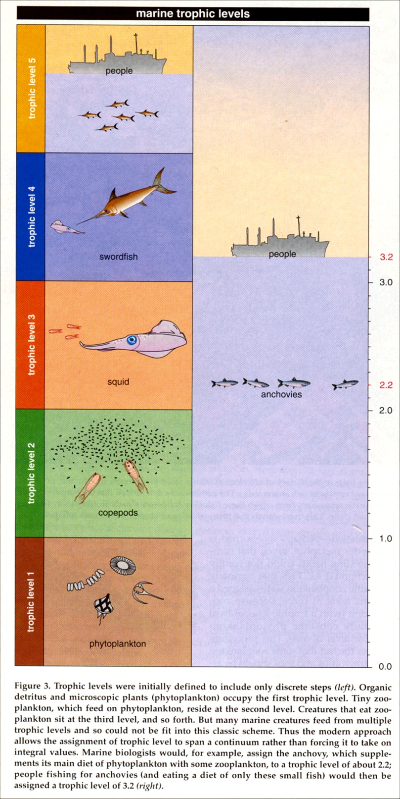
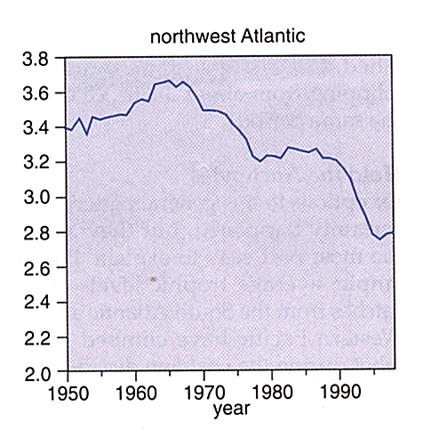
Fishing Down the Food Chain
6 February 1998, Volume 279, pp. 860-863. Daniel Pauly,* Villy Christensen, Johanne Dalsgaard,
Rainer Froese, and Francisco Torres Jr.
Notes:
Fishing down the food web indicates the trend of catching the larger higher trophic fish first until their supply is limited in which case fish from lower trophic levels are caught. The higher trophic level fish mostly eat other fish and the lower may have a diet of more invertebrates and plankton. This is not a sustainable pattern. Data are from 220 different species in 60 published articles of marine food webs. Analysis was by Ecopath software. Data from fisheries landings was used for comparison.

Slide 21
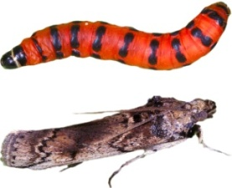
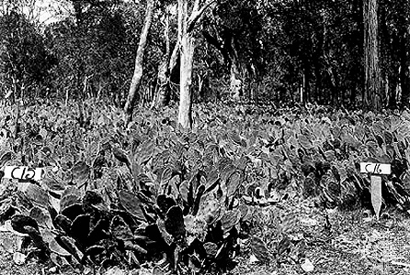
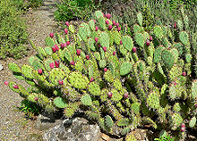
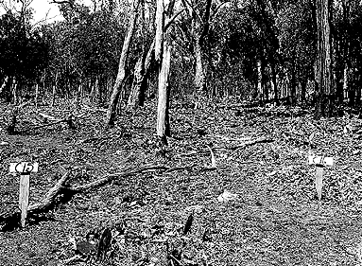
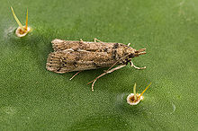
Biological Control of Invaders
Prickly pear cactus (Opuntia) introduced into Australia in 1839 as garden plant
Lacking native herbivores, quickly spread & became pest species covering 16,000² miles
The moth Cactoblastis introduced from Argentina in 1925
Larvae completely destroy cactus plants
By 1931 only scattered populations of Opuntia remained
Top: Dense stand of Opuntia cactus in Queensland, Australia
Bottom: After introduction of Cactoblastis
Notes:
The notes are obvious on the slide. The insets are a picture of the prickly pear cactus in its native environment of the Americas and a moth whose larvae effectively eat the plant. There were no controlling species in Australia thus the problem. The moth causes problems within the native environment where the prickly pear cactus is natural and has possible medicinal and industrial uses. One persons useful species is another's invasive species.

Slide 22
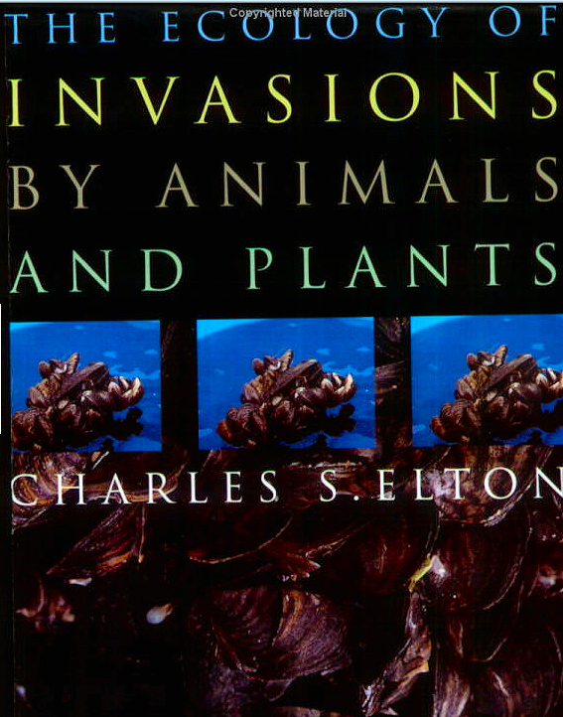
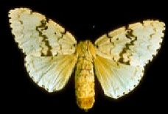
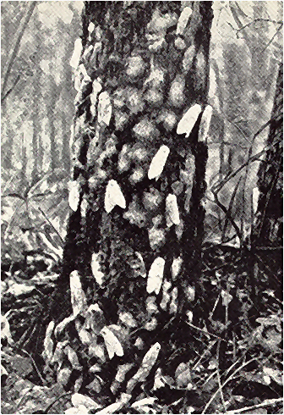
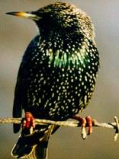
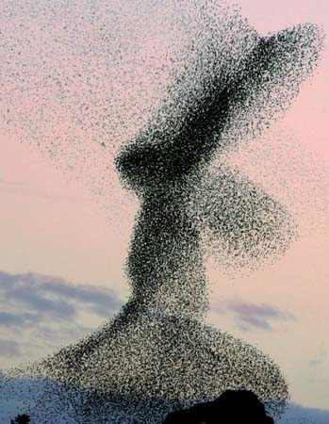
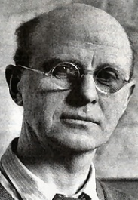
Invading Species
Gypsy moths cover tree in Medford, MA - 1889
1868 - introduced by French scientist Leopold Trouvelot in Medford, MA
First outbreak - 1889
Defoliates > 1 million acres (4,000 km²) of forest each year
Flock of Starlings
Introduced 1896 Central Park
By 1936 occupied eastern ½ of US
Outcompeted Eastern Blue Bird
Lowered abundances of many natives
www.invasivespeciesinfo.gov Gypsy moth video.
Notes:
The gypsy moth was also native to Europe and introduced into the US in 1869 for silk production. They devastate and defoliate trees as stated above. The European starling was introduced in 1890 as a plan to introduce all birds mentioned in the works of Shakespeare into the United States (USDA National Agricultural Library). Competes or outcompetes native species and destroys crops and is distributed throughout the US.

Slide 23
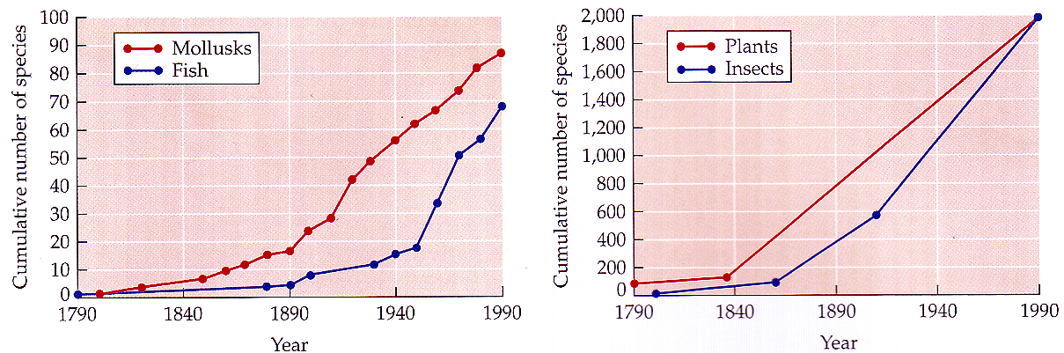
Invading Species
European settlers brought 100s of alien species
# of species invading continental US has increased steadily at ~10 sp/yr for plants & insects

Slide 24
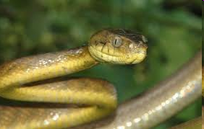
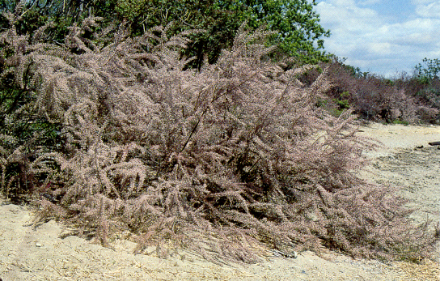
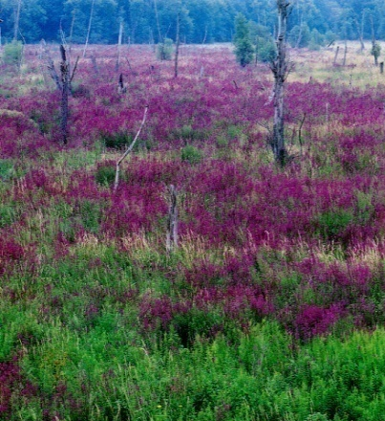
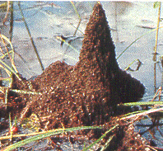
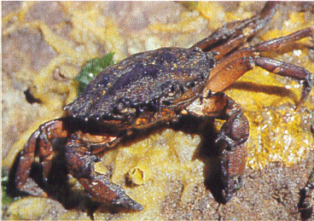
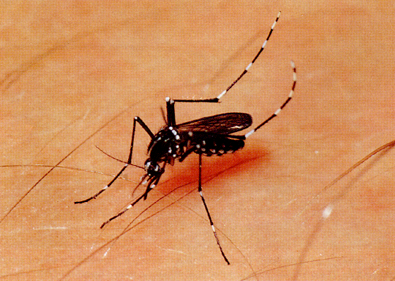
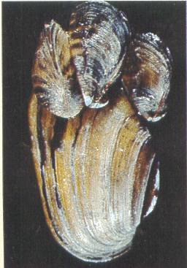
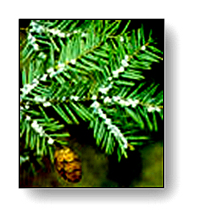

Most (Un)Wanted
Brown snake
Tamarisk tree
Purple loosestrife
Brown snake
Fire ant
Green crab
Tiger mosquito
Zebra mussel
Wooly adelgid
Notes:
Examples of invasive species. Brown snake on Guam- arrived by plane from New guinea and spread to whole island. Ate all of the birds. Fire ants are invasive in many areas of the world. Entered US by boat in Mobile, AL and now infests south and southwest. It bites and impacts people, animals, and crops. Zebra mussels are native to Russia and entered in the ballast of boats in the St. Lawrence Seaway. Major problem in the Great Lakes and other waterways. Affect water treatment plants. Purple loosestrife is native to Europe and has spread through temperate North American wetlands. Enter by ship and as a medicinal herb. Can reach high density and become part of canopy. Tiger mosquito was imported in tire casings imported for recapping (from Asia). Carries encephalitis virus and West Nile Virus. Active during the day. Tamarisk trees are invasive in Nevada where they cause problems with water resources. It was intentionally introduced as a wind break and shade tree. The European Green crab was introduced twice to US in ballast water from shipping- 1817 on East coast and 1980 on west coast. It preys on bivalves and other crustaceans. The wooly adelgid is native to Asia and introduced in 1920s to west coast and 1951 to east coast. It destroys Eastern hemlock trees.

Slide 25
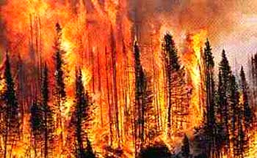
Modern View of Nature
“Nature is dominated by flux and change. The real constant is eternal turmoil.”
- W. Stevens
Nature never at “equilibrium”
External factors constantly cause disturbance & disruption
Hence:
  Community structure always changing
  No chance to settle into stable state
  Long term “Balance of Nature” nonexistent

Slide 26
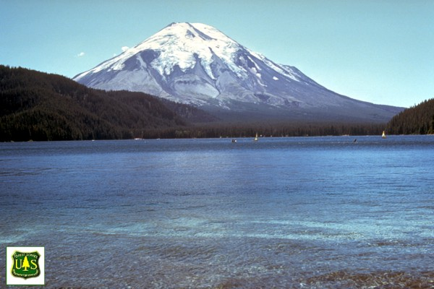


Mt. Saint Helens: Before, During & After
Spirit Lake before
Spirit Lake after
Eruption, May 18,1980
Notes:
The explosion May 18, 1980 was shown in the video in graphic detail but here in still life you can see the difference in one area impacted by the volcano. The northern flank of the mountain collapsed and the landslide covered 24 sq miles with 600 ft of debris. 520 million tons of ash were blown into the air over 230 sq mi. Knocked down 14 billion board ft of lumber.

Slide 27




Mt. Saint Helens Recovery- Secondary Succession
Notes:
The recovery has been remarkable of the 30 year period, especially around Spirit Lake. Secondary succession is series of changes to the community that was previously colonized but then disturbed or damaged. Mt. Saint Helens pushes this a bit but there were areas of significantly less damaged land that allowed for invasion into the newly opened blast area. Maybe the region called Pumice Plain is more like primary as it is rock being recolonized.

Slide 28

Satellite images in time-lapse video of 30 years of recovery
_youTubeNasaVersion_
http://www.wired.com/wiredscience/2010/05/mount-st-helens-recovery-from-space/
Notes:
The recolonization of the Mt. Saint Helens area has provided a unique opportunity for scientists to study the recovery. The time lapse is from Landsat series of satellites. Before 1984 images appear red because the Landsats could not see blue light wavelengths. See recovery first in NW away from volcano with Spirit Lake becoming greener in late 1990’s. The hold out region is called Pumice Plain and it is starting to show signs of life with flowers, insects, and small animals. This can not be seen from satellite.

Slide 29

Video: Satellite images in time-lapse video of 30 years of recovery
backup copy

Slide 30
Diversity vs. Disturbance
Diversity
0
1
Disturbance
Notes:
Shown are relative scales to indicate a range of disturbance where the lower numbers refer to frequency of disturbances. “At low levels of disturbance, more competitive organisms will push subordinate species to extinction and dominate the ecosystem. [1]. At high levels of disturbance, due to frequent forest fires or human impacts like deforestation, all species are at risk of going extinct. According to IDH theory, at intermediate levels of disturbance, diversity is thus maximized because both competitive K-selected organisms and r-selected species can coexist. This coexistence is a result of the differing life history strategies of species, which dictate a preference for high or low disturbance. K-selected species tend to be more competitive, because they invest a larger proportion of resources into growth and competition and thus generally dominate stable ecosystems over long time periods. In contrast, r-selected species, which colonize open areas quickly, can dominate landscapes recently cleared by disturbance. Therefore, in areas where disturbance occurs occasionally, both species can take advantage of the same region.” from Wikipedia.

