Slide 1
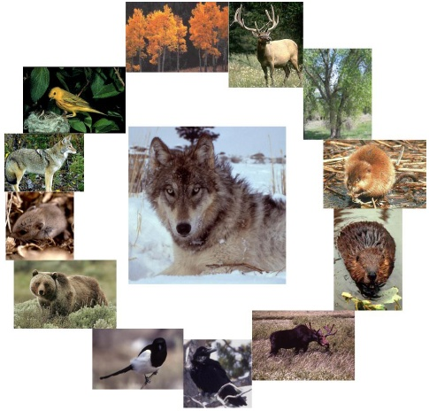
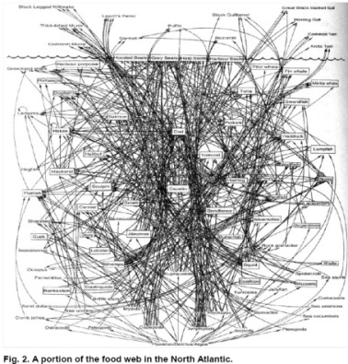
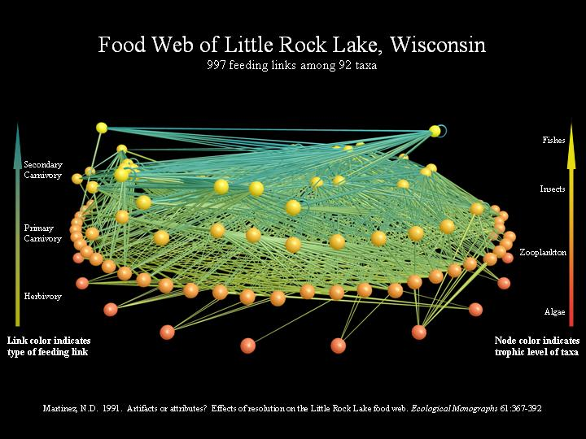
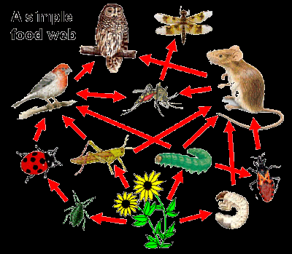
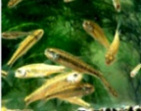
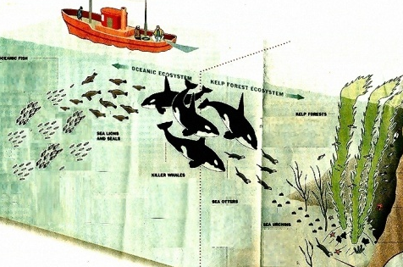
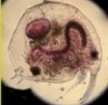

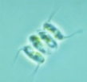
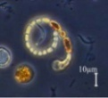
Food Webs & Ecosystem Structure
Minnows
Bosmina
Daphnia
Scenedesmu
Anabena
Notes:
All of the photographs illustrate different food networks or webs. Top left to right: aquatic ecosystem in Little Rock Lake, impact of wolves in an ecosystem, North Atlantic food web. Bottom left to right: simple forest food web, orcas and otters, part of a fresh water food web.

Slide 2
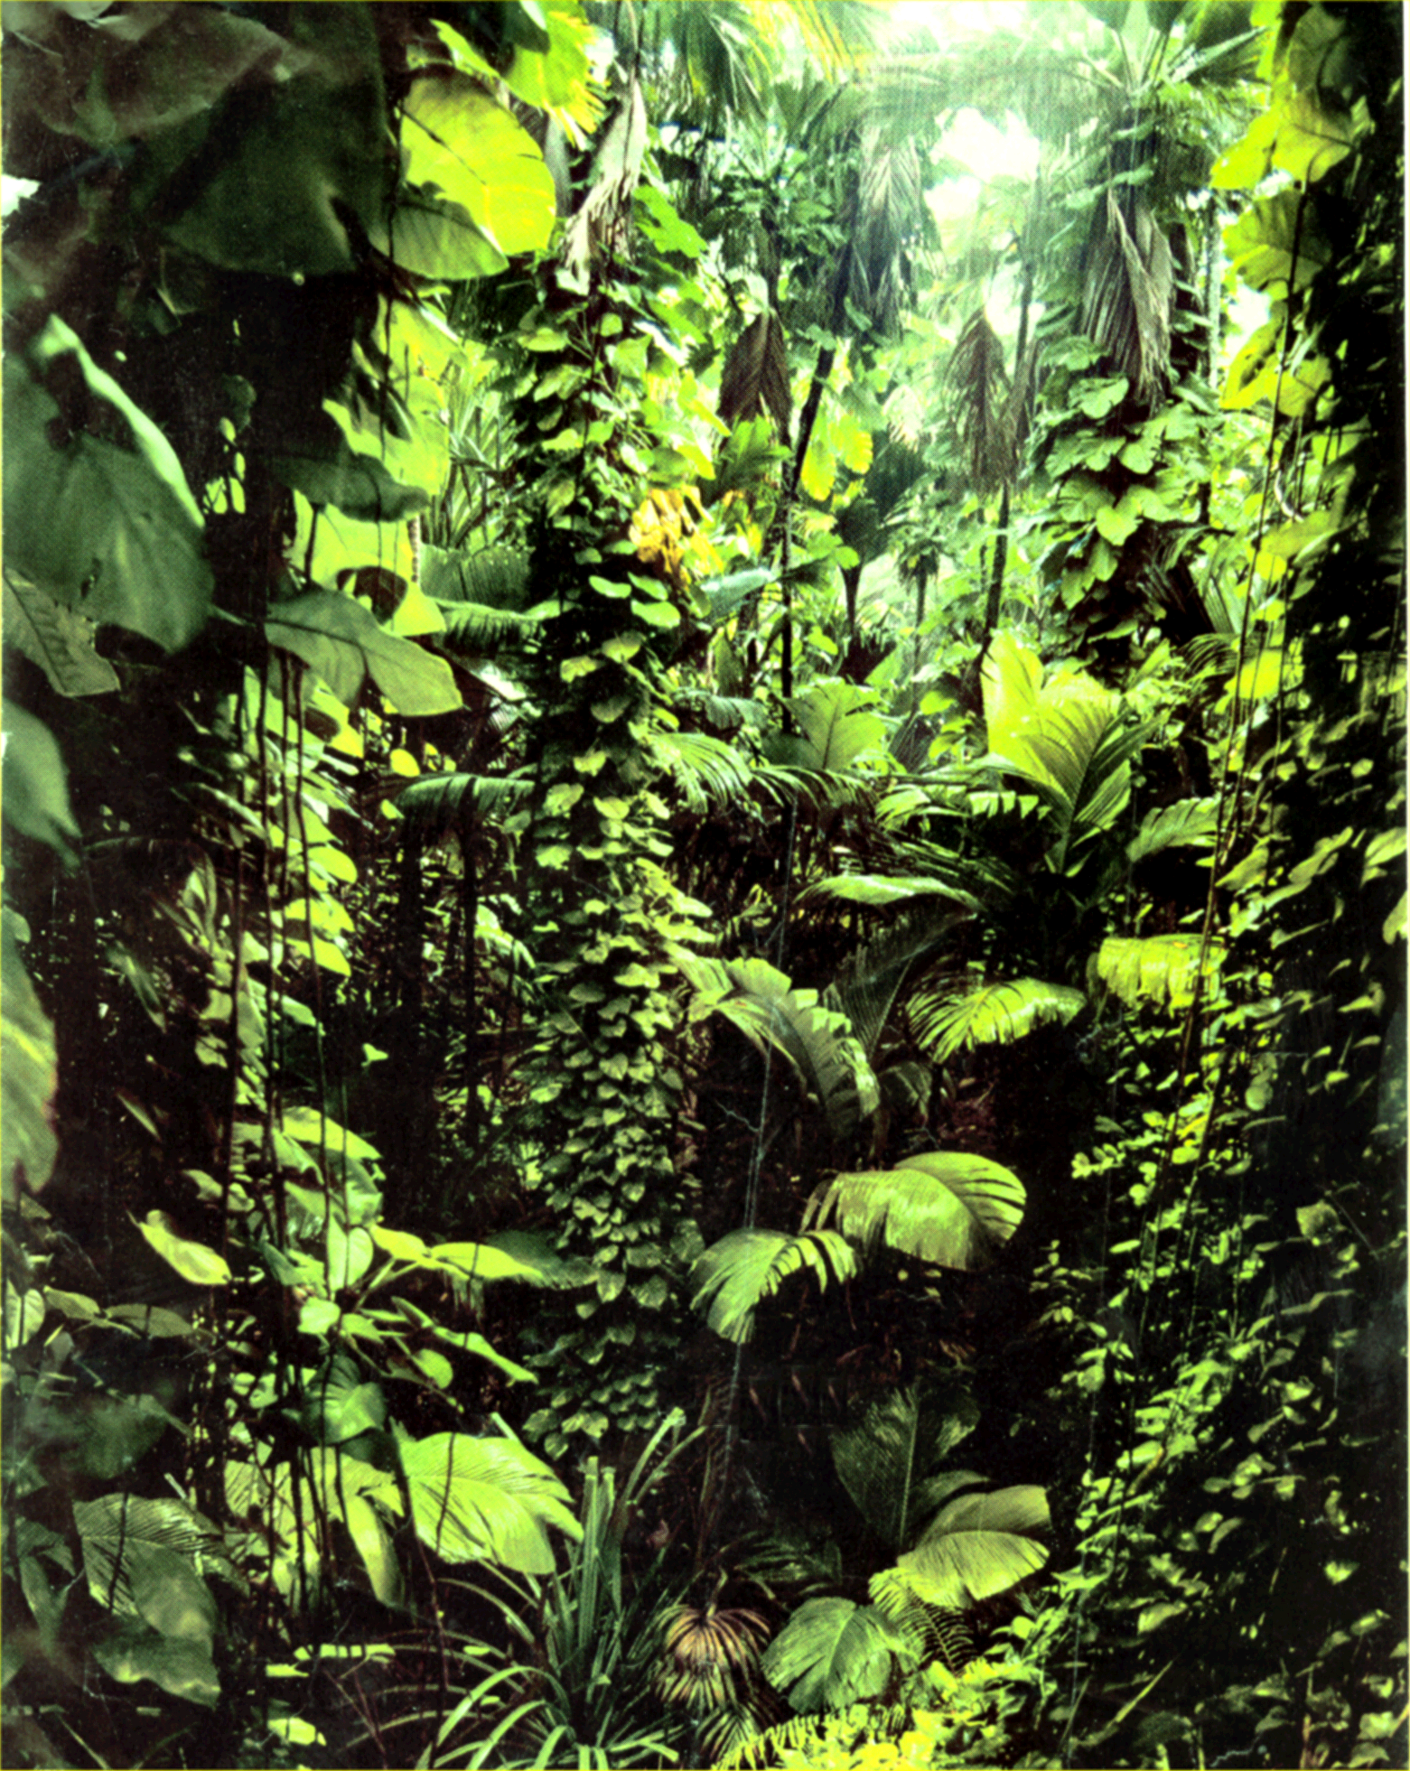
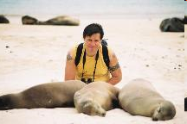
“One of the greatest intellectual challenges of the 21st century is to unravel ecological complexity and understand how ecosystems function.”
- Jeff Harvey, Science
Notes:
Harvey is a Senior Scientist with the Netherlands Institute of Ecology. His interests are inlife history of parasitoides, plant-herbivore-parasitoids interactions, and community ecology. Paraitoids spend most of their life in a single host which it ultimately kills. With normal parasitism, the host is not killed.

Slide 3
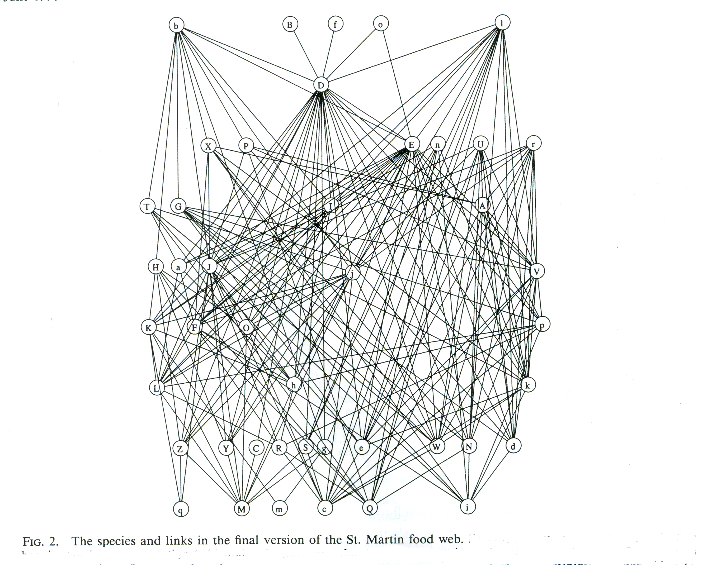
Ecosystems are Complex Adaptive Systems
Large number of interacting components
Interactions non-linear
Dynamics sensitive to initial conditions
Prediction from components difficult
Biotic components can adapt & change
Partial food web on island of St. Martin

Slide 4

Energy and Nutrient Flow Overview
backup copy
Notes:
Video provides an overview of community structure.

Slide 5
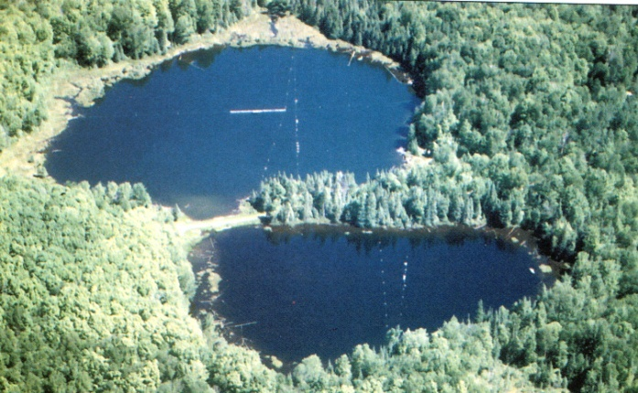
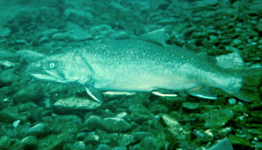


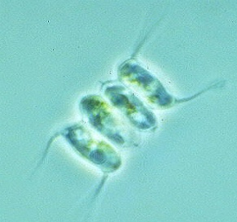

Trophic levels are hierarchical
Tertiary consumers
Trout
Secondary consumers
Minnows
Primary consumers
Bosmina
Daphnia
Primary producers
Scenedesmus
Anabena
Notes:
This is a freshwater ecosystem with only a few of its parts. At the base are phytoplankton which are the primary producers who fic CO2 and carry out photosynthesis. At the second level are the primary consumers who eat the primary producers. Above the phytoplankton are the minnows (secondary consumers) that feed on Zooplankton and above these are the Tertiary consumers- trout. Are there more levels in this ecosystem?

Slide 6
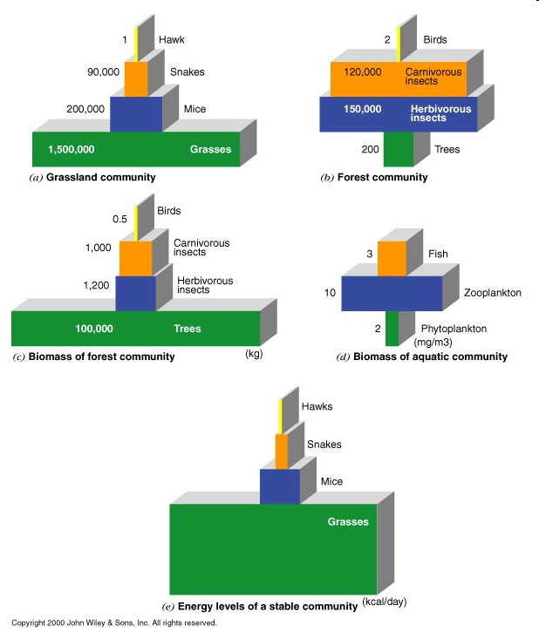
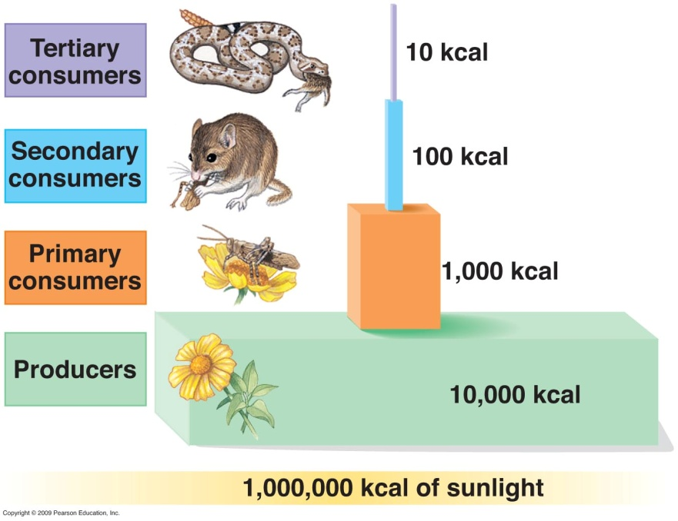
Trophic levels and energy relationships
Notes:
In both of these figures the energy relationships between the trophic levels are indicated. On the left is a simplified ecosystem where the input energy for the system is estimated. At the base of the triangle are the primary producers that capture approximately 1% of the available energy from the sun. The efficiency of photosynthesis from sunlight is about 0.5 to 4% depending upon environment and species. Some of the energy is used for their growth and about 10% is passed on to the primary consumers (grasshopper in this example). At each level only 10% of the available energy is carried on to the next level. Thus it is uncommon to see more than 4-5 trophic levels in the energy diagram of an ecosystem. The examples on the right show several different ecosystems indicating the biomass at the different trophic levels for different ecosystems. In fig a is a grassland community where individuals are counted. Obviously there is enough plant life or primary producers to support the system shown. However, in a forest ecosystem (b), a head count gives a skewed perspective. Trees are big and less numerous so a measure like that in fig (c) is better because it represents the biomass instead of the actual number of individuals. The same measurements in c do not work for the biomass of an aquatic community as the primary producers, phytoplankton, have little mass as shown in d. However, the phytoplankton are algae and they can reproduce rapidly thus their biomass is not the best way to represent their role. The best way is to represent the amount of energy available from the organism at that trophic level.

Slide 7


Now how will he make this connection?
&
http://www.youtube.com/watch?v=TE6wqG4nb3M
Notes:
A little musical review!!

Slide 8

Food Chains Song
Backup copy

Slide 9
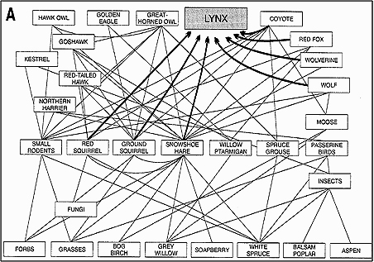
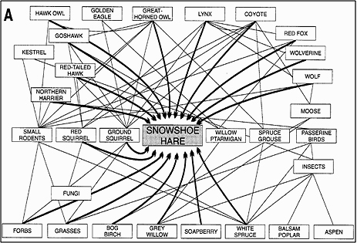
Remember the lynx and the snoeshoe hare?

Slide 10
How would the web be affected if lynx removed?
Snowshoe hare +
Red Squirrel +
Ground squirrel +
Grasses -
Bog birch -
Grey willow -
Soapberry -
White spruce -
Coyotes +
Red fox +
Wolverine +
Wolf +
Great horned owl + ?
Golden eagle + ?
Hawk owl + ?
Goshawk + ?
Kestrel + ?
Red tailed hawk + ?
Northern harrier + ?
Spruce grouse -
Willow ptarmigan -
Moose -
Small rodents - ?
Red squirrel - ?
Ground squirrel - ?
Passerine birds - ?
Forbs ?
Grasses ?
Notes:
The obvious impacts are listed in the upper part of the column. How would you know the impact on the birds of prey listed next (Great Horne Owl-Northern Harrier)? Lots of animals eat the vegetation thus Moose could be impacted by the increase in primary consumers. But how will the small rodents be impacted? Will the other predators pick up and drive their numbers down? Would the population be thrown into a different dynamic equilibrium?

Slide 11
How would web be affected if hares removed?
Red Squirrel +
Ground squirrel +
Grasses +?
Bog birch +?
Grey willow +?
Soapberry +?
White spruce +?
Lynx -
Coyotes -
Red fox -
Wolverine -
Wolf -
Great horned owl - ?
Golden eagle - ?
Hawk owl - ?
Goshawk -?
Kestrel -?
Red tailed hawk -?
Northern harrier -?
Spruce grouse +?
Willow ptarmigan +?
Moose -+?
Small rodents - +?
Red squirrel - +?
Ground squirrel - +?
Passerine birds - +?
Forbs +-?
Grasses +-?
Notes:
Similar questions here, just from a different perspective. Systems get complicated quickly.

Slide 12
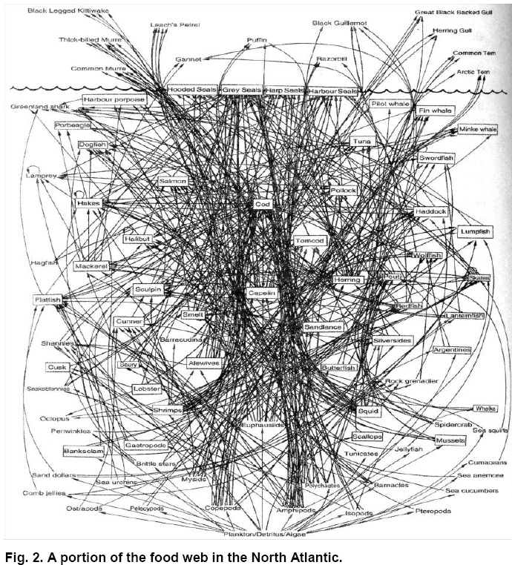
How can we understand web dynamics?
Computer models of webs with many species
Biologically realistic equations for interaction & dynamics, unlike L-V eqs.
Include biotic effects. parasitism, disease, mutualism
Incorporate evolution & variations among individuals
i.e. biotic components can adapt & change

Slide 13
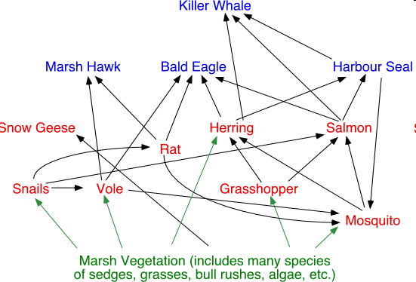
Modeling ecosystems
http://www.youtube.com/watch?v=VxYM-RgVqTI.
Notes:
This video shows how new computer models can be used to predict dynamic changes in an ecosystem. The spheres are species and the size grows or shrinks to indicate abundance. The cones show feeding relationships and rates where the pointed end of the cone is what gets eaten and the wide end of the cone who is eating it. The size of the cone indicates rates. The dynamics of most systems are such that fluctuations can be tolerated and while not an equilibrium the relationships do not have to remain steady. Models are useful for prediction of impact of species extinctions and for introduction of invasive species. The video provides an excellent example of how an ecosystem can be changed radically by removing a parasite, normally considered a good idea, and the fact that this changes the relationships in the ecosystem causing half of the species to go to extinction.

Slide 14

The Mother of All Complex Systems
~20,000 insect sp
1200 tree sp
1000 bird sp
200 mammal sp
10⁷ microbe sp?
Tropical Rain Forest along the Amazon
Imagine the model required to illustrate this food web and the amount of species information needed to build it.

Slide 15
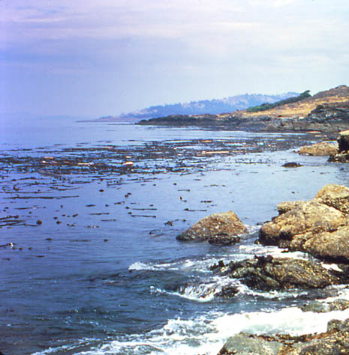
Pacific Coast Kelp Bed
Why did kelp ecosystems off Alaska begin to collapse in the 1990s?
Notes:
Image of kelp ecosystem and question: Why did kelp ecosystems off Alaska begin to collapse in the 1990s? note: This BioThinking activity involves the relations between two ecosystems in the North Pacific off the coast of Alaska: Off-shore oceanic ecosystem and on-shore kelp forest ecosystem. Orcas are predators in both ecosystems but prefer sea lions and seals over otters because of their size and fat (otters smaller and with little fat). Oceanic ecosystem: sea lions and seals eat fish and Orcas eat sea lions and seals. Kelp forest: otters eat sea urchins, sea urchins eat kelp, kelp provides nursery for oceanic fish. For simplicity, seals are excluded from this activity. They play a role similar to that of sea lions.

Slide 16
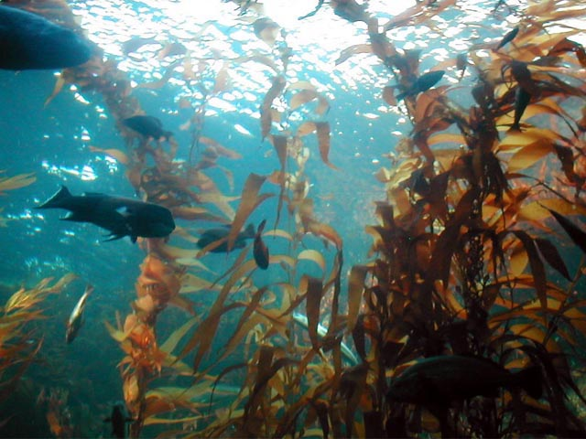
Kelp Forest is a Fish Nursery
Notes:
Image of kelp ecosystem with kelp and fish.

Slide 17
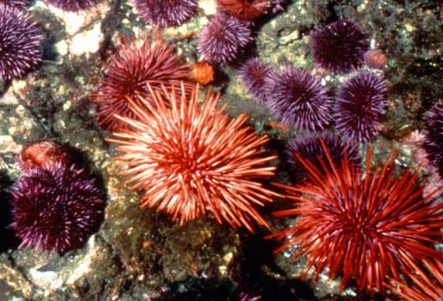
Sea Urchins Eat Kelp
Notes:
Images of sea urchins and kelp ecosystem with statement: Sea urchins eat kelp.

Slide 18
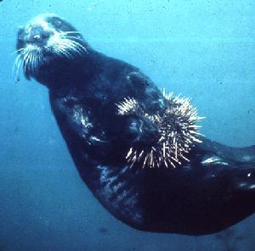
Sea Otters Eat Urchins
Notes:
Image of sea otter holding a sea urchin and image of a sea urchin with title: Sea otters eat urchins.

Slide 19
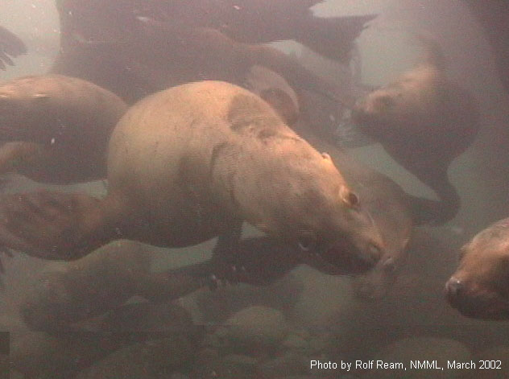
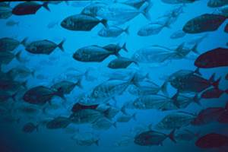
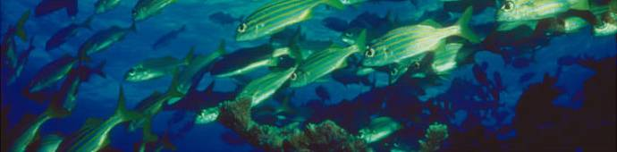
Sea Lions Eat Fish
Notes:
Images of sea lions and fish with title: Sea lions eat fish.

Slide 20
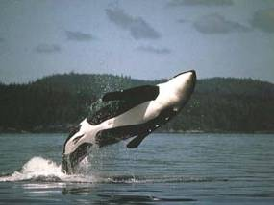
Orcas Eat Sea Lions
Notes:
Images of orca (killer whale) and sea lions with title: Orcas eat sea lions.

Slide 21
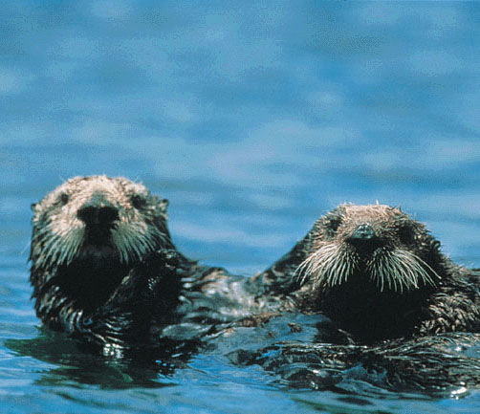
Orcas May Also Eat Otters
Notes:
Images of orca and sea otters with title: Orcas may also eat otters.

Slide 22
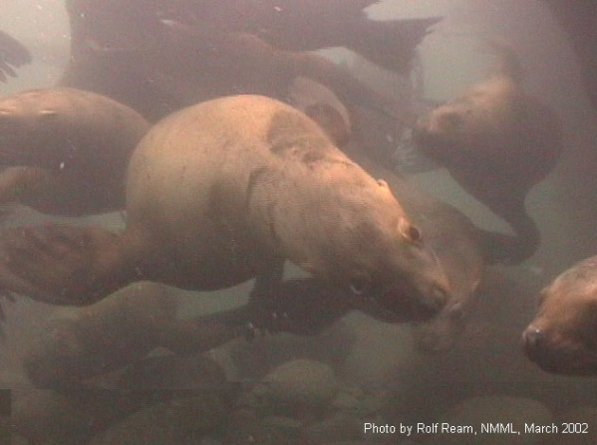
Oceanic and Kelp Ecosystems
Notes:
Images of key players in oceanic and kelp ecosystems and their feeding relationships: fish, sea lions, orcas, otters, sea urchins, kelp.

Slide 23
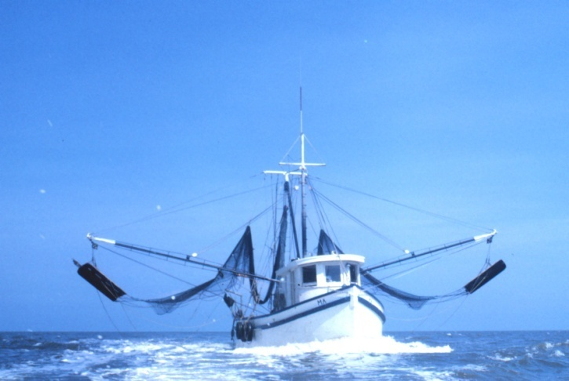
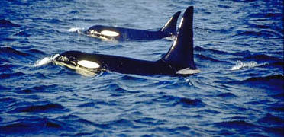

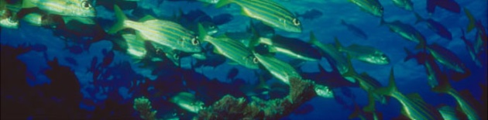

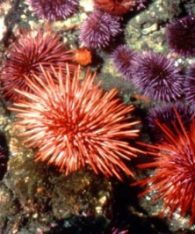
Oceanic and Kelp Ecosystems
What happens to the abundances of these species under increased fishing pressure?
Notes:
Image of fishing boat and key players as above and question: What happens to these ecosystems under fishing pressure? note: Have each individual complete a prediction sheet. Then ask students to turn to neighbor and compare predictions. After a minute or so, pick a group at random to give their predictions and the bases for their predictions to stimulate class discussion.

Slide 24
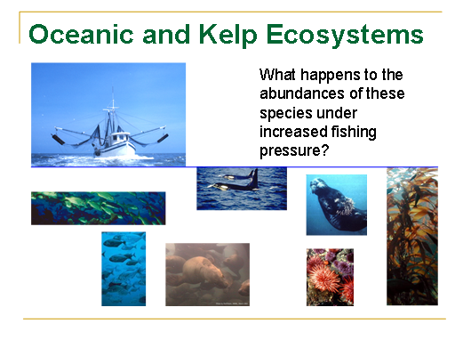
Attendance exercise
Fishing pressure in the North Pacific is about to increase five fold. Below, indicate your predictions concerning how this increase will affect the abundances of the species in the food web. Use an up arrow to indicate an increase, a horizontal arrow to indicate no change, and a down arrow to indicate a decrease. Enter a question mark if you think the direction of change can’t be determined from the information you have been given.

Slide 25
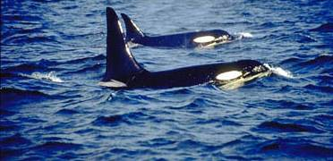

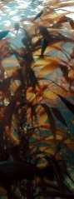


Oceanic and Kelp Ecosystems
… until kelp ecosystem and orca population collapse
Notes:
Images as in slide 16 but with smaller images of sea lions, otters, and kelp, and larger image of sea urchins to illustrate continuing reverberations in these food chains that were initiated by heavy fishing pressure. The end result can be the collapse of the kelp ecosystem and major disruption (or collapse) of the oceanic ecosystem.

Slide 26
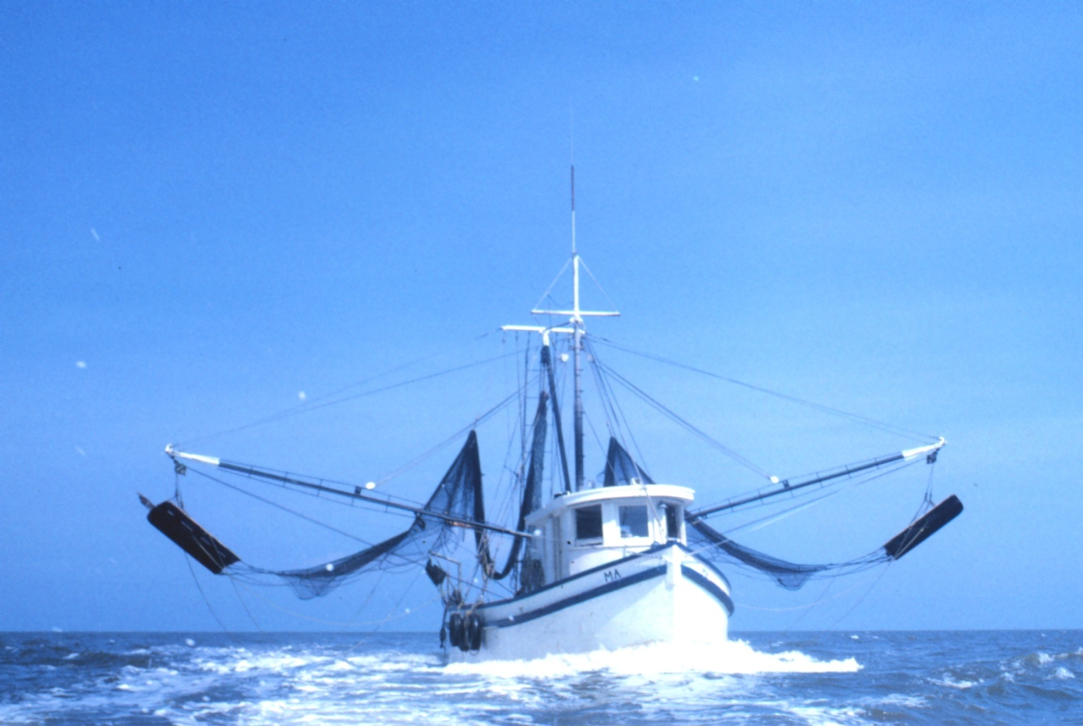
More Boats → Fewer Fish
Notes:
Image of fishing boat and statement: More boats leads to fewer fish.
note: Conclude ILA by asking class what role the otters play in the inshore ecosystem. They are keystone predators. What ecological principle is illustrated by humans? This is an example of competition where humans are competitively superior to sea lions and seals in harvesting oceanic fish. As a consequence sea lion and seal abundances decrease and orcas turn to eating more otters which, in turn, cause a collapse in the kelp ecosystem. With oceanic fish nurseries impoverished, oceanic fish abundance decreases even more.

Slide 27
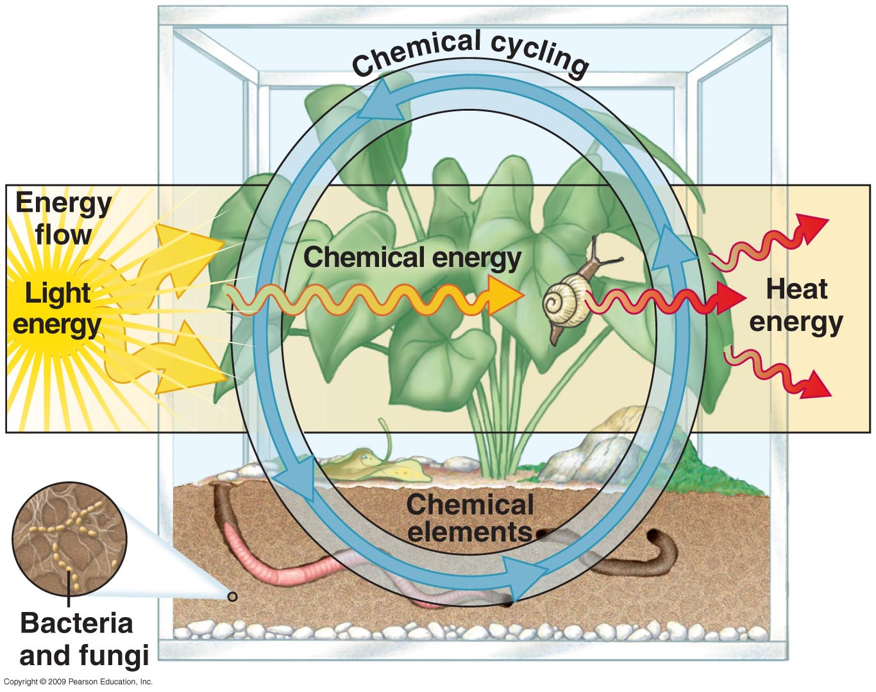
Review: Energy Flow and Chemical Cycling in a Simple Ecosystem
Notes:
We have discussed energy flow utilizing sunlight as the input energy source and primary producers as the plant or photosynthetic life forms as primary producers. The inefficiency of energy cycling has been demonstrated and explains why there are so few levels of consumers- systems rarely go beyond 3 to 4 levels. The part that we have not discussed is the chemical cycling. It is truly a cycle where the abiotic resources limit the overall ecosystem. The abiotic resources include air, water and soil while the biotic are members of the ecosystem. Chemical resources include C, N, P, and water. There are a few trace elements that are utilized. The primary producers acquire these chemicals and fix them into organic compounds that are then utilized in a similar way to the enrgy flow. However, dead organisms have their elements recycled by the decomposers, bacteria and fungi, who return the nutrients to the abiotic part of the ecosystem.

Slide 28
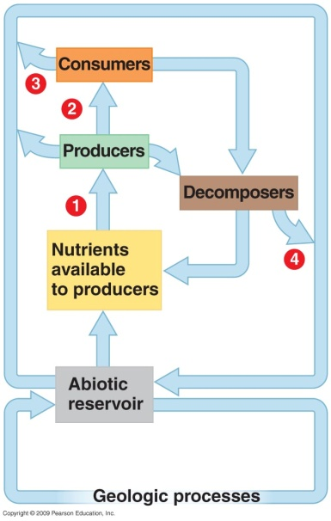
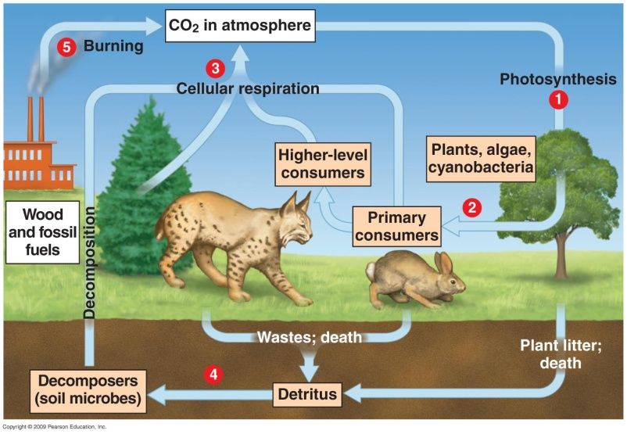
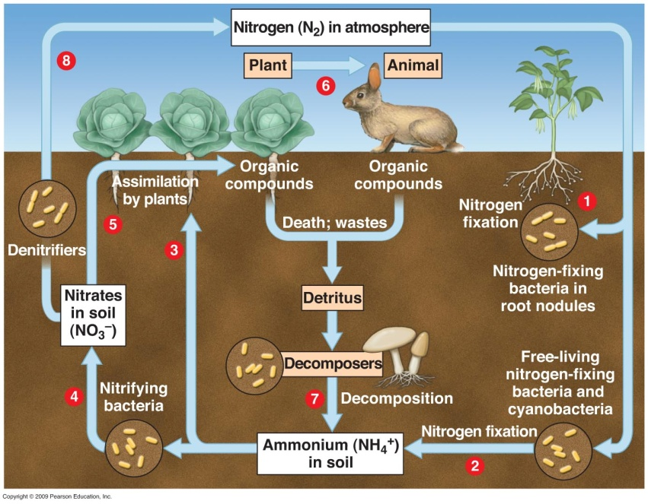
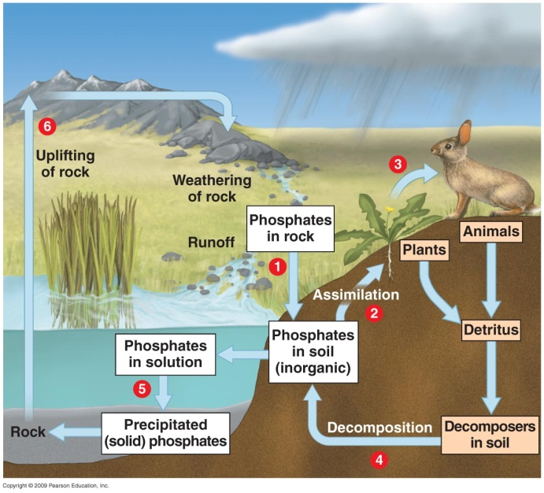
Biogeochemical cycles
Carbon
General
Phosphorus
Nitrogen
Notes:
The general cycle is a simplification from the previous slide where we show the abiotic reservoir and the geologic processes that provide access to the primary producers for uptake and distribution to the various levels of the trophic system. Notice the prominent roles of the decomposers. The abiotic reservoir is where the chemicals build up. Carbon comes from the CO2 in the atmosphere whereas P comes from the soil only. We will discuss the C, P, and N cycles presented in the other three diagrams in more detail in the following slides.

Slide 29
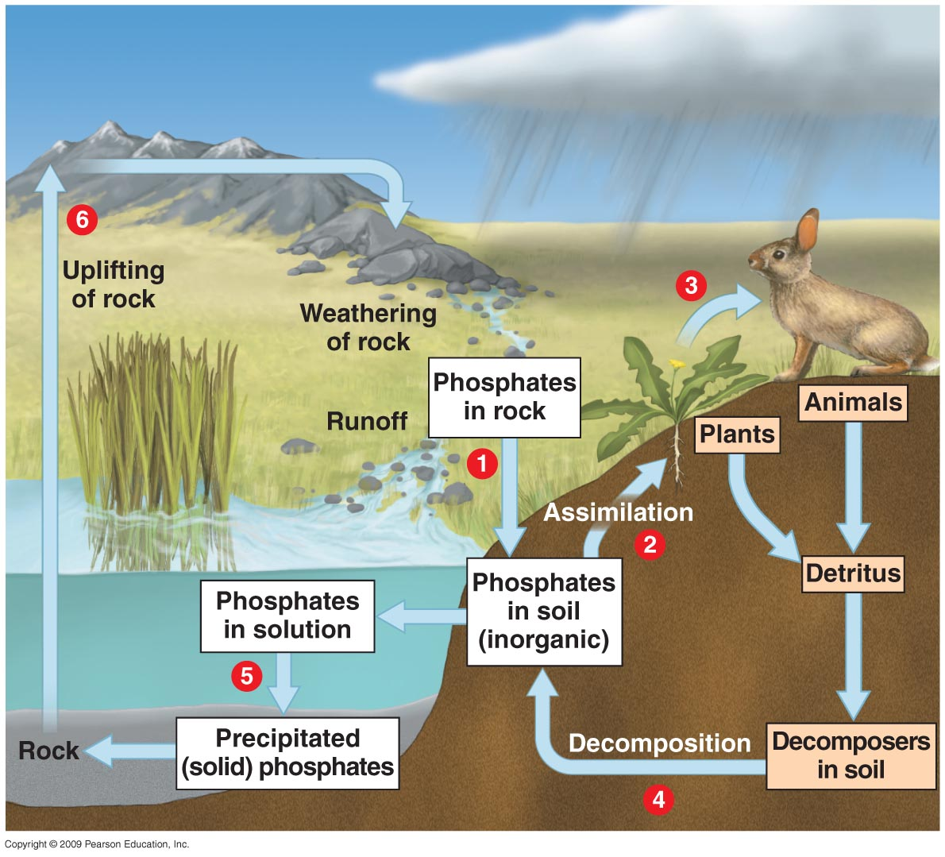
Phosphorus Cycling
Notes:
Rocks are the only source of P for terrestrial ecosystems and rocks with high P content can be mined. The biotic realm requires P for nucleic acids, ATP, and phospholipids. We need it for bones and teeth. Let’s follow the cycle. Weathering of rock adds inorganic phosphate PO₄³⁻ to the soil. Plants absorb and assimilate into organic compounds to put phophate into the biotic part of the cycle. Consumers pick it up and decomposers return it to the soil. Some terrestrial phosphorus leaches into the water system and eventually becomes part of rocks. This portion is removed from the cycle until the rocks are uplifted by geologic processes where they can be weathered.

Slide 30
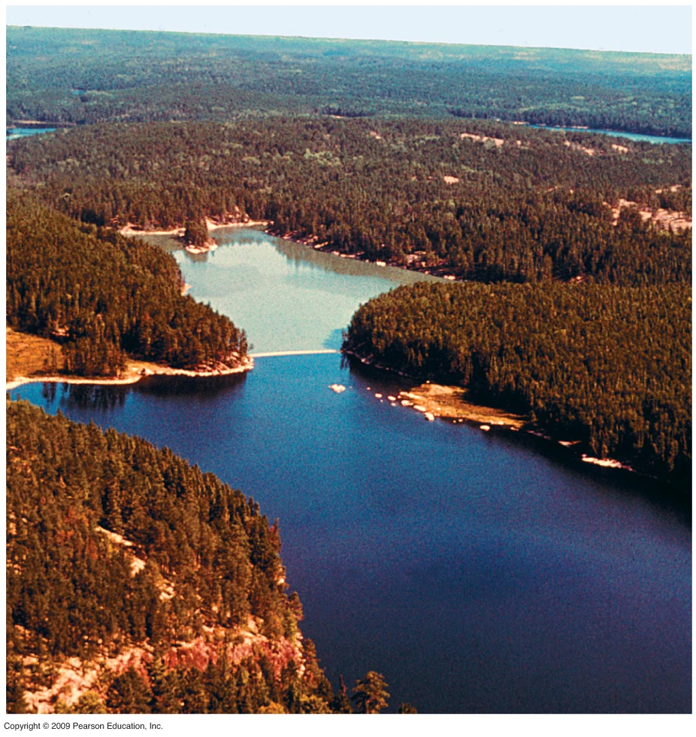
Phosphorus Gone Wild: Eutrophication of Lakes
P added
No additional P
Notes:
Many disturbances around lakes such as deforestation or building of homes have an impact on the run off of water. With P in the soil, it can be leached into the water. The lake above is in Northern Ontario and the study was done by Dr. David Schindler, Professor of Ecology at University of Alberta. His group divided a lake into two basins. In both sections additional C and N was added while only the upper portion of the lake received additional P. The additional P caused the algae and cyanobacteria to “bloom” or grow rapidly. This bloom causes a decrease in oxygen available during the night when photosynthetic organisms respire only. As the organisms die and settle to the bottom of the lake decomposers utilize more of the oxygen. This double whammy makes it more difficult for other organisms higher up the food chain to survive with reduced oxygenation of the water. Giant impact on fish. Why the experiment? In the late 1960’s eutrophication was a great problem and understanding the cause was important. The cause turned out to be P and the use of phosphate-containing detergents was a major problem as the added P leached into lakes.

Slide 31
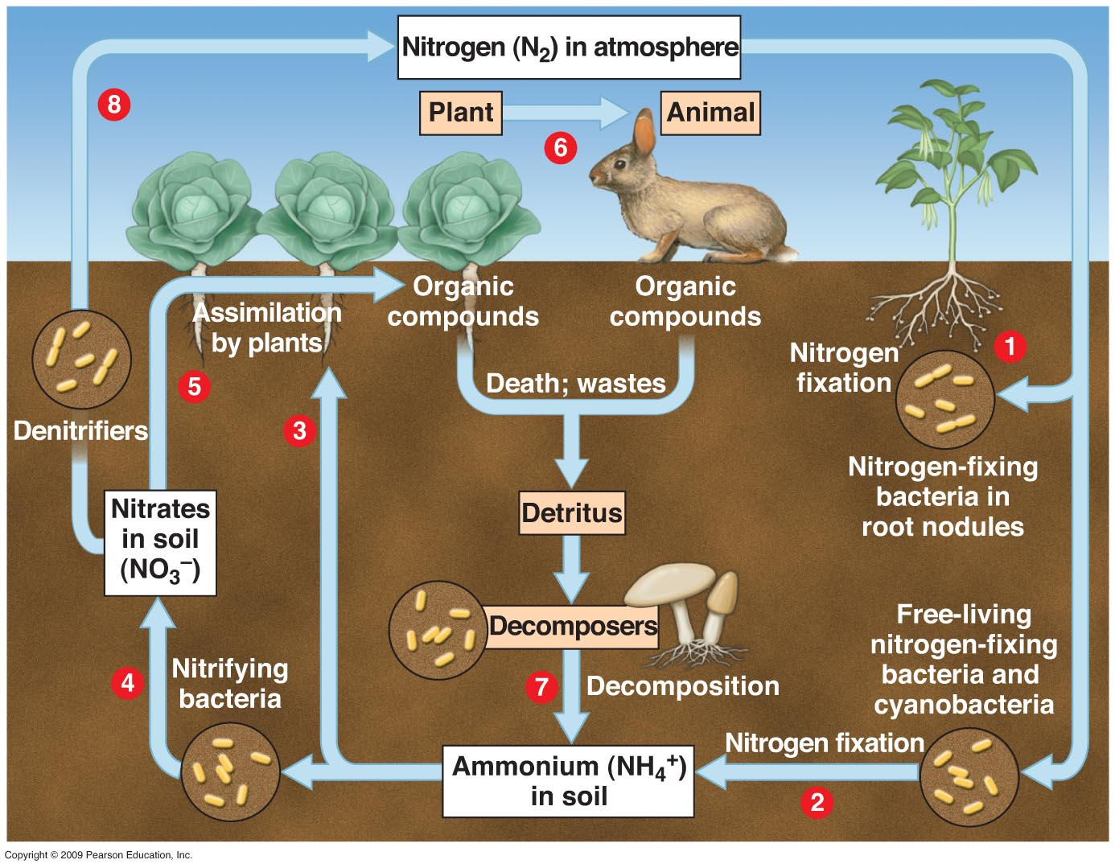
Nitrogen Cycle and the Importance of Microorganisms
Notes:
N is an essential element for all living systems as it is a component of nucleic acids and proteins. There are two abiotic reservoirs for N- air and soil. The atmosphere is 80% nitrogen gas- N₂- but plants cannot absorb it in this form. Bacteria must fix the atmospheric nitrogen and this process occurs in two communities of bacteria. Legumes and other specific plants have symbiotic relationship with N-fixing bacteria that live in their roots. These bacteria provide N directly to the plant in a form that they can utilize. Other free-living bacteria fix N and liberate it into the soil. In both cases the N is provided as ammonium or NH₄⁺. Some plants can take this up directly but other prefer it in the form of nitrates (NO₃⁻). From here assimilation to higher trophic levels occurs normally with amino acids and nucleotides being the most common recycled materials. Consumers excrete some nitrogen in organic form as urea which is useful as a fertilizer. Decomposers recycle the N as ammonium. The denitrifying bacteria can take nitrates and convert it into atmospheric N₂. Human activity has impacted the nitrogen cycle and our environment. Large amounts of fertilizer runoff and feedlot waste add N to our watershed. In aquatic systems where N is limiting, runoff can cause bloom os microorganisms and nitrates in drinking water can be converted to nitrites which can be toxic at high enough concentrations.

Slide 32

The Carbon Cycle
Notes:
C has an atmospheric reservoir and it cycles globally. C is the major component of organic molecules and obviously is important in the biotic realm. Photosynthesis provides the mechanism for fixation of CO₂ into more complex organic molecules and is a major role of primary producers. The higher trophic levels are dependent upon the primary producers. Cellular respiration by most living forms releases CO₂ to the atmosphere as do decomposers who recycle all living forms. In this part of the cycle there is almost a reciprocal relationship. However, look at item #5 where CO₂ is added to the atmosphere from burning of wood and fossil fuels. Here begins the arguments of global warming.

Slide 33
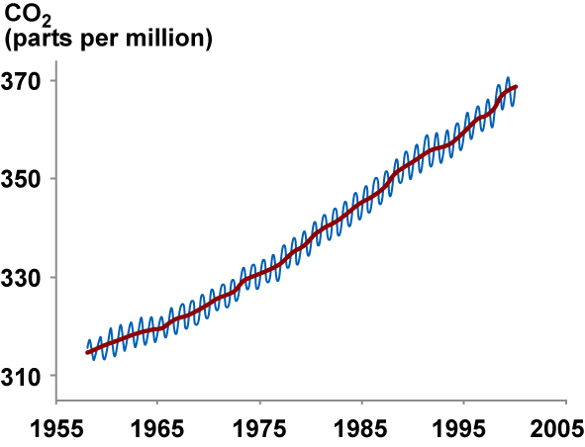
Global Warming
Video: Global Warming and Climate Change
Notes:
Review of video on Global Warming and Climate Change. At the beginning of the industrial revolution two centuries ago we began to use fossil fuels to drive industry. In 1896 Swedish scientist Svante Arrhenius published the first paper in Science implying a relationship between [CO₂] and temperature change. Suggested a doubling of [CO₂] led to a temperature change of 5ºC. This was the first indication of human impacts above the normal cycling relationship of [CO₂] and temperature. In March 1958 Charles D. Keeling began to measure [CO₂] at Mauna Loa Observatory in Hawaii with readings every 10 seconds for 40 years. This generated the famous Keeling curve shown in the figure. The seasonal variations in [CO₂] are shown by the up and down pattern where more CO₂ is fixed in the summer and less in the winter. The video then shifts to follow the work of Wally Broecker in relationship to the normal trans-Atlantic conveyor belt of ocean current impacts. It illustrates the normal affect of the current on warming Europe and states that a change in the operation of the conveyor would drive European temperatures down. What might cause this change is an input of freshwater which would cause the conveyor to shut down. The density of cold salty water is less than that of warm salty water and fresh water has even less density. Fresh water input can come from the melting of the polar ice cap which is occurring as temperatures increase. Addition of fresh water will stop the Atlantic conveyor and cause colder temperatures in Europe. If Global warming continues we can expect more radical climate changes that will vary with where we are looking in the Earth’s biomes.

Slide 34
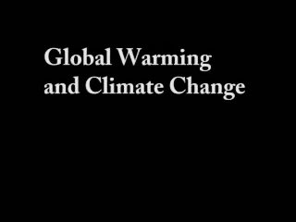
Video: Global Warming and Climate Change
backup copy

Slide 35
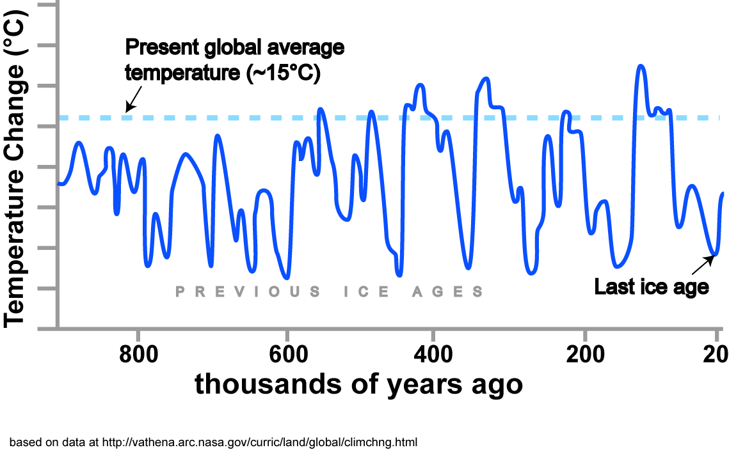
Earth’s Climate: Always Changing
Notes:
The 900,000 year history of Earth’s fluctuating surface temperature. Temperatures have varied ~7 degrees centigrade and correlate with ice ages occurring about every 100,000 years. Most of these data come from analysis of ice cores that have built up over long periods of time. This is from Antarctica. Delta deuterium data is used as a proxy for temperature information in ice cores. The ratio of H to D is indicative of temperature changes. In Antarctica, a cooling of 1°C results in a decrease of 9 per mil deuterium (Abysov et al. 1995).

Slide 36

Earth’s CO₂ Levels
Notes:
The 400,000 year history of atmospheric CO₂ concentration that shows a 100,000 year cycle that also correlates with the coming and going of ice ages. CO₂ can be measured from the trapped air bubbles in the ice column.

Slide 37

Why these fluctuations?
Do you see any relationship between temperature & [CO₂]?
Notes:
The temperature and CO₂ histories in slides 35 and 36 are presented together so they can be used to open a class discussion on the factors contributing to CO₂ concentration and global climate change.

Slide 38

Temperature and CO₂
380
Notes:
The 160,000 year history of CO2 concentration and temperature showing the similarity of ups and downs with CO₂ concentration change preceding that of temperature change. The unprecedented increase in CO₂ concentration in the most recent history is foreboding. We have not reached this concentration in the last 400,000 years. In the last 100 years the Earth’s average temperature has increased 0.8 degrees C with 0.6 of that in the last three decades.

Slide 39

Suess Effect
CO₂ Pool | Δ¹⁴C Value (‰) | δ¹³C Value (‰)
Fossil Fuels | -1,000 | -28
Terrestrial Biosphere | +45 | -26
Ocean | +45 | -10
Atmosphere | +45 | -8
Average delta values–both for stable carbon and radiocarbon–of the different major pools of carbon dioxide.
The addition of carbon dioxide that is depleted in C-14 lowers the C-14 proportion in the air.
Notes:
An Example Calculation…How the Sources Affect the Delta Value
Let's look at an example: Right now (in 2010) the natural atmosphere has about 380 parts per million, or ppm, of CO₂, with Δ¹⁴C of +45‰. If we add 1 ppm of fossil fuel CO₂, with a Δ¹⁴C of -1000‰, then the new Δ¹⁴C value in the atmosphere is a little bit lower: +42‰. On the other hand, if we instead add 1 ppm of CO₂ from a forest fire, the CO₂ from the fire would have the same Δ¹⁴C value as the atmosphere (or very close to it). The Δ¹⁴C of the atmosphere would not change.

Slide 40
Scientific Observations Consistent with Global Climate Change
Antarctic ice warming & breaking up
Arctic drying
California marine systems moving north
Tropical diseases leaving tropics
Destruction of coral reefs
Increased size of warm Pacific pool
Increased NO in Pacific
Melting of tropical mountain glaciers
Changing timing of seasons
Lengthening of growing season
Increase of ocean wave height
More frequent & bigger storms
Bore hole temperature data
The dozen hottest years of record since 1980
Hottest year of record was 2006
Greenland ice sheet
Heating of world’s oceans

