Slide 1
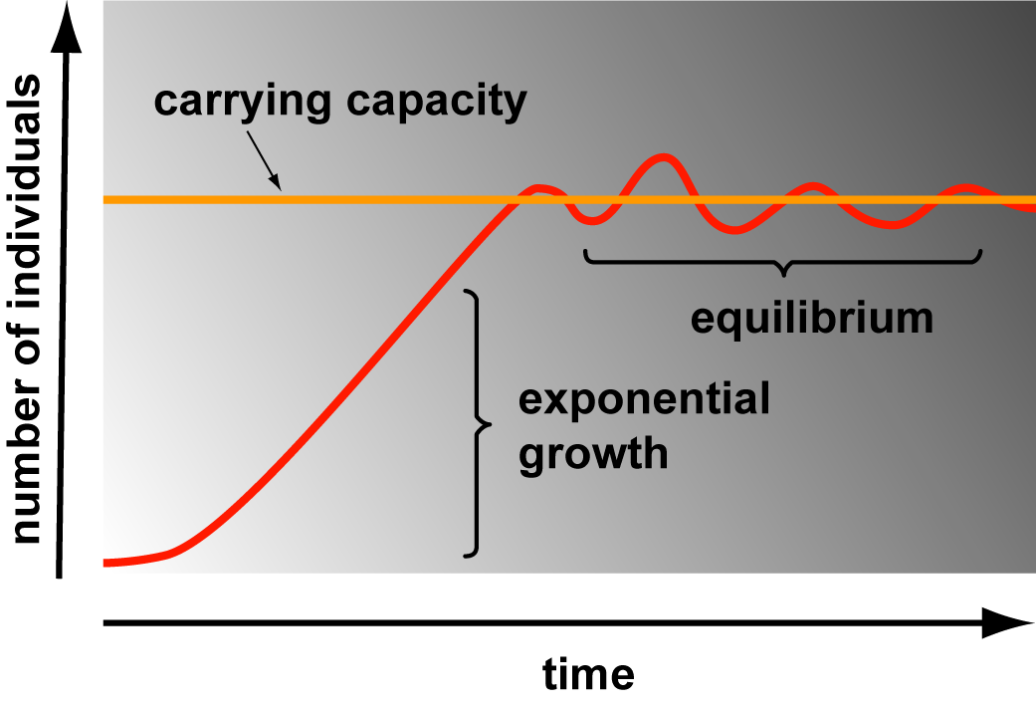
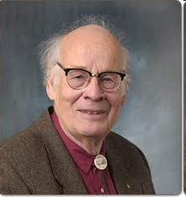
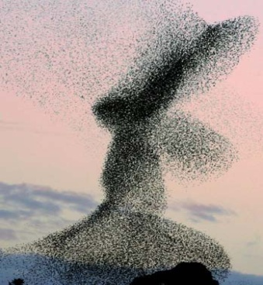
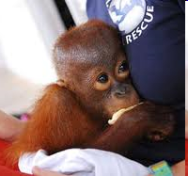
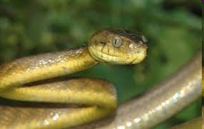
The Future of Planet Earth:
Reminders from previous classes
Notes:
Opening slide for a discussion of the future of planet earth. The first slide at the top is to remind us of the exponential growth function. The middle pictures show a massive flock of starlings which are invading species. The picture of Prof. Bartlett is to show the person that this session evolves around. Baby orangutan that was rescued- an endangered species because of habitat loss. The bald eagle- a success story because it is off the endangered species list. The brown snake is an invasive species that has eliminated almost all of the birds and other small mammals from the island of Guam.

Slide 2
Heat impact on ecosystems
backup copy

Slide 3
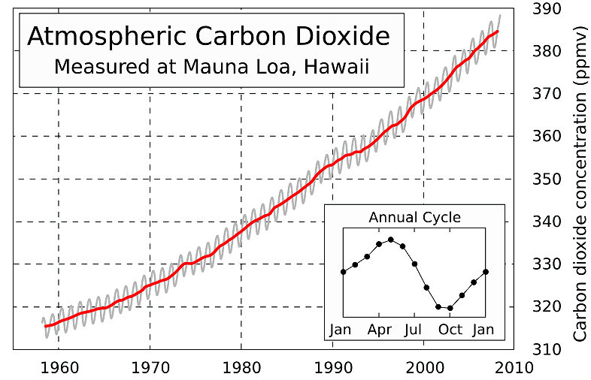
Global Warming
Roger Revelle & Charles Keeling began taking daily measurements of CO2 at top of Mauna Loa in 1958
Pre-idustrial levels were 280 ppm
Notes:
Reminder from previous class of [CO₂] impact on global warming.

Slide 4
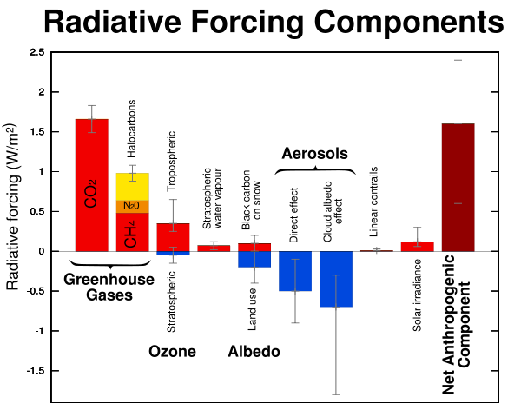
Global Warming Feedbacks
CO₂, CH₄
Water vapor
Aerosols
Ice/snow/clouds
Open water
Open soil
+
+
-
-
+
+
Notes:
However, there is more to global warming than just CO₂. According to the Oxford Dictionary, radiative forcing is the increase in the trapping of outgoing terrestrial radiation by greenhouse gases. Greenhouse gases include CO₂, methane, nitrous oxide and halocarbons which all add to the effect of trapping the heat which is the result of the long wavelength radiation. Aerosols and albedo tend to reflect light back and thus have a negative effect on warming. The Net anthropogenic component is what results from mankind.

Slide 5
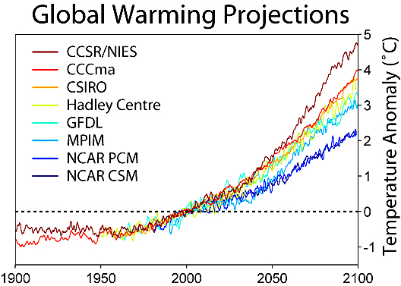
Global Warming Models
Amount of global warming dependent on levels of CO₂
If levels of CO₂ reach 900-1000 ppm then temperature increase could double over next 40 yrs from predicted 2-5^{O}C to 4-9^{O}C
Notes:
In upper diagram are a variety of different models used for climate prediction. Depending upon the model a 1.5-5.8ºC change is predicted between 1990 to 2100.

Slide 6
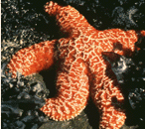
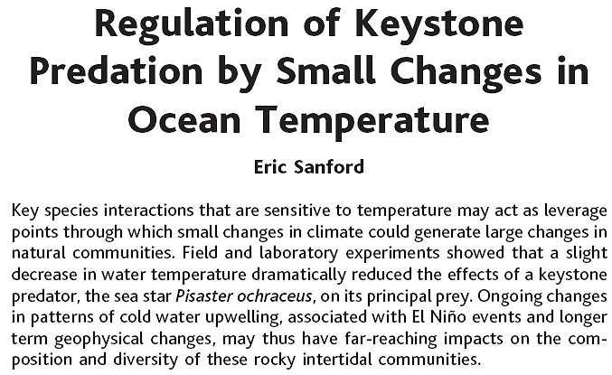
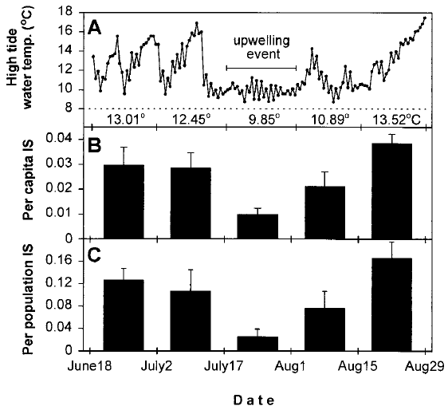
Ecological Impacts?
Tested whether strength of predation of Pisaster on Mytilus varied with water temp.
Upwellings caused significant (3x) drop in Pisaster predation as individuals consumed less & local density reduced
Strength of keystone interactions can be altered by slight shifts in temperature shifts & seasonality equivalent to those over next 40 yrs
Thus climate change may drastically alter community structure & dynamics and have a much more important impact than slow shifts in geographic distributions
“
Notes:
Pisaster is the star fish and is a predator of Mytilus which is a bivalve (mussel). Upwellings or decrease in temperature cause a drop in consumption by Pisaster. B is the mean per capita predation rate of Pisaster on added Mytilus and A is the high tide water temperature on those same days.

Slide 7
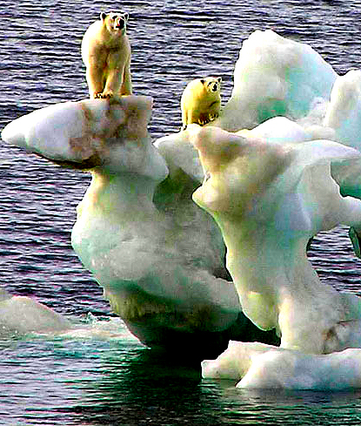
Ecological Impact
“Anthropogenic warming will lead to ecological impacts that are abrupt and irreversible, depending on rate & magnitude of climate change.” – IPCC 2007
Already ~70% of Earth’s species affected
Distribution shifts, abundance declines, smaller ranges; new parasites, diseases, competitors & predators
“An assault on the Bering Sea food web from top and bottom”: Fishing & hunting take top predators, climate change causing catastrophic shifts in plankton & zooplankton
In past 20 years, 80% drop in zooplankton abundance

Slide 8
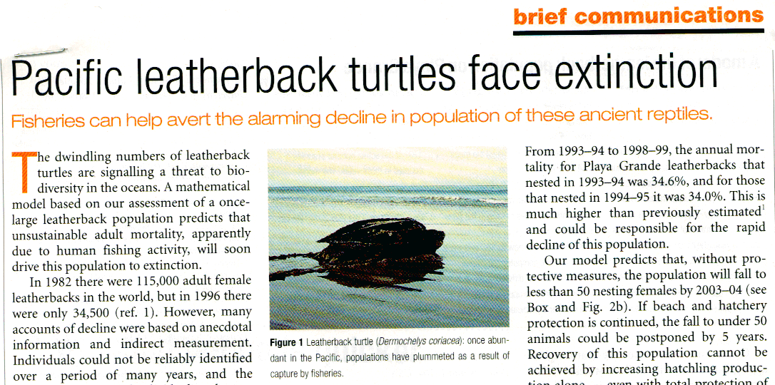
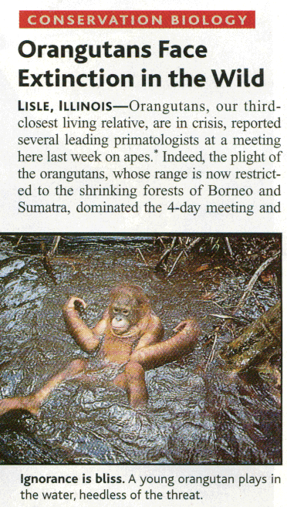
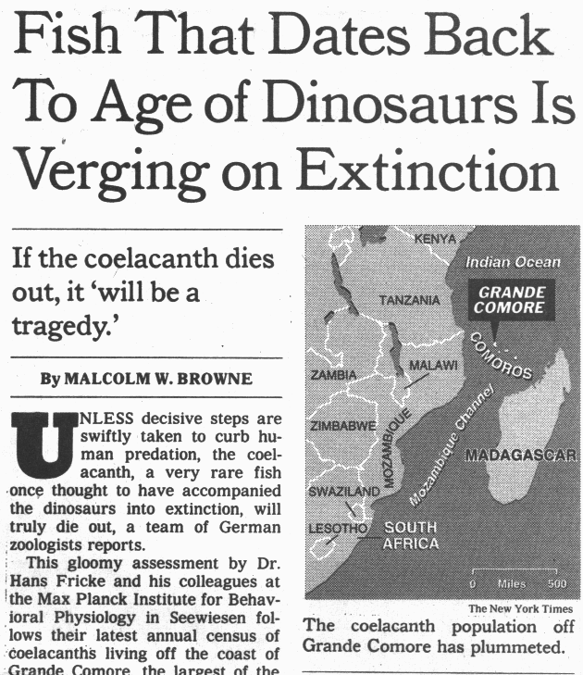
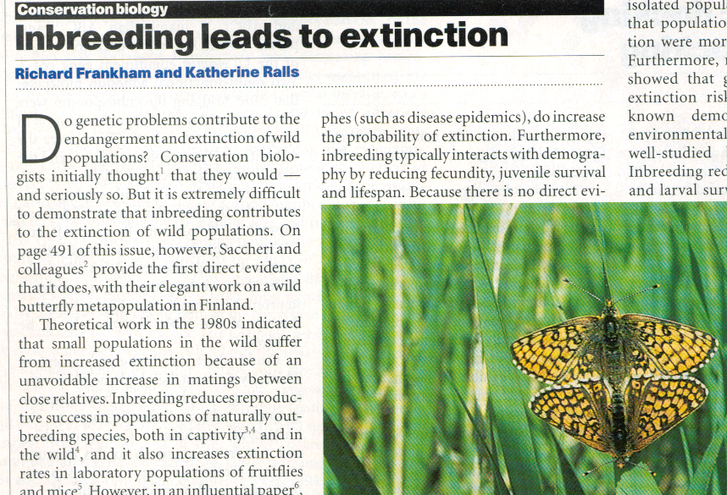
Passenger Pigeon
Extinction of species
Notes:
Coelacanth thought to have gone extinct 65 MYA was found in 1938- related to lungfish and tetrapods- is going extinct now because of human predation. Orangutan habitat is being destroyed in Indonesia over 80% of it destroyed. Leatherback turtles are largest living sea turtles and population in Pacific is threatened by man.

Slide 9
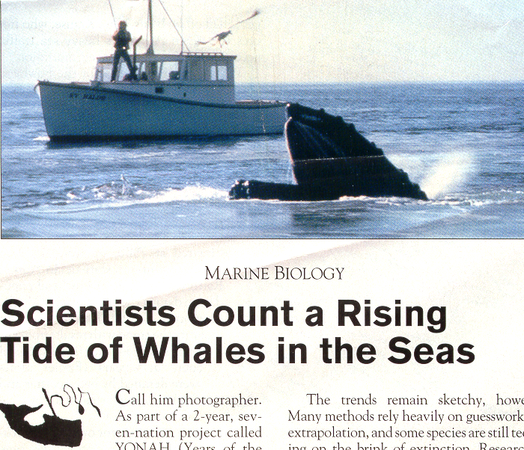
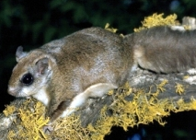
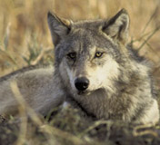
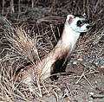
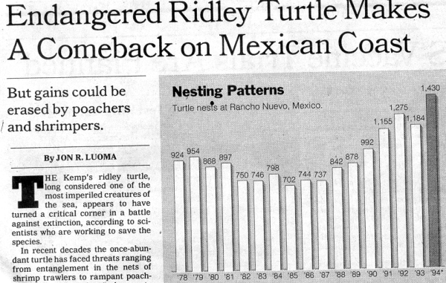
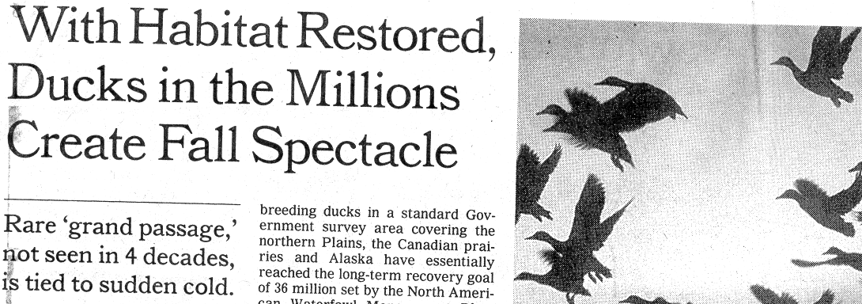
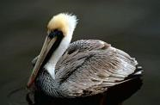
Success Stories
Flying squirrel recovered – off endangered list
Proposal to Delist
Gray Wolf
Black footed ferret
Bald Eagle back from edge of extinction
US takes brown pelican off endangered species list
By Karin Zeitvogel (AFP) – Nov 11, 2009
WASHINGTON — Nearly 40 years after it was pushed to the edge of extinction by pesticide use, habitat loss and hunting, the brown pelican was Wednesday taken off the endangered species list, US officials said.
Notes:
Original cause of problem for brown pelican was pesticide DDT and its ban with the action of other conservation efforts (stop hunting) have restored the pelican to the Eastern seaboard. Estimate ~650,000 in current population. Reintroduction of wolves into Northwest has been a success and discussed previously. Bald Eagle removed in 2007. there were many reasons for its previous decline which included human disturbance, habitat loss, deforestation, poaching, and pesticides. In 1963 only 417 nesting pairs were found (~100,000 pairs in 1782). The West Virginia Flying Squirrel was placed on endangered list mostly because of habitat loss. Their habitat was the old-growth spruce forests and a few survived in small patches. Us Forest Service and WV Division of Natural Resources have worked hard to restore the spruce forests which has allowed the flying squirrel to increase in numbers.

Slide 10
What made the success stories happen?
A plan for protecting species- The Endangered Species Act and conservation efforts
Landscape ecology- save the ecosystem not just the individuals
Protect biodiversity hotspots by making reserves
Restoration ecology to restore habitats as occured with the flying squirrel.
AND SUSTAINABLE DEVELOPMENT
Notes:
Landscape ecology helps by bringing fragments together with “bridges” and looking at connections between fragments or changing areas between fragments. Have fewer edge effects. Combinations of zoning reserves and sustainable development help.

Slide 11
Radical solutions
Drones used to fight deforestation. Plant more trees where it is difficult for human travel but easy to send drones to drop seeds
Clean up great Pacific Garbage Pack by floatation and slowly collect it.
Use of “anonymous hexacopter” to video and detect sensor information on polar bears behavior and decreased ice
Use LED lighting with indoor hydroponic crops and get more cycles/yr than outdoor growth (22h of light exposure)
Use road-side sensors as in speed traps to monitor animal movement and send alert- decrease road kill

Slide 12
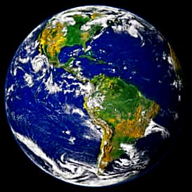
“Human beings and the planet are on a collision course. Our population growth and economy are destroying the Earth. Fundamental changes are needed if we are to avoid the collapse our present course will bring about. - The World Scientists’ Warning to Humanity, 2008
Notes:
In 1992 1,700 of the world’s leading scientists including the majority of Nobel laureates in the sciences issued this appeal. In 2008 there was an update.

Slide 13
Music Video: Full Steam
video
Annie Lennox and David Gray
Notes:
Lyrics to Full Steam from the David Gray album Draw the Line.
All our lives we’ve dreamed about it Just to find that it was never real This sure ain’t no great Valhalla Coming closer each turn of the wheel Forlorn, adrift on seas of beige In this our Golden Age
Even in our darkest hour Never thought that it could get so bad Bullied, suckered, pimped and patronised Every day your tawdry little lives So loose your head And step within The silence deafening
Now you saw it coming And I saw it coming We all saw it coming But we still bought it Now you saw it coming And I saw it coming but still Running full steam ahead
In and out of consciousness It breaks my heart to see you like this Crying, wringing hands and cursing fate Always so little far too late It’s 3 am I’m wide awake There’s still one call to make
Now you saw it coming And I saw it coming We all saw it coming But we still bought it Now you saw it coming And I saw it coming We all saw it coming But we still bought it
Now you saw it coming And I saw it coming But still running full steam Now you saw it coming And I saw it coming but still Running full steam Now you And I We all saw it coming But we still bought it Now you And I We all saw it coming

Slide 14
Music Video: Full Steam
backup copy
Notes:
Lyrics to Full Steam from the David Gray album Draw the Line.
All our lives we’ve dreamed about it Just to find that it was never real This sure ain’t no great Valhalla Coming closer each turn of the wheel Forlorn, adrift on seas of beige In this our Golden Age
Even in our darkest hour Never thought that it could get so bad Bullied, suckered, pimped and patronised Every day your tawdry little lives So loose your head And step within The silence deafening
Now you saw it coming And I saw it coming We all saw it coming But we still bought it Now you saw it coming And I saw it coming but still Running full steam ahead
In and out of consciousness It breaks my heart to see you like this Crying, wringing hands and cursing fate Always so little far too late It’s 3 am I’m wide awake There’s still one call to make
Now you saw it coming And I saw it coming We all saw it coming But we still bought it Now you saw it coming And I saw it coming We all saw it coming But we still bought it
Now you saw it coming And I saw it coming But still running full steam Now you saw it coming And I saw it coming but still Running full steam Now you And I We all saw it coming But we still bought it Now you And I We all saw it coming

